Slide 1
Trade/rv show prep
How to have a successful rv show
By Laurie Adams, Baraboo Hills Campground

Slide 2
Let me introduce myself…….#that’s laurie

Slide 3
who has done a trade show ?

Slide 4
Why do a trade show ??

Slide 5
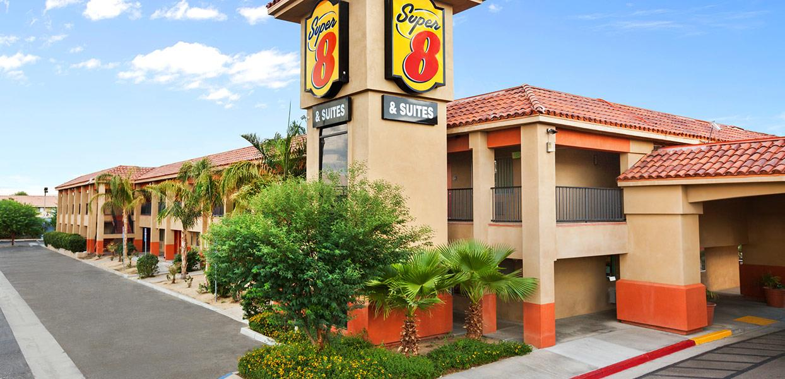
How do I get started ?
Once you’ve registered for the show, book your hotel !
Decide who is going – need bodies
Get your brochure up to date, need 2500 per show or more
Purchase a display booth
This can take awhile – don’t wait!
Month lead time
See alpha graphics flyer
Check out the booth here for sale today!
Print out your best colorful pictures big!
Print and laminate 11 x 18

Slide 6
Get registered – don’t wait!
Where are the shows? Waco can help with contacts – start preparing October/november
Green bay
Madison
Milwaukee
Minneapolis
Rockford
Chicago
iowa

Slide 7
How do we get the people to stop at our booth ?

Slide 8
You Need STUFF !!
See handout

Slide 9
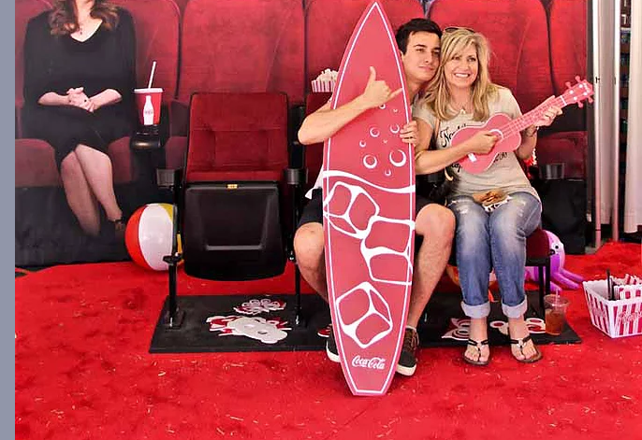
Examples of displays
Simple and fun
The more audience participation, the better
Photo booth with props is a great idea! Ahh millennials!

Slide 10
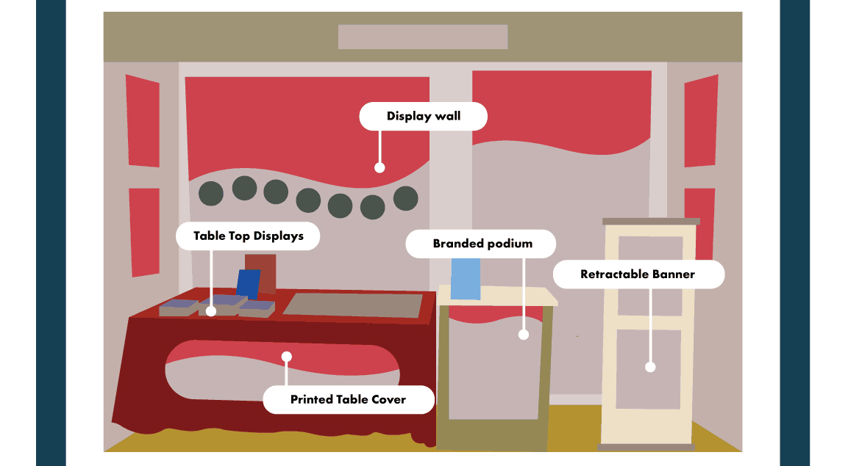

Slide 12
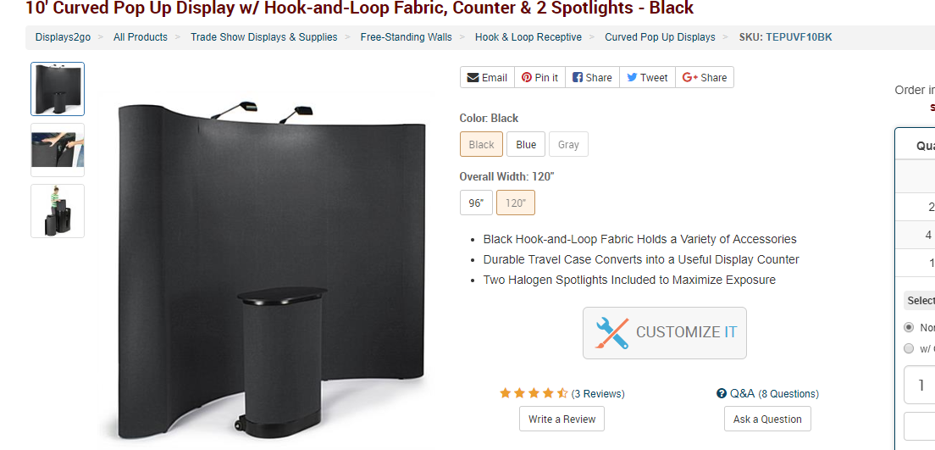

Slide 13
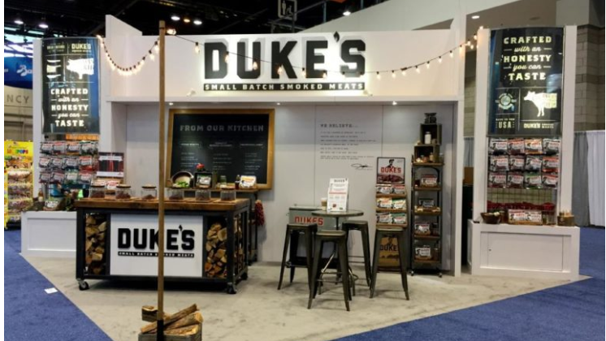

Slide 14
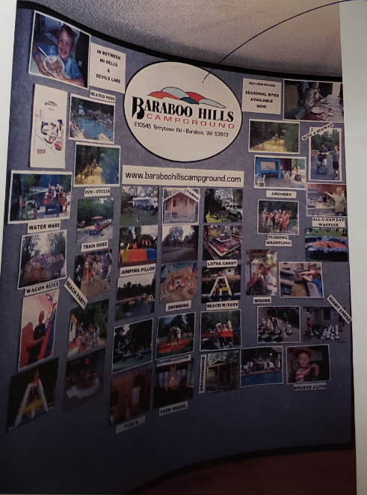
Arrange pictures
Name of campground at top
Website
11 x 18 pictures
Titles – tell the story
Advertise if you have seasonal spots open
This display is on sale – see me after the seminar

Slide 15
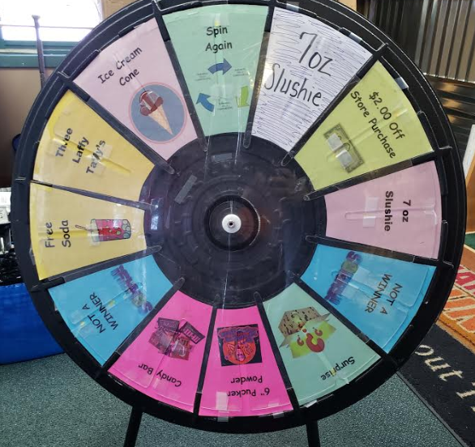
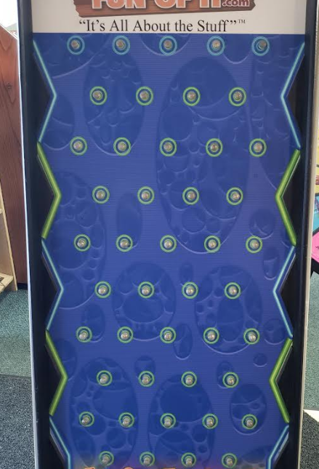
Host a game at your booth

Slide 16
Games to engage guests

Slide 17
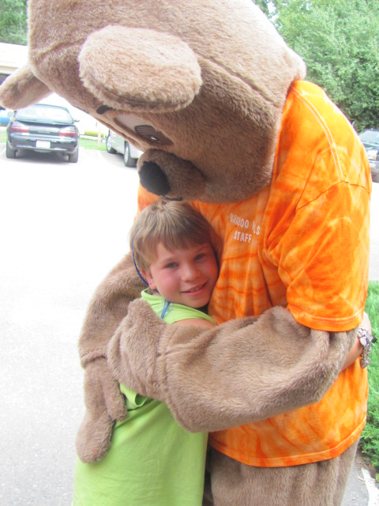
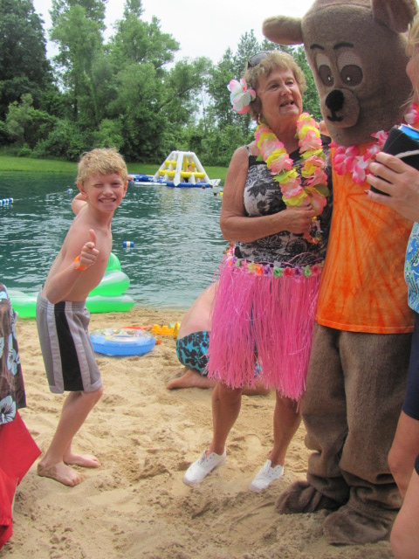
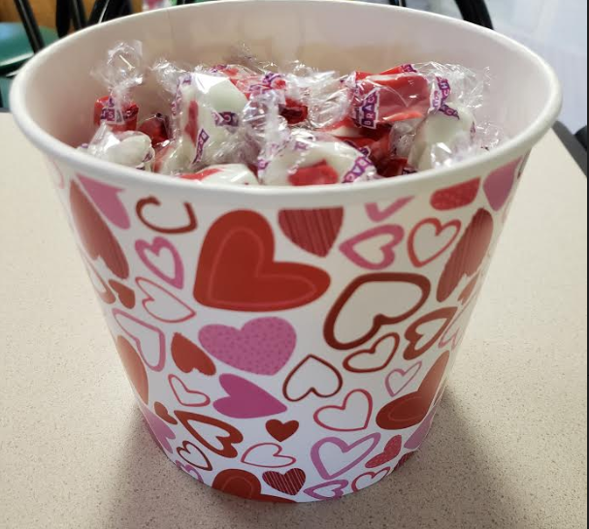
Its all about the kids
If you entice the kids, the parents will follow
Games
Candy
Fun pictures
Touchy feely “stuff”
Furry mascot

Slide 18
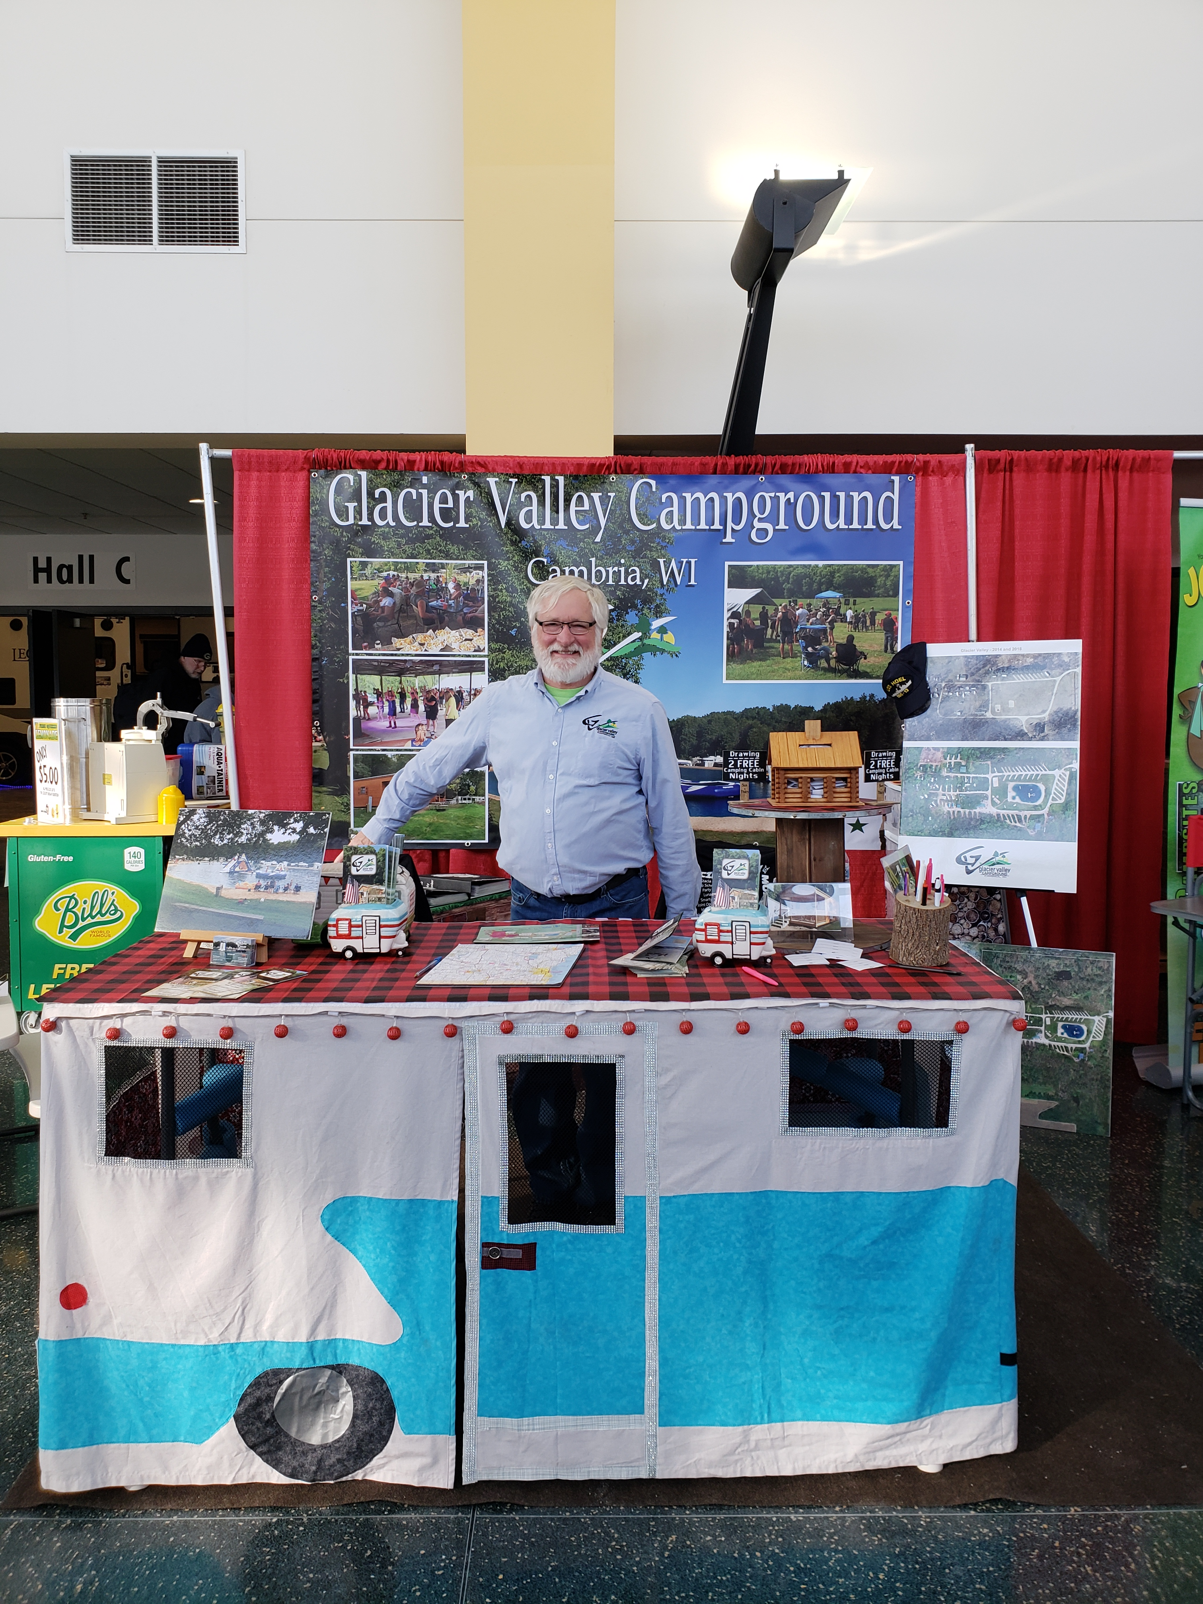
Booth idea
See the table cover ??

Slide 19
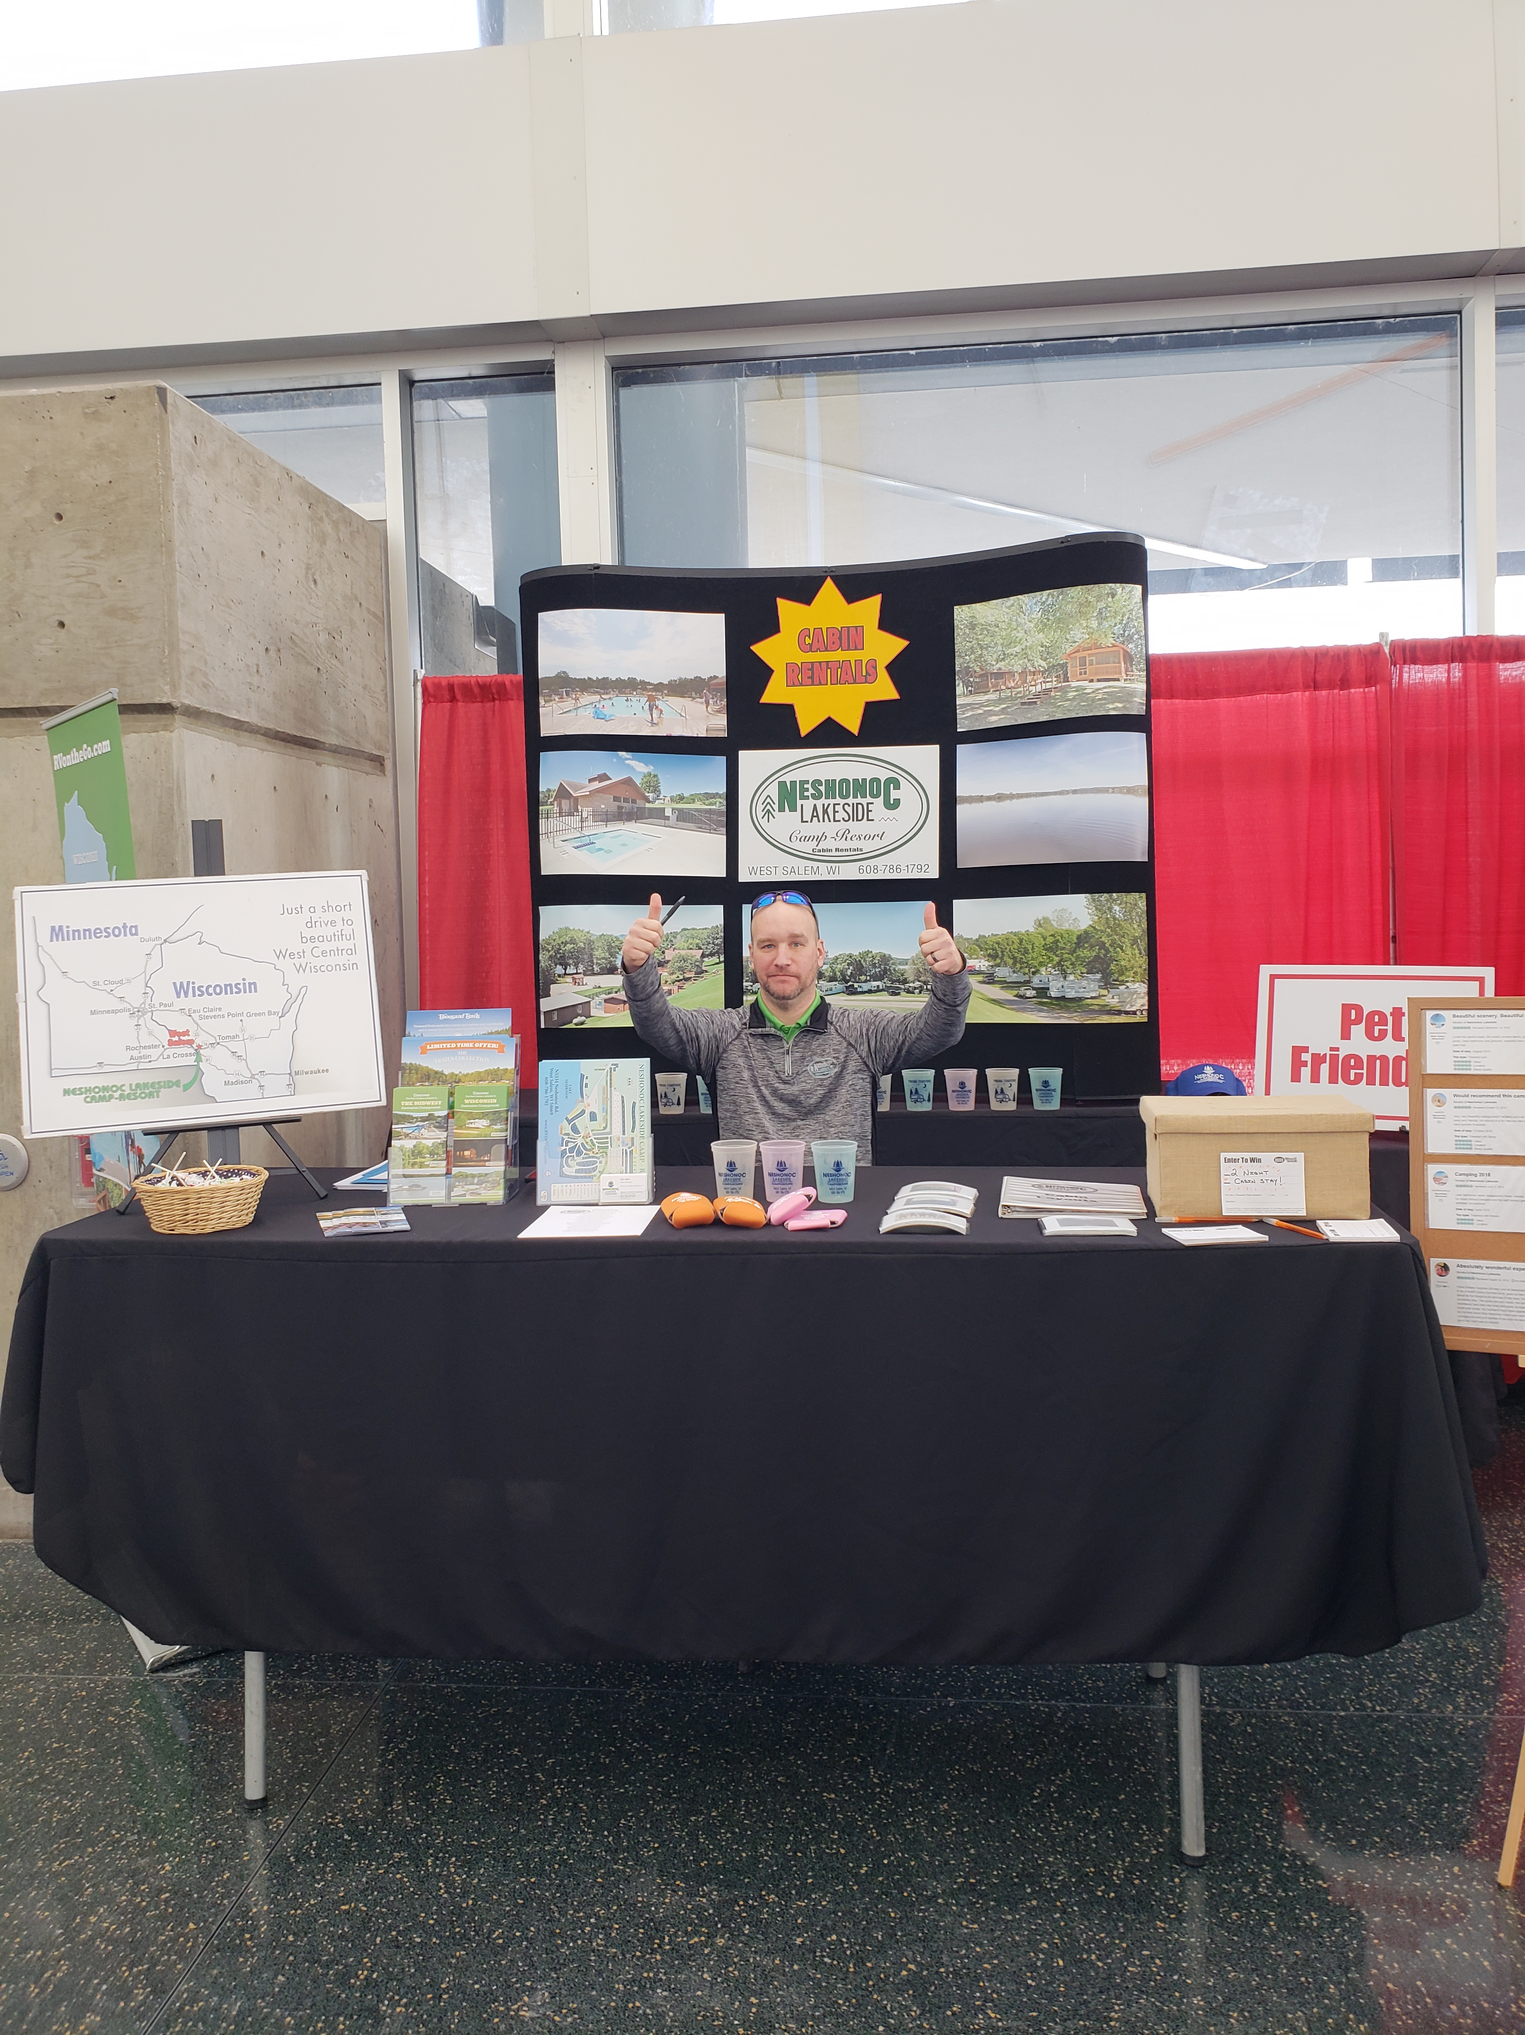
What 2 signs stick out

Slide 20
Prizes for addresses
Advertise a 2 night stay
Register here
Obtain name & address or email
Use these addresses each year to send new brochures/mailings

Slide 21
giveaways

Slide 22
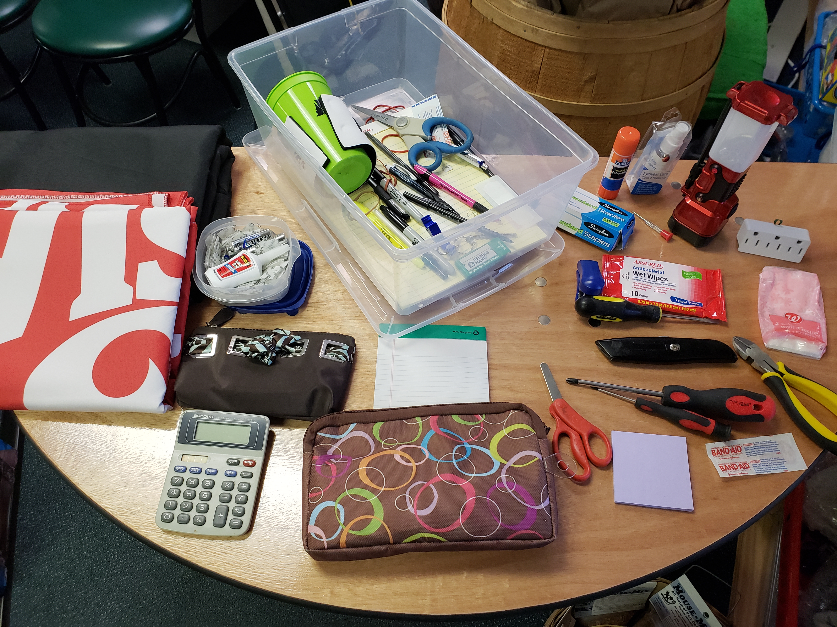
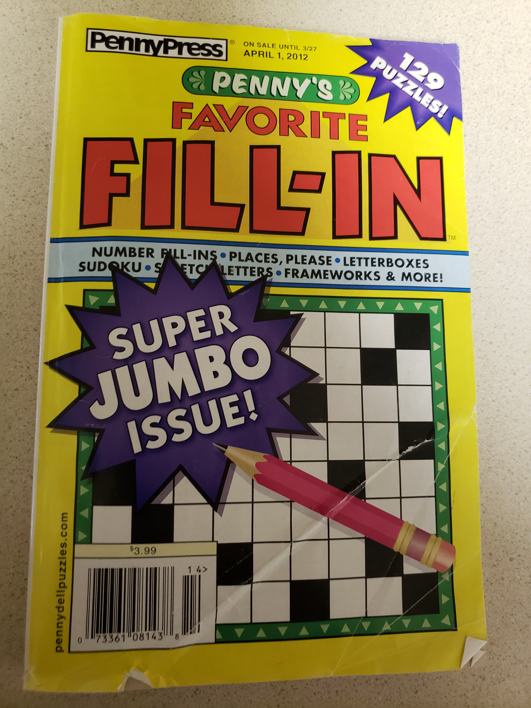
Necessities
Bring supplies!
Tools
Toiletries
Office supplies
It can get quiet at times………

Slide 23
Be ready
Sign that seasonal
Make that reservation
Show that rental
Bring seasonal agreement with you
Just in case…..
Know what sites are open
Have laptop in hand
They want to know now
Is it available ??
Pictures of cabins
Is it available
How many does it sleep ?

Slide 24
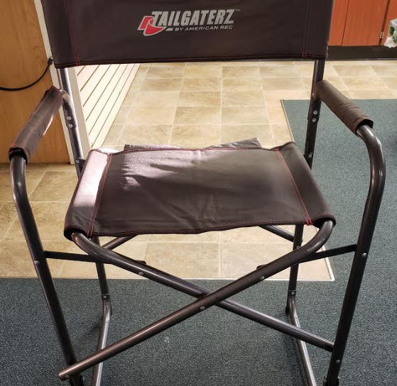
Bring comfortable chairs

Slide 25
Plan, plan, plan your layout
Don’t put a table between yourself and the customer.
It is very easy to become complacent during the lulls at trade shows and find yourself absorbed in checking e-mails etc. behind the table and not engaging people at all.
Set your table up in a manner that invites people to come INTO your booth. Camping is friendly, be friendly!

Slide 26
Pre show marketing digital marketing plan
3 Months out – Email your database. Tell them when and where and your booth #
1 Month out – Share your booth # and promos on Social Media
3 Weeks out – Facebook/Twitter/Instagram/Email database with your Giveaway information
1 Week out – Post on social media multiple times: about the show, who’s attending, booth activities
Showtime – Post “almost time” pics: traveling, set up, booth workers. Answer questions posted via the show hashtag

Slide 27
Social media – stay active tell all your peeps
facebook
instagram
twitter

Slide 28
The different mindsets of a tradeshow attendee
Scholar – serious hunt for campgrounds
Explorer – no stone unturned
Detective – collects every brochure
Fashionista – what’s in & what’s out?
Shopper – makin’ her reservation today!
Pillager – collector of freebies, candy
Social butterfly – you aren’t here to see, but to “be seen” too
Judge – let the campgrounds plead their case and after much thought, you book

Slide 29
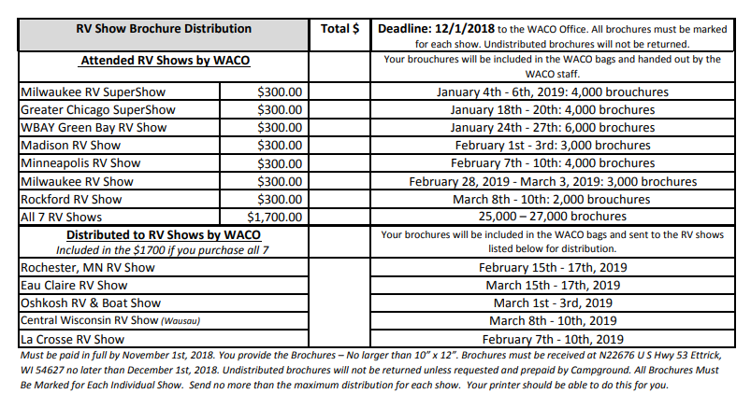
Get in the bag !
Literature Distribution Program
Are you in the bag ?
26,000 brochures into the hands of strangers

Slide 30
Thank you for attending

