Slide 1
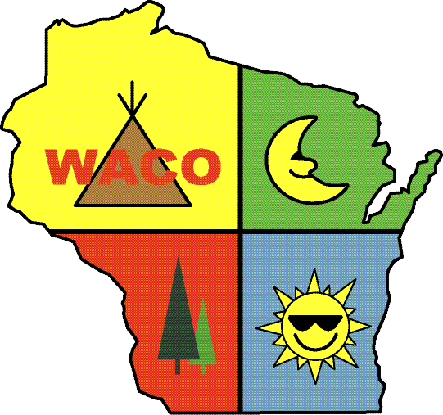
RELATIONSHIP MARKETING REALLY WORKS
Michael Moore, General Manager – Texas Advertising

Slide 2
Not THIS Michael Moore

Slide 3
Credentials
Texas Advertising has been a campground marketing company since 1994. AGS Guest Guides has been producing site maps for campgrounds since 1986.
I’ve been with Texas Advertising, a marketing and publishing company, for 15 years
We own AGS Guest Guides, which produces a thousand site maps and guest guides-per-year along with every of collateral you can think of
We also produce a half-dozen state campground directories such Texas, Arizona, Illinois, Missouri, Tennessee and Alaska
Also own and operate TXAD Internet Services

Slide 4
Relationship Marketing – What is it?
"Relationship marketing is a strategy designed to foster customer loyalty, interaction and long-term engagement. It is designed to develop strong connections with customers by providing them with information directly suited to their needs and interests and by promoting open communication.“ (Forbes Magazine)

Slide 5
Relationship Marketing – Why do it?
Your #1 source of business - Repeat and referral!
No matter what industry, the best source of business will always be repeat/referral
How do you market to them?
Other forms of marketing supplement and even increase repeat and referral business but any form of advertising and marketing we talk about is ultimately connected to repeat and referral

Slide 6
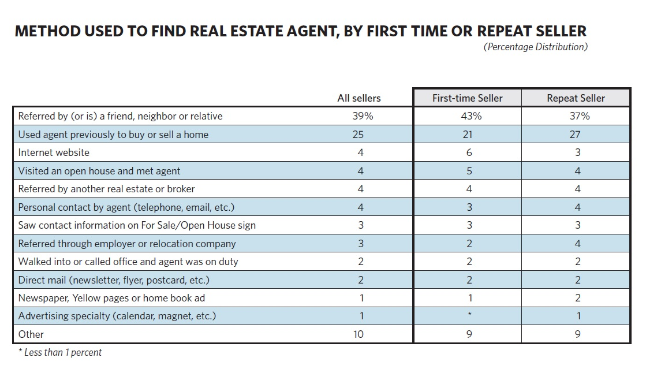

Slide 7
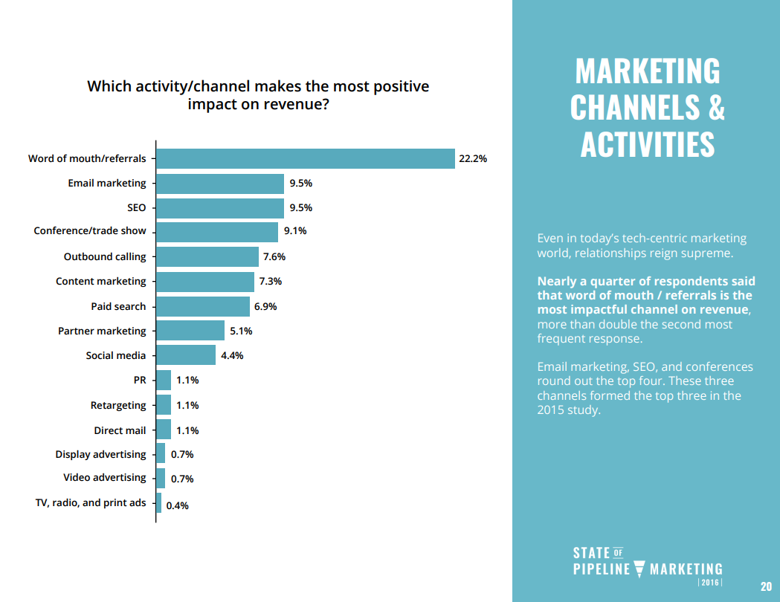

Slide 8
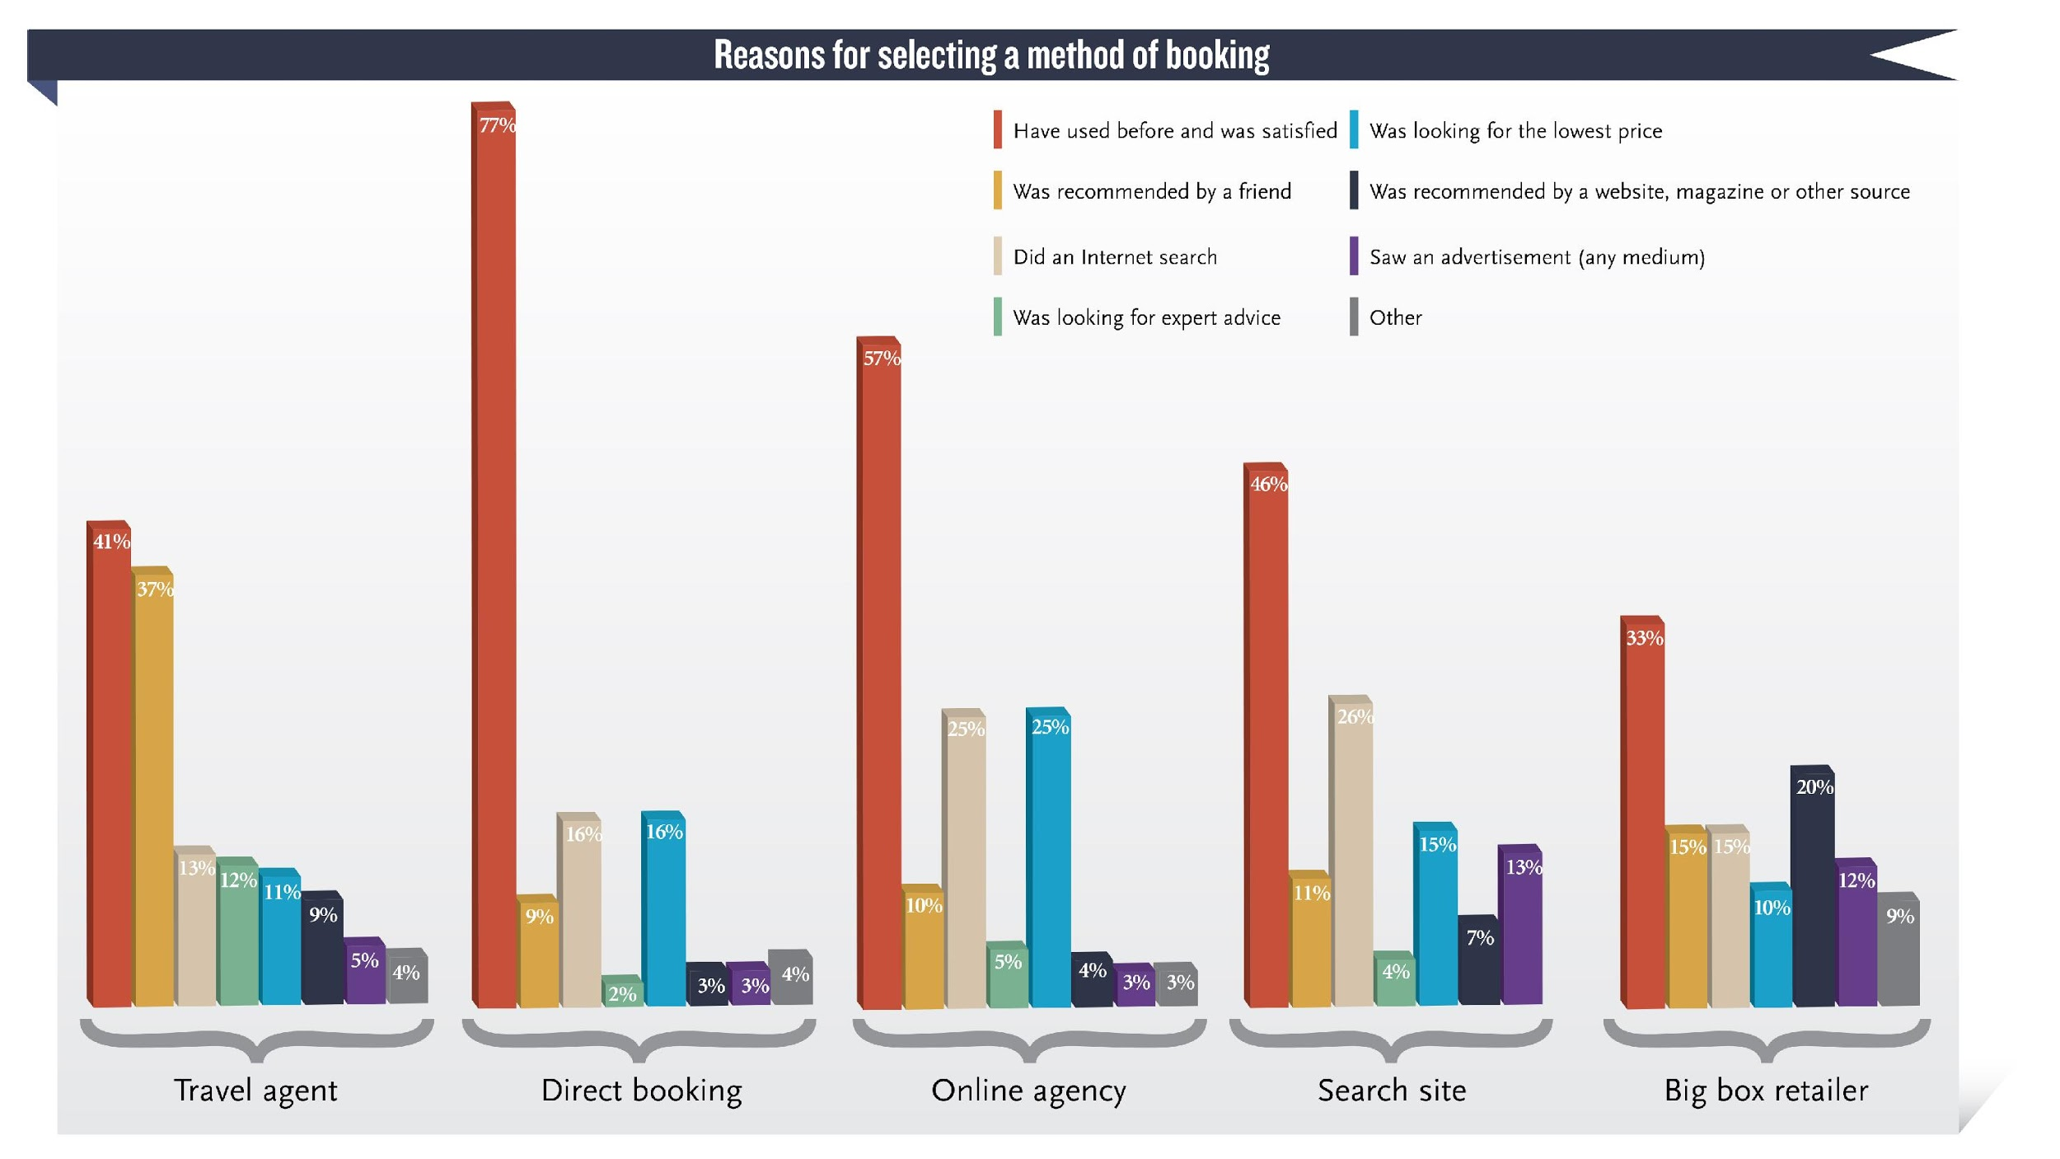

Slide 9
Relationship Marketing – Fostering Loyalty,etc
How do you foster customer loyalty, interaction and long-term engagement?
You could spend a million dollars on advertising but if you don’t provide a positive, memorable experience for your customers, they won’t come back and they won’t tell people about it
Cleanliness, friendly staff upon arrival
Interaction with other staff and customers
Are you reaching out to your customers after they leave?
Are you conducting your own customer satisfaction surveys?

Slide 10
Relationship Marketing – Providing info directly suited to their needs & interests
Site map / guest guide upon their arrival
1/3 of parks have used a guest guide (with local businesses supporting it) for 10 years or more
½ of parks get asked several times a day about services or products RVers need
80% of parks consistently support their advertisers by referring them to their customers
40% listed the top reason for advertising as the unique customer base
Source: AGS Study, 2019

Slide 11
Relationship Marketing – Providing info directly suited to their needs & interests
Parks – big and small – reach out to their community. Most of your guests aren’t familiar with the community and need information
Joining your Chamber of Commerce and networking
Getting your staff to experience local businesses and attractions in order to gain experience and share with your customer
Bringing local businesses that support your park and/or guest guide in to the campground.
Cater your parties
Mobile techs conducting workshop

Slide 12
Relationship Marketing – Providing info directly suited to their needs & interests
7 out of 10 tourists and visitors pick-up brochures at their travel destination
Placing rack cards or brochures at state travel centers or chambers of commerce
95% of visitors had their travel plans influenced by information from a brochure / magazine
Being listed in things like the PCOA directory
83% plan to visit a business or attraction highlighted in a brochure, map or travel guide
78% of visitors consider altering their travel plans as a result of a brochure
53% of travelers use brochures to plan their trip before they arrive at their vacation spot
43% of visitors share their travel literature with three-plus travel companions
(source: Bentley.edu)

Slide 13
Relationship Marketing – Providing info directly suited to their needs & interests
Website / app component for those on their phones
Which demographic was most likely to say technology improved their camping experience?
22% of baby boomers (ages 55-73)
19% of millennials (ages 24-42)
18% of Gen Xers (ages 43-54)
12% of mature (ages 74+)
3.7 additional days of camping due to access to technology
Source: 2018 North American Camping Report

Slide 14
Relationship Marketing - Promoting open communication
Is your front desk always staffed? How do they address walk-ups and phone conversations?
Is the emergency number always available?
Are you reaching out after their stay?
Are you responding to reviews on review websites?

Slide 15
Google as a form of communication
5.5 billion Google searches every day
Claim your Google business listing and update your information, especially your contact information
Offer availability options
Allows your park to properly be located on Google maps
Also allows customer reviews and, more importantly, feedback

Slide 18
More Google – Providing information for your customer
Google AdWords
Bid on terms people use to find you
For example – Philadelphia rv parks, poconos camping
Think of search terms as supply and demand – the more demand for terms and less supply, the higher the price
Campground example:
rv parks Houston tx, Houston rv parks in the national campaign
rv parks and rv parks near me in local search area of the Houston area
Cost - $1.50-$6.00 per click

Slide 19
What should I spend?
As a general rule, small businesses with revenues less than $5 million should allocate 7-8 percent of their revenues to marketing. This budget should be split between 1) brand development costs (which includes all the channels you use to promote your brand such as your website, blogs, sales collateral, etc.), and 2) the costs of promoting your business (campaigns, advertising, events, etc.).
This percentage also assumes you have margins in the range of 10-12 percent (after you’ve covered your other expenses, including marketing).
Any startup or new businesses should allot a few points more.
(Source: US SBA)

Slide 20
Facebook Tips For You!
Create a Facebook Business page!
If you don’t provide a place for people to reach out on Facebook, a site with 2.27 billion users, you’re making it harder for them to give you money
Speaking of money, you can book reservations from Facebook
Provides a free web listing that provides you an online presence that is easily searchable on Google search results
Offers a way to push out information to your current or potential customers such as holiday plans or specials events
Provides a way to get feedback from your customers and respond to the good and bad
Also makes it easier for your customers to post pictures to their friends via your page

Slide 22
Instagram Tips For You!
Create a campground-specific account
Take nice photos of various events and activities – something you would send a relative
Use hashtags – (#camping). Hashtags are Instagram’s method of search results. So if someone is searching #camping or #poconoscamping, your photos will show up. But don’t go crazy as the more hashtags, the more spammy it looks
Ask your followers questions! Things like ‘what's your favorite thing about the 4th of July?’ This shows your followers you’re a real person
(Source: Shortstack.com)
Use Instagram stories to create polls, answer questions, post live video and highlight special events

Slide 23
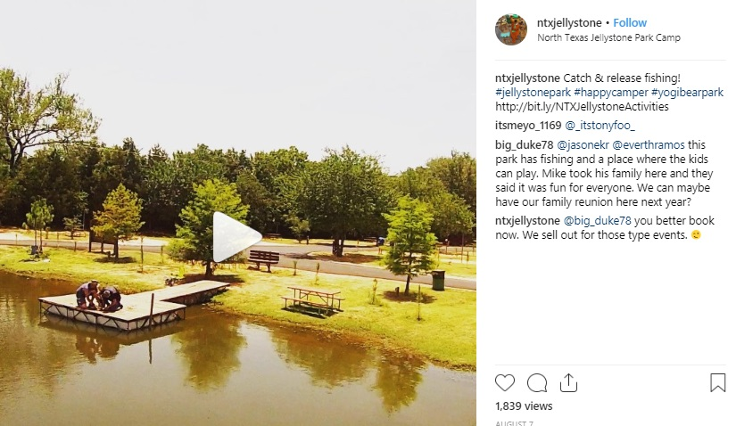

Slide 24
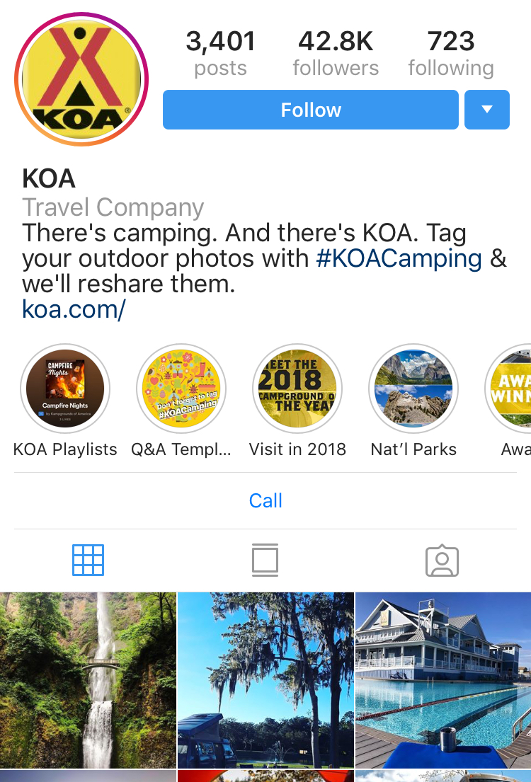
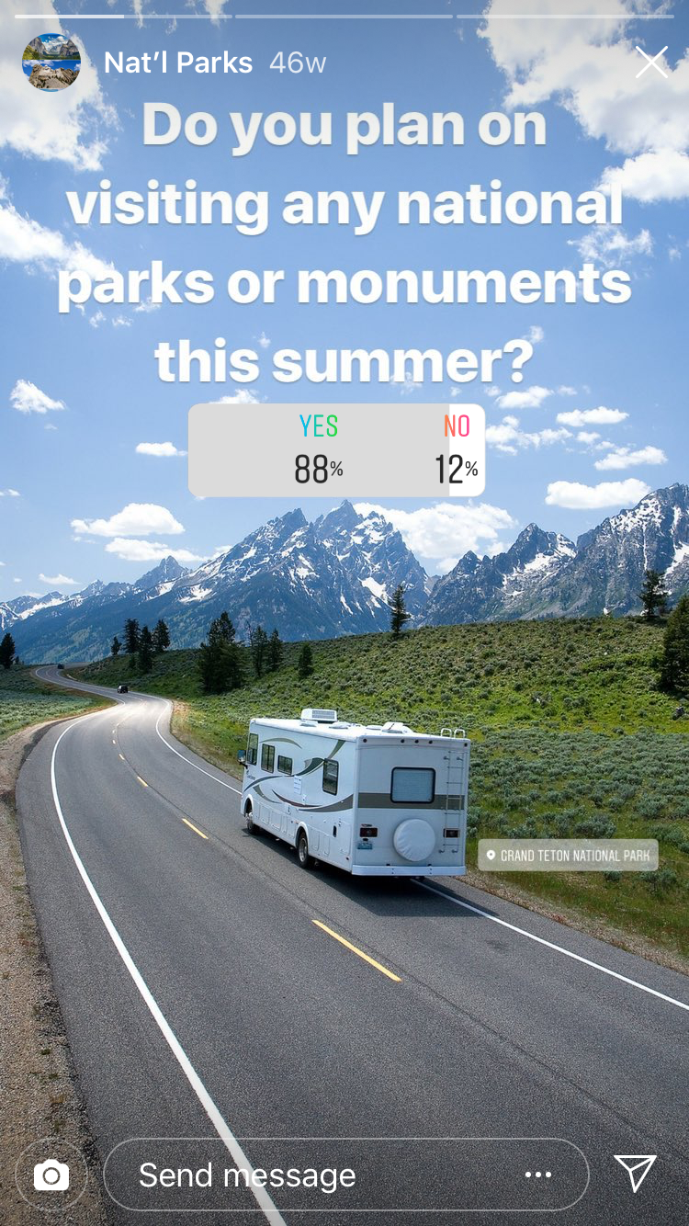

Slide 25
Blogging for RV Parks
Blogging is more for your repeat and referral business – information and education customers on what’s happening at your park
Even though you may not get a ton of clicks from the blogs, you do get a following and develop a following and a place for someone to jump in and get to know your business beyond the info on your website
Event blogs tend to get the most traction for RV Parks
They are a great way to link out to partners and have partnering businesses link to you. After all, if you’re promoting a local business, they should promote you right back
It develops original and relevant content that can help with gaining traction in the rankings in Google and others
Depending on the length of the blog, it helps increase the time on site
Continued blogging also helps increase continual web traffic if you blog on a regular basis
Make sure to do it consistently, even if it’s once a month so that people that visit the blog, know there is a human behind it

Slide 26
YouTube
Top three websites in the world (Source: alexa.com/topsites)
Google
YouTube
Facebook
Like Facebook, if you don’t have a dedicated, page you’re missing out on billions of people – 1.9 billion as of September 2018.
53% of users are 35-plus years old – not just for kids
Videos have 41% higher click-through rate and are showing up higher on Google Search Results, showing up as much 50 times higher than a typical website
(source: videonitch.com and searchenginewatch.com)

Slide 28
YouTube – Why is this important?
If you don’t take control of your name on YouTube, any customer – happy or unhappy - can post a video at (or about) your campground and have it be the only content showing on YouTube / Google.
Take ownership of your name and get video content out there – no matter how short or simple it is.
50% of videos up to two minutes are viewed all the way through. So make them short and put the more applicable material first.

Slide 30
How do I track all this stuff?
On the web, Google analytics or some sort of tracking on your website
Can check things like referrals and sources to determine how and which websites people came to yours from.
Be sure to look at new visitors compared to returning. Returning visitors should not cost the same as new visitors
For print ads, print distribution are viewed as the same as website impressions
How many guides were printed? How many people see one guide (couples)? How many times do they flip through those guides? Multiply that out!
Create unique URLs or addresses only to that print ad. From there, you can see how many people visited that URL and, therefore, determine how many people found you via that particular ad
From looking at your analytics, you can put pen to paper and determine a) about how much business are you getting and b) what’s the cost compared to the revenue that’s bringing in

Slide 31
Tracking the long term
If you’re tracking your marketing, the first question should be ‘have you visited us before?’
This way, you can easily count as repeat and move on to asking specifically where they heard about you
Remember that any ‘new’ business brought in this year won’t just give you money this year but can act as residual income
If you give them a good experience, they’ll be back
How many years have people stayed at your park?
Bottom line? How you doin’?
If you’re doing good, why make wholesale changes?

Slide 32
Ask me anything!
Contact:
michael@texasadvertising.net
817-426-9395

