Slide 1
RV Industry Perspective
Amy Bliss, Executive Director
Angie Diedrich, deputy executive director
WI RV Dealers Alliance

Slide 2
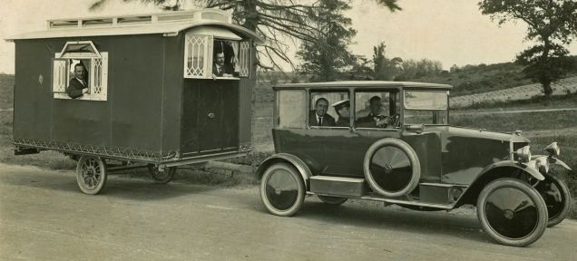
Industry Historical Perspective
RV industry was born about 1910
First RV were custom built
Popularity of RVs grew as more roads going west were being paved
RVs were used as post war housing

Slide 3
Industry Historical Perspective

Slide 4
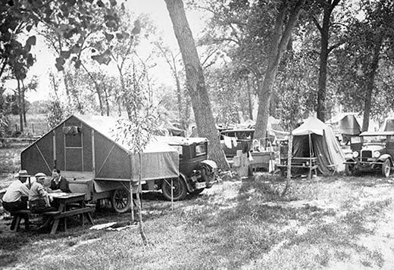
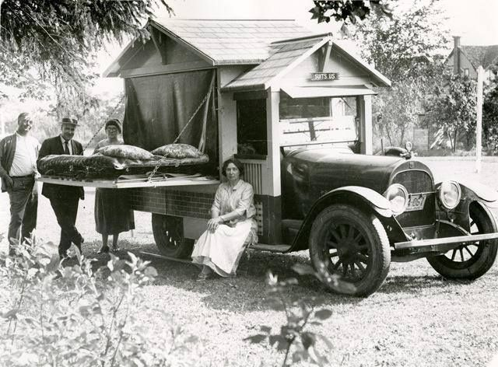
Industry Historical Perspective

Slide 5
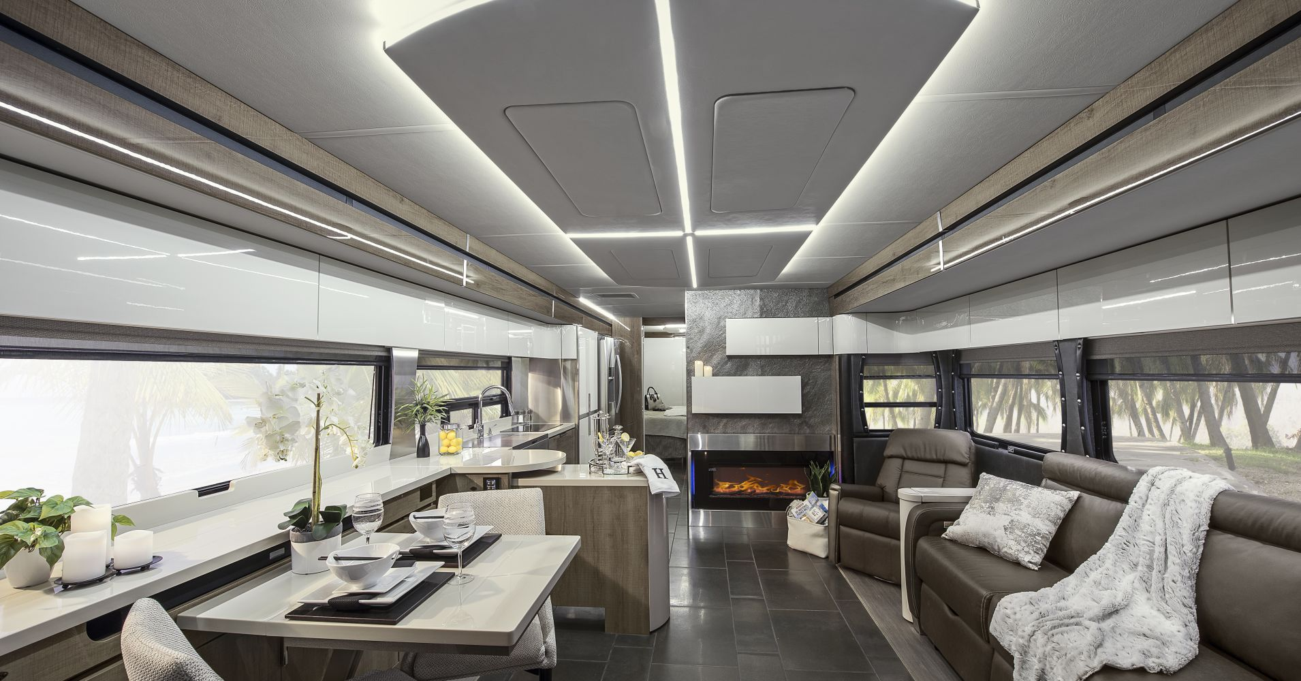
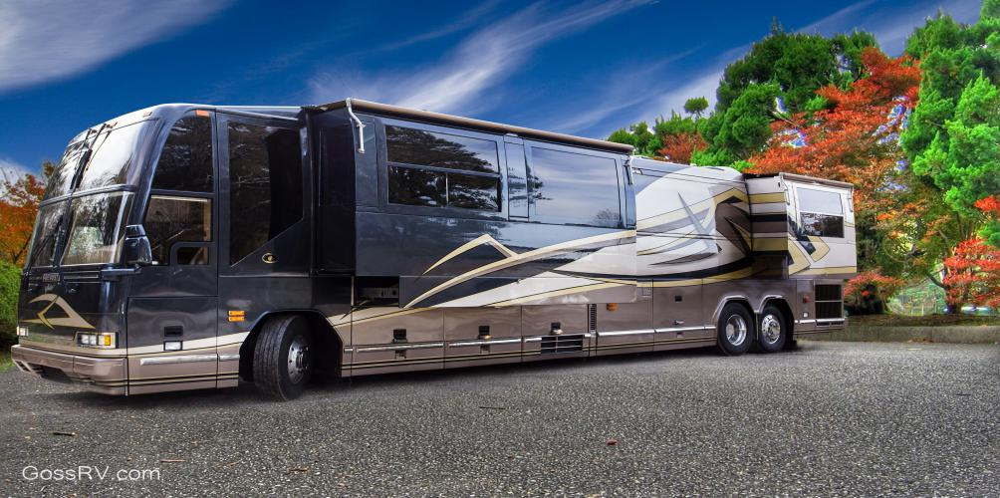
Industry Historical Perspective

Slide 6
ABOUT WRVDA
Less than three years old
Formed to watch for legislation that would be negative to the industry and to advocate for positive legislation
Provides legislative efforts and training for members

Slide 7
RVDA Board of Directors
Chairman – Mick Ferkey, Greeneway RV
Vice Chair – Gary Roskopf, Roskopfs RV
Secretary/Treasurer – Todd Oberg, Country Campers
At Large – Mark Doughty, Dick’s RV
At Large – John Gajewski, King’s Campers
At Large – Tom Schiek, Schiek’s Camping Center
At Large – Tim Wegge, Burlington RV Superstore

Slide 8
The lines are becoming blurred
Manufactured Homes
Modular Homes
RVs
Tiny Homes
Camping Cabins

Slide 9
Top Manufacturers OF RV SALES in Wisconsin
Manufacturer Market Share
Thor Industries 48.4%
(Thor owns 17 RV companies)
Forest River 36.6%
Grand Design 4.3%
All others <2%
Note: Data for Non-Motorized RVs Only. Data provided by Statistical Surveys.

Slide 10
Top Manufacturers OF Park model SALES in Wisconsin
Manufacturer Market Share
Kropf 80% of Wisconsin’s market
Forest River 20%
Data provided by Statistical Surveys

Slide 11
Top 5 RV model lines of 2018
Cherokee from Forest River Salem from Forest River
Jay Flight from Thor Industries
Rockwood from Forest River
Hideout from Thor Industries
Note: Data for Non-Motorized RVs Only. Data provided by Statistical Surveys.

Slide 12
Non-motorized RVs
Travel Trailer
Fifth Wheel
Camping Trailer
Park Model
GoRving has a full list of all RV types.

Slide 13
2018 RV sales In Wisconsin (non-motorized)
Unit Type Units Sold
Travel Trailer 7519 Fifth Wheel 1502 Camping Trailer 308 Park Model 186 9515
Note: Data for Non-Motorized RVs Only. Data provided by Statistical Surveys.

Slide 14
Retail Statistics
Year Units Sold
2018 9515
2017 9176
3.7% increase over last year
Note: Data for Non-Motorized RVs Only. Data provided by Statistical Surveys.

Slide 15
What’s Hot and What’s Not in 2018
RV Type Percent Change from 2017
Travel Trailer + 5.5%
Fifth Wheel - 1.6%
Camping Trailer -10.7%
Park Model - 2.1%
Data provided by Statistical Surveys

Slide 16
Motorized RVs
Class A
Specialty design build
21-40 feet in length
Class B
Built on van or panel truck shell
16-22 feet in length
Class C
Built on automobile van frame
21-35 feet in length

Slide 17
Motorized RV sales In Wisconsin
Type 2014 2015 2016 2017 2018
Class A 207 261 277 303 313
Class B 47 54 49 79 98
Class C 234 281 331 408 416
Total 488 596 657 790 827
Data provided by Statistical Surveys

Slide 18
Two Biggest trends Dealers see
More Technology
Solar Panels – reduce carbon footprint and less usage of RV generator
Staying Connected – more or better Wifi connection while camping
More Power
More technology means more power needed to run multiple devices
Increase in RV Rentals
More online rental sites

Slide 19
Dealer Wish list From campgrounds
More camping sites that can accommodate their customers
50amp minimum electrical service
Larger sites to accommodate new models from manufacturers
Less seasonal and more weekly rental sites
To work together to promote the recreation industry

Slide 20
Road back in time
Visit the RV/MH Hall of Fame in Elkhart Indiana!
The RV Founders Hall displays trailers, photos, and memorabilia reaching back to the 1920's and 1930's and is open to the public. The museum presents chronological and technological advancements in the industry from before WW I to the present.

Slide 21
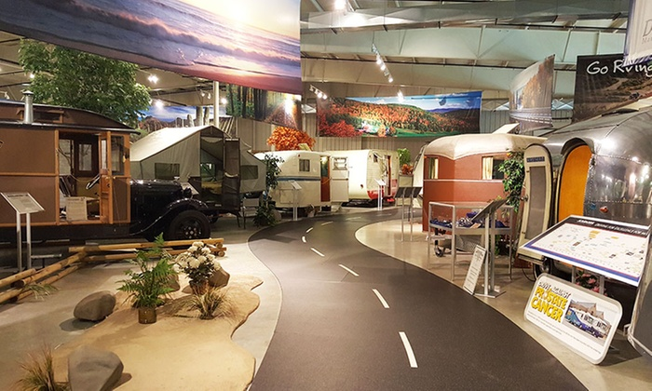
RV/MH Hall of Fame Museum

Slide 22
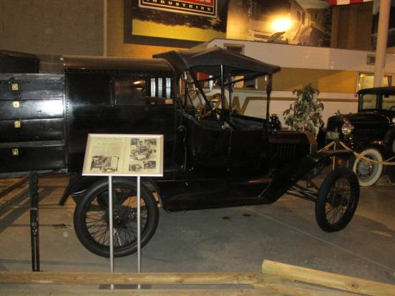
1915 Model T with Telescope Apartment
(This has a pop out kitchen!)

Slide 23
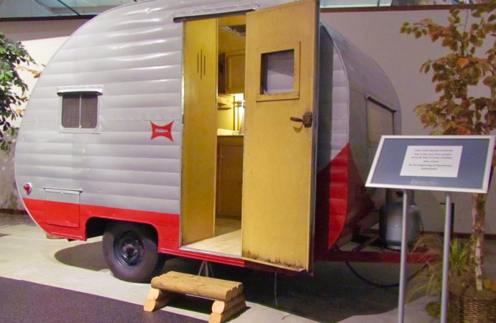
1950 Fleetwood Sporter
(Fleetwood’s First RV)

Slide 24
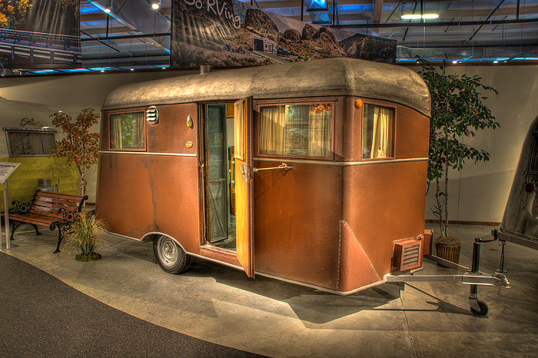
1935 Covered Wagon 17’

Slide 25
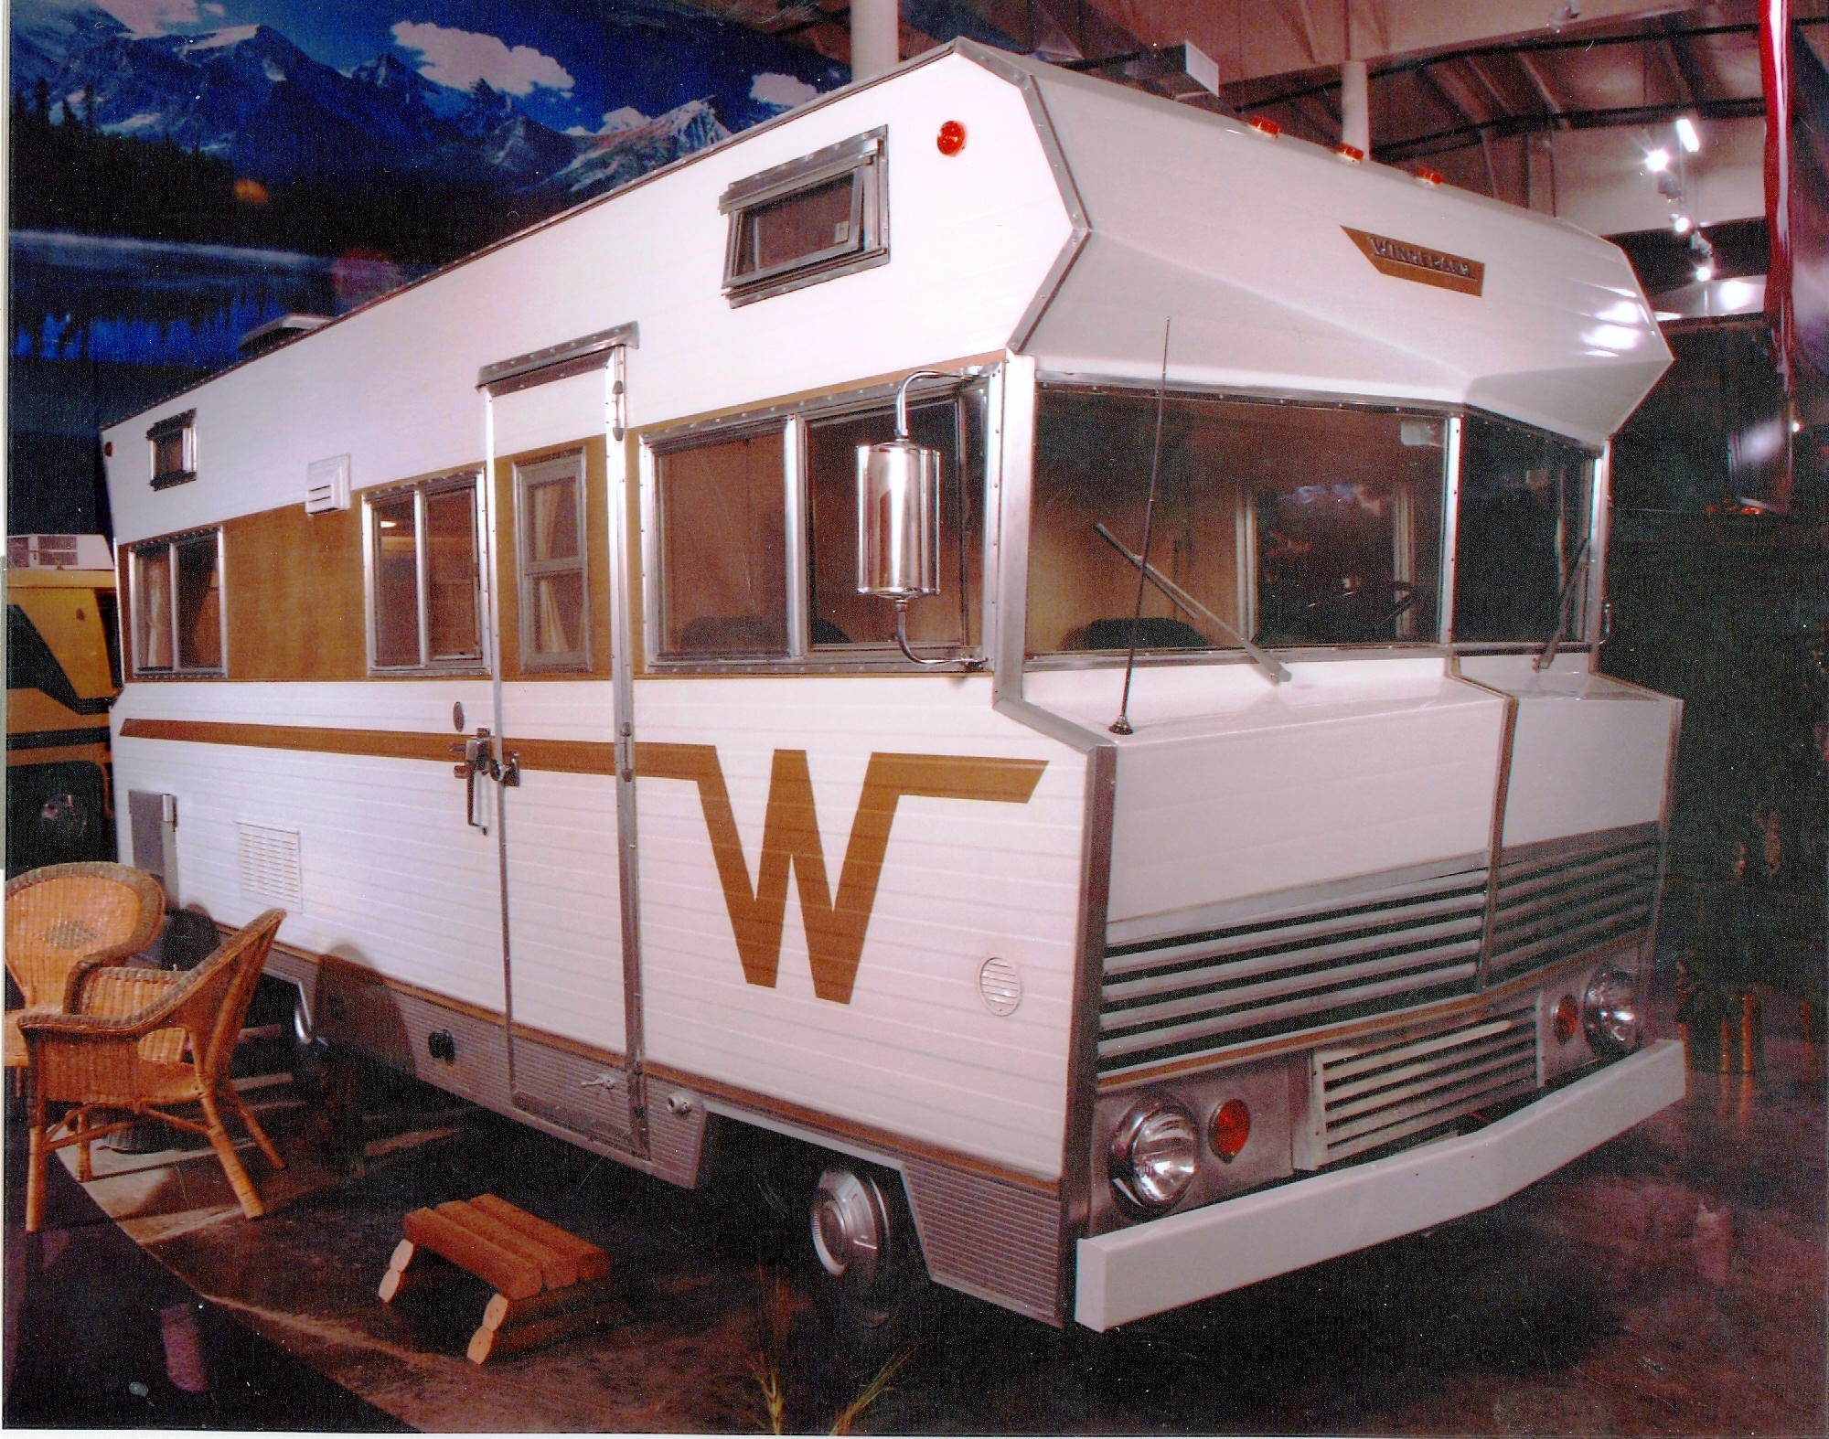
1967 Winnebago

Slide 26
Contact us
Amy Bliss – Executive Director amy@housingalliance.us
Angie Diedrich – Deputy Executive Director angie@housingalliance.us
Website - rvwisconsin.org Phone – 608-255-3131

