Slide 1
Running a Kids Program (Activities on a Budget) 2019
By Krystal Pracki
Rose’s Enchanted Forest Campground
cheer4u87@hotmail.com

Slide 2
Take Aways:
Memorial Day Programs
Labor Day Programs
4th of July Programs
Other Activities
Budget friendly activity centers (make and take)
Questions

Slide 3
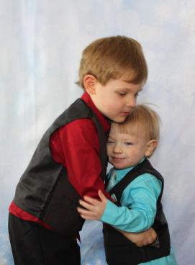
Who am I?
Teacher
Special Education
Elementary Education
Daughter of Campground owners
Mother of 2 boys
Kaleb and Kody

Slide 4
Memorial Day
Glow bugs
T-shirts
Bird feeders/Wind Socks
Closed circuit flashlights/constellations

Slide 5
Labor Day
Bat houses
Igloo and popsicles
Tepee and satchels
Home-made chalkboards

Slide 6
4th of July
Splash Bombs
Recycled water toys/beach balls
Splash bombs and balloon balls
Leaf printed canvas tote bags/Drip Drip Drench

Slide 7
Other Activities
Christmas in July
Visit with Santa
Hayrides
Sun catchers
Halloween
Trick or treating
Carnival games
Foam pumpkins

Slide 8
Splash Bomb
Materials for one splash bomb
3 sponges (with no scrubby sides)
$2.98 for a 6 pack
1 hair tie
$2.69 on Amazon
Scissors
$2.23 2 pack at Walmart
Sharpie (to write names)
12 pack $6.94 on Amazon
We used kiddy pools as water refill stations to have the water fight

Slide 9
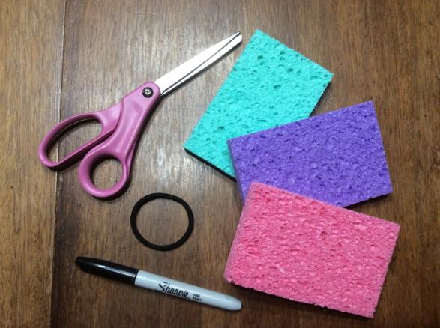
Splash Bomb

Slide 10
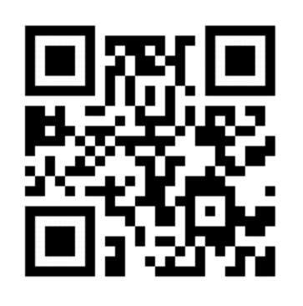
QR SPLASH BOMB

Slide 11
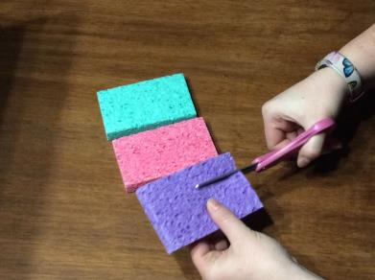
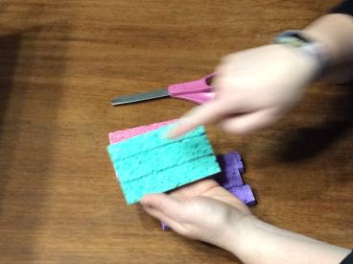
Cut sponges lengthwise into 3 strips (2 cuts)

Slide 12
Repeat on other two sponges

Slide 13
Arrange in a block

Slide 14
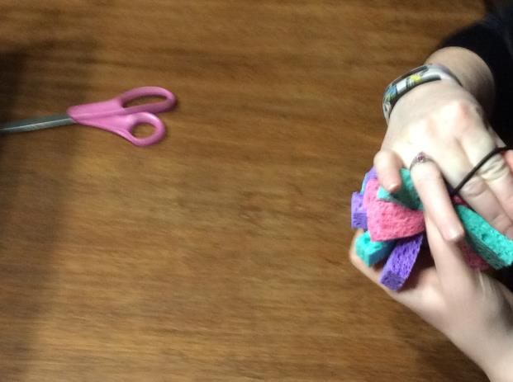
Wrap hair tie around middle

Slide 15
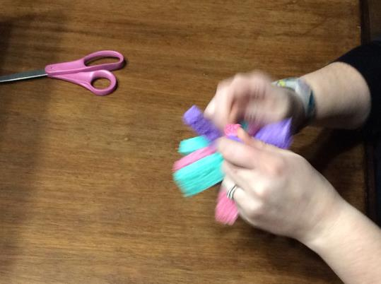
Fluff Splash Bomb

Slide 16
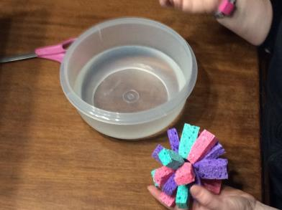
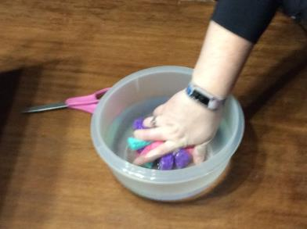
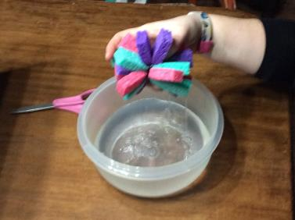
Dunk in water and enjoy

Slide 17
Satchel
Materials for one satchel:
Fabric 4 1/2 x10 inches for each
$4.00/yard Walmart for a thicker fabric
Hole punch
$6.78 on Amazon
Yarn
$2.94 at Walmart
Scissors
$2.23 2 pack at Walmart
Sharpies (for decorating only)
12 pack $6.94 on Amazon
Masking/scotch tape
$1.66 at Walmart

Slide 18
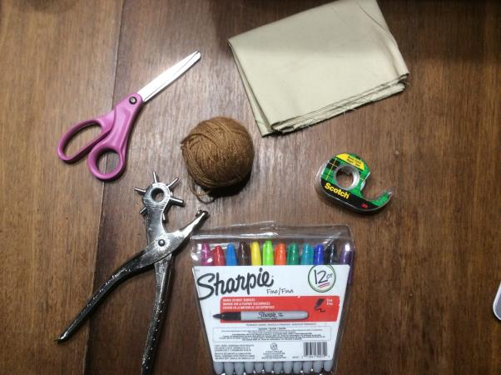
Satchel

Slide 19
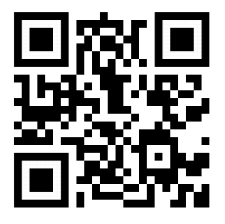
QR SATCHEL

Slide 20
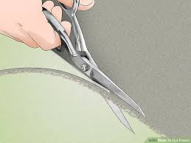
Cut fabric in 4 ½ in x 10 in rectangle

Slide 21
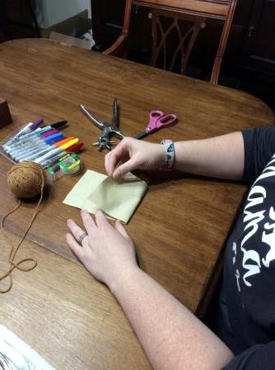
Fold

Slide 22
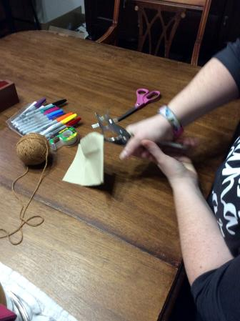
Punch holes

Slide 23
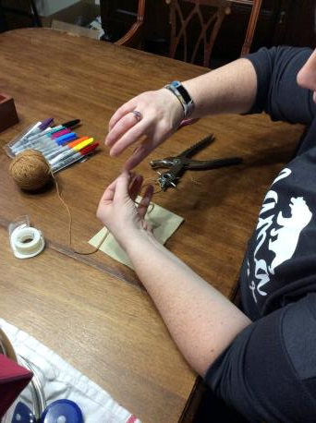
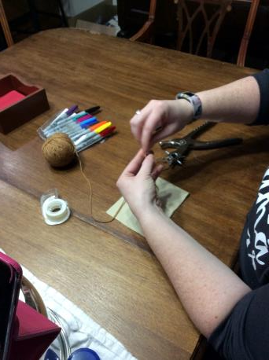
Prepare yarn

Slide 24
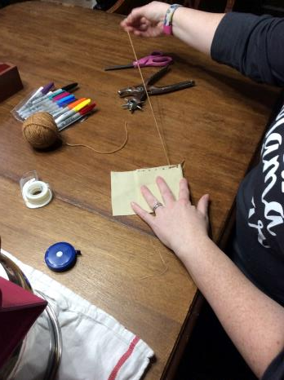
Tie knots at the ends

Slide 25
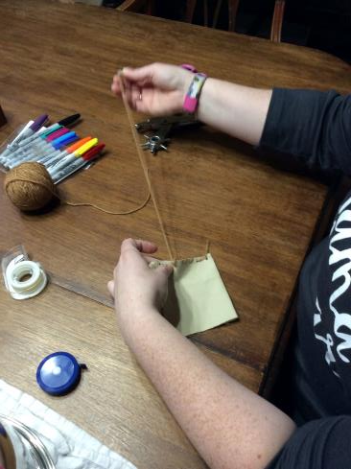
Stich satchel

Slide 26
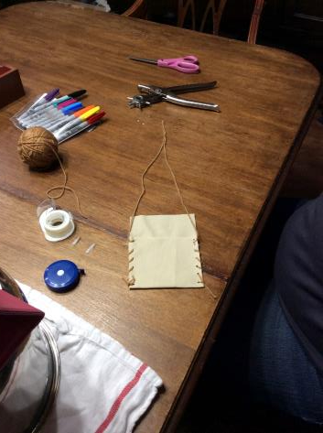
Finish at top

Slide 27
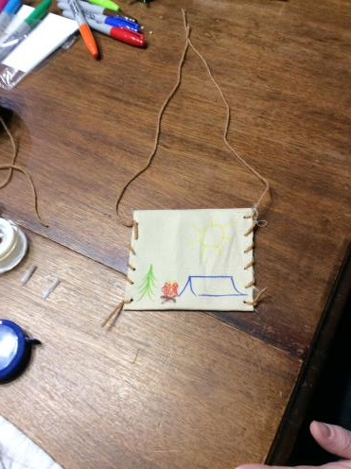
Draw a picture

Slide 28
Leaf Canvas
Materials for one leaf canvas:
6x6 stretched canvas
$.62 each on Amazon, case price
Sharpies
12 pack $6.94 on Amazon
Pencil (if you want to pre draw)
$1.97 for 10 at Walmart
Leaf (silk, printed or real) could also use a flower or something from a nature hike
Silk on Amazon $9.99 for 650 Leaves
Q-tips
350/$1.00 at Dollar Tree
Rubbing alcohol
2 pack $7.00 at Walmart

Slide 29
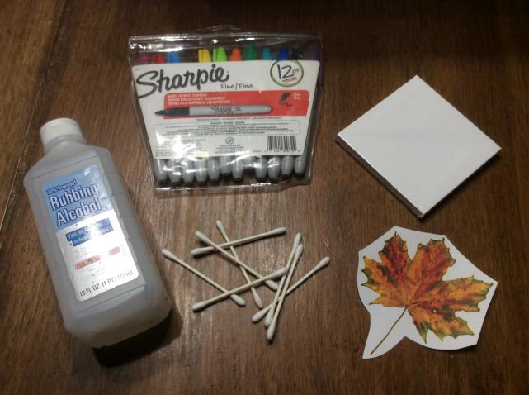
Leaf Canvas

Slide 30
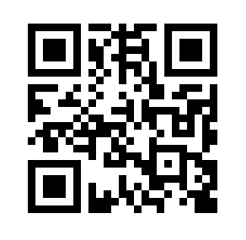
QR LEAF CANVAS

Slide 31
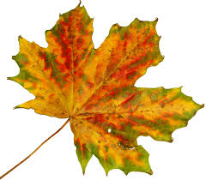
Find leaf

Slide 32
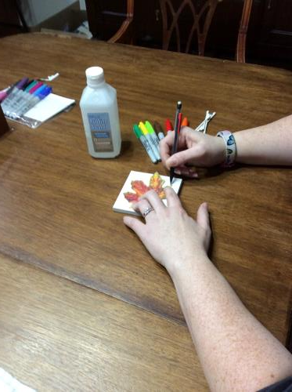
Draw leaf on canvas with pencil (optional)

Slide 33
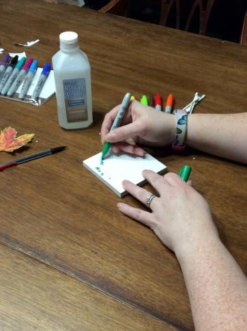
Draw leaf on canvas with sharpies (it can help to color a bit an dab a bit at a time to allow best color run)

Slide 34
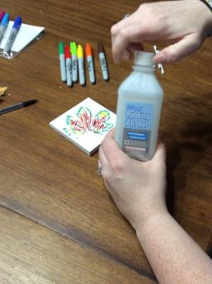
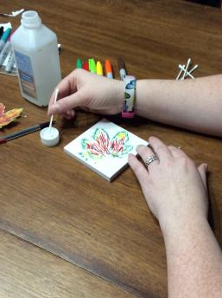
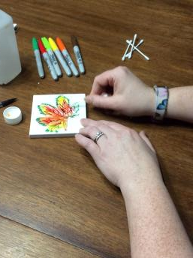
Dab alcohol on to drawing (it can help to color a bit an dab a bit at a time to allow best color run)

Slide 35
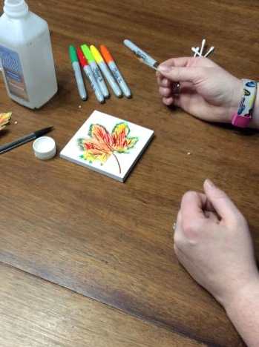
Allow do dry

Slide 36
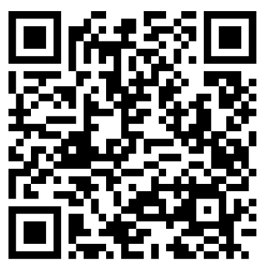
Website

Slide 37
Questions?
Does anyone have any questions?

