Slide 1
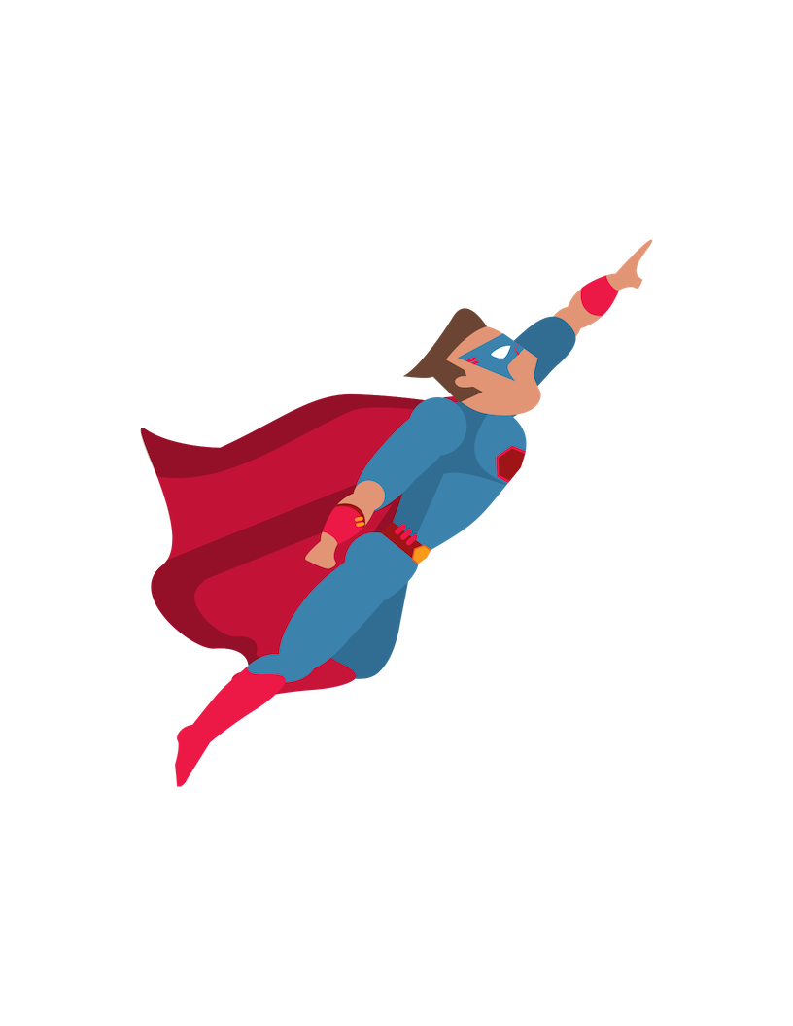
Super Facebook Ad Results
Without a bunch of
time and effort
BY RENEE SOMMER

Slide 2
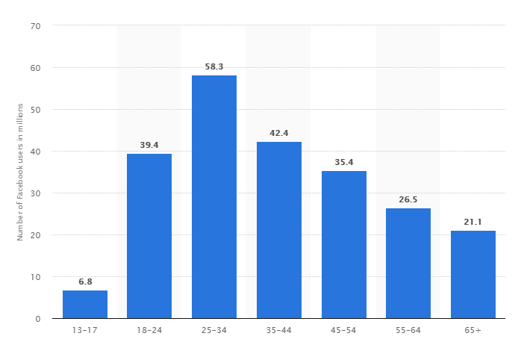
Facebook Statistics
As of June 30, 2017, Facebook enjoys 2.01 billion monthly active users
79% of Americans use Facebook—the platform with the second closest usage percentage is Instagram, at 32%.
More than half (53%) of US Residents use Facebook “several times a day”
83% of women and 75% of men use Facebook

Slide 3
Why Use Facebook
Lower your advertising spend
Reach a more targeted audience
Builds trust, helps with seo, and acts as a mini-site
Hands down the best way to connect with past, current, and potential customers

Slide 4
Why Listen to Me
Worked for a Facebook Ad Agency
Saw the good/bad/ugly
Built a successful niche business only using Facebook for advertising
Have helped many other niche businesses utilize Facebook – and helped them avoid the agency trap

Slide 5
Why Facebook Ads Fail

Slide 6
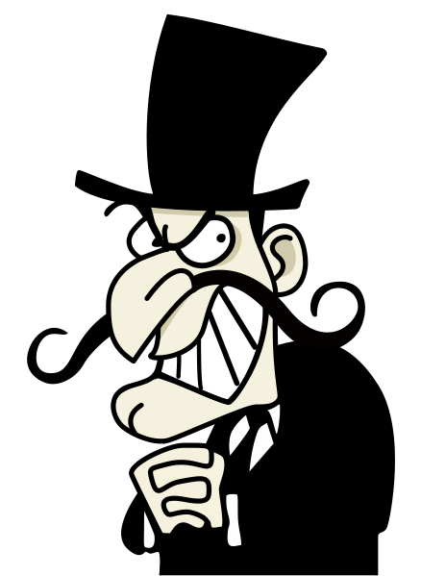
Unclear Audience
Trying to appeal to everyone – you can’t
Guessing who your audience is

Slide 7
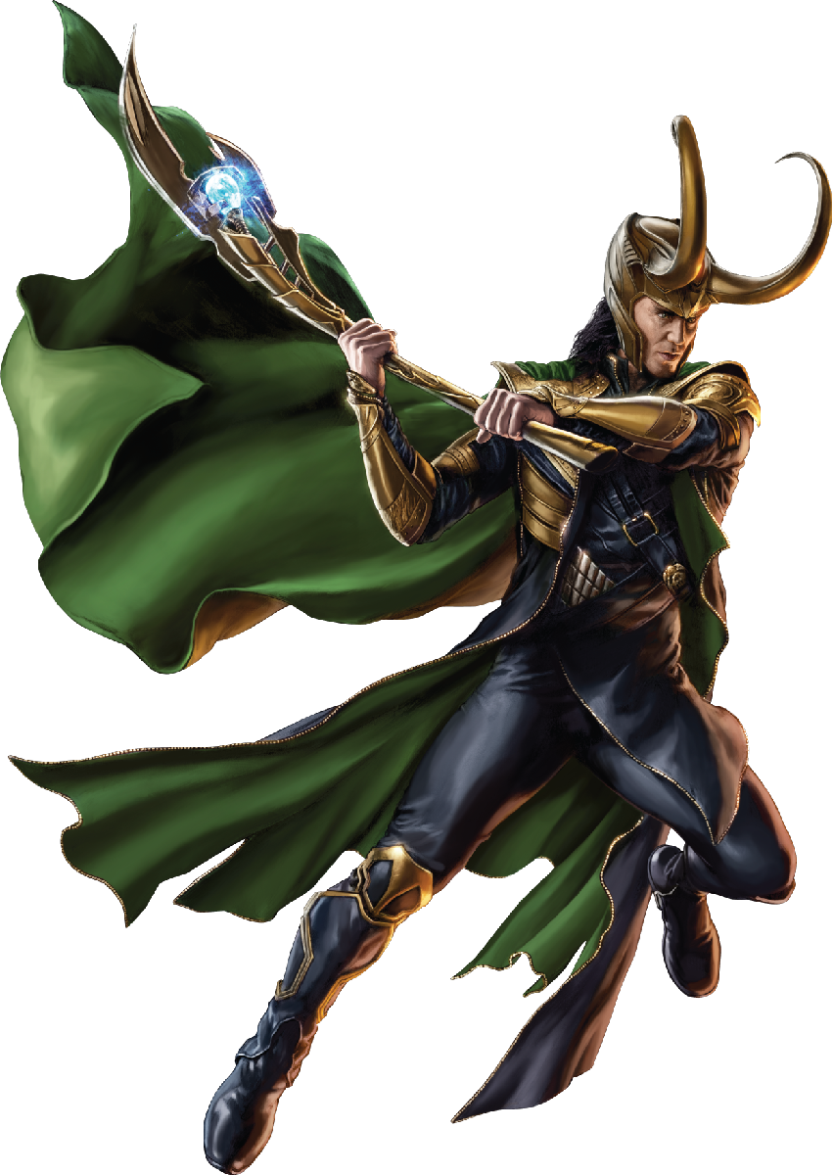
Unclear Message
If you’re talking to everyone online, you’re talking to no one
Taking too long to get to the point – or you don’t have one at all
No call to action!!!

Slide 8
Lack of Budget
Can’t spend enough to properly test
Can’t afford long term ads and multiple ad sets

Slide 9
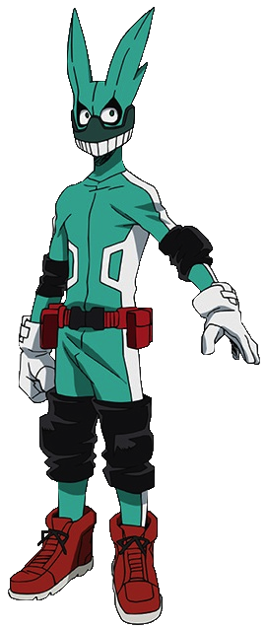
Saturated Market
There’s always a way around it
Newsfeeds get flooded
Comes back to audience and targeting

Slide 10
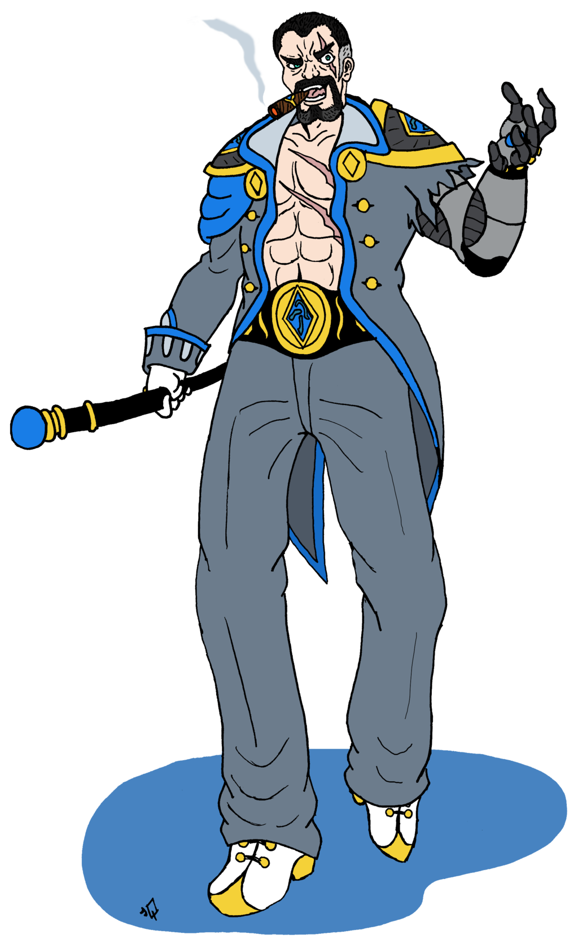
Because someone gave you just enough information to ensure you’d fail
Ad agencies want you to fail
Buy their programs
Hire them to do it
Stay out of the feed

Slide 11
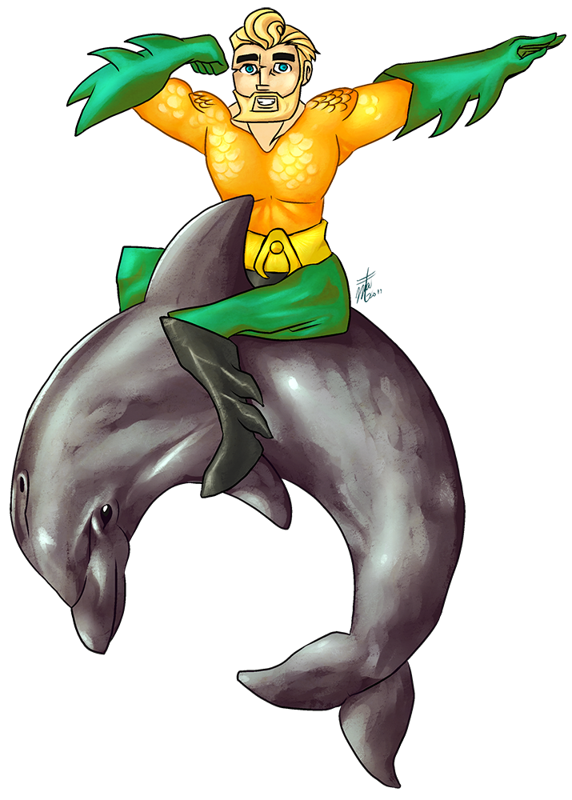
Getting Your Organic Game in Place

Slide 12
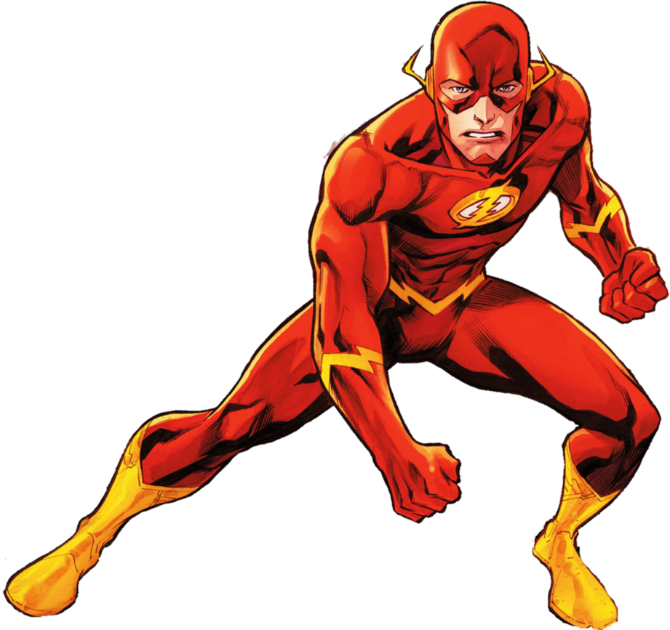
What is ‘organic game’?
Strategic plan for creating/sharing content that gets you the most amount of engagement/reach for little to NO MONEY
This Photo by Unknown Author is licensed under CC BY-NC

Slide 13
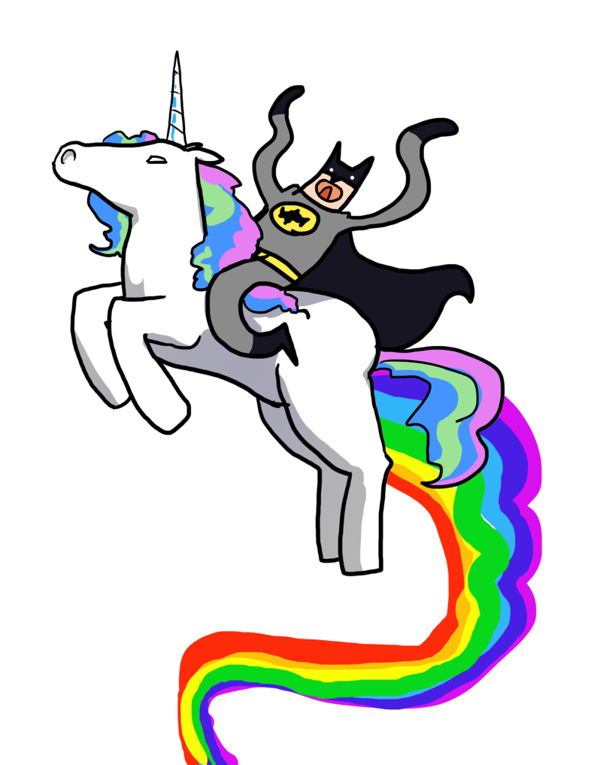
Know Your Audience – Handout
Your content should be ABOUT THEM NOT YOU
Who are they demographically?
What makes them laugh?
What do they worry about?
What do they like about camping?
What do they not like about camping?

Slide 14
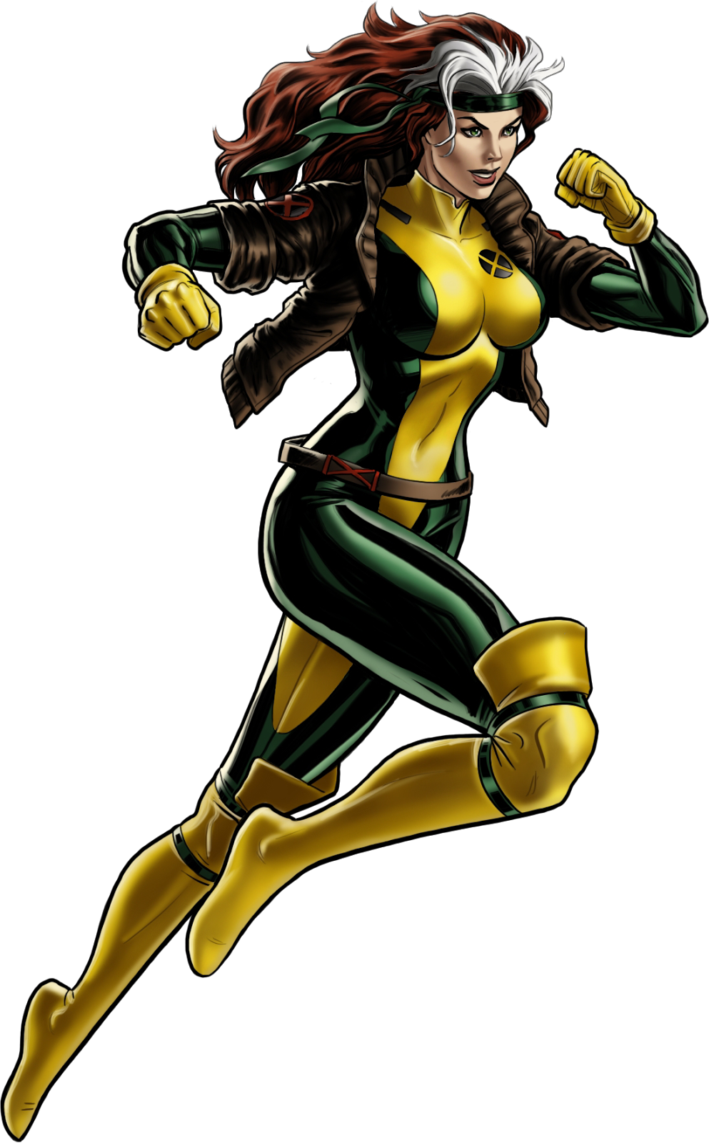
FOCUSING ON THEM OVER YOU
Makes people feel special
They feel seen
Sales posts speak to how it benefits them instead of your needs

Slide 15
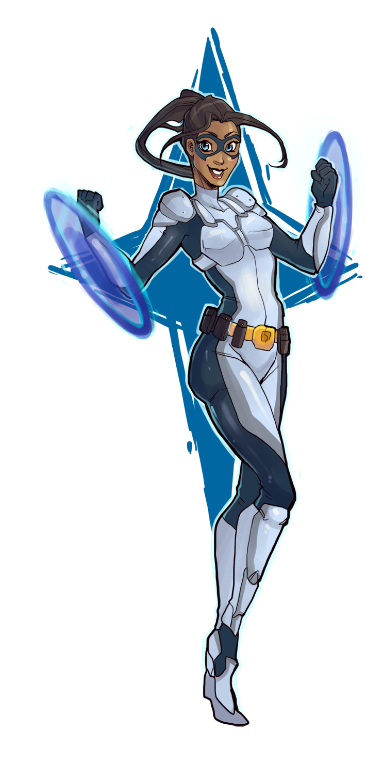
WHAT DOES THIS HAVE TO DO WITH ORGANIC REACH
Much more likely to engage with content
When they engage, it boosts your reach
If they see themselves, they become invested in your success – which means they engage more AND BUY MORE

Slide 16
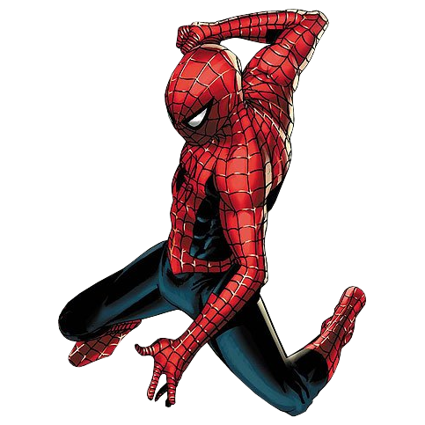
Build a Relationship
Let them see YOU
Behind the scenes
Make them feel special
Be consistent
Ask for the sale – but not constantly

Slide 17
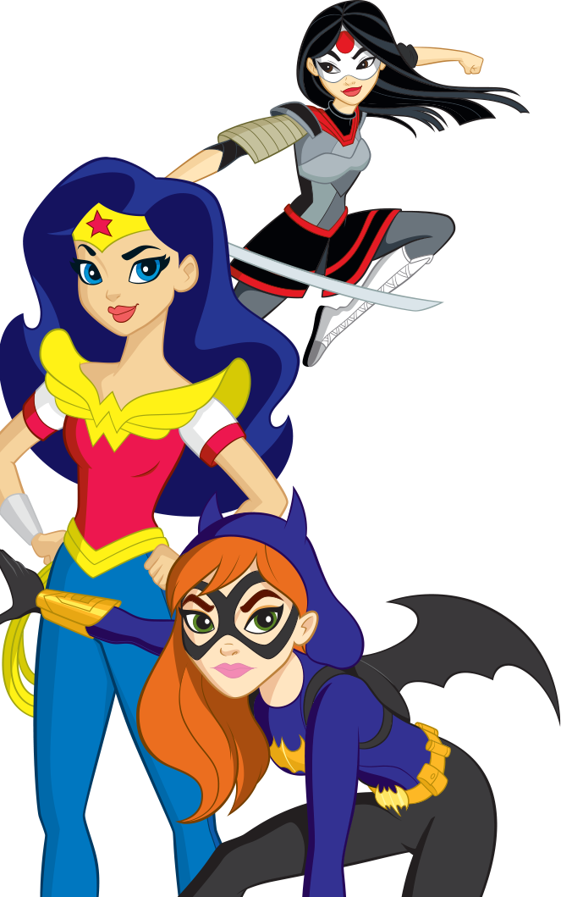
Encourage Engagement
Start conversations
Feature them
Share what they will share

Slide 18
What about the algorithm?
Yes, it does exist and it’s a very real struggle.
The Good News is that everything we just went through helps you to rank higher on FB’s Algorithm.

Slide 19
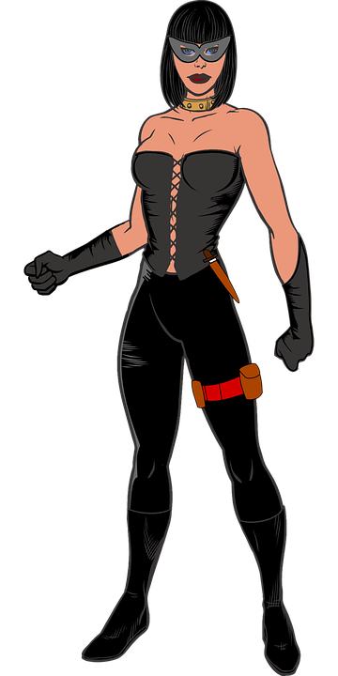
Here’s the big secret FB Ad Agencies don’t want you to know

Slide 20
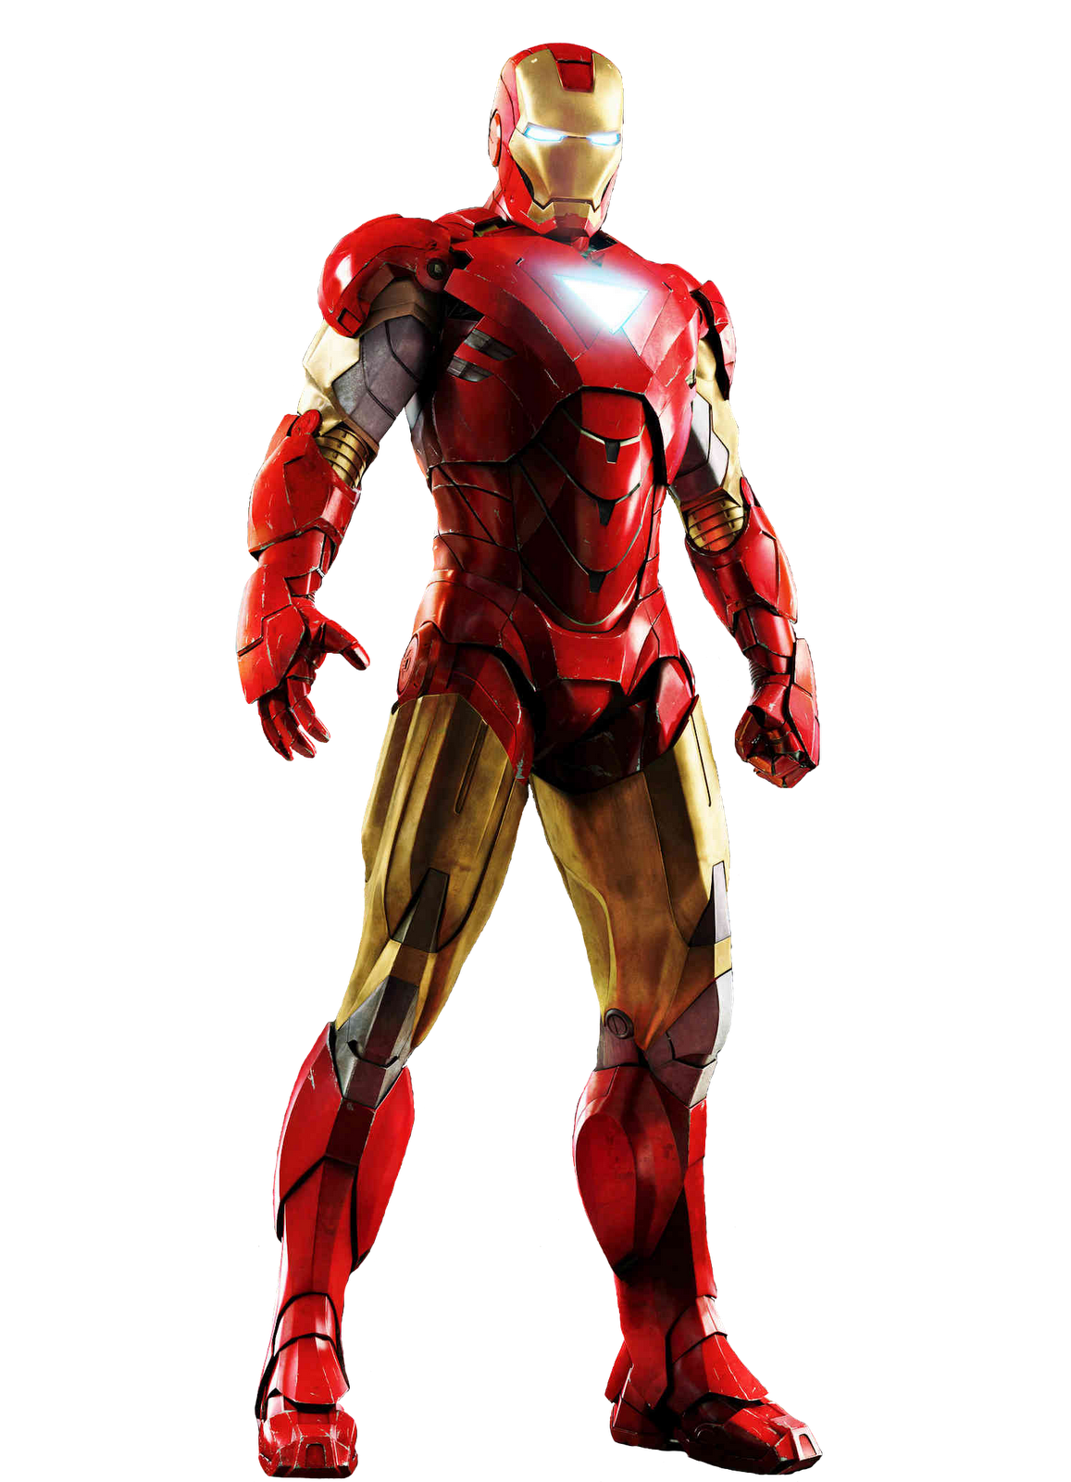
If you’re doing your organic game correctly, you don’t need them.

Slide 21
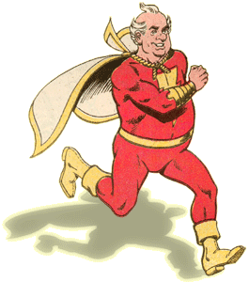
Organic
Ads
Notes:
Organic is the superhero here. FB boost is it’s super cool car that helps get them where they need to be faster. Ads are the bumbling sidekick that when they work, work really, really well. And when they don’t, they get caught by the villain and you have to save them too. Ie. They’re more work than they’re worth.

Slide 22
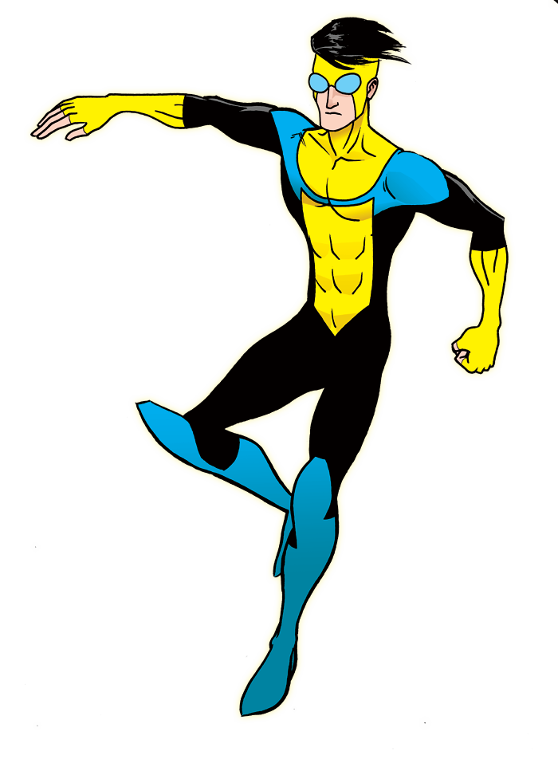
Who are you advertising to?
Finding your targeted audience
This Photo by Unknown Author is licensed under CC BY-NC

Slide 23
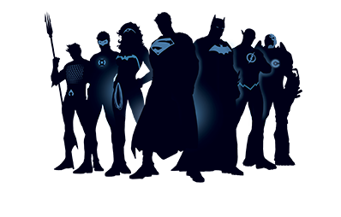
Your followers (and possibly their friends) are your best audience
Facebook’s own research found that everyone is no more than 3.5 degrees separated.
The closeness of users is beneficial for marketers trying to overcome Facebook’s algorithm, which is notorious for slashing organic reach for brands.
Facebook pages with smaller followings generally have higher reach and engagement rates.
Facebook ads with some sort of social proof had 300% more conversions, and 50% lower cpas and cpcs (also helps with the algorithm if you’re using a post!)

Slide 24
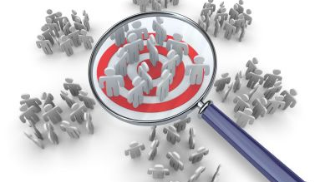
Use what you know about your audience to create a targeted audience

Slide 25
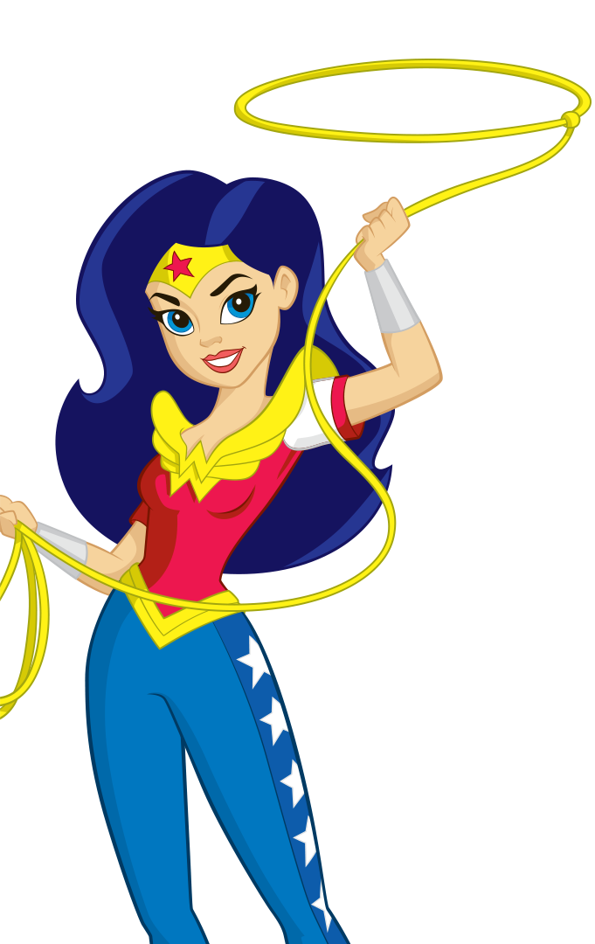
Creating a Custom Audience
Capture them so you can advertise to them

Slide 26
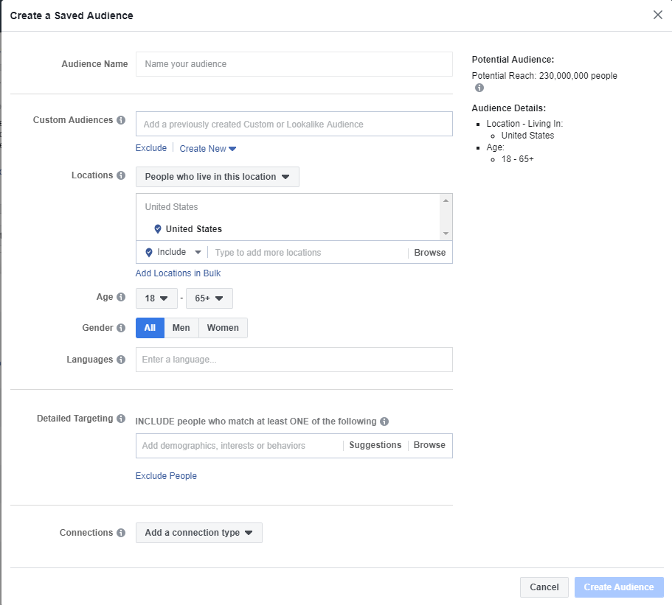
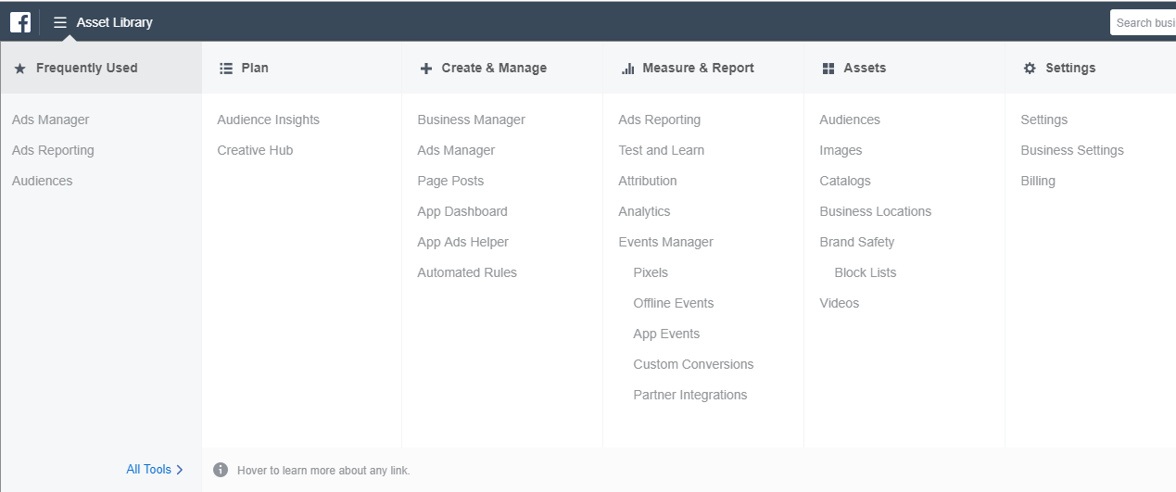
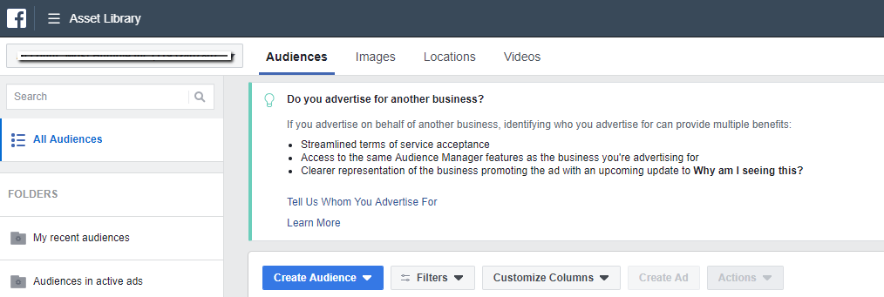
How to find it in ads manager

Slide 27
Options for targeting
Exhaustive list – demographics, likes, jobs, interests, etc.
Use what you know
More Advanced Options – lookalike, traffic
Try to get a ‘defined’ audience

Slide 28
When to boost a post
When you’ve got a ‘hot’ one
When you’ve got a message to get out there asap
When engagement seems low
Your budget is small but you need to get the word out

Slide 29
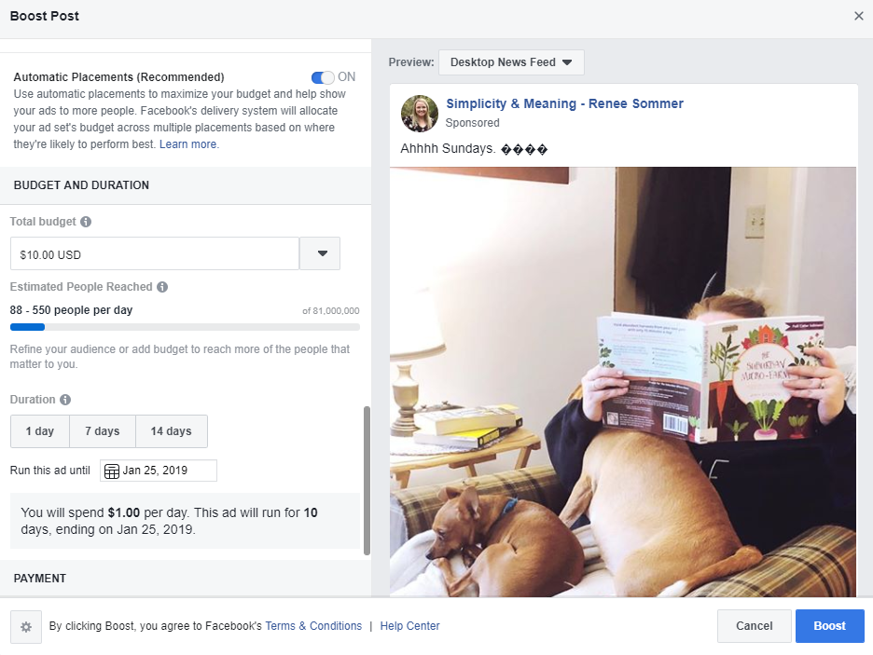
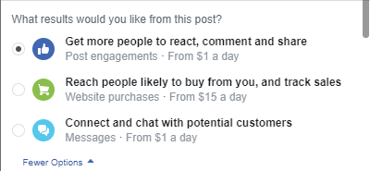
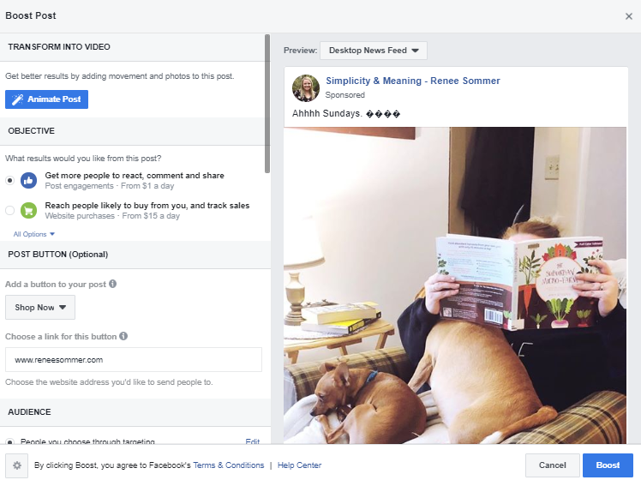
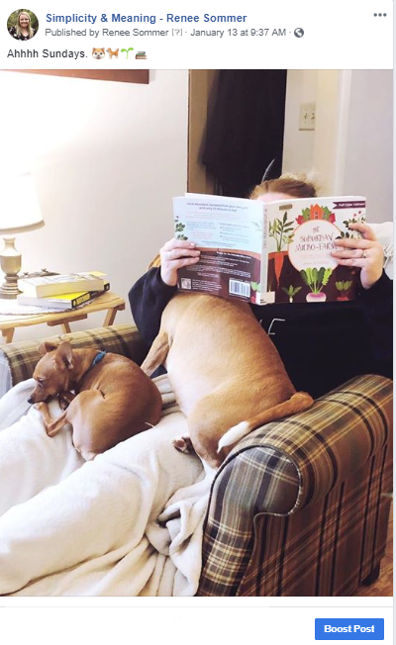
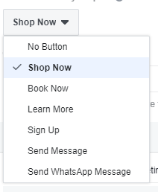
How to boost a post

Slide 30
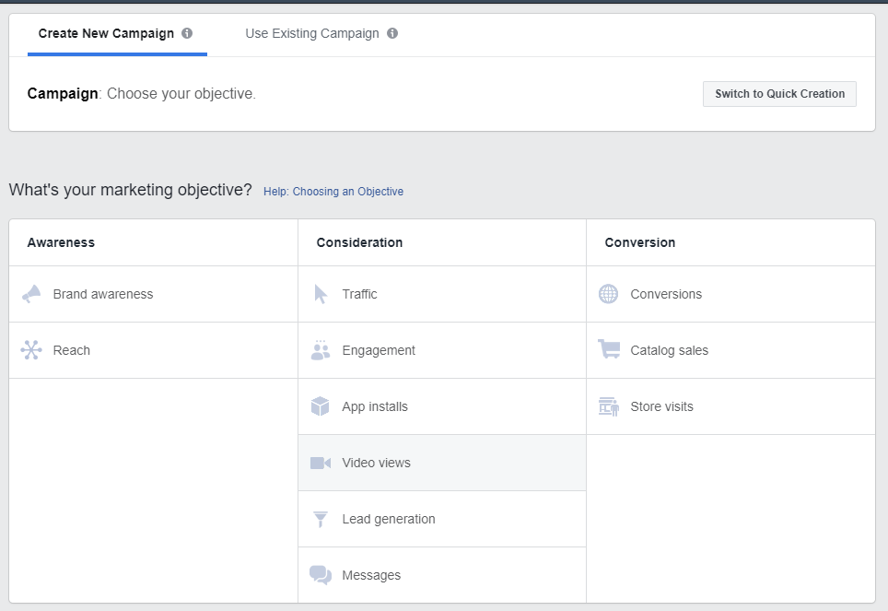
When to run an actual ad
You don’t have many followers
You have a specific objective
You want video views

Slide 31
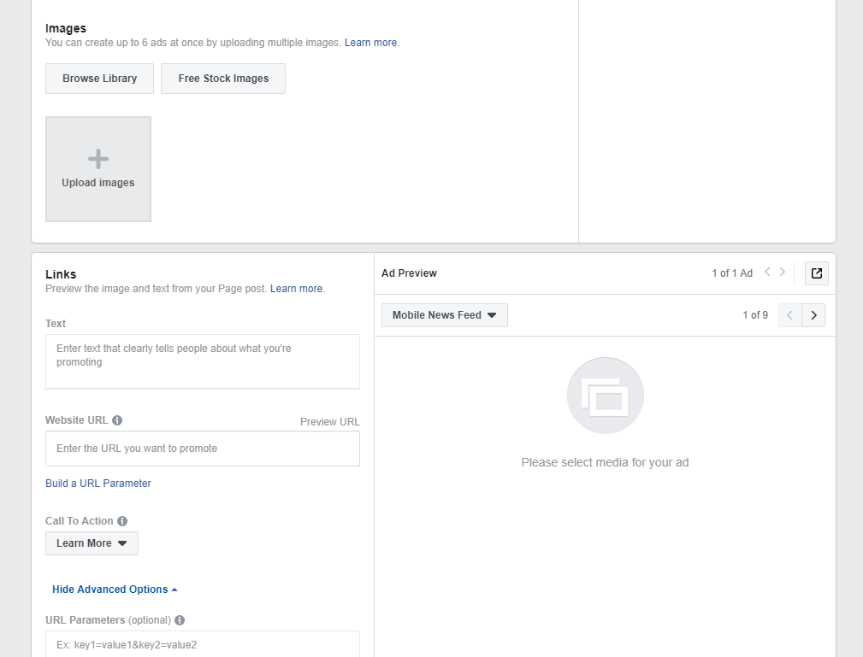
How to Create an ad

Slide 32
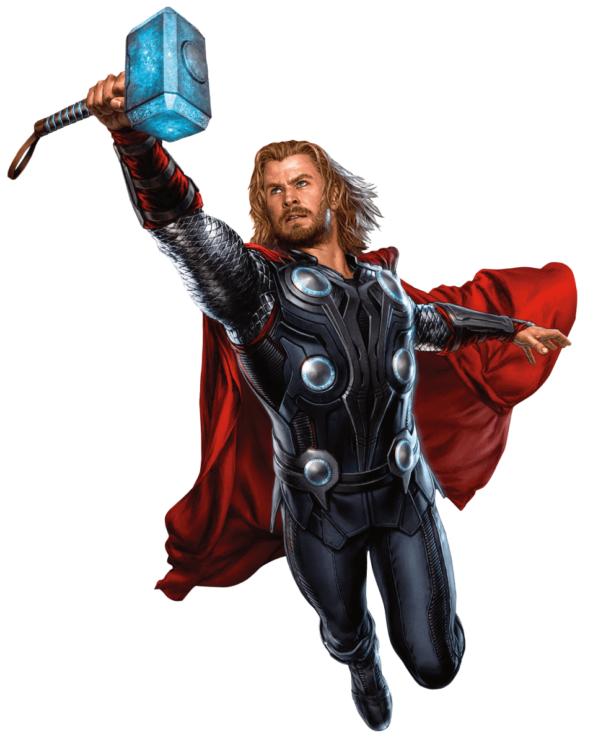
summary
If you get good at organic posting and building relationships, you won’t need fancy Facebook ads
A lot of the hype is agency created
Focus on your ideal clients – what do they want to see?
Boost to help things along and beat the algorithm

Slide 33
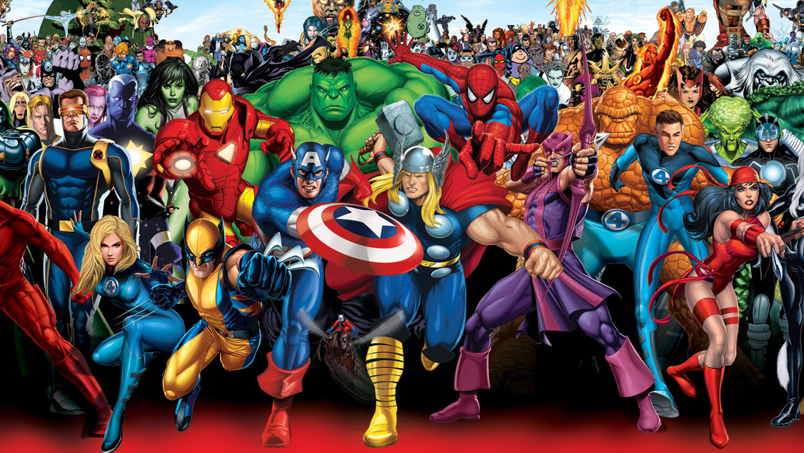
Questions?
This Photo by Unknown Author is licensed under CC BY-NC-ND

