Slide 1
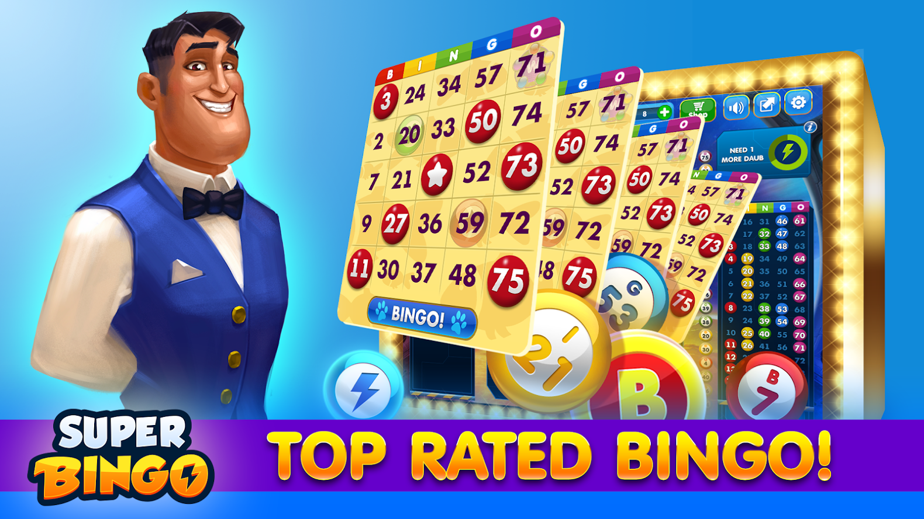
BY:
CARLA BROWN

Slide 2
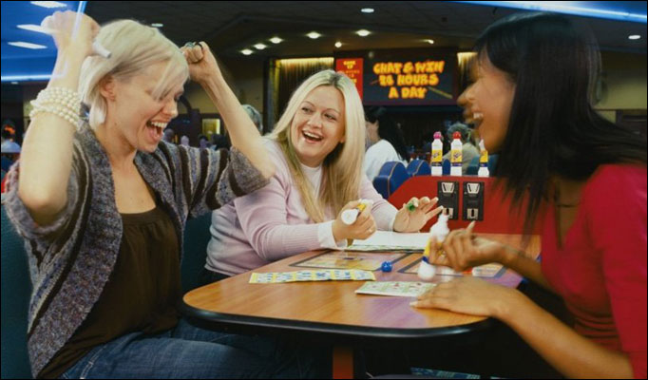
FACTS!
BINGO IS A GAME OF CHANCE
THERE ARE MANY FORMS AND VARIATIONS OF BINGO
YOU CAN MAKE A BINGO GAME OUT OF ALMOST ANYTHING
BUT MOST OF ALL, BINGO IS FOR EVERYONE!

Slide 3
SOME OF THE TYPES AND VARIATIONS OF BINGO!
75 BALL BINGO
90 BALL BINGO
PATTERN BINGO
BAR BINGO
TV THEME
COUNTRY BINGO
GLOW BINGO
DEAL OR NO DEAL BINGO
HUMAN BINGO

Slide 4
Pattern BINGO!
IN PATTERN BINGO, YOU CAN ACTUALLY USE PATTERSN THAT ARE PRE-MADE OR MAKE YOUR OWN PATTERN USING THE FREE BINGO WEBSITE!
YOU CAN MAKE HOLIDAY PATTERNS, SPORTS PATTERNS ETC..
I TRY TO USE SHORTER PATTERNS FOR PEOPLE THAT ARE IN A HURRY AND LONGER PATTERNS FOR PEOPLE WHO WANT TO STAY LONGER. YOU WILL KNOW YOUR OWN BINGO CROWD!

Slide 5
BAR CHIP BINGO!
THE PARTICIPANT BUYS AS MANY BEER CHIPS AS THEY WANT.
THEN BUYS THE BINGO CARDS WITH THE BEER CHIPS.
THEN THE BINGO CALLER COUNTS ALL OF THE BEER CHIPS COLLECTED FROM THE CARDS THAT ARE BROUGHT.
THE WINNER WINS ALL OF THE BEER CHIPS!

Slide 6
TV THEME BINGO!
A FEW THINGS NEEDED!
BLUETOOTH SPEAKER
BINGO CALLERS PHONE
YOUTUBE

Slide 7
COUNTRY MUSIC BINGO!
A FEW THINGS NEEDED!
COUNTRY MUSIC BINGO CARDS
BLUETOOTH SPEAKER
PHONE OR BLUETOOTH COMPUTER
YOUTUBE

Slide 8
GLOW BINGO!
A FEW THINGS NEEDED!
BLACK LIGHTS
GLOW HATS OR GLOW STICKS
GLOW DABBERS

Slide 9
DEAL OR NO DEAL BINGO!
ITS REGULAR BINGO WITH A TWIST!
YOU PLAY UNTIL SOMEONE BINGO’S
THE WINNER THEN GETS HIS CHOICE OF TWO COVERED PRIZES
HE CAN SAY DEAL OR NO DEAL
IF HE PICKS NO DEAL
HE CAN STAND BY FOR THE NEXT FASTEST BINGO ON THE SAME CARD,TO WATCH IF THEY PICK WHAT HE HAS OR THE OTHER.
IF THE OTHER PICKS THE UNCOVERED THEY BOTH WALK AWAY WITH WHAT THEY PICKED. IF THE 2ND WINNER PICKS THE 1ST WINNERS PRIZE THEN HE GETS THE OTHER.

Slide 10
HUMAN BINGO
THIS ONE WOULD BE GOOD FOR KIDS AND ADULTS OUTSIDE!
MAKE UP YOUR CARDS WITH RANDOM THINGS LIKE, FIND SOMEONE WHO HAS ON BLACK SOCKS.
HAVE THAT PERSON INITIAL THAT SPOT AND MOVE ON.
USUALLY BETTER PLAYED IN A LARGE AREA WITH A LARGE CROWD.
YOU CAN ALSO USE THIS AS A NETWORKING OR ICEBREAKER
FAST PAST AND FUN

Slide 11
ALL
ABOUT
FUN!
GET
YOUR FREE BINGO CARDS
GENERATED
MYFREEBINGOCARDS.COM
BE
CREATIVE!
ALSO
MAKE UP YOUR OWN
ON THE SAME
WEBSITE

Slide 12
PRINT-BINGO.COM
GO TO PRINT BINGO CARDS.
CLICK ON STANDARD NUMBERED BINGO CARDS.
CLICK ON FOUR NUMERIC BINGO CARD PER PAGE.
CLICK ON MANUAL BINGO CARDS.
PRINT THEM.
THEN CLICK ON THE RELOAD PAGE ICON.
THEN REPEAT STEPS 4-6, FOR AS MANY CARDS AS YOU WOULD LIKE!

