Slide 1
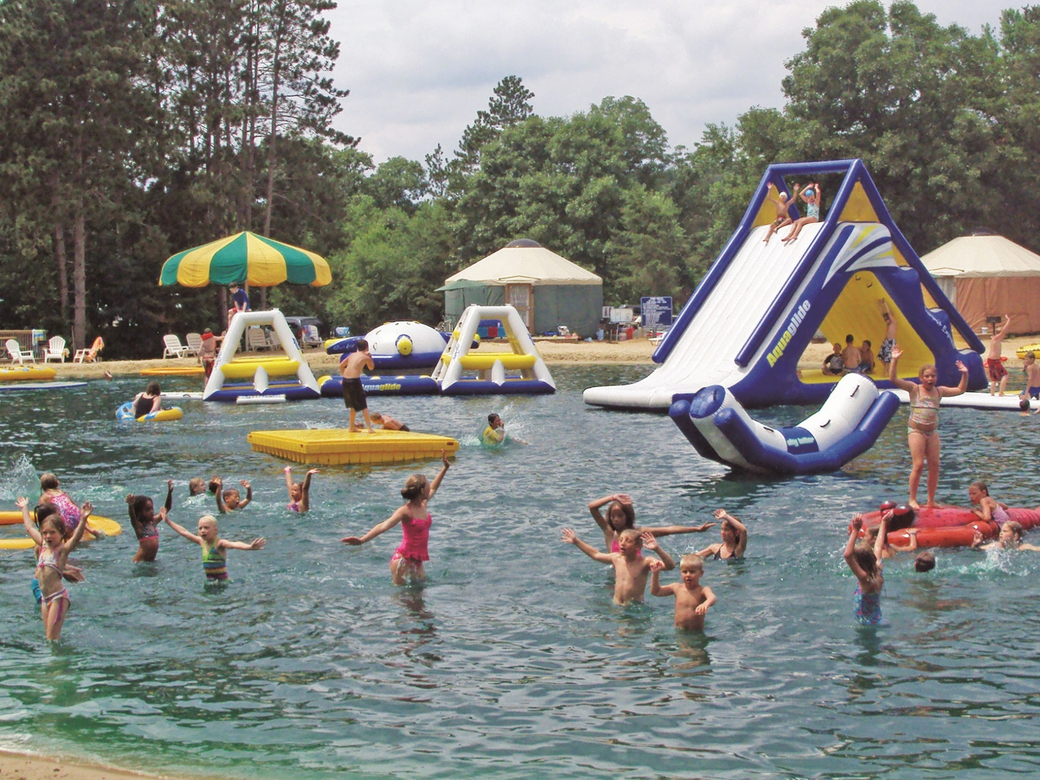
Recreational Swim Ponds
WACO Convention 2019

Slide 2
Background
2005
Primary focus is working on public and private lakes and ponds
Increased focus on “recreational swimming” ponds
Concept to completion involvement
Wisconsin, Indiana, Kentucky, Illinois, Florida
Planning phases New York, Michigan, Calilfornia

Slide 3
Goal: Improve the camping experience
Past and current operations
Fun and Sun?
Review of regulations
Recommendations

Slide 4
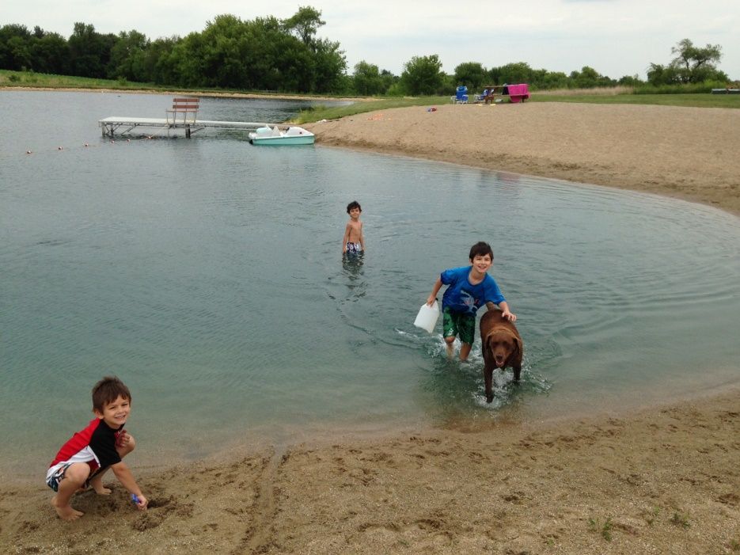
Change…
From this…

Slide 5
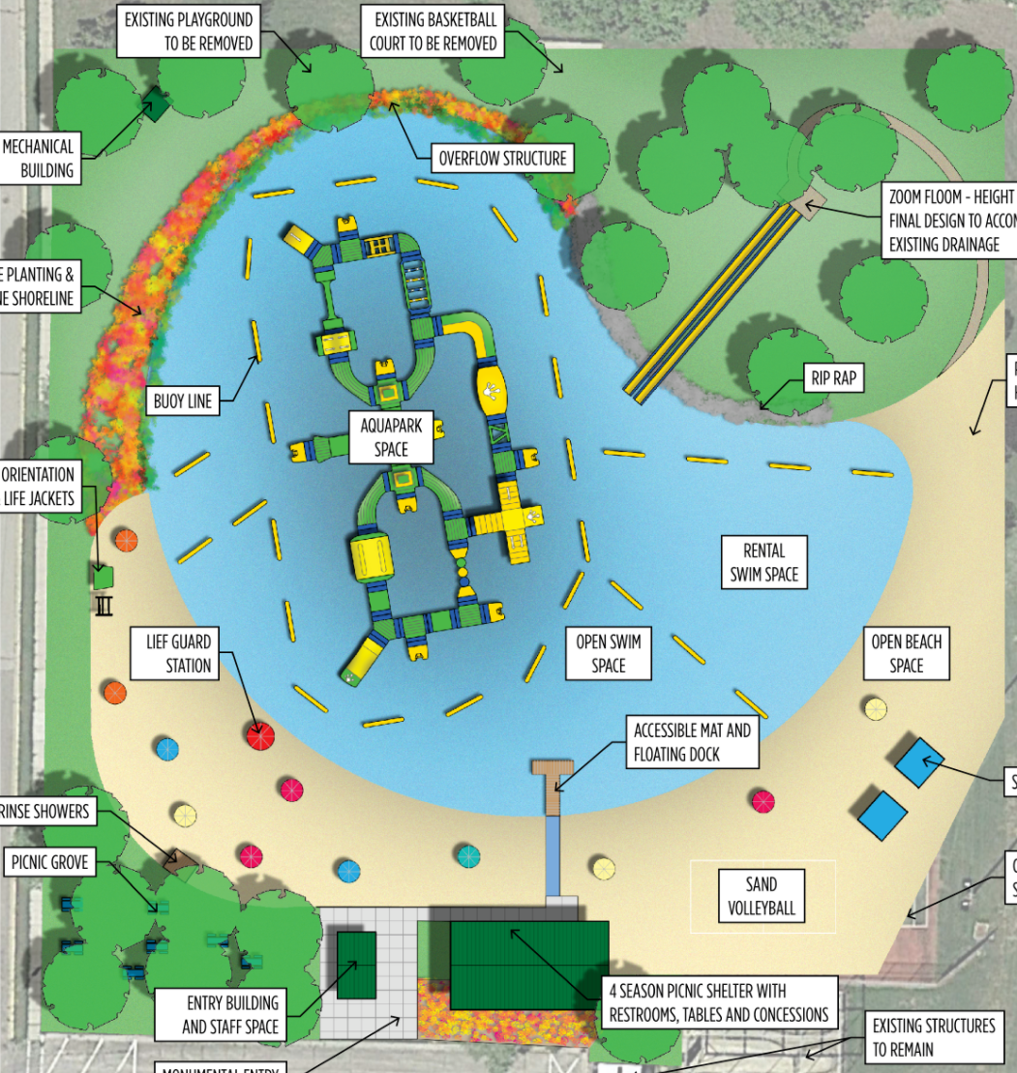
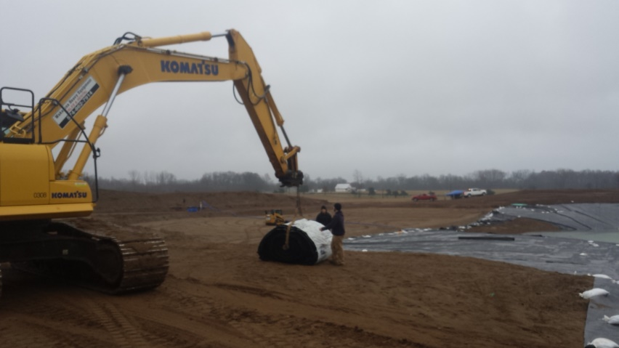
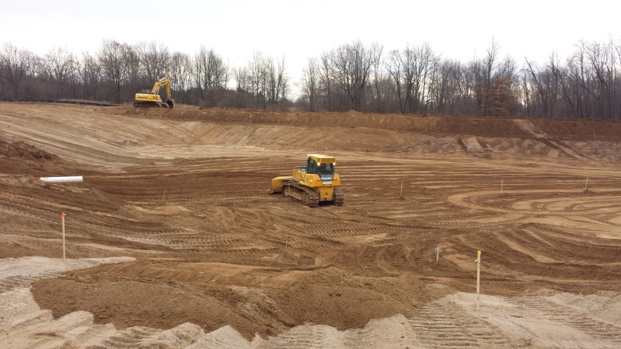
Recreational Swim Ponds Today
To this…

Slide 6
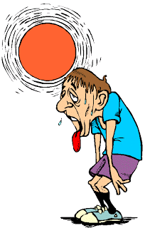
Seasonal Operation
Spring/Early Summer
Inflatables
Sand and Site Prep
Basic Opening
Summer
Full Operation
Treatment Schedule
Put out Fires
Early Fall
Remove Inflatables
Winterize
Walk away and head south

Slide 7
Fun and Sun
Highly Diverse Recreational Facility
Amenities for all Ages
Multiple Zones
Shallow Sand Beach – zero entry
Dry Beach – sandcastles
Deep Zone – inflatables
Secondary recreation – volleyball
Non-swim sessions – Ambiance
Increase user flow

Slide 8
Regulatory review
Construction Permits
WI DNR
Army Corps of Engineers
County
Local zoning
Operational
WI DNR
NR107 and NR109 Aquatic Plant Management
Resources
Wisconsin Beach Health
Local Department of Health *does not include building code permits, sanitary, facilities, ect

Slide 9
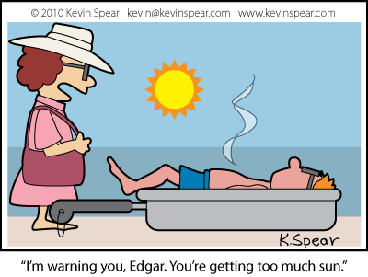
Best Management Practices
Consistency throughout the industry
Pro-active solutions
Safety awareness
Operator involvement
Understand water quality issues and how to address them
Designated maintenance schedule
Importance of education and disclosure

Slide 10
1) Monitor Change Over Time
“Wait, my pond didn’t look like this yesterday”
Usually – doesn’t change overnight
Monitor trends
Incorporate operator staff to perform routine tests

Slide 11
Water Quality vs Algae Blooms

Slide 12
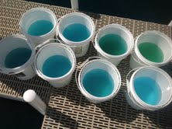
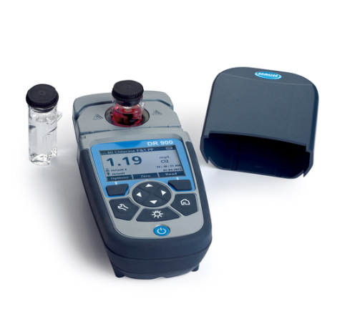
Testing, monitoring, and data collection
$500-2500 capital investment

Slide 13
Data log form

Slide 14
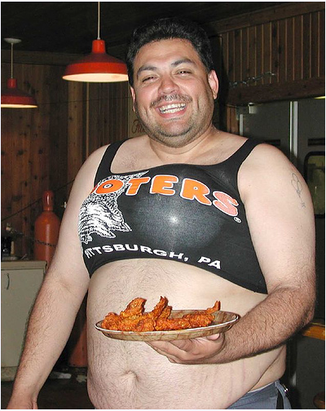
2) It’s all in the presentation…

Slide 15
Jump in the water’s fine?

Slide 16
Behind the Scenes Treatment Process

Slide 17
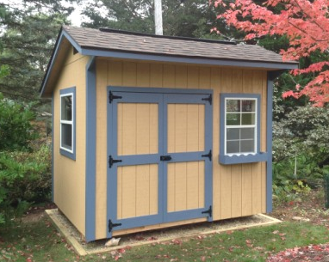
Mechanical Sheds
$1600-$5000+ depending complexity

Slide 18
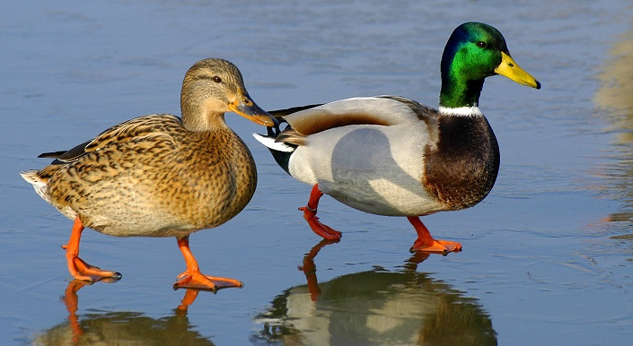
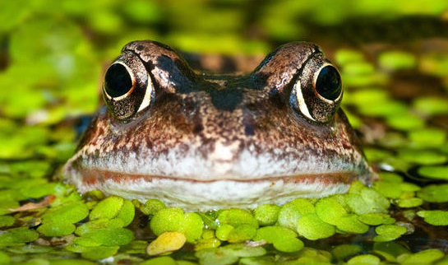
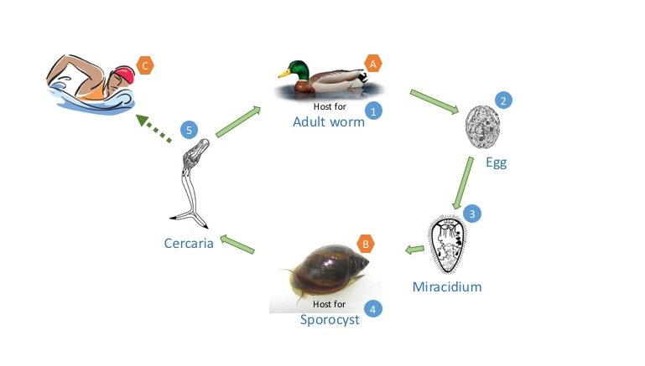
“If you build it they will come”
3) Unwanted Guests
Field of Dreams; Bible; or?

Slide 19
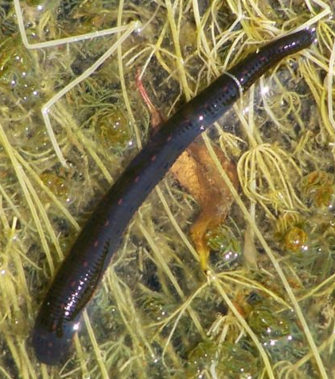
Leeches
One of most feared creatures on earth
Generally speaking completely harmless
Typically overwinter in muck at bottom of pond
Appear in various numbers
Most ponds – no issue

Slide 20
Leeches Options
Panic application – Copper Sulfate
Don’t kill your pond!
Likely illegal rates and application
Working with DNR for improved treatment method
Largemouth bass

Slide 21
Swimmer’s Itch

Slide 22
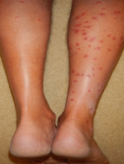
Swimmer’s Itch Options
Positive ID
Break the cycle
Waterfowl
DON’T FEED
Snails
Games with the kids
Suntan Lotion
Rigorous drying with a towel
Bathing/showering
Remove the muck

Slide 23
Out of site out of mind?
4)Pond Cleanout Plan

Slide 24
Why Suck the muck?
Internal nutrient loading
Environment to host organisms
Stir the pot
Loss of water depth

Slide 25
Pond Basin Cleaning Options
Off season – Spring or Fall?
Prepare a plan for your pond
Pond size
Bather load
External influence (runoff)
Discharge site
Water source
Frequency
Labor

Slide 26
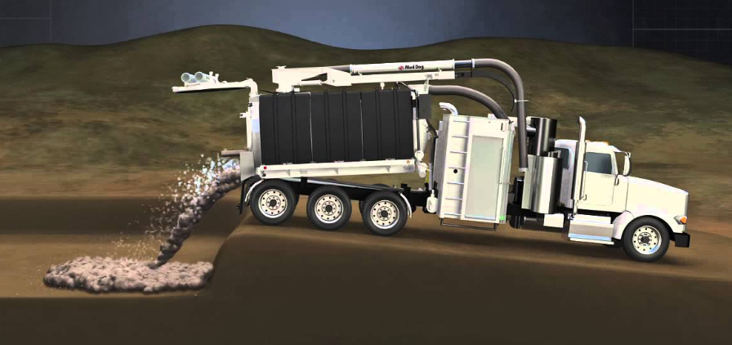
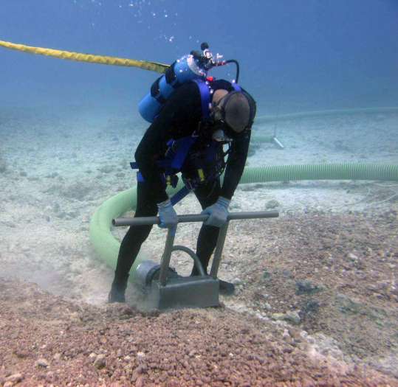
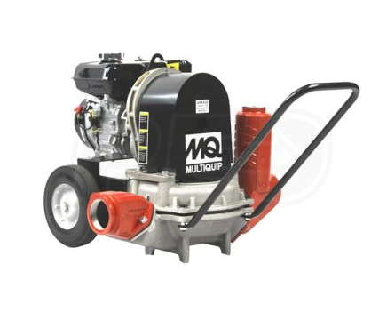

Slide 27
Key Benefit's
Reduce high organic muck from pond
Perform maintenance
Inspection of facilities
Re-dress sand beach
Bring the pond back to like-new conditions

Slide 28
Water Quality Management
Typical

Slide 29
Water Quality Management
Non-invasive green planktonic algae
Harmless except to your eyes - aesthetics
Feeding on excess nutrients
Safety risk - clarity

Slide 30
Water Quality Management
Age of your pond
1-3 years vs 4+ years
Time to cleanout the pond?
Bather load
25-50/day/acre to 300+/day/acre
7 days per week
Happy medium? 1 bather/200 sq ft?
External sources
Runoff
Waterfowl
Fertilizers
Environment – dilution factor
Maintenance schedule
Set schedule to a variable schedule
Monitor trends better

Slide 31
Water Quality Management
Routine testing of the water
Injecting vs application
Early Season – pre swimming season
Flocculants/Coagulants
Ultrasound
Managing Bather Load
Re-application after rain events
Cleanout schedule

Slide 32
Moving forward
“Lake Like Experience” concept
Consult with local Health Department
Proper signage or posting
Information center
SDS Sheets
Pictures
Action plan

Slide 33
Moving forward
Safety concerns
Life jacket use policy
Designated swim zone
Supervision
Installing equipment provided by qualified suppliers
Consulting with installation professionals - anchoring procedures

