Slide 1
2020 National Electric Code
Current Trends & Topics
What does it mean to you?
Presented by: Wade Elliott

Slide 2
Learning Outcomes
Identify NFPA Standards for electrical installations, systems, and equipment in RV Parks and Campgrounds.
Explain the code standard change process and time table.
Describe the impactful changes to the 2020 code as an RV operator
Paraphrase the purpose of GFCI protection as it relates to the operation of an RV Park.
Utility Supply Group

Slide 3
NFPA (National Fire Protection Agency)
History & background
Function
Limitations & Participants
Three Year Code Cycle
www.nfpa.org
Utility Supply Group

Slide 4
NFPA (National Fire Protection Agency)
What is an AHJ?
Authority Having Jurisdiction. An organization, office or individual responsible for enforcing the requirements of a code or standard, or for approving equipment, materials, an installation or a procedure.
Utility Supply Group

Slide 5
2020 NEC Article 551 Key Components
Receptacles 551.71 MINIMUM REQUIREMENTS: 100% 20 amp GFCI Protection, 70% 30 amp, 20% 50 amp. If you have a 50 amp receptacle you must have a 30 amp receptacle. A big push for GFCI Protection. Look for AHJs to pay attention to 20 amp GFCI. Not required on 30 or 50 amp
RV Site Supply Location 551.77 Locate 5 to 7 feet from drivers side, Minimum receptacle height of 24”
Power Supply 551.44 RV shall have only “1” power supply cord . More than one (1) 30 or 50 amp cord feeding an RV IS NOT ALLOWED. Auto Transformers (Buck Boost) are not allowed
Utility Supply Group

Slide 6
2020 NEC Article 551 Key Components
Distribution System 551.72 RV Site power must be served with single phase service (can use 3 phase to provide single phase).
Feeder Circuit Capacity 551.72(D) Neutral conductors shall have the same ampacity as the ungrounded conductors. What is a Feeder circuit? Branch Circuit? Service? How does that apply in the 2020 code (GFCI protection)
Load Calculations 551.73 50@12000va; 30@3600va; 20@ 2400va.
Utility Supply Group

Slide 7
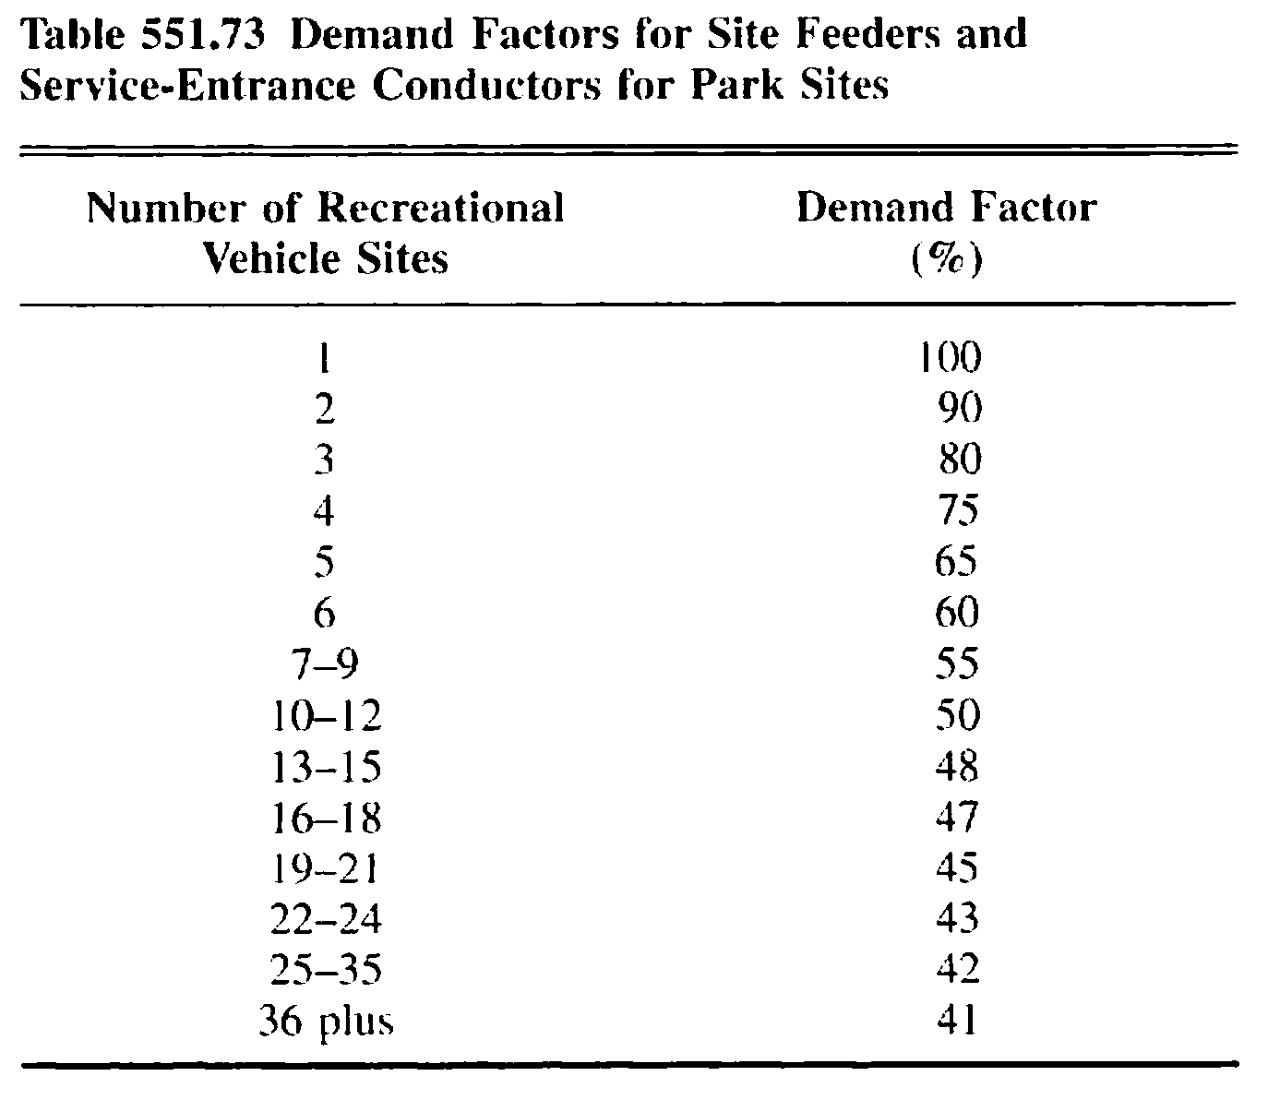
Demand Factor Table 551.73
Utility Supply Group

Slide 8
Typical Load Calculation Old 2014 NEC Code
Using Table 551.73
Assuming (17) 50 amp sites
17 x 9600va / 240v = 680 Amps (100%)
680 amps x .47 demand factor= 320 Amps
Utility Supply Group

Slide 9
Typical Load Calculation Current 2017 NEC Code
Using Table 551.73
Assuming (17) 50 Amp sites
17 x 12,000va / 240v = 850 amps (100%)
850 amps x .47 demand factor = 400 Amps
Utility Supply Group

Slide 10
Key 2017 NEC Changes
Grounding 551.75 & 250.32(A): Change language to ‘Grounding electrodes SHALL NOT be required, but are allowed’
Load Calculations 551.73 : Increase 50 amp rating from 9600vA to 12,000vA (100%)
100 Amp RV Services: No changes for 2017 or 2020. 2023?
Utility Supply Group

Slide 11
GFI protection on 50 & 30 amp receptacles
Happening in the Marina Industry
During 2017 code cycle, language was added to Article 210.8 that was being used by AHJ’s to require IN EVERY 30 & 50 Amp application.
Held off for RV Sites. (Why?) - Additive Leakage - Feeder vs Branch circuit

Slide 12
GFI protection on 50 & 30 amp receptacles
210.8 (B): Other Than Dwelling Units. All single phase receptacles rated 150v or less, 50 amps or less… installed in the following locations … shall have GFCI protection for personnel – Outdoors
90.3: Code Arrangement. This code is divided into the introduction and nine chapters… Chapters 5, 6 & 7 apply to special occupancies, special equipment or other special conditions and may supplement or modify the requirements in Chapters 1-7

Slide 13
Key 2020 NEC Changes
GFCI protection is a very hot topic. The mantra… “we increase GFCI requirements, electrocutions decrease.” In many areas of the NEC (113 articles) GFCI protection is now required on up to 50 amp circuits in various locations (e.g. outdoors)

Slide 14
Key 2020 NEC Changes
Prohibition for auto transformers (Buck Boost), Surge Protectors are OK
Restriction to only 1 power supply (30 or 50 amp) to an RV
New RV’s will have polarity device. RV Parks should be checking their pedestals for mis-wired circuits
20 amp Receptacle will be Weather Resistant

Slide 15
Questions & Comments:
Thank you for attending!!!
Please stop by the USG Booth during the trade show if you have follow up questions and comments.
Utility Supply Group

