Slide 1
Cracker Barrel On IT Fun Stuff
Adam Malsack Lake Arrowhead Campground
Ben Stefan
Grand Valley Campground

Slide 2
What’s Your Biggest Technology Challenge?

Slide 3
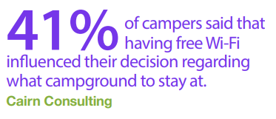
Technology & Camping
Nearly all campers (97 percent) state that they bring some type of technology with them while camping.
27% of millennials and 25% percent Gen X campers say sharing camping experiences through social media is important

Slide 4
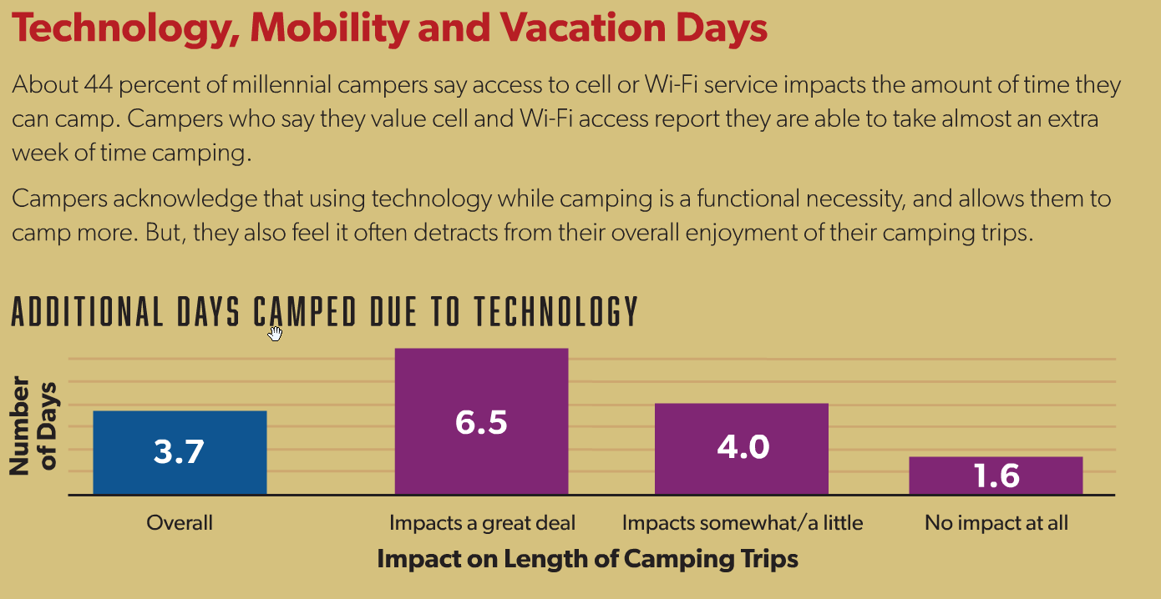
Smartphones are gaining in popularity, while the use of laptops, tablets and GPS devices are waning.
https://koa.com/north-american-camping-report/

Slide 5
Campground Internet
Fiber
DSL
WISP
Satellite
Cellular

Slide 6
Wi-Fi
Free vs Paid
Coverage
Filtering for Security & Bandwidth Savings
Client Throttling
Acceptance Page with Terms of Use

Slide 7
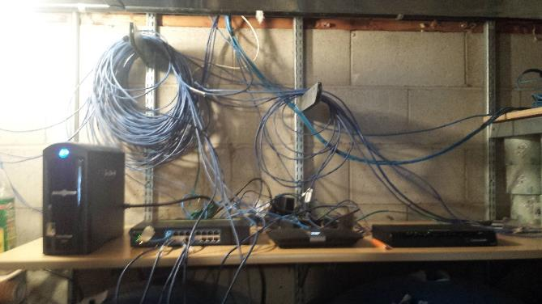
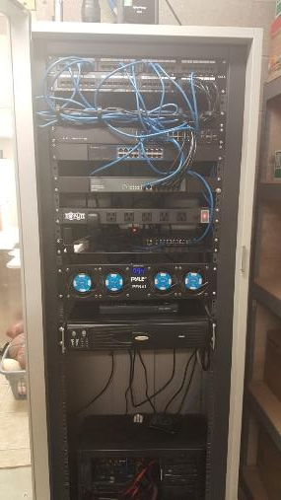
Networking & Security
Server Rack
Routers
Switches
UPS
Security
Internet Connection Sharing
PCI Compliance

Slide 8
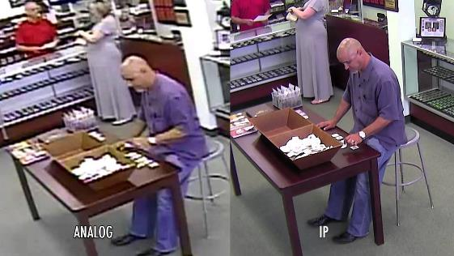
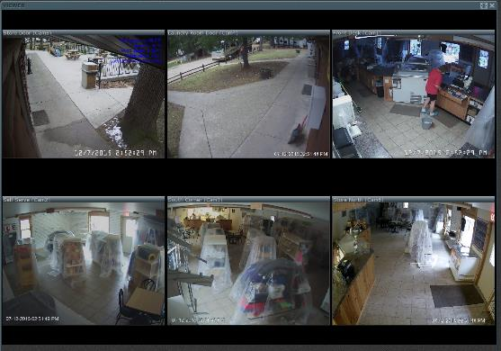
Security Cameras
Types of Cameras
Remote Access
Alerting
Camera Locations
Pool
Pond
Gate\Entrance
Other Buildings
Playground

Slide 9
Store Technologies
Point of Sale
ATM
Phone Systems
Backups
Printers & Copiers
Software
Credit Cards
Digital Signage
Computers

Slide 10
Websites
Accessibility/ADA
Secure - Https://
Analytics
Mobile Friendly
Easy to Update

Slide 11
Smart Home → Campground
Temperature Monitoring
Thermostats
Switches
Lights
Locks
Outlets\Power Strips

Slide 12
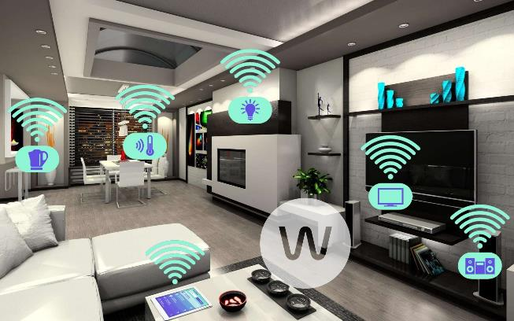
Tech Toys
Drones
Tile
Smart Watch
Power Packs

