Slide 1
Top Retail Food Violations
Kara L. Paul, MPA, RS
Retail Technical Specialist
Department of Agriculture, Trade & Consumer Protection

Slide 2
Outline
Inspection agency
Contact Information
Top Violations
Prevention
Notes:
Here is the plan for our time today. I want to briefly discuss how our agency is set up and important contact info. Then we will focus on what the current most frequently written violations are to hopefully help you be proactive and prevent these at your facility.

Slide 3
Notes:
Retail licenses are issued by the Department of Agriculture, Trade and Consumer Protection or by an agent of the department such as a local, city or county health department.

Slide 4
Department of Agriculture, Trade and Consumer Protection Division of Food & Recreational Safety Bureau of Food & Recreational Businesses Retail & Recreational Safety Produce Safety Manufactured Food Services Dairy Compliance, Licensing and Technology
Notes:
Here is the breakdown of our section within DATCP. You as a campground/restaurant owner will work mainly with Retail and Rec Safety and our licensing section.

Slide 5
Contact Information
Your local County/City Agent
DATCP Licensing
608-224-4720
datcpdfslicensing@wi.gov
DATCP Retail Specialists
datcpdfrsretail@wisconsin.gov
DATCP Complaints
608-224-4714
datcpfoodcomplaintsemergencyresponse@wi.gov
Notes:
If you have questions regarding your current license or to obtain a license you need to contact your local health department or DATCP. For any questions you can always contact your local health department or the retail specialists. Complaints can again be filed with your local health department or the DATCP complaints mailbox.

Slide 6
DATA USED
2017 routine and pre-inspection
Over 5,000 inspections completed by state staff alone
Restaurant/Retail
Data from state and agents using the Health Space inspection program.
Notes:
To determine the top violations I used inspection data from 2017. Our state staff alone completed over 5,000 inspections in 2017. I used data entered by both our state and agent inspectors into our Health Space inspection .

Slide 7
Top 22 Violations
Notes:
20 is boring so I decided we should review the top 22 violations

Slide 8
#1 Improper Cold Holding Temperatures
Time-Temperature Control for Safety (TCS) cold foods must be held at 41 degrees F or below
Notes:
The top vote getter for violation written most often is Improper cold holding. Like it says on the slide cold foods must be held at 41 degrees F or below. The temperature danger zone is 41 to 135. So that means cold food must be below 41 and hot foods above 135 – we don’t want anything in the middle.

Slide 9
KNOWLEDGE CHECK
Is it ever safe to hold TCS cold food above 41 degrees F?
YES!!
Notes:
This leads us to our first knowledge check.

Slide 10
Facility has a time as a public health control agreement in place with their licensing agency
Food is in the cooling process
135 degrees F to 70 degrees F in 2 hours
70 to 41 degrees F in an additional 4 hours
Notes:
How is it possible to safely hold a food out of temperature control? There are a couple of situations where this may occur. First, if you have an approval with your inspector to use time instead of temperature for control. For example, you hold sliced tomatoes out of your cooler over a busy period or at a buffet or you hold hot foods without added temperature control. If this is the case then you would hold those foods for 4 hours and then toss whatever is left. If you do this you must have a process and approval in place with your inspector ahead of time. Otherwise, food may not be held at 41 degrees F or below if it is in the cooling process.

Slide 11
#2 Equipment Food Contact Surfaces Clean, Nonfood Contact Surfaces Utensils
4−601.11 (C) Equipment, Food−Contact Surfaces, Nonfood−Contact Surfaces and Utensils
NonFOOD−CONTACT SURFACES of EQUIPMENT shall be kept free of an accumulation of dust, dirt, FOOD residue, and other debris.
Notes:
Equipment food contact and utensils nonfood contact clean. This is one of our good retail practices/general sanitation violations

Slide 12
#3 Food Contact Surfaces & Utensils Clean
4−601.11(A) Equipment, Food−Contact Surfaces, Nonfood−Contact Surfaces and Utensils
EQUIPMENT FOOD−CONTACT SURFACES and UTENSILS shall be clean to sight and touch.
Notes:
#2 & #3 come from the same code reference dealing with cleaning. Here we have pizza pans that are quite dirty. And while the pan will be heated up to most likely kill any bacteria concerns the food contact surfaces still need to be maintained. Another example of this would be keeping the Interior of ice machine clean.

Slide 13
#4 Test Kit Available
4−302.14 Sanitizing Solutions, Testing Devices
A test kit or other device that accurately measures the concentration in mg/L of SANITIZING
solutions shall be provided.
Notes:
You are required to have a method available to test your sanitizer. Most common sanitizers used include Chlorine, (bleach), ammonia (pH), iodine & hot water. The picture shows some of the test papers used. Your will need to have the specific testing method for your sanitizer. You can’t test ammonia with chlorine test strips.

Slide 14
#5 Date Marking
Time-Temperature Control for safety foods (TCS) must be date marked.
Used or discarded within 7 days
Date must include the day of preparation
Date Marking System must be understood by employees
Notes:
The 5th most common violation is date marking. All TCS food must be dated. So, typically when an inspector looks in a cooler they are expecting to see food with dates on it. Not only does the food need a date but the employees must also understand what that date means. Is it a discard date or a prep date?

Slide 15
Answers to Common Date Marking Questions
⧫ Milk must be date marked
⧫ Commercially Processed Salads are exempt
⧫ You don’t need to purchase special date dots, masking tape and a sharpie work great
Notes:
Some common date marking questions we get as inspectors: Yes, milk must have a DM we cannot go by the sell by or use by date. Commercially processed salads are exempt from a 7 day datemark – you may use the processing date on the container provided by the manufacture. Any method is acceptable as long as all employees understand it.

Slide 16
#6 Storage of Food
Raw animal food must be separated from raw ready to eat foods
Think: Store in order of cook temperatures
Notes:
The reason for this requirement is the concern we also see in this picture. The raw beef is being stored above a food item that may be ready-to-eat. We want you to think of food storage in order of cook temperatures.

Slide 17
Notes:
You can remember stacking order by cook temperature like this handout shows or think RTE always on top, then swim, walk, fly

Slide 18
#7 Physical Facility Clean
6−501.12 Cleaning, Frequency and Restrictions
(A) The PHYSICAL FACILITIES shall be cleaned as often as necessary to keep them clean.
(B) Except for cleaning that is necessary due to a spill or other accident, cleaning shall be
done during periods when the least amount of FOOD is exposed such as after closing.
Notes:
Most restaurants get pretty dirty following a busy lunch or dinner service and that is fine. But you need to make sure that you have a system, man power in place to get caught up after the lunch or dinner rush.

Slide 19
#8 Hand Wash Sign Provided
A hand wash sign must be provided at all sinks used by employees to wash their hands.
Sinks in the kitchen/prep areas
Sinks in restrooms
Notes:
Provide a sign to remind employees to wash their hands at all designated hand wash sinks.

Slide 20
6−301.14 Handwashing Signage A sign or poster that notifies FOOD EMPLOYEES to wash their hands shall be provided at all HANDWASHING SINKS used by FOOD EMPLOYEES and shall be clearly visible to FOOD EMPLOYEES.
Notes:
Here is the official code language for this violation and more sign options.

Slide 21
#9 Chemical Sanitizer Solution
KNOWLEDGE CHECK
WHAT IS THE CONCENTRATION NEEDED FOR MECHANICAL SANITIZING OF DISHES/UTENSILS WITH BLEACH?
Notes:
The #9th most common violation also brings us to another knowledge check regarding sanitizer solutions. What is the concentration needed for mechanical sanitizing of dishes or utensils if you are using bleach?

Slide 22
Notes:
50 ppm chlorine/bleach. If you are manually washing and sanitizing dishes or Food Contact surfaces with bleach then it is 100ppm. Notice the dark test strip, this shows a concentration of 200 plus ppm. More bleach is not better, it will not sanitize better, but it will cost you more since you are using more sanitizer.

Slide 23
Bleach
100 PPM for manual
50 PPM for mechanical
You must read the product label to know what concentration is needed for food contact sanitization
Ammonia, hot water, iodine…
Notes:
Also, remember if you purchase your sanitizer from a store you must read the label to make sure it has instructions for how to mix it for use on FCS. It will all need to unscented.

Slide 24
Notes:
Here are more pictures of sanitizer test strips - Most common: Ammonia Chloride and Bleach

Slide 25
#10 In-Use Utensil Storage
Notes:
In 10th place we have improper storage of in-use utensils. These pictures actually show proper storage techniques. What we don’t want to see are utensils laying beside foods or on counter tops

Slide 26
3-304.12 In-Use Utensils, Between-Use Utensils
Store in the Food with handles up at the same temperature as the food
Clean & sanitized area of the food preparation table or cooking equipment
In running water with sufficient velocity to flush particulates to the drain if used with moist foods such as ice cream or mashed potatoes
In a clean & protected location
In a container of water that is maintained at 135 degrees F or above and is cleaned every 4 hours
Notes:
Here is the code citation: store the utensils in the food, on a clean and sanitized surface, for ice cream scoops they are typically stored in running water, at the same temperature of the food the utensil is serving.

Slide 27
#11 Equipment In Good Repair
4−501.11 Good Repair and Proper Adjustment
(A) EQUIPMENT shall be maintained in a state of repair and condition that meets the requirements
specified under Parts 4−1 and 4−2.
Notes:
#11 is Equipment in good Repair. This is a very broad code reference. Examples of concerns would be a cracked microwave interior, torn gaskets, doors that do not close properly.

Slide 28
Equipment in Good Repair cont.
Durability
Corrosion – resistant
Smooth
Cleanable
Composition
Limitations of copper, lead, wood, etc.
Notes:
Since the reference includes parts 1 & 2 we also want to consider the composition of the equipment and ask is it durable, smooth, easy to clean. In the picture you see a copper mug – the concern with copper is leaching by acidic drinks. So we want to consider what type of food/drink will be in the copper mug of is the interior of the mug lined.

Slide 29
#12 Certified Food Manager
12−201.11 General
(A) An individual who operates a FOOD ESTABLISHMENT or at least one MANAGER of a FOOD
ESTABLISHMENT, shall have a certificate issued by the DEPARTMENT that states that the individual or MANAGER has passed a DEPARTMENT APPROVED examination on FOOD protection practices as required in s. 254.71
Required for all restaurants
Required for all retail establishments conducting restaurant activities
Certification is good for 5 years
Certificate must be posted in public view
Course provider directory is available online
Notes:
All restaurants and retail establishments serving food are required to have a minimum of 1 CFM on staff. The certificate is required to be posted in public view and it expires 5 years from the exam date.

Slide 30
Notes:
This is just an example of one type of CFM certificate.

Slide 31
Certified food manager
https://datcp.wi.gov/Documents/CFMCourseDirectory.pdf
Small Operators Course
Acceptable if you have 5 or fewer food employees
Must first take the “full” certified food manager course, upon renewal you may take the small operators course
Notes:
There is a directory of people/businesses that teach the CFM course online at the DATCP website or just google WI CFM. In addition you will find information on the small operators course. This is available to businesses that have 5 or fewer food employees and in order to qualify you must also take the “full” CFM course/exam first. Then 5 years later at expiration time you would be able to take the small operators course.

Slide 32
#13 Food Disposition
3−501.18 Ready−to−Eat, Potentially Hazardous Food (Time/Temperature Control for Safety Food), Disposition
(A) A FOOD specified under ¶ 3−501.17 (A) or (B) shall be discarded if it:
(1) Exceeds the temperature and time combination specified in ¶ 3−501.17 (A), except time that the product is frozen;
(2) Is in a container or PACKAGE that does not bear a date or day; or
(3) Is appropriately marked with a date or day that exceeds a temperature and time combination as specified in ¶ 3−501.17 (A).
Notes:
Food disposition - When is this marked as a violation? To put it simply it will be marked out during an inspection if there is a TCS food with No Date Mark or y ou have exceeded the 7 allowable days

Slide 33
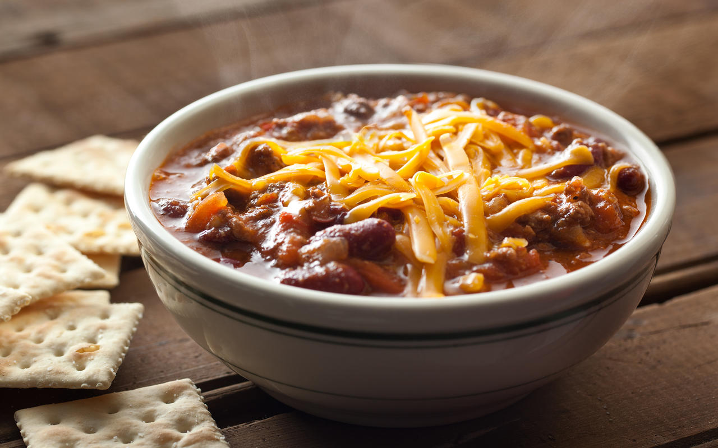
KNOWLEDGE CHECK
You cooked up some hamburger on January 1st. Then, you combine the hamburger with other ingredients to make chili on January 3rd.
What date does the Chili get for it’s date mark?
January 7th
You get a total of 7 days. Always go off the date of the oldest ingredient to determine your expiration date.
Notes:
Jan 7th. Always use the date from the oldest ingredient to determine the expiration date.

Slide 34
#14 Hand Towels/Drying Method Provided
6−301.12 Hand Drying Provision
Each HANDWASHING SINK or group of adjacent HANDWASHING SINKS shall be provided with:
(A) Individual, disposable towels; Pf
(B) A continuous towel system that supplies the user with a clean towel; Pf or
(C) A heated−air hand drying device; Pf or
(D) A hand drying device that employs an air−knife system that delivers high velocity, pressurizedair at ambient temperatures. Pf
Notes:
There must be an approved method for drying hands at all hand wash sinks. This could be a dispenser like you see in the picture, a roll of paper towels, or the forced air hand dryers.

Slide 35
#15 Non-Food Contact Surface Clean
4−602.13 Nonfood−Contact Surfaces
NonFOOD-CONTACT SURFACES of EQUIPMENT shall be cleaned at a frequency necessary to preclude accumulation of soil residues
Notes:
For example, the interior of microwave

Slide 36
#16 Temperature Measuring Device Hot/Cold Unit
4−204.112 Temperature Measuring Devices.
(B) Except as specified in ¶ (C) of this section, cold or hot holding EQUIPMENT used for POTENTIALLY HAZARDOUS FOOD (TIME/TEMPERATURE CONTROL FOR SAFETY FOOD) shall be designed to include and shall be equipped with at least one integral or permanently affixed TEMPERATURE MEASURING DEVICE that is located to allow easy viewing of the device’s temperature display.
Notes:
All coolers or hot holding units must have a thermometer internally or externally mounted.

Slide 37
#17 Wiping Cloth Storage
3−304.14 Wiping Cloths and Working Containers, Use Limitation.
(B) Cloths in−use for wiping counters and other EQUIPMENT surfaces shall be:
(1) Held between uses in a chemical sanitizer solution at a concentration specified under § 4−501.114;
Notes:
What is the concern in this picture? (ARROW) Wiping cloths must be stored IN the sanitizer between uses, No wet wiping cloths should laying on counter tops.

Slide 38
#18 Hand Wash Sink Accessibility
5−205.11 Using a Handwashing Sink
(A) A HANDWASHING SINK shall be maintained so that it is accessible at all times for EMPLOYEEs
use. Pf
(B) A HANDWASHING SINK may not be used for purposes other than handwashing except as
specified in § 2−301.15. Pf
(C) An automatic handwashing facility shall be used in accordance with manufacturer’s instructions.
Notes:
In short, don’t use your hand wash sink to store dirty dishes or personal items. Don’t block access to a sink with a garbage can, work table etc.

Slide 39
KNOWLEDGE CHECK
DO YOU HAVE TO WASH YOUR HANDS BEFORE PUTTING ON SINGLE USE GLOVES?
YES!!

Slide 40
#19 When To Wash Hands
2−301.14 When to Wash
FOOD EMPLOYEES shall clean their hands and exposed portions of their arms as specified under § 2−301.12 immediately before engaging in FOOD preparation including working with exposed FOOD, clean EQUIPMENT and UTENSILS, and unwrapped SINGLE−SERVICE and SINGLE−USE ARTICLES and:
(A) After touching bare human body parts other than clean hands and clean, exposed portions of arms;
(B) After using the toilet room;
(C) After caring for or handling SERVICE ANIMALS or aquatic animals as specified in 2−403.11 (B);
(D) Except as specified in ¶ 2−401.11 (B), after coughing, sneezing, using a handkerchief or disposable tissue, using tobacco, eating, or drinking;
(E) After handling soiled EQUIPMENT or UTENSILS;
Notes:
That leads us into the 19th most commonly written violation – When to wash hands. From the code reference I have posted here you will see you must wash your hands quite often during a work day, including after using the restroom, touching your hair, handling dirty equipment or service animals.

Slide 41
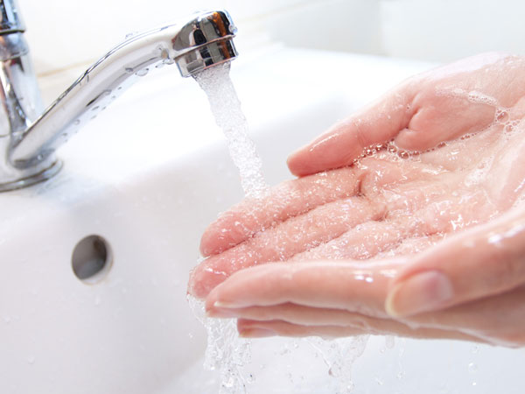
When to Wash cont.
(F) During FOOD preparation, as often as necessary to remove soil and contamination and to prevent cross contamination when changing tasks;
(G) When switching between working with raw FOOD and working with READY−TO−EAT FOOD;
(H) Before putting on gloves for working with FOOD; and
(I) After engaging in other activities that contaminate the hands.
Notes:
The list of when to wash continues - to prevent cross-contamination, when switching from raw to RTE foods; here’s our knowledge check answer – before putting gloves & of course any other activity you might do that could contaminate your hands.

Slide 42
#20 Shielding Bulbs
6−202.11
Light Bulbs, Protective Shielding
Notes:
All lights in food production, storage areas must be shielded or shatterproof.

Slide 43
#21 Hand Soap Provided
6−301.11 Handwashing Cleanser, Availability
Each HANDWASHING SINK or group of 2 adjacent HANDWASHING SINKS shall be provided with a supply of hand cleaning liquid, powder, or bar soap.
Notes:
Hand soap must be provided at all hand wash sinks. It does not need to be permanently mounted, but must be provided

Slide 44
#22 Labeling
Notes:
The last violation I want to cover is labeling. In the pictures here you can see there are different items with no labels? These would both be marked as a violation during an inspection. The squeeze bottles do not bear a common name label so employees are aware what is in them and the packaged, grab n go baked goods have no label on them either. So, what is exactly required?

Slide 45
Labeling cont.
3−602.11 Food Labels
(A) FOOD PACKAGED in a FOOD ESTABLISHMENT, shall be labeled as specified in LAW, including 21 CFR 101 — Food labeling, and 9 CFR 317 — Labeling, marking devices, and containers.
5 Main Label Components
Product Name
List of Ingredients
Food Allergen Declaration
Net Contents/Quantity
Business Name & Address
Common name bulk foods
Notes:
Bulk foods, squeeze bottles, working containers must have a common name label to prevent confusion or cross contamination. Why do they need a label? I have 3 containers of white power. One is flour, one is powdered sugar and one is rat poison. Does anyone here feel confident they know which one is the poison? This is why labeling in a kitchen setting is so important. Next we have foods that are packaged for customers to purchase. If food is packaged, which can simply mean wrapped in plastic wrap for a customer to grab n go then a label is required. There are 5 parts to the label: the product name, ingredients listed in order of greatest to least, declaration of allergens if they are not clearly stated in the ingredient list, the quantity and the business name and address

Slide 46
Notes:
So here is an example of a label: Product name. Ingredient list. From the list we see there are no allergens so a statement is not needed. Weight. Business name and address.

Slide 47
FINAL KNOWLEDGE CHECK
ARE YOU READY FOR YOUR NEXT INSPECTION?
Notes:
Hopefully the answer is yes. But here is your opportunity to ask more Questions?

Slide 48
Kara L. Paul, MPA, RS kara.paul@wisconsin.gov 715-491-4405

