Slide 1

Keeping Customers Engaged All Year Round
Tia Anderson & Amber Pedersen
Stoney Creek RV Resort

Slide 2
Providing Family Fun for Everyone!
Our background
Themed weeks
Activity Idea Share
Keeping Campers updated
Social Media Tools
  CampersAPP
  Facebook
    Engaging Posts
    Ads
Off Season Boost

Slide 3
2017Themes
April 21st-23rd: Earth Day Weekend
April 28th-30th: Welcome Weekend
May 5th-7th: Cinco de Mayo Weekend
May 12th-14th: Mother’s Day Weekend
May 19th-21st: Hero’s Weekend
May 26th-29th: Memorial Day Weekend
May 30th-June 4th: 70’s Week
June 5th-June 11th: 80’s Week
June 12th-18th: Family Fun Week
June 19th-25th: Wild West Week
June 26th-July 2nd: America Week
July 3rd-9th: Death by Chocolate Week
July 10th-16th: Christmas in July Week
July 17th-23rd: Morey’s Birthday Week
July 24th-30th: Carnival Week
July 31st-Aug 6th: Hawaiian Luau Week
August 7th-13th: Game Show Week
August 14th-20th: Prince and Princess Week
August 21st-27th: Pirates and Mermaid Week
August 28th-September 4th: End of Summer Bash/Labor Day
September 8th-10th: Back 2 School Weekend
September 15th-17th: Morey’s Mystery Weekend
September 22nd-24th: Fall Fun Weekend
September 29th-October 1st: Halloween Weekend 1
October 6th-8th: Halloween Weekend 2
October 13th-15th: Halloween Weekend 3

Slide 4
Week Long Themes vs Weekend Only
Started week long themes/activities 7 days a week in 2015
(Between Memorial Day and Labor Day)
  Increased weekday (Sunday-Thursday) occupancy by 23%
Wednesday = Saturday
  Good way to work out any kinks before Saturday!
Cost:
  2015- hired staff specifically for activities… learned its not necessary.
  2016- trained our Front Desk & Grill Staff to do activities- so no extra staff is needed on week days for activities (minus our activity director)
    Extra Benefit: Increase Staff Morale!

Slide 5
Best of the Best
Most Popular (Customers always ask for it): Game Shows
  Deal or No Deal
  Let’s Make A Deal
  Newlywed Game
  Minute to Win it
Most Participation: Candy Bar BINGO
Most $$: Tye Dye
Newest Success: CLUE, Beer BINGO, & Foam Fun
Always Winners:
  Scavenger Hunts: Picture, Clues, Themed, Selfie, Night time
  Relay Races (themed)- Example: Hero’s Weekend
  Gagaball Tournaments
  Family Olympics
What are your best activities?

Slide 6
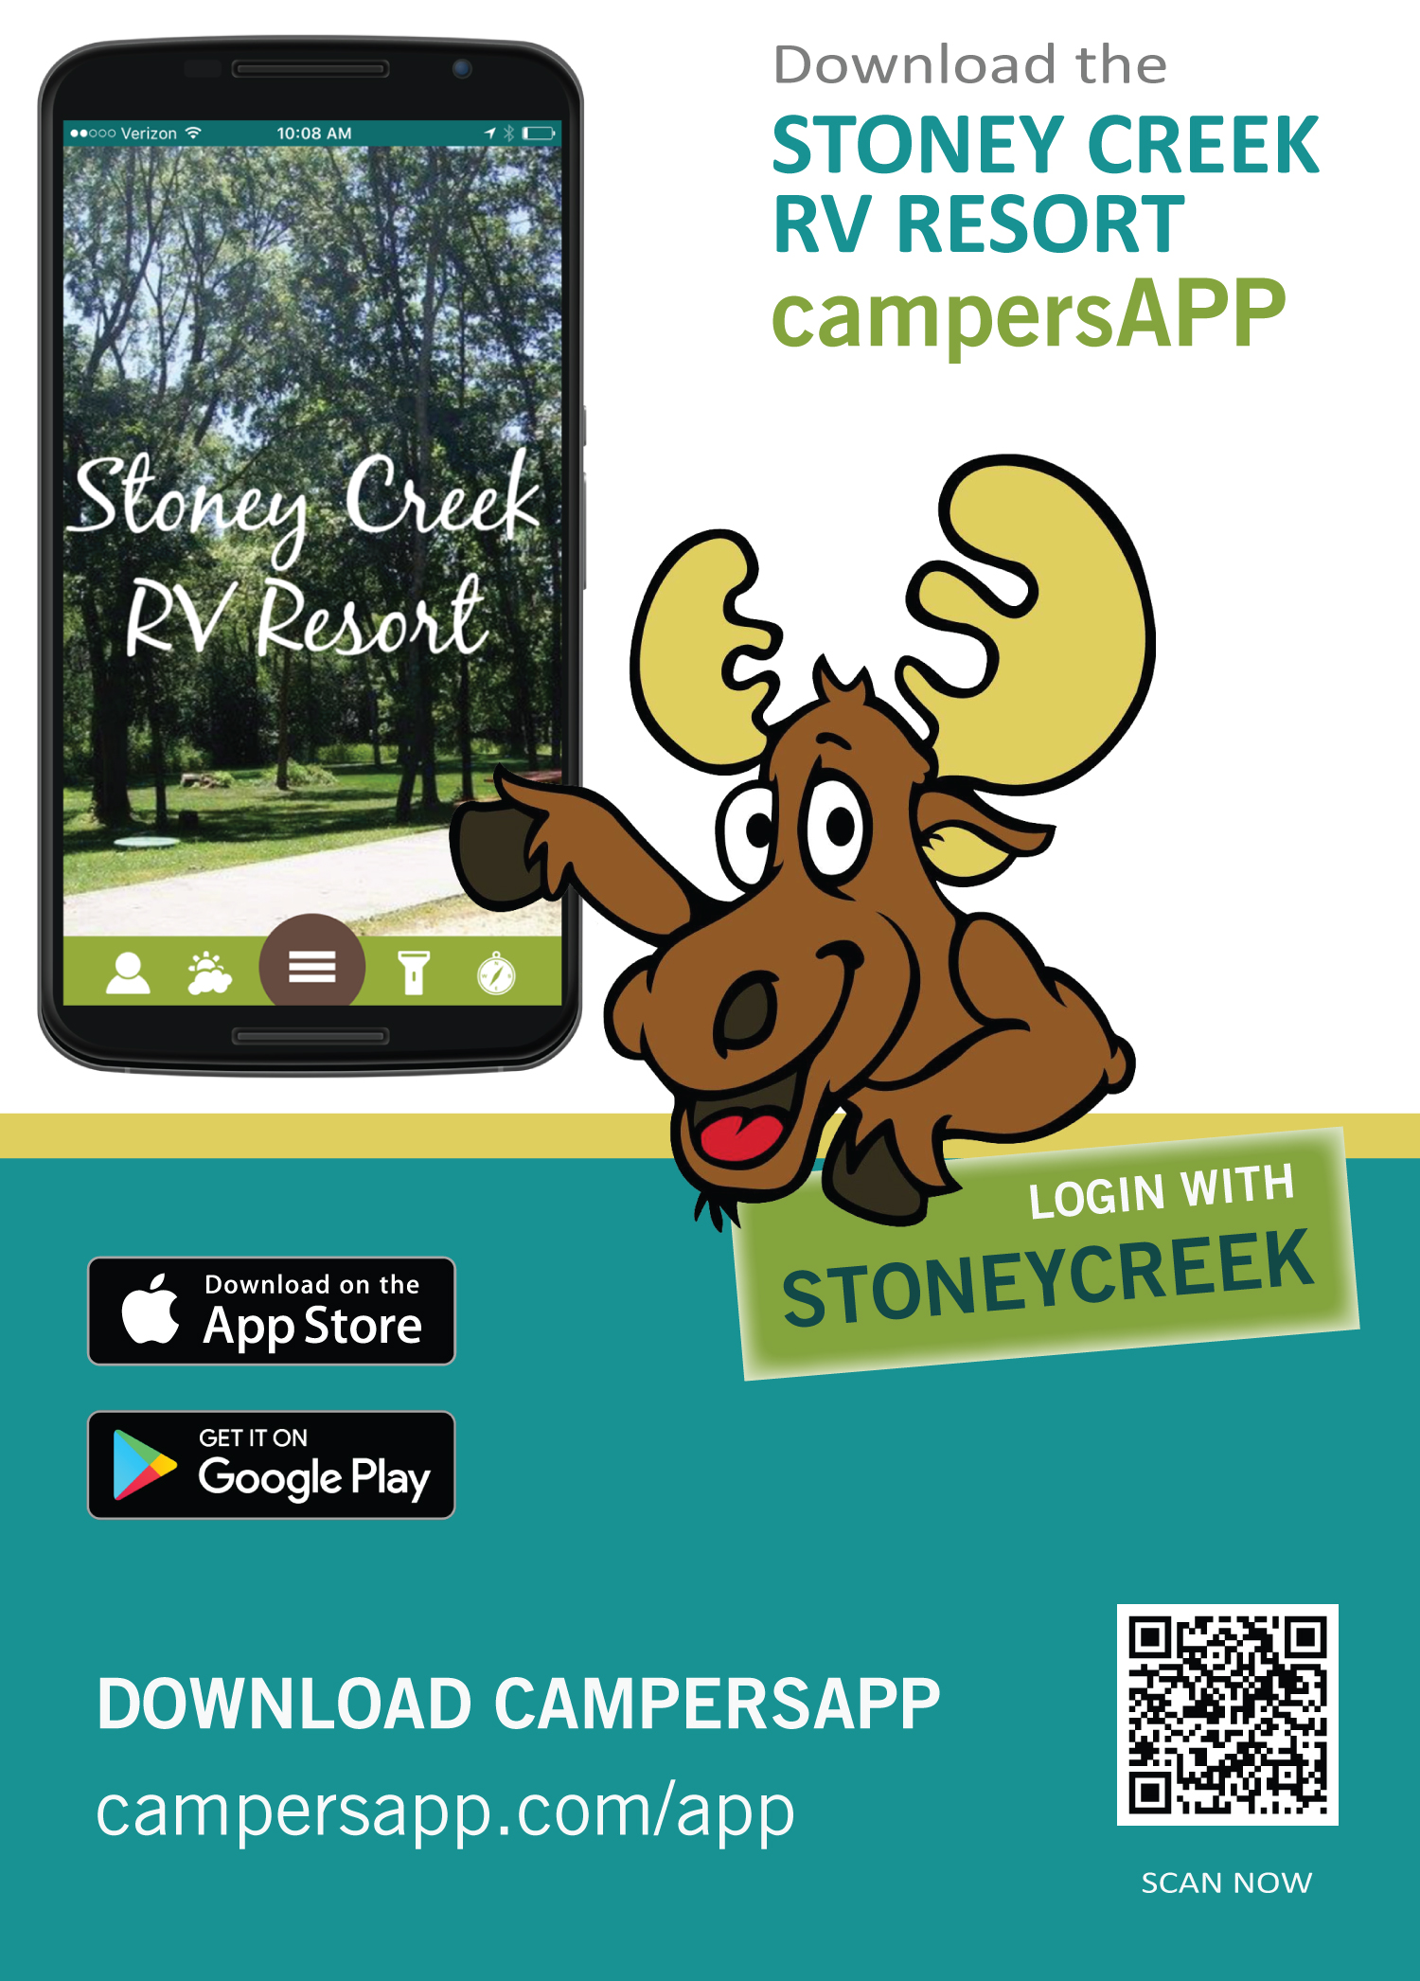
Keep your Campers Updated in Season:
How do your campers know about activities?
  Activity Schedules - Handed out at Check in & Available at Front Desk
  Activity Boards around Park
  Activities on your website & social media
What happens when the weather cancels an activity?
Social Media
Text Alerts
CampersAPP

Slide 7
Keep your Campers Updated Off-Season:
Newsletter
  Monthly Moosletter- started Jan 2015
    Over 300 subscribers we email it to
    Plus we post it on website
    February Moosletter Stats:
      Sent to 330 people
      Viewed 368 times
      Clicked “Book Now” or “Website” button 34 times
Social Media
  Instagram
  Twitter
  Facebook

Slide 8
Using Social Media for Engagement
Instagram
  Created July 2014
  330 Followers
  Week of February 27th: 1,009 Impressions (# of times posts were seen)
Twitter
  Created winter 2014
  Morey the Moose’s Twitter Account
Facebook:
  July 2014: 380 Facebook Likes
  February 2017: 3,695 Facebook Likes

Slide 9
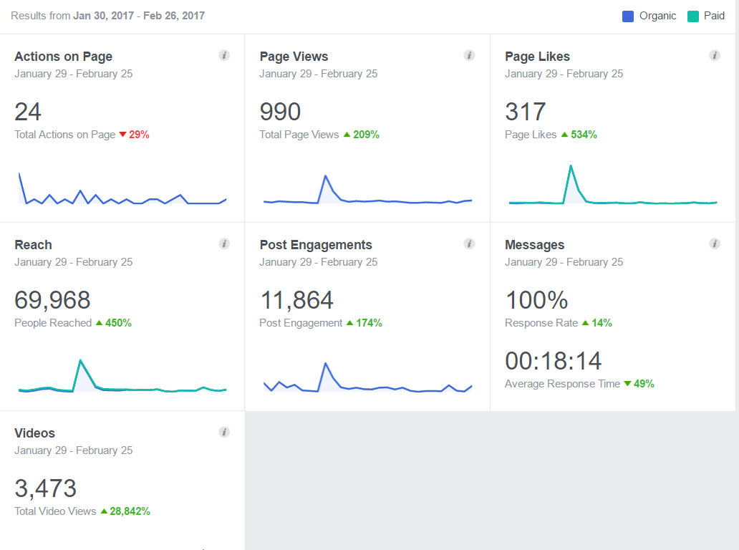
Facebook Insights
Action on Page
  Action Button- You customize
  “Book Now”
Page Views
Page Likes
Reach
Post Engagement
Messages
Videos
Organic
Paid

Slide 10
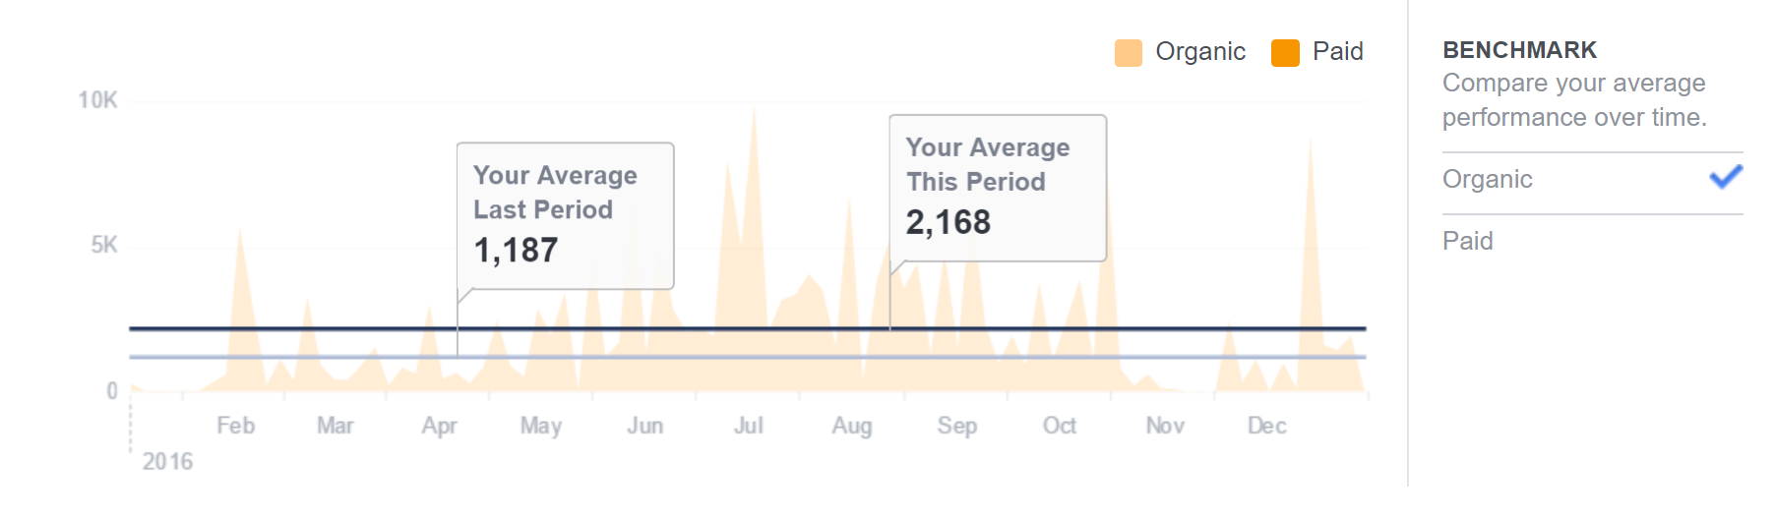
Average Reach for Reference
What’s “Reach?”
  Reach gives you a measure of how many people were exposed to your page, post, message or ad. People may not always click on your content, but they may be more likely to engage with your business when they see your message.

Slide 11
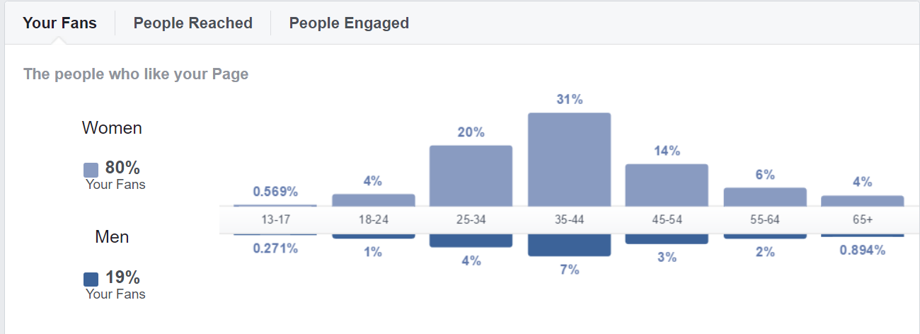
Demographics

Slide 12
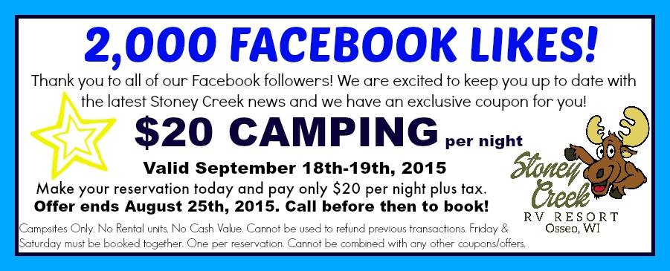


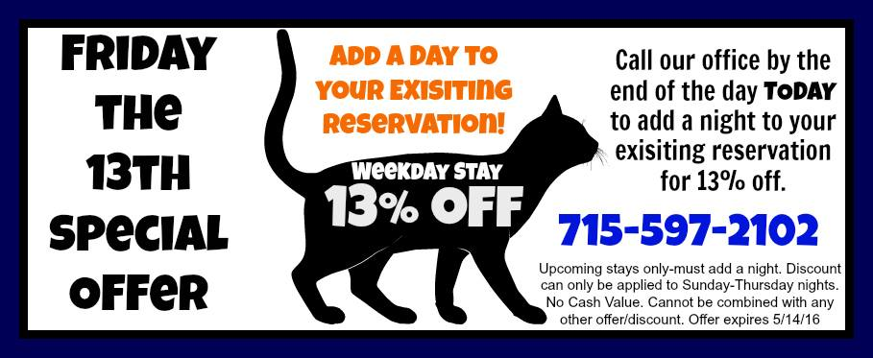
Limited Time Offers- Facebook Only

Slide 13
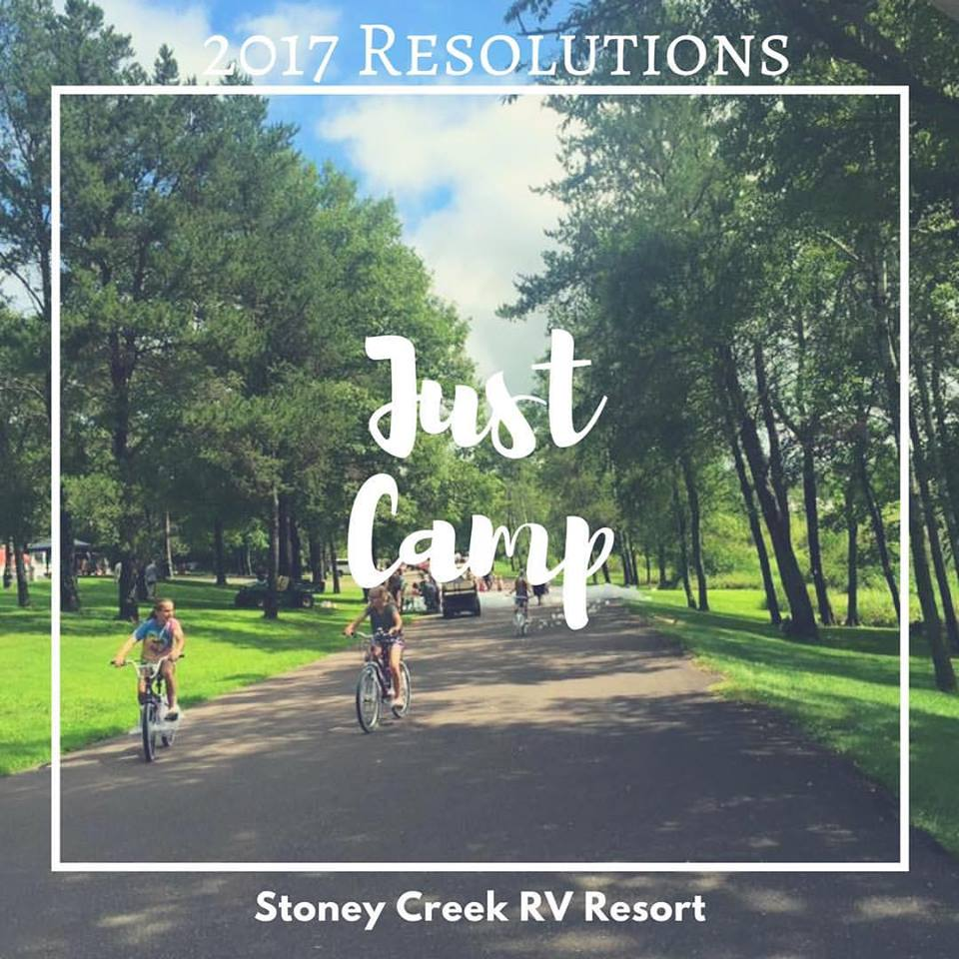
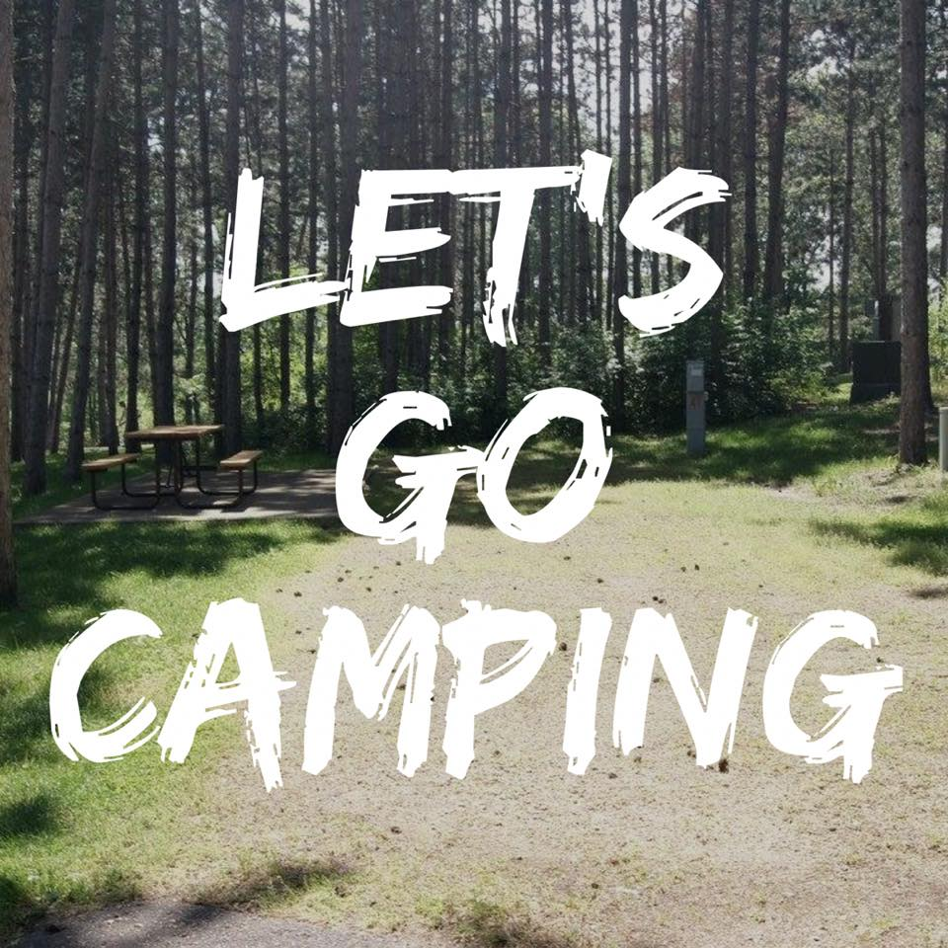
“Inspiration” Post
Reached 4,165 people
17 Shares
114 Post Clicks

Slide 14
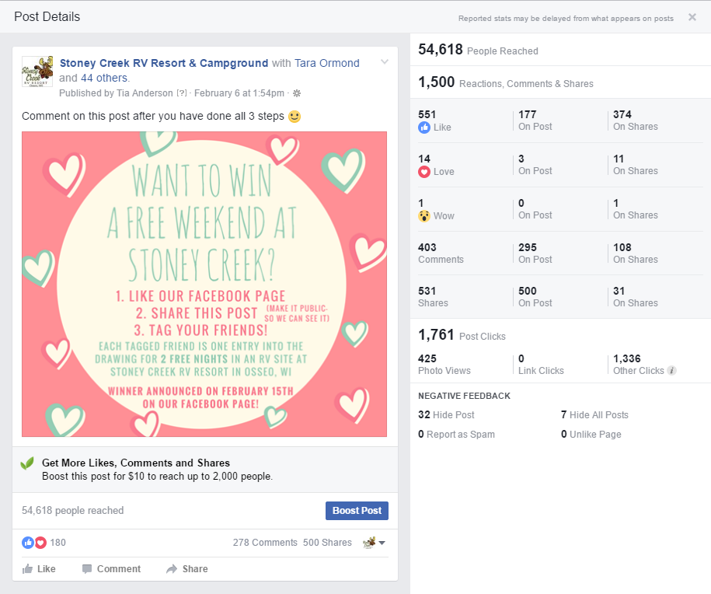
Contests/Drawings/Giveaways
Paid $0 for post
Reached 54,618 people
Page received 164 NEW likes in 1 days (average is 3 likes per day)
500 Shares
278 Comments
Total Cost= 2 nights of camping for prize

Slide 15
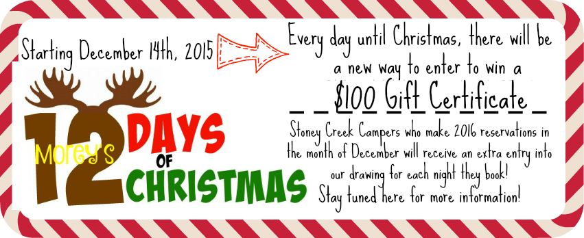
Morey’s 12 Days of Christmas
Started in 2015 – enter by reservation nights and scavenger hunt
2016- enter by gift certificate purchases and scavenger hunt

Slide 16
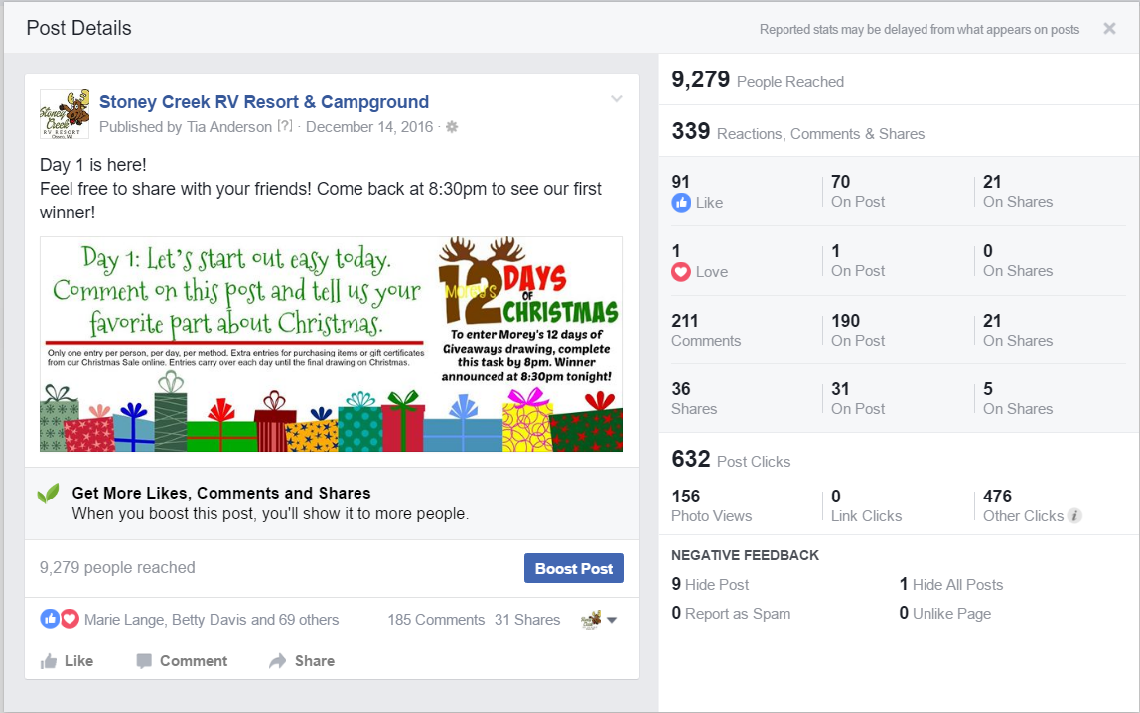

Slide 17
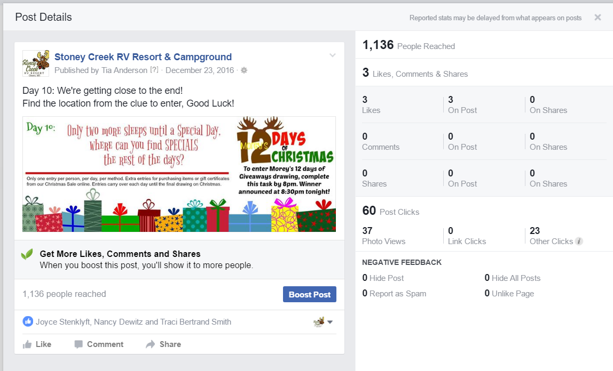

Slide 18
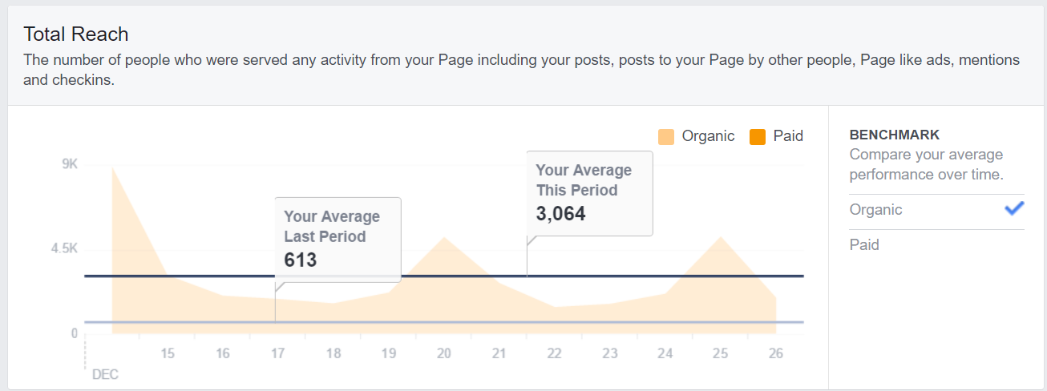
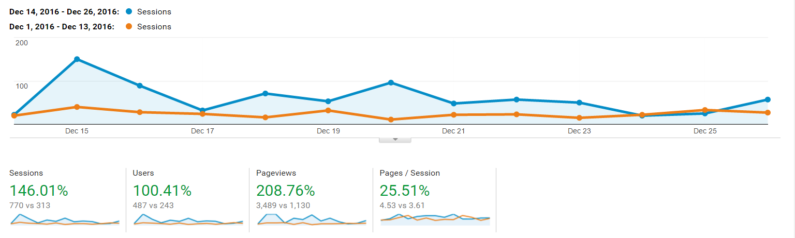
12 Day Results
Cost:
  Gave away a $10 prize every day (either store item or gift certificate)=$120ish
  Grand Prize: $100 Gift Certificate

Slide 19
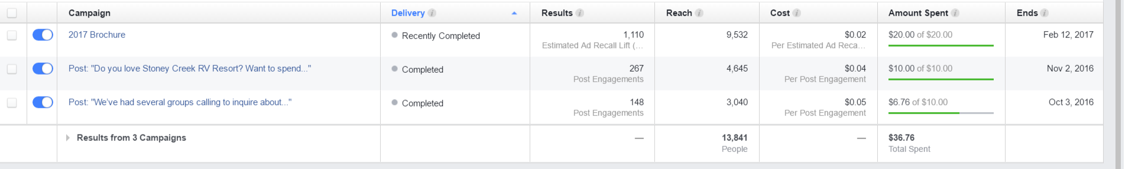
Facebook Ads
After our first Facebook Ad, Facebook gave us a free $10 credit.
What's estimated ad recall lift (people)?
  Estimated ad recall lift (people) is a metric available for campaigns with a brand awareness, video views or the Page post engagement objective.
What’s “Reach” for an ad?
  Reach gives you a measure of how many people were exposed to your message during an ad campaign. People may not always click on your ads, but they may be more likely to engage with your business when they see your message.

Slide 20
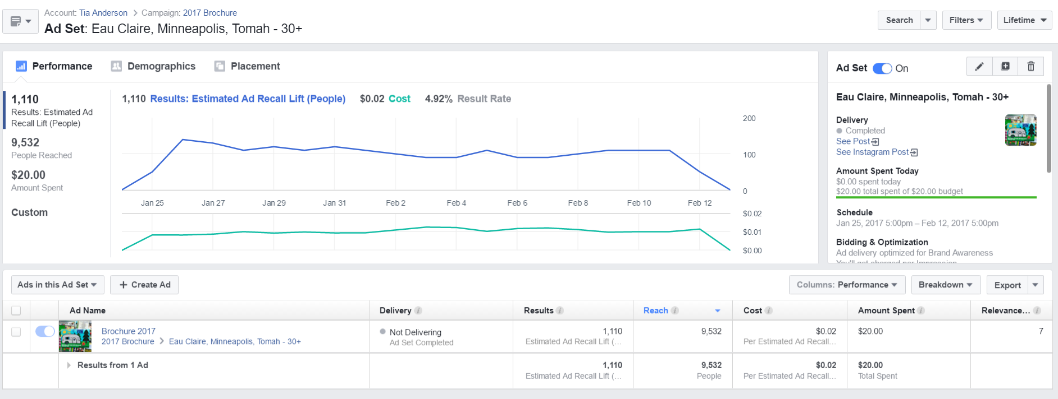
Best Facebook Ad Results

Slide 21
Off Season Increase
April Weekends:
  Buy 1 night, get 2nd Free (Earth Day & Welcome Weekend)
Previous years: Free Wristbands for first 2 weekends in May.
  2017- no posted specials, only limited time Facebook offers
Weekend before Memorial:
  Always Hero’s Weekend- Buy 1 night, get 2nd free- campsites only.
Week after Memorial: 70’s Week
  Started at $20 per night, now $25- already full
Weekend after Labor Day: Back 2 School Weekend
  Started at $25 per night- this year $30
Next two weekends in September were free wristbands- eliminated that this year.
Last three weekends of season are Halloween: Buy 1 night, get 2nd free campsites.
Occupancy:
  Pre-season (April to Memorial) has increased 64%
  Late-season (Labor Day to Close) has increased 109%
Revenue:

Slide 22
Thank you!
tia@stoneycreekrvresort.com
www.stoneycreekrvresort.com

