Slide 1

Bed Bugs in Lodging Facilities
Samantha Fiscus, REHS, AFO, CPO
Department of Agriculture, Trade & Consumer Protection
WACO Convention 2017

Slide 2
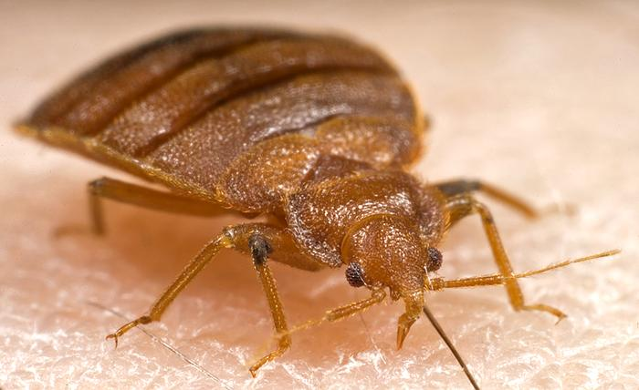
Objectives
Identification
Life Cycle
Evidence
Behavior
Locations
Spread
Health Concerns
Treatment
Inspection
Action Plan

Slide 3
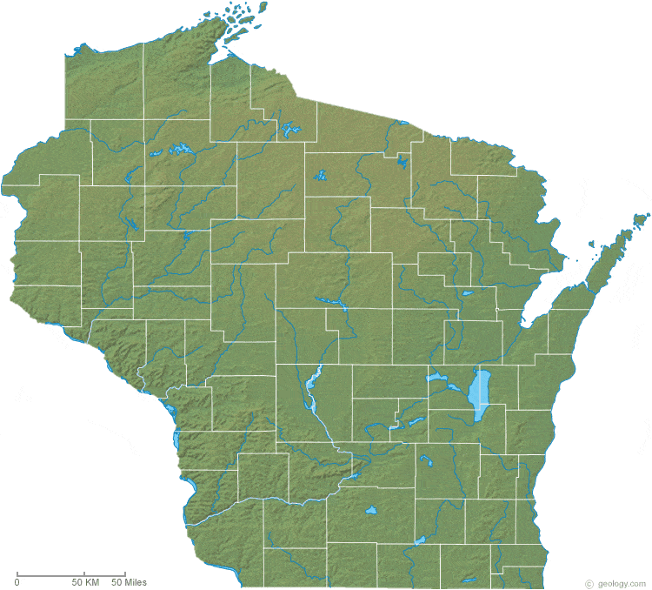
Stigma
Anywhere
Anyone
WHEN not IF
History
Notes:
-Throughout WI
-They are not only in the tourist areas like Wisconsin Dells or Door County and also not just in major cities, but they can be found in urban areas too. -Found in many various types of facilities like: homes, apartment/condos, hotels, summer camps, resorts, rental cottages or cabins, daycares, hospitals, schools, movie theatres, public transportation, etc.
-Stigma
-Stigmas create denial. A lot of people believe that the presence of beg bugs means poor sanitation and that is not usually the case.
-No one is immune to the possibility of bed bug exposure.
-Even 5 star hotels have to manage and control bed bugs. It can effect any type of facility.
-The lodging industry needs to let go of the stigma relating to bed bugs.
-It’s a matter of WHEN you will have to deal with bed bugs, not if you will have to deal with them….
-So the best thing to do is be prepared when it does happen and have an action plan.
-So how did they come to Wisconsin? History:
-Bed bugs date all the way back to about 3,300 years ago in ancient Egypt.
-Early colonists first brought them to the U.S. and for decades they thrived.
-In the 1950's, they had been all but eradicated due to new and readily availability pest control products and also through the widespread use of vacuums and washing machines.
-And then in the 1990’s there was a resurgence because people began to travel internationally more often, pest control products and methods of treatment became more targeted rather than universal and also there was a lack of public awareness about pest prevention methods.

Slide 4
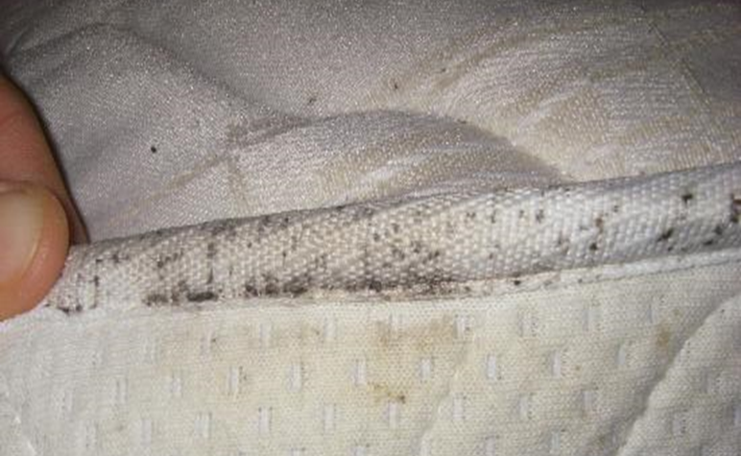
Denial
Untrained staff
NO Action plan
Inadequate treatment methods
Police and fire dept
Refusal to enter
Residential complaints
INFESTATION
Notes:
-Stigma leads to denial which then leads to delay or no treatment at all. This then causes an infestations. Once a lodging facility is infested, complaints greatly increase.
-Untrained staff can also contribute to an infestation. If the maintenance staff or housekeeping staff is unaware of what to look for, where to look and how to manage and control the problem, the minor presence becomes uncontrollable.
-Facilities without action plans tend to have a harder time when trying to eliminate bed bugs from their establishment. They tend to keep reappearing and spreading throughout the facility. It is strongly suggested that every lodging facility have an action plan and train their staff accordingly. We will talk more about the action plans later on.
-Inadequate treatment methods are not always effective and will then extend the duration of the presence of bed bugs. Many facilities use home method remediation like propane heaters or chemicals in order to save money but their results are unsatisfactory or the type of home remedy treatment method is commonly misused. This causes a concern about carbon monoxide asphyxiation when they use propane heaters and/or chemical exposure due to improper use or amount used.
-Local health department staff report police and fire personnel refusing to go into properties with bed bugs.
-We receive many complaints from residential communities where an individual may live in an infested apartments and the landlords is not addressing the issue. Our department doesn’t have regulatory authority over non-public, unlicensed lodging facilities so our influence is minimal. The consistant presence within the community can lead to the increase spread of bed bugs to the public facilities.

Slide 5
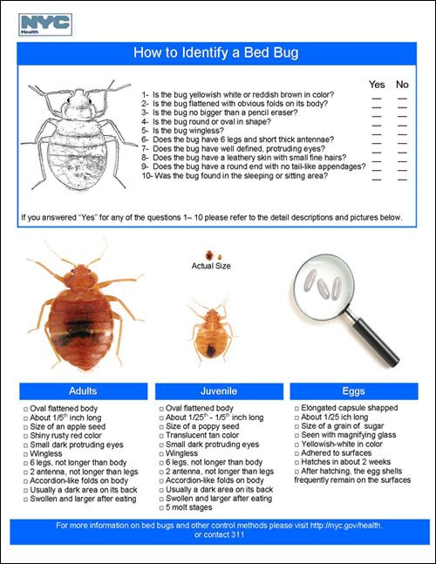
Notes:
-Bed bugs or Cimex Lectulaius) have also been called "red coates," "mahogany flats," and "wall-lice.“
-Shape and size:
-They are very small, flat, broad-oval, wingless insects with 6 legs that range in size from 1- 7 mm. As they feed, they become more swollen and elongated.
-Color:
-The unfed adults bed bugs are mahogany to rusty brown color. Engorged bed bugs are red-brown color after a blood meal. Nymphs (baby bed bugs) are nearly colorless when they first hatch and become brownish as they mature and feed.

Slide 6
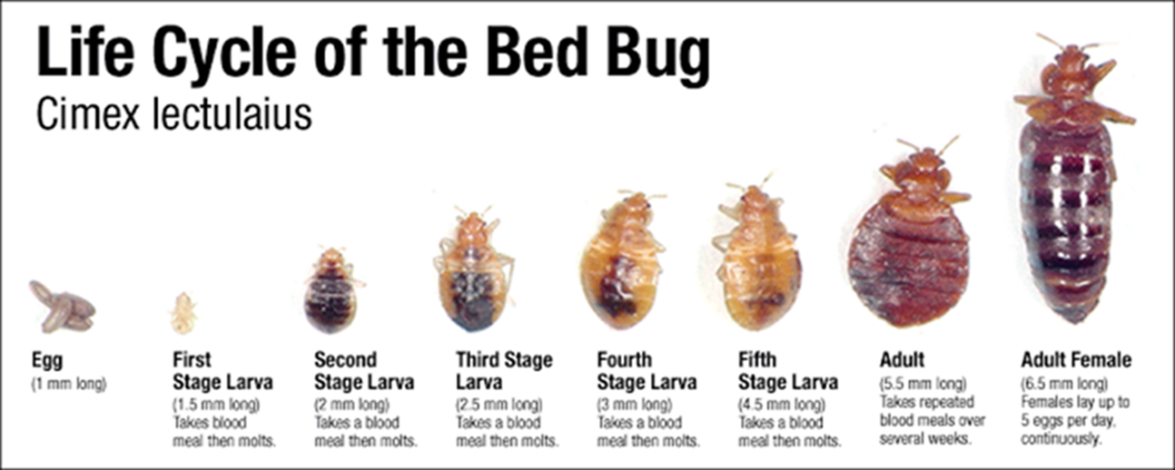
Life Cycle of Bed Bugs
Females
    1-5 eggs per day
    540 eggs per lifetime
5 stages of development
Reach maturity at 21 days
Lifespan 6-12 months
Notes:
-Female bed bugs lay one to five eggs per day which is an average of 540 eggs in a lifetime. They typically lay their eggs after having a blood meal and lay eggs in cracks, crevices or folds of rough surfaces.
-Bed bug nymphs grow to full adulthood in about 21 days and go through five stages of development before they reach maturity.
-A bed bug will molt once during each stage of development, though a blood meal is required for a molt.
-An adult bed bug can live for several months without a blood meal and live for 6-12 months.

Slide 7
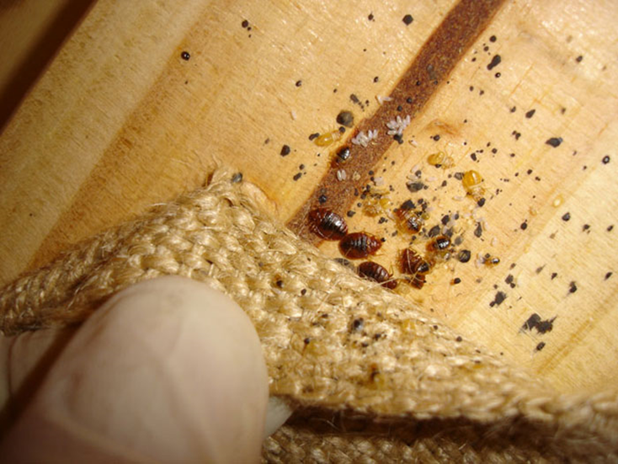
Evidence of Bed Bugs
Notes:
-Live insects
-Receive complaints of bite marks
-Insect molts a number of times on its way to becoming an adult so you may see exoskeletons.
-Fecal deposits are left by insects after feeding. Dark red or black color. It looks like someone took a ball point pen and created stippling on the surface.
-Possibly see eggs although they are quite small, sticky, slightly light colored/translucent and may be hard to find.

Slide 8
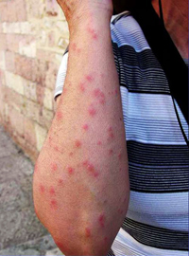
Bed Bug Behavior
Purpose
  Feed
  Mate
  Lay eggs
Feed on blood at night
  Takes 5-10 minutes
  Post feeding ritual 5-10 days
Cryptic
Adaptable
Kairomones
Movement
Notes:
-A Bed bug’s purpose is to bite humans or other warm blooded creates in order to feed on their blood. This is called a blood meal. They usually feed at night. They can survive for months without a blood meal. Bed bugs usually require 5-10 minutes to engorge themselves with blood. They feed by inserting two hollow, beak-like feeding tubes into their host. The first tube injects the bug's saliva, which contains anesthetics to numb the feeding area so a lot of people don’t know they are being bit until later. Then the second tube draws blood. After feeding, they move to secluded places and hide for 5-10 days. During this time, they do not feed but instead digest their meal, mate and lay eggs.
-They are cryptic so that makes them excellent at hiding. They remain hidden for most of there lives. Bed bugs love to hide in cracks and crevices.
-They are adaptable and cunning. React to their surroundings. Super bug- where they are becoming immune or resistant to chemicals.
-Kairomones. They sense carbon dioxide given of by host, like mosquitos, and that is why we commonly see them near the head of the bed.
-Movement. Bed bugs do not jump like fleas, fly like mosquitos, but rather move at a moderate pace depending on their age and size.

Slide 9
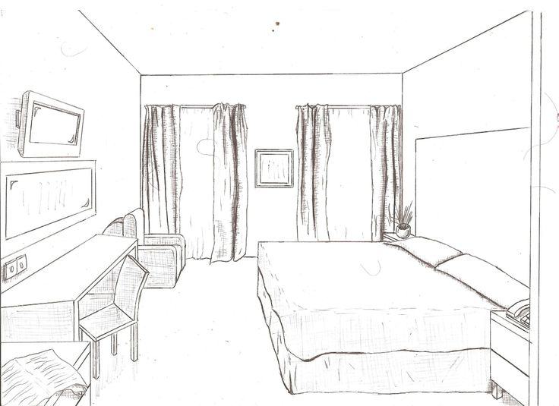

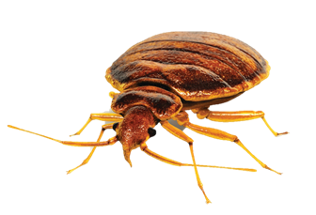
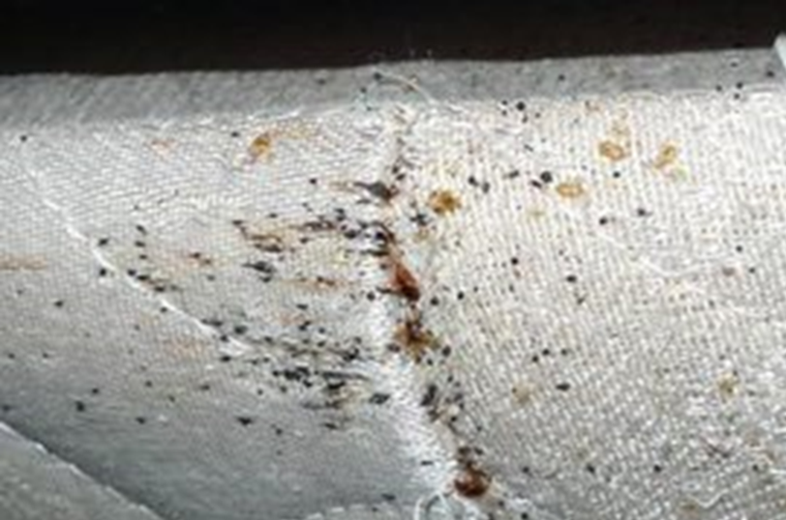

Common Bed Bug Locations
Notes:
-Bed bugs are usually found in living or sleeping quarters and more specifically the head of the bed or they are within 10 feet of the bed.
They love undisturbed, small locations like the cracks and crevices of bedding material or furniture. They can also be found in items located near the bed.
Human living and sleeping quarters
Head of the bed
Withn 10 feet of bed
Cracks and crevices
Headboard
Mattresses
Box springs
Sheets
Pillows
Furniture
Convertible sofa sleepers
Night stands
Electrical items
Outlets
Alarm clocks
Lamps
Baseboards
Wallpaper

Slide 10

Spread of Bed Bugs
Guest Items
  Luggage
  Shoes and clothing
Establishment
  Distance
    100 ft/night
  Room to Room
  Hallways
  Common areas
  up/down, left/right

Slide 11
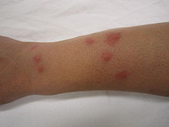
Health Concerns
Exposure
  Anxiety
  Insomnia
Bites
  No evidence of disease transmission
  Reactions
  Secondary infections
  Scarring
Notes:
Bed bugs in general can cause anxiety and insomnia to occur in individuals who are exposed.
After a bed bug feeds off the person’s blood, a small, itchy, red welt will appear one to several days after the bite.
Each person is going to react differently. Reactions could be a mild itching to a serious rash that leads to scarring.

Slide 12

Facility Bed Bug Treatments
Professional pest control company
Heat treatment
  Dismantle room
  Increase consistent air flow
  Minimum of 120° F
Chemical
Diatomaceous Earth
Steam
Vacuuming
Bed bug trained dogs
Notes:
Professional pest control company
Heat treatment
Dismantle room
Increase consistent air flow
Minimum of 120° F
Chemical
Diatomaceous Earth
Steam
Vacuuming
Bed bug trained dogs

Slide 13
Remediation and Prevention Disadvantages
Several treatments and combination of treatments
Cost
Home remedies dangerous
Hard to see (small)
Clutter
Air flow to all areas
Constant temperature
Too high of temperature- melted fire extinguishers
DE- must walk across areas
Misuse of chemicals
Resilient to chemicals
Freezing bed bugs
Mattress pads

Slide 14
Bed Bug Inspection
Prepare
Start with Bedding
Bed
Around Bed

Slide 15
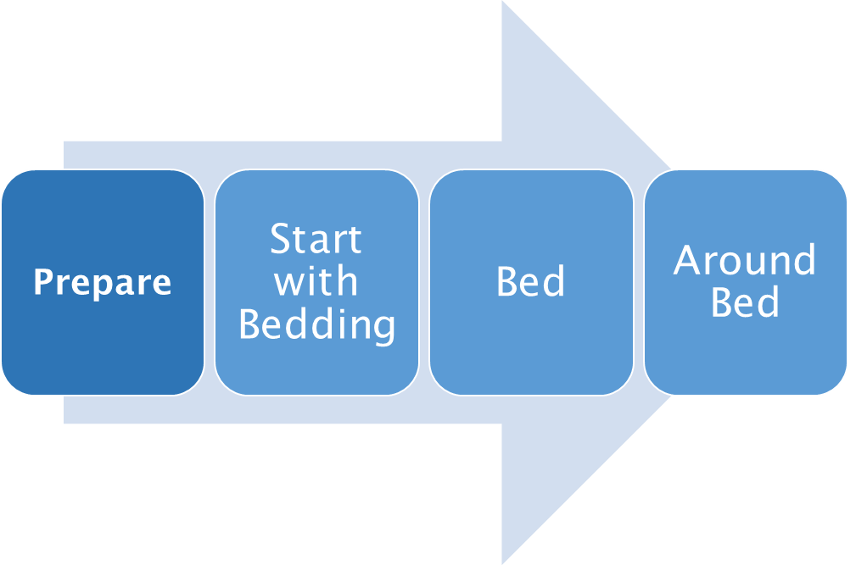
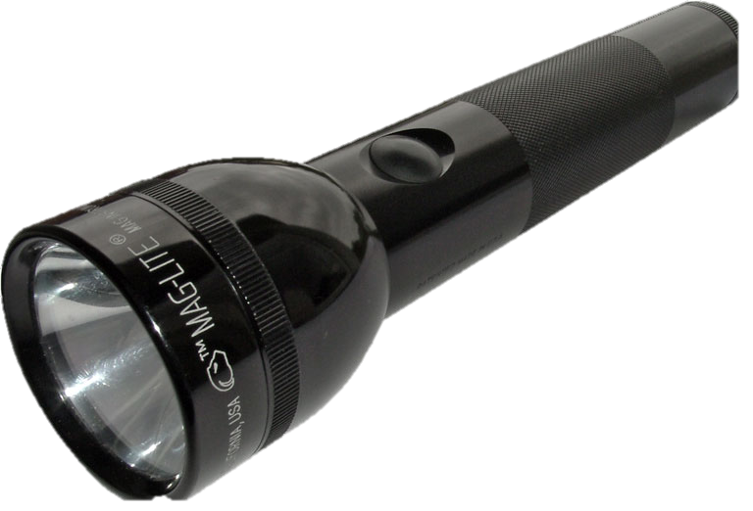
Step 1. Preparation
  Vacate room(s)
  PPE
  Coworker/assistant
  Flashlight

Slide 16
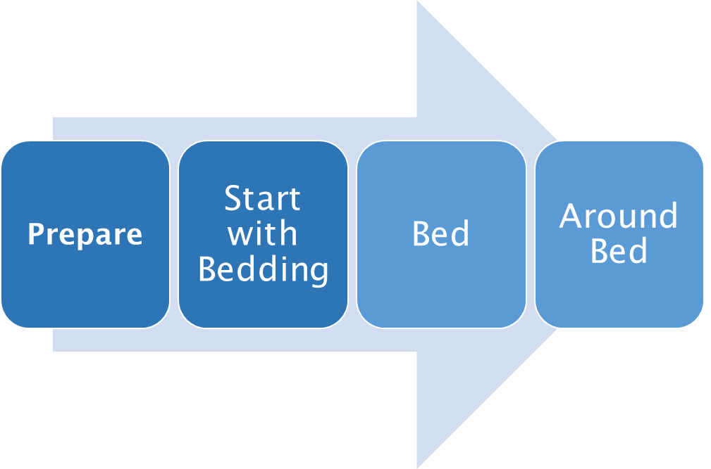
Step 2. Start with the bedding
  Check all surfaces, crevices and folds
  Inspect and remove bedding
    Pillows
    Blankets
    Sheets
    Mattress pad

Slide 17
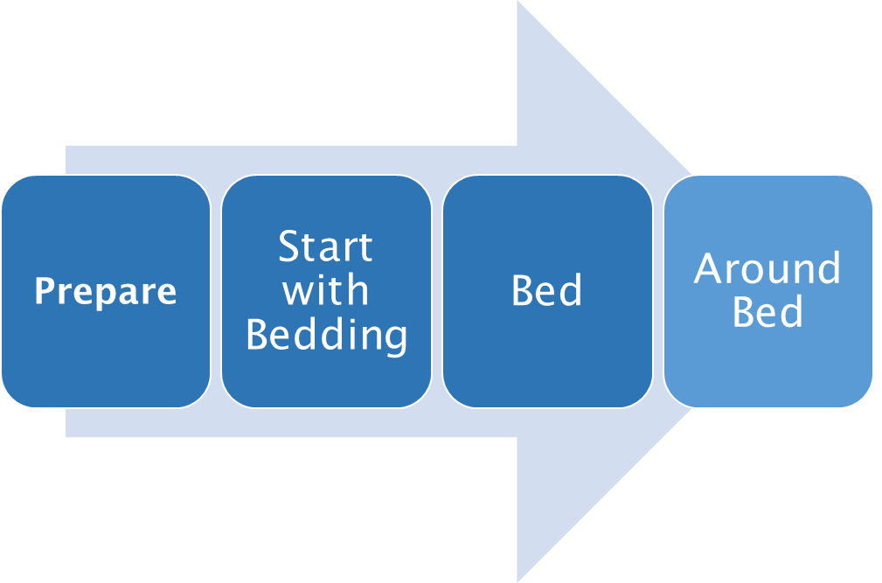
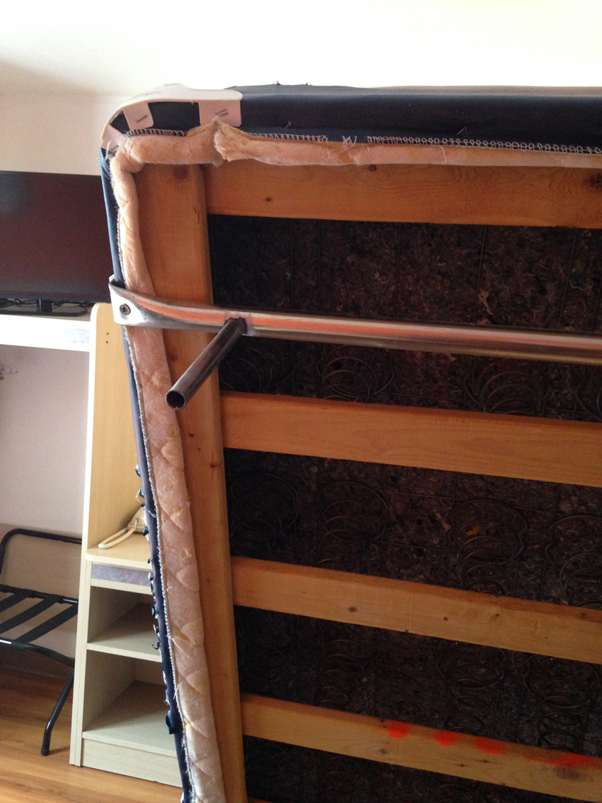
Step 3: Continue to with the bed
  Inspect, lift and prop up
    Mattress
    Box Spring
  Inspect the bedframe area and floor around the bed
  Disassemble headboard

Slide 18
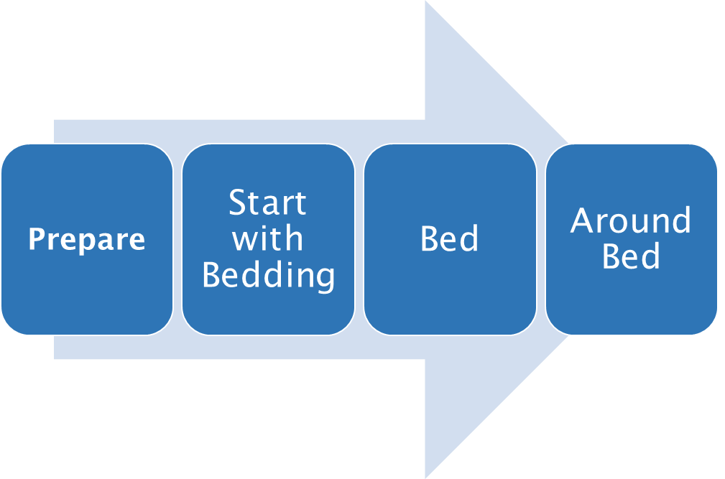
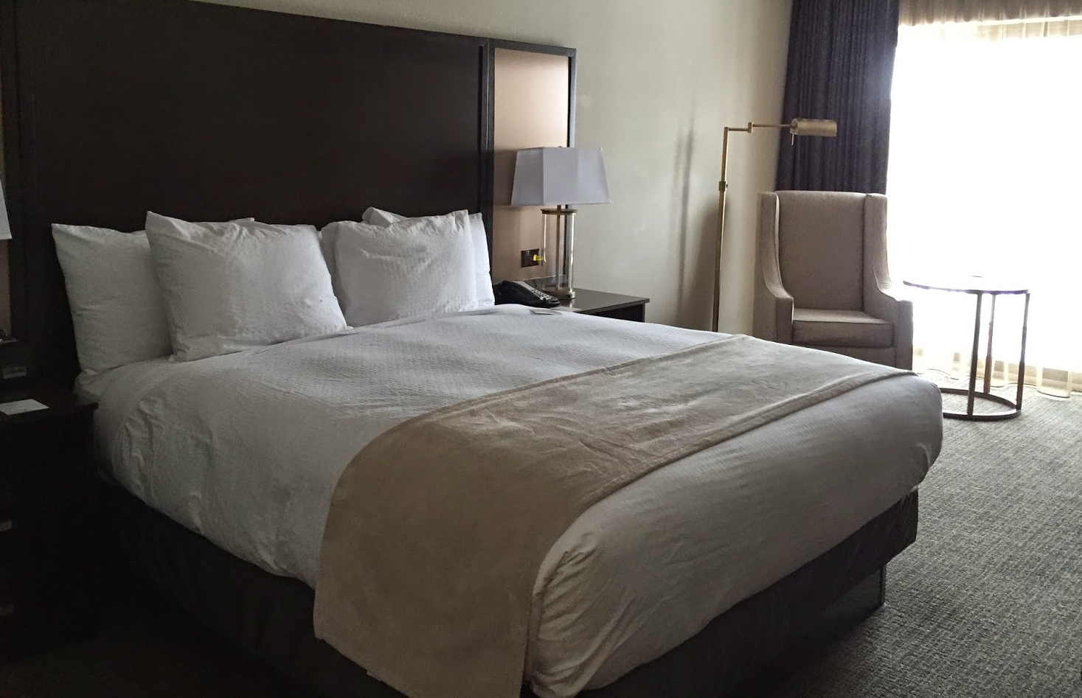
Step 4. Areas near bed
  Upholstered furniture
  Nightstand and all items on the nightstand
  Wall, outlets, hanging pictures

Slide 19

Action plans
Facility Specific
Proactive approach
  Prevention
  Monitoring
    Educate Staff
  Response
    Treatment
      Tracking
Increase effectiveness and efficiency
Notes:
Action plan is like an emergency response. What are they going to do: Includes Logs.

Slide 20

Action Plan Resource
National Pest Management Association (NPMA)
  Best Management Practices for Bed Bugs (BMPs)
    Guidelines
      developed by industry professionals, regulators, academics, and entomologists

Slide 21
Conclusion
They are everywhere!
  Matter of WHEN, not IF
Bed bug biology and behavior
Health Concerns
Remediation Treatments
How to inspect
Importance of Action Plans

Slide 22
Contact Information
Division of Food and Recreational Business
  Campgrounds
  Recreational and Educational Camps
  Pools
  Lodging
datcpdfrsrec@wisconsin.gov

