Slide 1

WACO
Lessons Learned

Slide 2
Selling Your Campground
      1. Have a Realtor
2. Due a Water Test
3. Have an Appraisal

Slide 3
Have a Realtor When Buying or Selling

Slide 4
Have a Realtor When Buying or Selling
Do not try to buy or sell yourself.

Slide 5
Have a Realtor When Buying or Selling
Do not try to buy or sell yourself.
They represent you as the buyer or seller.

Slide 6
Have a Realtor When Buying or Selling
Do not try to buy or sell yourself.
They represent you as the buyer or seller.
They work though all the paper work.

Slide 7
Have a Water Test Before You Sell.

Slide 8
Have a Water Test Before You Sell.
A. What is Required by the State?

Slide 9
Have a Water Test Before You Sell.
A. What is Required by the State?
B. Arsenic in Groundwater.

Slide 10
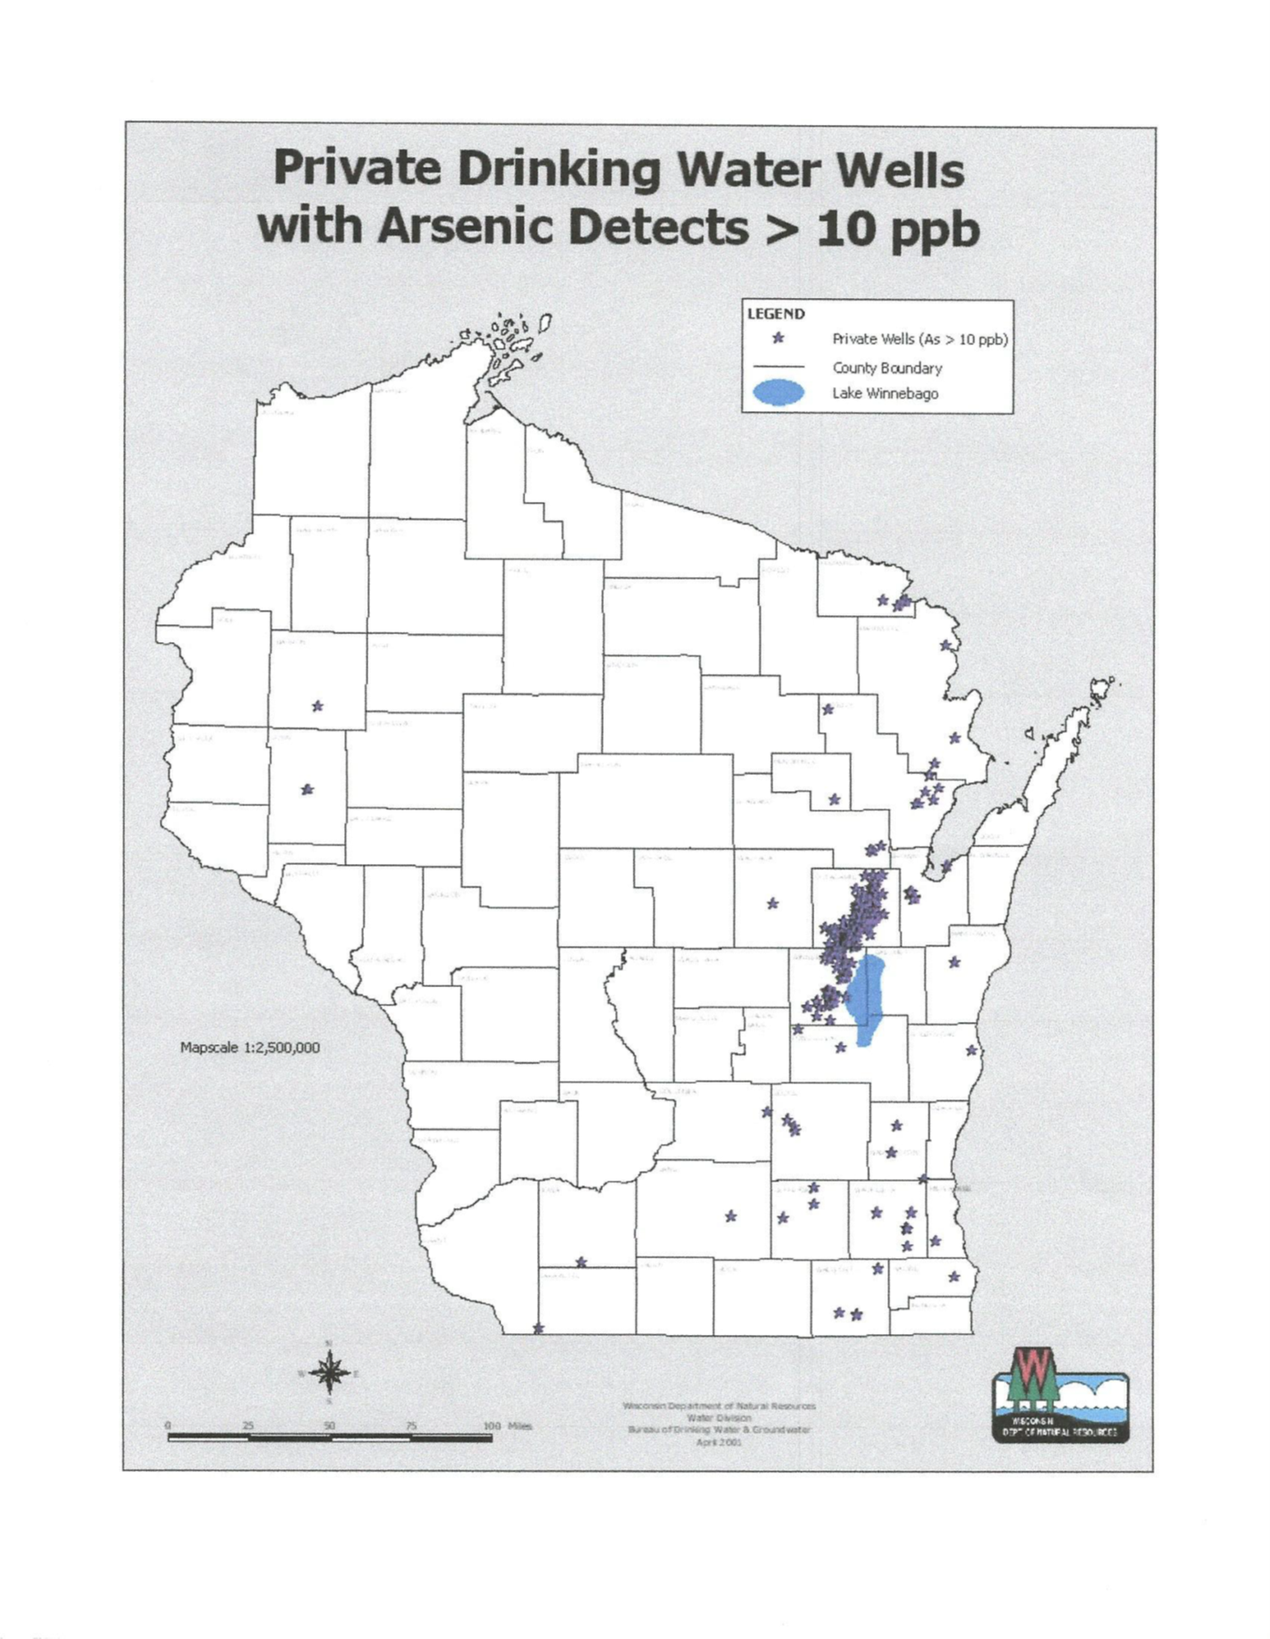

Slide 12
Have a Water Test Before You Sell.
A. What is Required by the State?
B. Arsenic in Groundwater.
C. Potable Water to all Sites.

Slide 13
Have a Water Test Before You Sell.
A. Required by the State.
B. Arsenic in Groundwater.
C. Potable Water to all Sites.
D. Purification

Slide 14
Have an Appraisal

Slide 15
Have an Appraisal
Appraisal Process
1. Cost Approach
2. Income Approach
3. Sales Comparison

Slide 16
Cost Approach
“The Cost Approach considers current costs of reproducing a property, less depreciation. Depreciation is normally from three sources: Physical Deterioration, Functional Obsolescence and Economic Obsolescence. The value arrived at by this approach is a summation of the market value of the land, assumed vacant, plus the depreciated reproduction cost of the improvements.”

Slide 17
For my Campground
“For the purpose of this report, only Income Approach and Sales Comparison Approach to value will be analyzed to estimate final value.”

Slide 18
“It is not appropriate to use cost approach on vacant land and the majority of improvements on the property have reached an age when cost approach would not be reasonable indication of value. With the exception of the golf course, the buildings on site date to the 60’s.”

Slide 19
Income Approach
“The Income Approach measures the present value of the anticipated future net income or benefits derived from a property.”

Slide 20
Income Approach
Value = Net Operating Income/Rate
Net Operating Income is the total calculated gross income, less total calculated operating expenses of your campground.
Rate is: “A national market survey for the first quarter of 2014 giving an overall Cap Rate of 10% for campgrounds. The source for this survey is Realtyrates.com-Investors Survey. Another guide, wicampgroundsforsale.com places the average cap rate at 10% also. However, with current lower economic values and limited market a lower cap rate of 9% would be expected.”

Slide 21
Sample
Value = Net Operating Income/Rate
Net Income of $80,000/ .09 = $888,888 Value

Slide 22
Sample
Value = Net Operating Income/Rate
Net Income of $80,000/ .09 = $888,888 Value
If you increase your net income by $20,000 to $100,000
Net Income of $100,000/ .09 = $1,111,111 Value
An increase of $222,223 in Value

Slide 23
Sales Comparison
“Sales Comparison Approach produces an estimated value by comparing the sales and/ or listings of similar properties in the same or similar areas to the subject. Informed buyers and sellers in the market place, use this technique to establish an indicated value as established.”

Slide 24
“The comparable property’s sales price, in some cases listing price, is then adjusted for superior or inferior differences to the subject. Adjustments are added or subtracted to sales price and the results is the adjusted sales price. The adjusted sales price is than compared to other adjusted sales price(s) of other similar comparable(s) and used to reconcile a sales comparison approach value.”

Slide 25
“Reconciliation: The process by which adjusted comparable values or approaches to value are weighted the same or one more than another to derive a market value for the subject. This is accomplished by use of the mode, median or mean average or by the use of weighted average. The weighted average is the decision by the appraiser to weight one or more comparable properties or approaches more than others because of their relevance or similarity.”
My appraiser weighted my properties 40%, 40% and 20%.

Slide 26
Sample
Not using weighted values
Comparable Property #1 with adjusted sale price =$1,100,000
Comparable Property #2 with adjusted sale price =$1,000,000
Comparable Property #3 with adjusted sale price = $900,000
Comparable Property average adjusted sale price =$1,000,000
So the comparable sales value is $1,000,000

Slide 27
Summary of Samples
The three approaches to value
Cost Approach…………………………………..$N/A
Income Approach………………………………$888,888
Sales Comparison Approach………………$1,000,0000

Slide 28
Summary of Samples
The three approaches to value
Cost Approach…………………………………..$N/A
Income Approach………………………………$888,888
Sales Comparison Approach………………$1,000,0000
To come up with the apprised Value, appraiser used the following:
“Reconciliation: Sales Comparison Approach is weighted 60%, Income Approach weighted 40%.”

Slide 29
Summary of Samples
40% of $888,888 = $355,555
60% of $1,000,000 = $600,000
Indicated Value: $955,555
The Appraised Value is then $955,555

Slide 30
Summary of Samples
If you increase your net income by $20,000 to $100,000
Net Income of $100,000/ .09 = $1,111,111 Value
40% of $1,111,111 = $444,444
60% of $1,000,000 = $600,000
Indicated Value: $1,044,444
The Appraised Value is then $1,044,444

Slide 31
You accept an Offer of $1,000,000
The Buyer indicates a Bank preapproval of $800,000 with $200,000 down payment for the total of the $1,000,000.
The Bank indicates that this is contingent on a loan of 80% of the appeased Value.

Slide 32
You accept an Offer of $1,000,000
The Buyer indicates a Bank preapproval of $800,000 with $200,000 down payment for the total of the $1,000,000.
The Bank indicates that this is contingent on a loan of 80% of the appeased Value.
The Banks appraisal comes in at $955,555.
The Bank will now only loan them 80% or $764,444.
The Buyer now needs to come up with $35,556 more money.

Slide 33
You accept an Offer of $1,000,000
The Buyer indicates a Bank preapproval of $800,000 with $200,000 down payment for the total of the $1,000,000.
The Bank indicates that this is contingent on a loan of 80% of the appeased Value.
The Banks appraisal comes in at $955,555.
The Bank will now only loan them 80% or $764,444.
The Buyer now need to come up with $35,556 more money.
But if the Banks appraisal comes in at $1,044,444 no problem.

Slide 34
In Conclusion
      1. Have a Realtor
2. Due a Water Test
3. Have an Appraisal

