Slide 1
Office of Business Development
Effective Engagement with Government
Department of Administration
Joe Knilans – Director
Nancy Mistele – Director

Slide 2
Who are we?
Office of Business Development
Business Ombudsman… and so much more!
Advocate for business interests within government;
Troubleshoot, problem solve, get answers & solutions for you from state agencies;
Gather your ideas on how to support your business, improve process and reduce the regulatory burden…
Share information and ideas on how to effectively engage with government officials
Navigator to State (and other) resources
Notes:
Who we are – what we do: Governor relocated the office into DOA;

Slide 3
Success comes from being known ….
Outreach with business owners, trade associations, Chambers of Commerce, etc.
Presented at > 1000* events in all 72 Wisconsin Counties
Met with over 20,000* business owners
> 1000* requests for assistance from Wisconsin businesses
Received 75* regulatory reform ideas; currently under review
* CRM statistics: 12/31/2016
Notes:
Success to date

Slide 4
What is our Role?
Introduce you to our services
Support & Promote The Small Business Regulatory Review Board
Share our experience & knowledge of government with an eye toward helping you interact more confidently with government.
Encourage Action: you have a very important role in regulatory form.
Advance your ideas to improve procedures, rules and statute
en·light·en : The action or state of being enlightened. synonyms: insight, understanding, awareness, wisdom,, broad-mindedness;
em·pow·er : give (someone) the authority or power to do something. synonyms: authorize, permit, allow, enable, equip, emancipate, unshackle, set free, liberate made stronger and more confident, especially in controlling their life and claiming their rights.

Slide 5
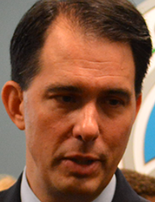
Small Business Regulatory Review Board est.2003
Empowered to review existing rules and propose changes to reduce burden on business
Encourage partnership between small business and state agencies; advocate for realistic rules & regulations
Agencies required to submit economic impact analysis of all proposed rules on small business.
Enforce agency compliance with Regulatory Flexibility Act
For too long, the overregulation of business has stifled job growth within our state and repelled job creators from others. The common sense reforms contained in our proposal will take the power of regulating…. and put it back where it belongs – in the hands of the people.”
- Governor Scott Walker
Notes:
Governor reformed board membership; we are the 24/7 support for the SBRRB and share their story: EO #61 (requiring agencies to support small business through action and rule; we bring citizens and agencies to the table;

Slide 6
Agencies have Regulatory Flexibility
Act-296 was passed in 2013 giving State Agencies flexibility with minor violations.
Minor Violations refers to:
  Violation does not cause serious harm to the public
  Violation Is committed by a small business
  Violation is not willful
  Violation is not likely to be repeated
  There is a history of compliance by the violator
  The small business has voluntarily disclosed the violation
Notes:
Agencies may have the hammer but they don’t need to use it in all circumstances

Slide 7
Civics 101: Laws & Rules
The Legislature passes the laws
The Agencies write the rules. May take months or years.
The Walker Administration requires new rules be reviewed and compared with statute to ensure original intent is clearly defined
Many laws & rules (on the books for years) are in need of reform
Ultimately, from our vantage point, it’s the interpretation of rules that generate problems; there isn’t always a single, definitive interpretation that is easy to apply, follow or understand.
Guidance Documents are not rule or law.
Notes:
What you need to know about the process so you can be effective….
When receiving a rule interpretation – ask to see the code. Know where the cause and effect are coming from.

Slide 8
Why Participate in Rule Making & Hearings?
Guide the Development of Smart Regulation that doesn’t burden business or come with significant costs & barriers
Avoid unintended consequences….. engage at the front end of the process (before drafting) and the product will be better. Review draft (again) before adoption to tweak as necessary.
Your input will help the Legislature and agencies understand the cause and effect of their work.
Understand the process for adopting Rules and Regulations
Know how, when and where to engage!
Know why it’s important
Know what to do and when to do it for maximum effect…………
Notes:
Example of the Campground Code Writing – Engagement with Agency and Legislators; Take time to engage – better outcomes: Affected parties will know how code changes will be positive or negative.
Rule making / Public Hearings / Your Representatives
Why? Avoid unintended consequences

Slide 9
How have we been effective?
Assist Industry in getting to the Rule Making Table – The WACO example
Assistance with permitting, prompt response; audits, meetings, etc.
Act as a ‘navigator’ to state agency resources
2nd set of eyes to review current rule interpretation: secured change of outcome
Provide information to agency leadership for their review of current practice
Provided analysis / developed proposal to improve public access to comment on rules underway
Assisted in the development of online public access to review and comment on rules being drafted and information on upcoming public hearings
Notes:
Rule changes requested by WACO – we got them ‘to the table’; this interaction produced better results and avoided unintended consequences and helped guide us to recommendations to improve public input channels; seek more engagement through legislation

Slide 10
Enlightenment is a 2-way street:
Your Knowledge & Experience ‘enlightens’ others
Don’t assume the Agencies or Legislature know where the current problems are in rules and regulations; often the issue is interpretation.
Who better to provide input on how to guide regulation? Those who ‘walk the walk’…. That’s you!
Know your legislators – offer your opinions and suggestions
Present your reform ideas & suggestions (online option.)
Avoid unintended consequences - It’s easier to guide language and make adjustments before rules are adopted
Know what’s happening that affects your industry. Comment on proposals; attend public hearings; voice your opinion and/or opposition on proposed rules before they become final.

Slide 11
Top Business Concerns in Wisconsin
Labor Shortage / Lack of qualified applicants
Health Care Costs
Excessive Regulation
Taxes
Transportation Infrastructure Funding
90% of CEOs surveyed said Wisconsin is headed in the right direction
89% of the Business leaders rate Wisconsin’s economy as
“moderate to strong”
Reduce/Reform regulation was the #1 answer as the most significant thing state government could do to help (owners) business
Wisconsin Manufacturers & Commerce
Semi-annual survey Dec 2016

Slide 12

Governor’s Initiatives to support business, provide education & skills training to expand the workforce
Eliminate rules, regulations & red tape
Efficient resources for local schools to help students develop skills needed for college, career and life; career oriented training to open doors to good jobs
Move people from government dependence to true independence; help people get training & skills for their career and eliminate barriers between good people and good jobs
Make services we depend on more efficient & reliable
Connect rural communities (Broadband Expansion Grants)
End one-size-fits-all Washington mandates
“I believe that smaller government is better government….. in the areas
where government does play a legitimate role, we should demand that it I
s done better.” - Governor Scott Walker
Wisconsin is Working (#WIWorking)

Slide 13
Legislative Initiatives
Red Tape Review & Right the Rules
Started in 2013-2014 and continuing in the 2015-2016 Session:
The Assembly has reviewed 25% of the administrative code, working to remove unnecessary, burdensome, and outdated regulations.
Public input has been gathered at roundtable events across the state.
Members of the public can submit comments and suggestions on at (www.Facebook.com/RedTapeReviewWI) or on Twitter (www.Twitter.com/RedTapeReviewWI).
“With her years of experience in the Assembly, the agricultural industry and local government, I cannot imagine a person better suited to lead this project than Rep. Joan Ballweg,” said Speaker Vos, “I want to thank her for heading up this initiative.”
Notes:
Across the board interest in reform; let’s be sure they know what business needs so the right things are addressed

Slide 14

Regulate the hole size – really?
Swiss Cheese
The importance of industry knowledge….
Input from those essential to good rule making. Comments help guide us to an administrative code that truly works!

Slide 15
Enlightened, empowered, now what?
Confidently interact with state agents
Engage with authority
Recognize you have something to offer
Ask questions and provide solutions
Know there’s room for interpretations…
There are others who can help
Notes:
Mission: By providing this information we can remove the mystique of government (this isn’t rocket science); help you understand how to engage to get different (hopefully better) results in each and every interaction (better customer service) and provide some incentive on why to offer ideas and opinions
Building Inspector Examples / Slow response times / Squeaky wheels get assistance (don’t wait them out – it’s futile)

Slide 16
Confidently Engage with State Agents
When you see the written language within code as it relates to the interpretation made in any given situation, it is easier to understand the requirements as presented, seek alternate and satisfactory solutions and make adjustments to be in compliance.
Have agent cite the rule requirements (specifically)
Put the requirements in writing
Ask if other parts of code come into play
Ask to see any guidance documents on the issue
Notes:
Wedding Barn Example / Pond Expansion (who’s exempt and who requires DNR engagement)

Slide 17
Submit your ideas for reform. A truly effective administrative code depends on input from those with firsthand experience of the problems in current laws & rules!
Request Help… (Call or online)
Recommend a Rule Change – (call or online)
Make referrals of OBD…..
Don’t be a spectator – be a participant!
Notes:
Participatory government

Slide 18
Office of Business Development
Joe Knilans
Director
Office of Business Development
WI Dept. of Administration
Phone: (608) 267-7394
E-mail: joe.knilans@wisconsin.gov
Nancy Mistele
Director
Office of Business Development
Wisconsin Dept. of Administration
Phone: (608) 267-7873
Email: nancy.mistele@wisconsin.gov
OBD Request for Help Recommend a Rule Change

Slide 19
Small Business Regulatory Review Board Members
Steve Davis — Co-owner of Ardy & Ed’s Drive-in, Oshkosh
Erich Korth —Vice President of Transport Repair Specialists Inc., New London
Pravin Raikar—President Lockstep Solutions LLC, Brookfield
Jim Ring —President/CEO of Park Towne Development Corp., Madison
Melissa Remis — Premier Solutions; Independent Associate ofLegalShield, Onalaska
Guy Wood — Tender Care Transport, Inc., Eau Claire-Chippewa Falls
Connie Smith – Ward-Brodt Music; Madison
Adam Neylon — State Representative and Chairman
Howard Marklein —State Senator and Vice Chairman
Website: smallbusiness.wi.gov
Email: SBRRB@wisconsin.gov

Slide 20
State Government Resources
Remaining slides are links to various government programs of interest. This is not intended to be inclusive but represents previous requests for information.
Contact us in the event you cannot find what you’re looking for at any state agency website.

Slide 21
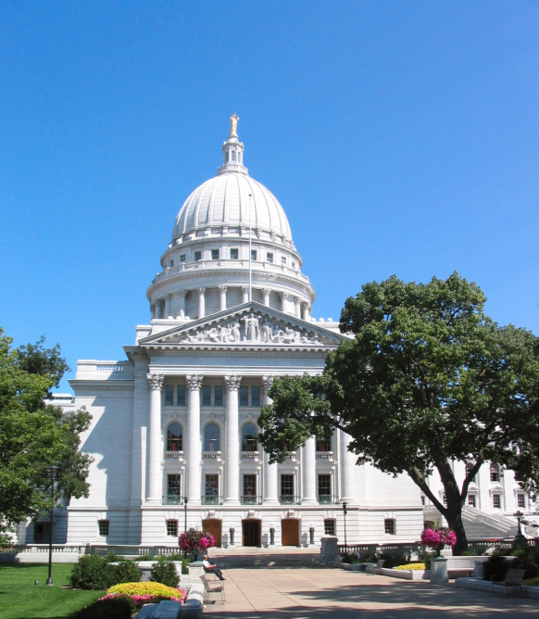
Directories to the Legislature
Assembly Member Directory
Assembly Committees
Senate Member Directory
Senate Committees
Notes:
Hyperlink to Legislature Directories

Slide 22
Online Rule Draft Review & Comment
One-Stop location to view rules that are open for comment go to Wisconsin Legislature Home Page (legis.wisconsin.gov)
Improved online access to rules being drafted
(Centralized site / no longer need to watch individual agency websites.)
Review or print this how-to (guide) to provide comments online (comments go directly to state agency that drafted the rules.)
Find information on upcoming public hearings
Your comments may help improve rules before they are adopted.
Notes:
Rule changes requested by WACO – we got them ‘to the table’; this interaction produced better results and avoided unintended consequences and helped guide us to recommendations to improve public input channels; seek more engagement through legislation

Slide 23
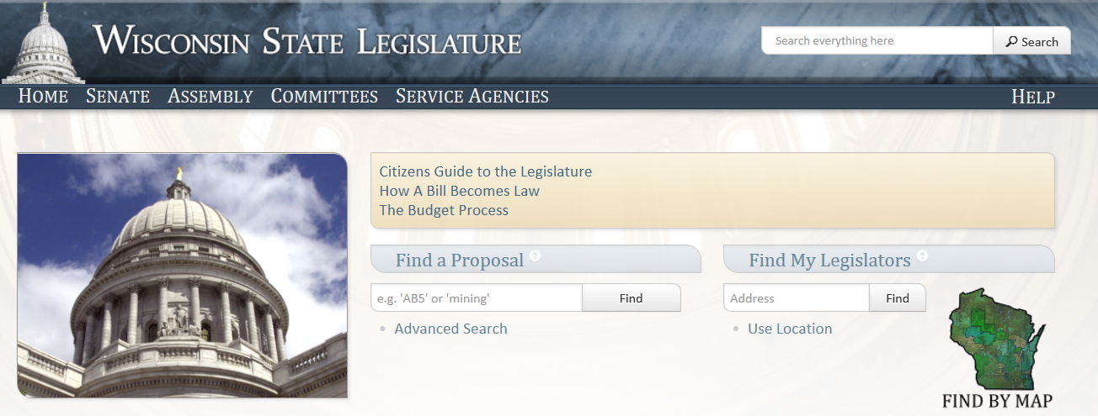
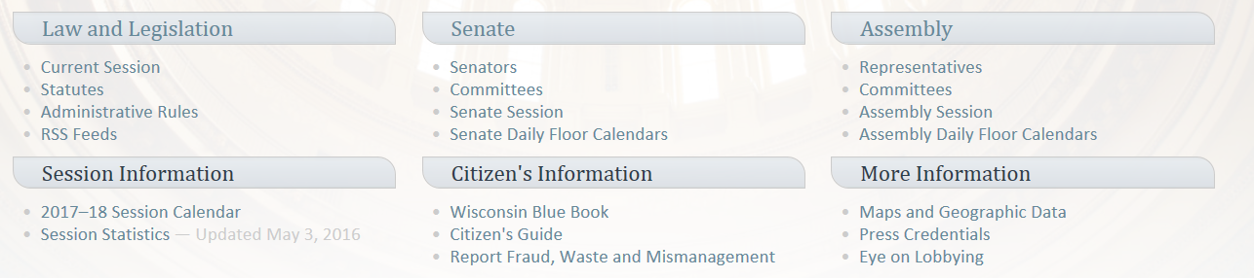
Legis.wisconsin.gov

Slide 24
DOA Resources
Inter-governmental Relations
Procurement Desk Guide
Energy, Housing and Community Development
Dept. of Administration
Supplier Diversity Programs (business Certification)
Vendornet – Doing business with Wisconsin
Wisbuild – State construction project
Job Opportunities

Slide 25
Wisconsin Economic Development Corp
Select Wisconsin
Entrepreneur Assistance
Business Growth Assistance
Export Assistance
Community Development Assistance
Community Account Managers
Investment Opportunities; Angel Investors

Slide 26
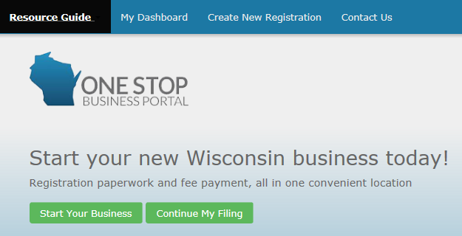
One Stop Business Portal
The Wisconsin One Stop Business Portal creates an easy step-through process where Wisconsin's businesses can find the requirements and tools they need to start a business in Wisconsin.

Slide 27

Made in Wisconsin
Proclaim your Wisconsin origin: The Wisconsin Economic Development Corporation (WEDC) created a clean, modern logo for companies to use that complements the Wisconsin Department of Trade, Agriculture and Consumer Protection’s Something Special From Wisconsin™ Program.
The Made In Wisconsin® logo can be adapted to reflect your production processes.
There is no cost to use the certification mark. Upon application approval users can download high-resolution image files.
Follow this link to join the Made In Wisconsin® Program.

Slide 28

Something Special from Wisconsin
The program logo provides a quick and reliable way to identify genuine Wisconsin products and services at grocery stores, retail outlets, farmers' markets and restaurants throughout the state, nationally and internationally.
Any business can participate in the program if at least 50 percent of the value of its product or service is attributable to Wisconsin ingredients, production or processing activities.
Program members benefit from having a “Wisconsin” brand identity that consumers recognize as top quality and high value.
Surveys indicate that >70% of Wisconsin consumers are more likely to purchase a commodity made or grown in Wisconsin than one from outside the state.
Info at DATCP WEBSITE

Slide 29
Veterans Services
Wisconsin proudly leads the nation in providing education benefits to those who have served, as well as to their family members. The WDVA provides a number of educational programs for state veterans – such as the Wisconsin GI Bill - that are in addition to any federal Veterans educational benefits that may be available.
Link: http://dva.state.wi.us/Pages/educationEmployment/Education.aspx
The WDVA is dedicated to assisting veterans in transitioning to a civilian career through resources such as its Retraining Grant or easing the process for Professional Occupation licensure.
Link: http://dva.state.wi.us/Pages/educationEmployment/EmploymentVeterans.aspx
The WDVA provides resources for employers who are seeking skilled and talented veterans to join their workforce. For instance, the Veteran Employment Grant supports businesses that hire veterans.
Link: http://dva.state.wi.us/Pages/educationEmployment/EmploymentEmployers.aspx
Veterans interested in learning about the benefits available to them should visit myWisVets, the State of Wisconsin’s tool for expedited eligibility processing.
Link: https://applications.dva.wisconsin.gov/myWisVets
Entrepreneurship Grant Program: The WDVA awards grants to non-profit organizations that provide entrepreneurship training, or technical, business or other assistance to veteran entrepreneurs in order to improve employment incomes.
Link: http://dva.state.wi.us/Pages/educationEmployment/OtherResources.aspx

Slide 30
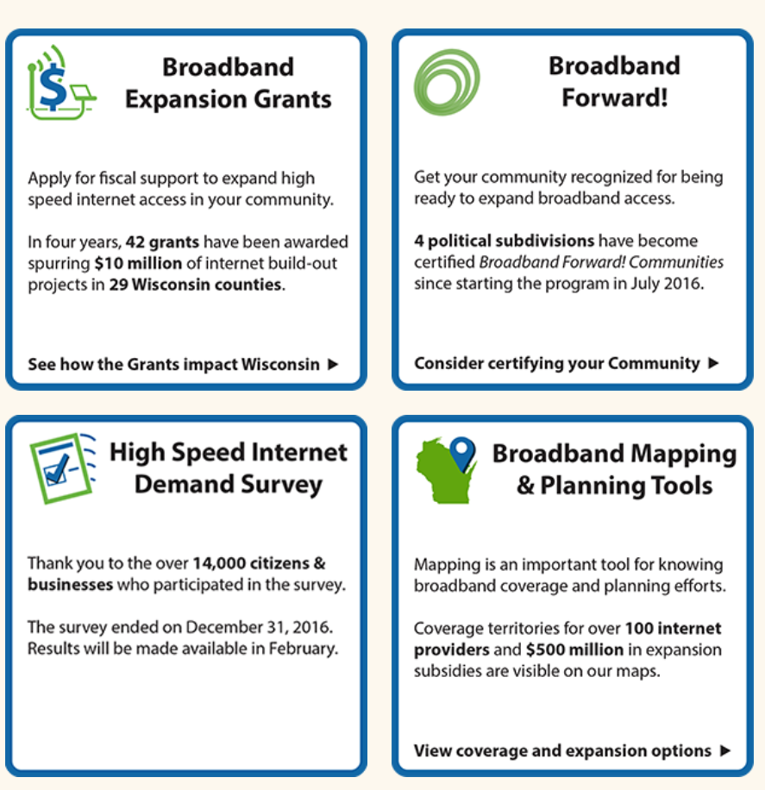

Contact Information:
Angie Dickison
State Broadband Director
Angie.Dickison@Wisconsin.gov
608-267-9138
www.psc.wi.gov
www.link.Wisconsin.gov

Slide 31
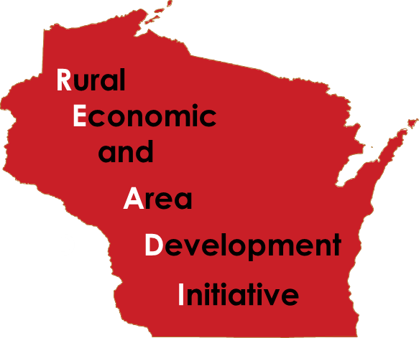
READI Program
http://doa.wi.gov/Divisions/Housing/Bureau-of-Community-Development/READI-Program/
For more information contact David Pawlisch at (608) 261-7538

Slide 32

READI Program Summary
Supports Units of General Local Government that are not HUD entitlement communities (Excludes Milwaukee, Waukesha, Dane Counties and municipalities with pop. > 50,000.)
Applicants must grant the award funds to Community Development Organizations (CDO).
A DOA-certified CDO must be identified in the READI application.
READI uses CDBG funding to provide targeted economic development investment in a single unit of general local government, or a rural region.
2016: $10 million allocated to capitalize the READI program. Projects must include economic development and housing.
  Individual grants up to $1Million.
  Total of ($500K for Economic Development, $300K for Housing, and $200K for training.)
READI PROJECTS must benefit persons of low and moderate income.

Slide 33
READI Program Summary
READI’s Focus:
- Economic Development (Job Creation)
- Workforce Housing
- Job Training
What sets READI apart from existing DEHCR-CDBG programs is that once all repayments and reporting from the original loan have satisfied HUD requirements, the State will send a letter to the UGLG/CDO confirming the CDO may use the repayments for a new activity.
Repayments to a CDO are not subject to reporting as CDBG Program Income. Reuse of the funds need not meet all of HUDs rigorous reporting requirements.
Use of repayments must be used for:
  - Neighborhood revitalization,
  - Community economic development, or
  - Energy conservation projects

Slide 34

WI Workforce Incentives
WISCONSIN FAST FORWARD (Law effective March 2013)
Implement an enhanced Labor Market Information System (LMIS).
Address Wisconsin’s skills gap through employer grants for customized skills training to fill current job openings and ongoing skill requirements.
http://wisconsinfastforward.com
VOCATIONAL REHABILITATION
OJT: Custom work / training program; DVR pays 50% of salary/fringe ≥ 90 days
TWE: Work experience; DVR pays wages for 90 days
LTE Program: For public agencies; DVR pays wages for 6 months
Place and train: customized (business designed) training
http://dwd.wisconsin.gov/dwd/publications/dvr/pdf/dvr_17248_p.pdf

Slide 35

Worker’s Compensation & Unemployment Insurance
WI: $1.8 billion-dollar-a-year system, frequently recognized as a national model.
    Worker’s Compensation: http://dwd.wisconsin.gov/wc/
    Submit suggested law change: wcadmin@dwd.wisconsin.gov
    Info on WC Advisory Council http://dwd.wisconsin.gov/wc/councils/wcac/
  UI benefits intended for employees who lose employment through no fault of their own. To receive benefits, claimants must have a proven work history with a UI employer. Up to 26 weeks/benefit yr. Min $54/Max $370.
    Submit law change ideas: UILawChange@dwd.wisconsin.gov
    UI Advisory Council http://dwd.wisconsin.gov/uibola/uiac
    Unemployment Benefit Fraud: http://dwd.wisconsin.gov/uiben/contac.htm

Slide 36
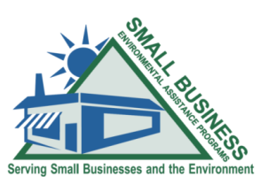
What is the SBEAP?
Small Business Environmental Assistance Program is a non-regulatory program providing small businesses with information and connections, helping them do the right thing for the environment and their business.
Assistance with business start-up, permitting, compliance, understanding of state & federal environmental regulations, and sustainable practices.
(855) 889-3021 OR DNRsmallbusiness@wi.gov
Website: http://dnr.wi.gov/topic/smallbusiness/
Notes:
Focus on “do the right thing” however the business can get there. Our main goal is to assist small businesses find the environmental resources that they need. If we can help them reduce emissions before being regulated and stay small enough to not be affected by regulations, that would be ideal. If they need to be regulated, we help get them started, file the right paperwork, and then they work with the appropriate program contacts to stay in compliance.
So many small business are still not aware of permitting/compliance needs for DNR programs. We can help small businesses sort out where to start. Once they have the right paperwork filed, then the small businesses are handled by the programs as needed and appropriate to their regulatory category in each.
Small businesses assisted by SBEAP are defined as 100 employees or less, independently owned, not a major source of air pollution (emits < 50 TPY of any regulated pollutant and < 75 TPY of all regulated pollutants), and not a large quantity hazardous waste generator (less than 1,000 kilograms or 2,205 pounds).

Slide 37

Wisconsin Works (W-2)
Department of Children and Families
The Wisconsin Works (W-2) program is available to parents of minor children: family income below 115% of the Federal Poverty Level (FPL).
Each W-2 eligible participant meets with a Planner who helps the individual develop an employability plan.
To qualify for assistance, participants must meet program requirements.
Participants have a lifetime limit of forty-eight months in the program

Slide 38
Wisconsin Works (W-2)
Department of Children and Families
How Does W-2 work?
W-2 is a time-limited program that provides temporary cash assistance and case management services to low-income parents and pregnant women. W-2 is a work program for adults willing to engage in work activities; it is not an entitlement. Low-income parents and pregnant women may participate in W-2. Both parents may be eligible for W-2, even if the child only lives with one. W-2 can help participant gain the skills needed to get a job. For those with a disability, a worker at a W-2 agency will help with applying. Pregnant women may receive cash assistance and case management.
W-2 Provides:
•Case management services;
•Vocational education and training;
•Assistance with searching for housing, child care, and employment;
•Assistance applying for SSI/SSDI; and
•Work experience, through supervised worksites.
To receive assistance, participants are required to work, or take part in activities helping them get ready to work.
How Does W-2 work?
W-2 is a time-limited program that provides temporary cash assistance and case management services to low-income parents and pregnant women. W-2 is a work program for adults willing to engage in work activities; it is not an entitlement. Low-income parents and pregnant women may participate in W-2. Both parents may be eligible for W-2, even if the child only lives with one. W-2 can help participant gain the skills needed to get a job. For those with a disability, a worker at a W-2 agency will help with applying. Pregnant women may receive cash assistance and case management.
W-2 Provides:
•Case management services;
•Vocational education and training;
•Assistance with searching for housing, child care, and employment;
•Assistance applying for SSI/SSDI; and
•Work experience, through supervised worksites.
To receive assistance, participants are required to work, or take part in activities helping them get ready to work.

Slide 39
Wisconsin Works (W-2)
Department of Children and Families
Milwaukee Response Initiative (MRI)
Transform Milwaukee Jobs (TMJ)
Transitional Jobs (TJ)
Job Access Loans
Trial Employment Match Program (W-2 TEMP)

Slide 40

SUBSIDIZED Employment Programs
service delivery Models
Matching Model
Matches individuals to available subsidized jobs that require specific sets of skills, abilities, and aptitudes.
Based on comprehensive assessment of the individual’s skills, abilities, and aptitudes in addition to an assessment of the subsidized job requirements to assure a good match between them.
Sector Model
Provides sector-specific training that prepares individuals for subsidized jobs in those sector.
Sector or sectors served by a subsidized employment program in a given area will depend on partnerships with subsidized employer and training providers developed by the contractor.

Slide 41
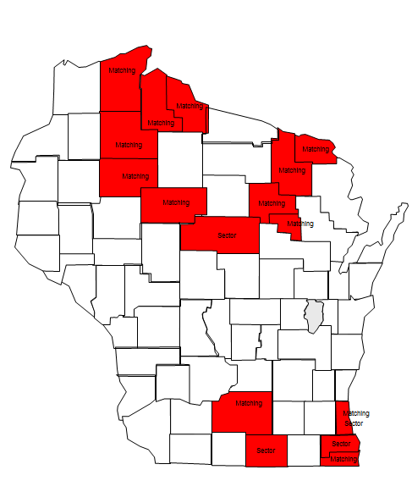
Summary of Subsidized Employment
  $13,7000,000 annual funding
  Estimated 1,387 enrollments for up to 1040 hours of subsidized employment
  Target groups for all programs include
    NCPs who owe child support
    Long-term unemployed
    Ex-offenders
    Family reunification plans
    Former foster
  Primary services
    Subsidized employment
    Training and education
    Case management
    Substance abuse screening and treatment
  Piloting alternative service models to determine what works best

Slide 42
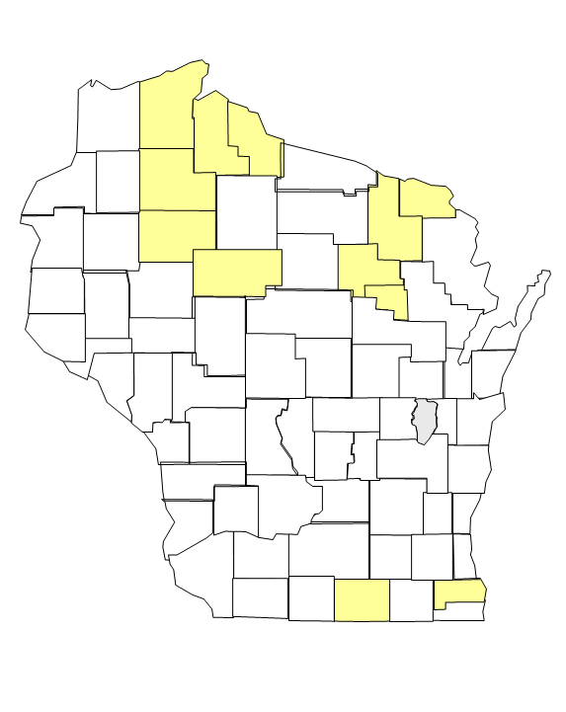
Transitional Jobs (TJ)
  July 1, 2016 implementation date
  Pilot locations:
  Urban areas: City of Beloit and Racine County
  Rural areas: Forest, Langlade, Menominee, Florence, Ashland, Bayfield, Iron, Sawyer, Rusk, and Taylor Counties
  $2,000,000 annual funding
  Estimated 209 enrollments
  Target population:
  Unemployed offenders, unemployed parents who owe child support, unemployed parents of children in child welfare system, and unemployed youth aging out of out-of-home care
  Service delivery models:
  Urban areas: Sector
  Rural areas: Matching
  Employment-focused

Slide 43
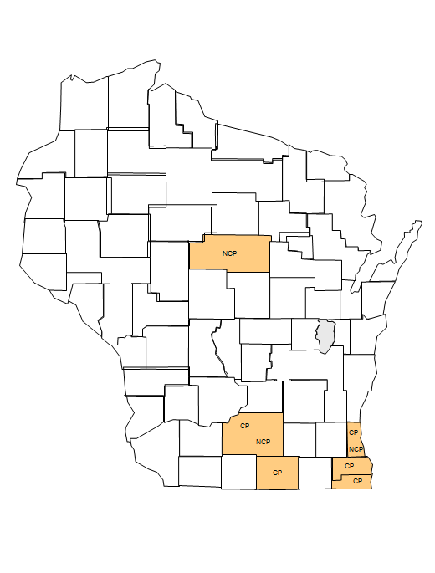

Trial Employment Match Program (W-2 TEMP)
  March 1, 2016 implementation date
  Pilot locations:
  Custodial Parent (CP) TEMP: City of Beloit and Dane, Kenosha, Milwaukee, and Racine Counties
  Noncustodial Parent (NCP) TEMP: Dane, Marathon, and Milwaukee Counties
  $5,200,000 annual funding
  Estimated 236 CP enrollments and 252 NCP enrollments
  Target population:
  Unemployed CPs who have received W-2 in the last 12 months and been in a CSJ or W-2T for at least six months
  Unemployed NCPs who are cooperating with child support and whose CP is participating in W-2 or receiving Wisconsin Shares
  Service delivery models: Matching and Sector
  Employment-focused
  Expand NCP services to include stipends for educating and training

Slide 44
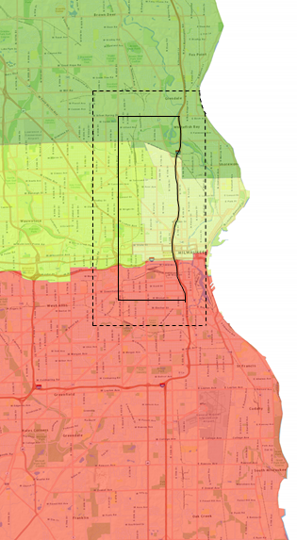
Transform Milwaukee Jobs (TMJ)
  January 1, 2016 contract renewal date
  Geographically limited
  $5,000,000 annual funding
  Estimated 530 annual enrollments
  Target populations:
  Unemployed ex-offenders, unemployed parents who owe child support, unemployed parents of children in child welfare system
  Unemployed youth aging out of out-of-home care
  Service delivery model: Matching
  Employment-focused
  Expand services to include education and vocational training in 2016 contract

Slide 45
Wisconsin Department of Agriculture, Trade and Consumer Protection
Division of Agricultural Development
What We Do:
Farm business support: https://datcp.wi.gov/Pages/Growing_WI/FarmCenterOverview.aspx
Financial analysis and consultation
Farm ownership transition planning
Conflict mediation
Business plan review and analysis\Transitioning to organics/value-added
Beginning farmer and minority farmer support and consultation
Notes:
We support Wisconsin agricultural businesses from the farm to the international marketplace by ensuring sound financial business planning, along with an understanding of the regulatory requirements.

Slide 46
Agribusiness support: https://datcp.wi.gov/Pages/Growing_WI/FoodAndAgCenterOverview.aspx
(processing, marketing)
Financial planning/Business ownership transitions
Market and business expansion planning
Where to find funding (grants, commercial lending, etc.)
Regulatory requirements
Something Special From Wisconsin branding program
International trade: https://datcp.wi.gov/Pages/Growing_WI/InternationalAgribusiness.aspx
Am I ready to export my product?
Exporting regulations and permits
Where are my global customers? How do I reach them?

Slide 47
Wisconsin Department of Agriculture, Trade and Consumer Protection
Bureau of Consumer Protection
The Wisconsin Department of Agriculture, Trade ​and Consumer Protection is the state’s primary consumer protection agency. The Bureau of Consumer Protection has broad authority to regulate unfair business practices.
What We Do:
https://datcp.wi.gov/Pages/Programs_Services/ConsumerProtection.aspx
Operate the Consumer Protection Hotline; Email: DATCPHotline@Wisconsin.gov or call (800) 422-7128
Regulate unfair and deceptive business practices
Administer Wisconsin’s telemarketing “Do Not Call” Law
Educate consumers on best practices to combat and avoid identity theft
Regulate hazardous consumer products
Enforce environmental regulations related to consumer products
Provide informational brochures on specific consumer protection-related topics
Notes:
We support Wisconsin agricultural businesses from the farm to the international marketplace by ensuring sound financial business planning, along with an understanding of the regulatory requirements.

Slide 48
Academic & Career Planning
The vehicle for connecting
college & career readiness
Right Time, Right Fit, No Dead Ends
Academic and Career Planning, (ACP) is a student-driven, adult-supported process in which students create and cultivate their own unique and information-based visions for post secondary success, obtained through self-exploration, career exploration, and the development of career management and planning skills.
Notes:
Robin - RESEARCH Supports!
Presented at 2012 Govs Council on College & Workforce Readiness
NATL Research from Joan Wills, Senior Policy Fellow at the Institute for Educational Leadership
Findings drawn from 5 year study.
Key Points:
States are leading the way in promoting ACPs. Six years ago, 22 states required them through law or regulation. In 2012, 35 states have mandated or are piloting them.
Among the reasons for this increase are evidence that ACPs help reduce the number of dropouts while engaging students at risk, providing better links to rigorous and relevant curriculum for all students, and establishing better connections amongst parents, students, and schools.
There is also evidence that suggests exposure to career opportunities has value as young as 4th grade, while substantive research indicates that formal planning should start for all students in the middle school years.
Though the “ideal” frequency that students should review their plans has not been determined, once a year is not sufficient. States should not promote the concept of an ACP if it simply becomes a rigid checklist that must be completed once a year. If approached as merely another task, it has no relevance for the students and parents. It is critical to recognize ACP development as a process.
Promising practices emerging from research that are part of this process include:
Dedicating time to conduct ACP work as often as two-three times a week, often during an advisory period. “Youth do better when they have the opportunity to develop confidence to develop their own goals in order to become self-reliant and capable of managing their own life choices.”
Providing students the opportunity to connect with a mentor/advisor throughout their high school years to support their ACP goals. Evidence supports the need to create ongoing connections with the same adult in a small setting.
Alignment to state-established career clusters helps students, staff, and schools to provide focus.
Developing opportunities for student-led parent/teacher conferences is an effective tool for a successful ACP.
All school staff, businesses, postsecondary institutions, community organizations, and parents need to be involved in the delivery of the plan, and states and school districts need to think about the roles, functions, and how to engage each of these groups effectively.
While all school staff need to be engaged and supportive, a key leadership group should be established in each school and district to develop the plans and monitor progress. Though school counselors will often be part of this group and may be tasked to lead the group, the administration should provide sufficient evidence of support and involvement to ensure effective implementation.
There are a range of options for state action and implementation of ACPs.
States must determine the scope of ACP implementation (i.e. all students will do them or some subset of the population), and when they should start (i.e. middle school, high school).
Most states have conducted a pilot phase of at least a year in selected districts, with professional development first provided to pilot schools and then to all districts and schools.
State agencies collaborate to build user-friendly systems that include career information, interest assessment tools, etc. Local, non-mandatory options do exist, but research is not complete on how well these voluntary/incentive-based options work and what the best incentives are to promote them.
District and school-level officials in the states she studied were very supportive of the academic and career plans, and were not concerned about a mandate, which Joan found surprising. However, she emphasized that any statewide implementation should be phased in over time, and not done overnight, to be successful.
The concept of a pilot phase was emphasized so that schools and districts could determine what worked best without being constrained by a state policy that was too rigid. States and districts have done this without a lot of new money, but the areas where money was spent were professional development and high quality electronic ACP software that is linked to labor market data and student information systems.

Slide 49
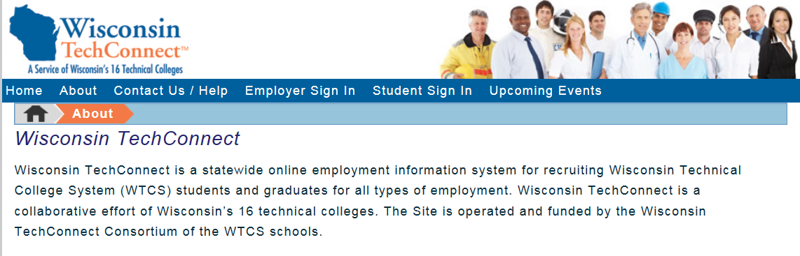
Wisconsin Tech Connect

Slide 50
SBDC (FREE) Business Answerline
Wisconsin Business Answerline (800) 940-7232
M-Th. 9 a.m. to 5 p.m. REAL LIVE PERSON!
SBA Mentor/Support Map
SBA District Office (WI)
SBA – Region 5 Office of Advocacy
Apply to Serve on Council or Commission
walker.wi.gov/governor-office/apply-to-serve

Slide 51
Wisconsin Community Action Program Assn
Jobs and Business Development programs provide local support throughout Wisconsin
Dedicated to helping low and moderate income individuals and families start or expand their small businesses.
Since its inception in 1989, the JBD program has given birth to more than 1,900 new businesses and created 5,610 new jobs.

Slide 52
Office of Business Development
Contact us if we can be of assistance.
Nancy & Joe
Directors
Office of Business Development

