Slide 1
CAMPGROUNDS
QUESTIONS AND ANSWERS Updated
JIM KAPLANEK, RETAIL FOOD AND RECREATIONAL TECHNICAL SECTION CHIEF
MARY ELLEN BRUESCH MS, RS, RECREATIONAL TECHNICAL SPECIALIST
Division of food and recreational safety, WISCONSIN DEPARTMENT OF AGRICULTURE, TRADE AND CONSUMER PROTECTION

Slide 2
OVERVIEW
Some new terms
Frequently-asked questions (and answers)
Important resources
Experiences with the ‘new’ code
Updates and news from DATCP
Your questions and concerns

Slide 3
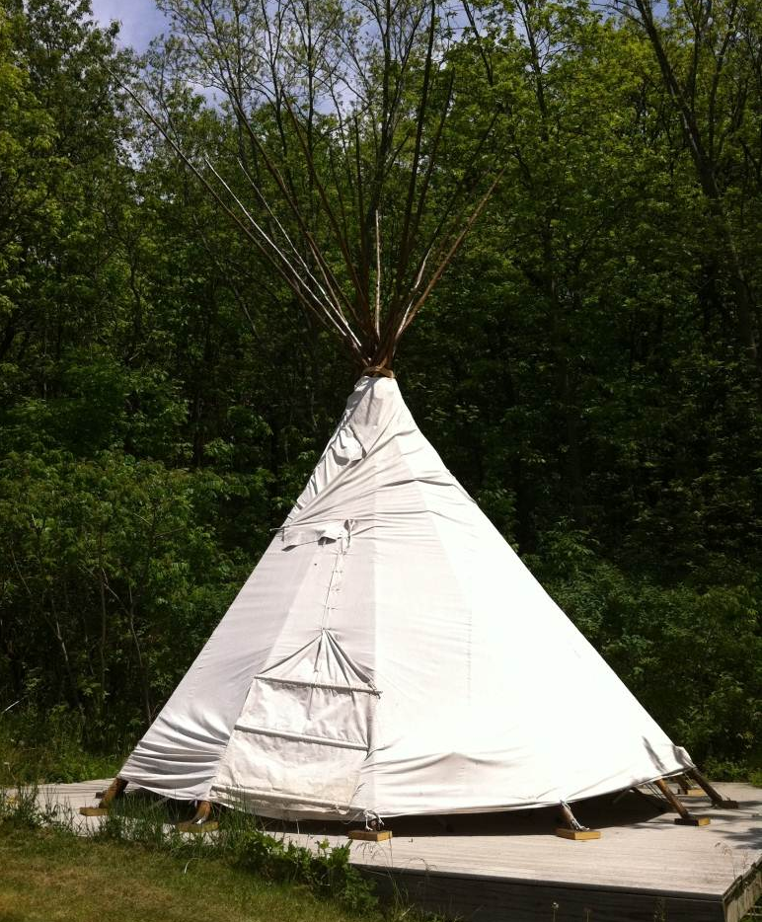
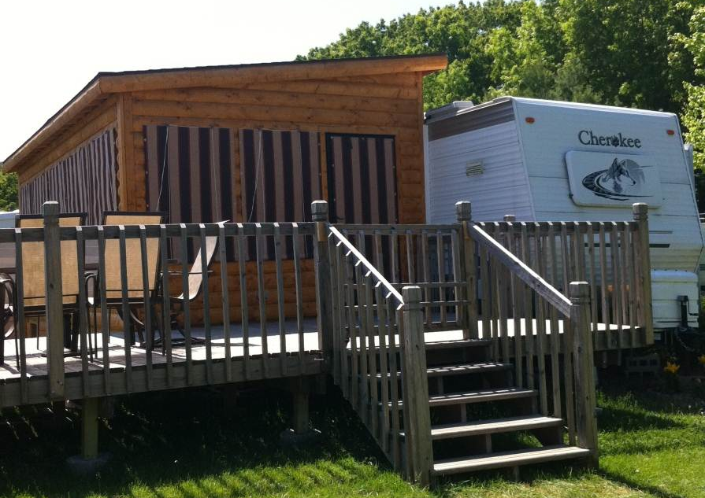
NEW TERMS
Camper body
  Where campers sleep
    Tent
    RV
    Camping cabin
    Van
Accessory
  Deck
  Shed

Slide 4
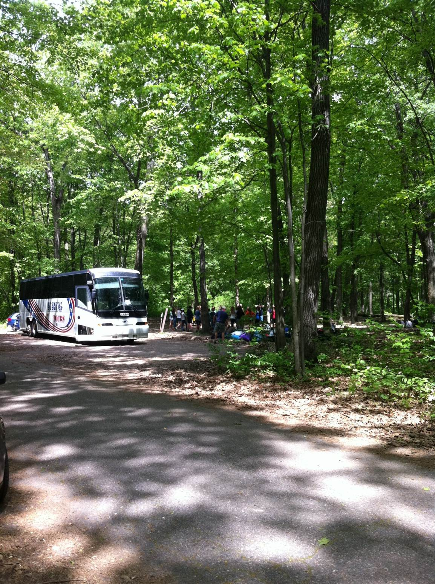
NEW TERMS
Camping unit
  Camper body only
    If Campsite there before February 1, 2016
  Camper body and any accessory
    If Campsite added on, after February 1, 2016
  Slide-outs never included

Slide 5
DISTANCES WITHIN A CAMPSITE: ACCESSORIES
Q: Is there a minimum or maximum distance that an accessory must be from the camper body, for an existing site (there before February 1, 2016), or for a new campsite (added on, after February 1, 2016)?
A: No.
  Distances may affect measurements between campsites
  No minimum or maximum distance that is required within the campsite per the Campground Code.
  Local zoning agencies may have requirements

Slide 6
MORE ABOUT ACCESSORIES
Q: What about distances that affect whether an accessory may need to be considered in measurements between campsites?
A: If an accessory is located within 10 feet of the camper body
  It is part of the camping unit for new campsites
  Not part of the camping unit for existing campsites

Slide 7
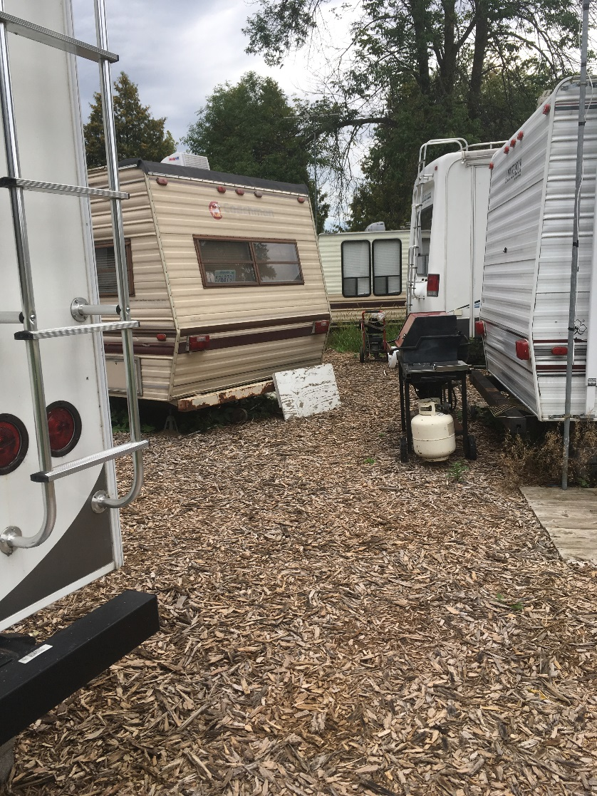
BETWEEN CAMPSITES (EXISTING)
For existing campsites, what distance is required between camping units?
  10 feet
  Camping unit is only the camper body
  Even if the camper body adds an accessory on or after February 1, 2016
  Slide-outs again not included

Slide 8
BETWEEN CAMPSITES (NEW)
For new campsites, what distance is required between camping units?
  10 feet
  Camping unit includes any accessories
  Slide-outs again not included

Slide 9
NEW CAMPSITE
ADJACENT TO EXISITING
Q: What if a new campsite is added—how far does the new camping unit need to be from the existing camping unit?
A: The measurement from camping unit (camper body and any accessory) to camping unit (existing camper body and any accessory)
  Must be 10 feet apart

Slide 10
HOW ARE WE HANDLING SEASONAL RVS AND SPACING?
If there is a new deck on an RV in an existing campsite
  If the campsite is existing, measurement is from the camper body
If there is less than 10 feet between RVs (camper bodies) that were there last season
  Corrective action plan
If a new RV arrives
  It must be at least 10 feet from the next RV

Slide 11
SANITARY STATIONS
Q: What if there is no sanitary station and no connection to sewer, POWTS or (TRUE) RV transfer tanks?
A: If there are 20 or fewer sites designated for independent camping units a variance may be approved if:
  Sanitary station within 25 miles open to users during same camping season
  Agreement from private or public sanitary station covering period of time when campground open to campers

Slide 12
RV TRANSFER TANKS
Q: 100% of sites designated for use as Independent are connected to TRUE RV transfer tanks. What is needed?
A: Arrangements for disposal from the transfer tank
Sanitary station is not needed
  Variance is NOT needed
  Back-up toilets are still needed (capacity)

Slide 13
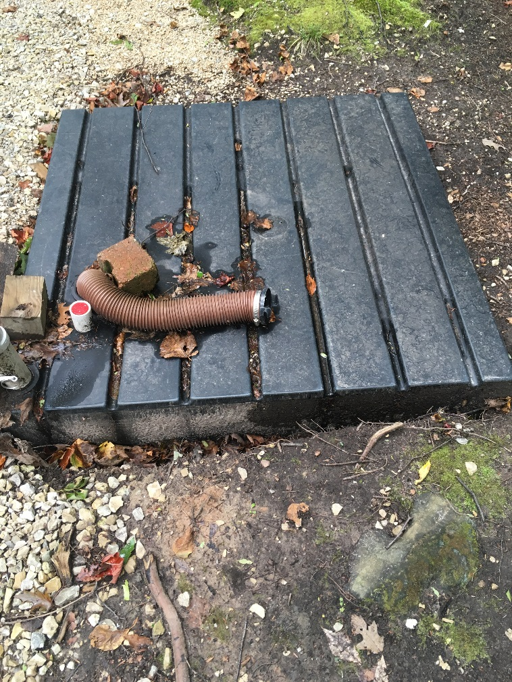
RV TRANSFER TANKS
Must be TRUE RV transfer tanks

Slide 14
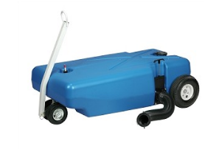
PORTABLE TRANSFER TANKS
These may not serve as RV Transfer Tanks when considering whether a Sanitary Station is needed, but are OK for transporting waste to an on-site Sanitary Station

Slide 15
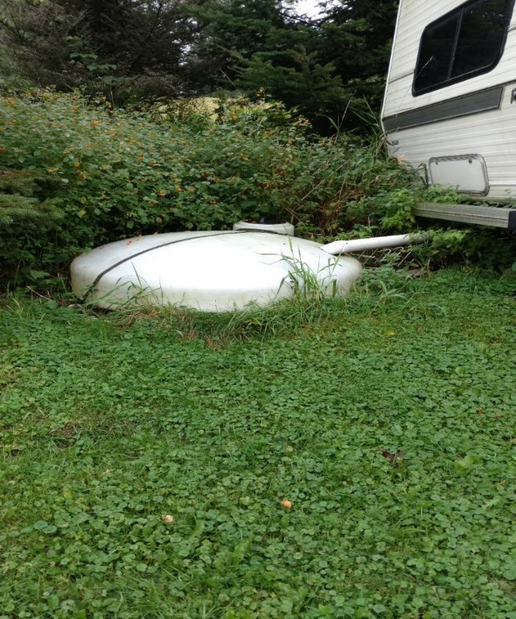
SIMILAR TANKS
These need DSPS review, and could potentially be approved by DSPS
Obtain approval letter from DSPS

Slide 16
PHONES
Q: Is a Landline on site required?
A: No, code does not require
  Landline
  Specific location for phone
Sign is required indicating where phone is available for emergency use
Phone must be available 24/7

Slide 17
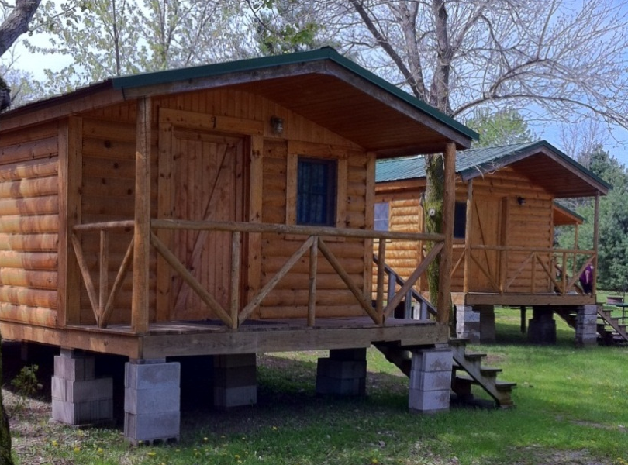
OWNERSHIP
Q: May someone put a camping cabin that they own into a campground they do not own?
A: Yes. The owner of the campground does not need to own the camping cabin.
  It must meet UDC

Slide 18
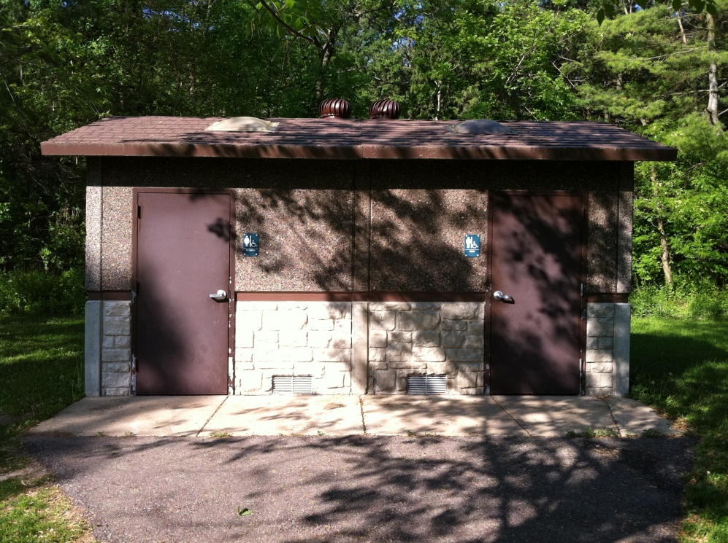
FIRE EXTINGUISHERS
NOT HERE
HERE
Required in Commercial Buildings
  Offices, lodges, game rooms
Not Required in toilet buildings, fish cleaning stations, picnic shelters

Slide 19

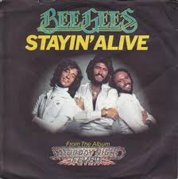

RECORDS
Q: Do records need to be kept at the campground?
A: They may be stored off-site if available to inspector for review

Slide 20
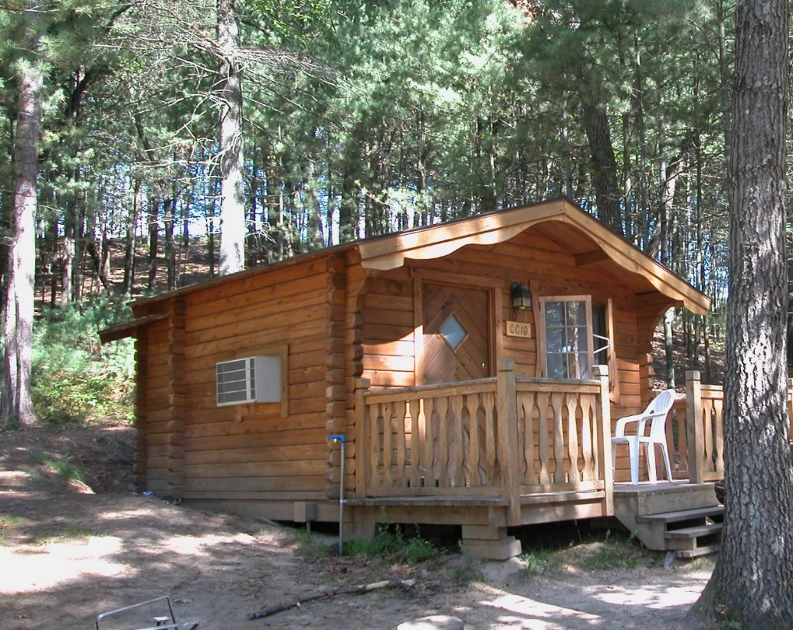
CAMPING CABIN CONSIDERATIONS
Must be 400 sf or less
Slightly over=apply for a Variance
Electrical or plumbing OK as long as it meets DSPS requirements

Slide 21
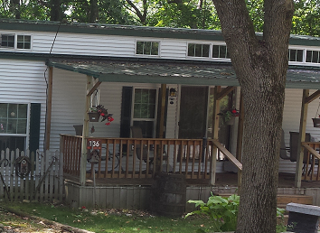
DECKS and SQUARE FOOTAGE
Q: Is a deck part of the square footage measurement to determine whether the cabin is 400 sf or less?
A: No, only the interior measurement counts.

Slide 22
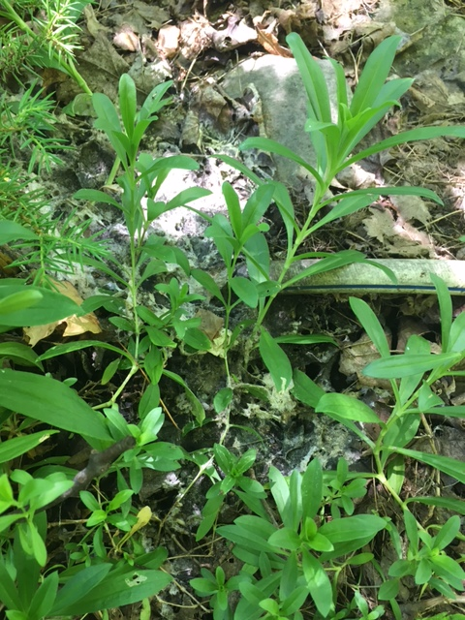
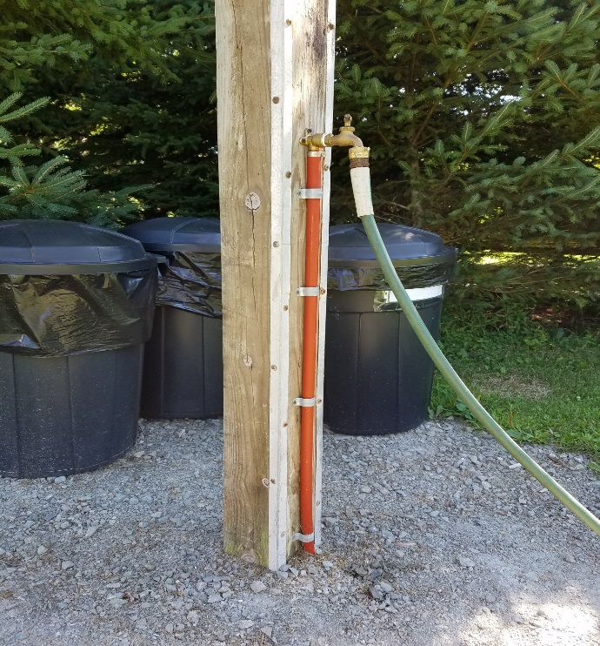
PLUMBING NOTES
Plumbing must be to SPS Code
No buried hoses

Slide 23
PLUMBING NOTES
Splitters do not meet code
“T” complies with code

Slide 24
IMPORTANT RESOURCES
Licensing
  New campgrounds
  Campgrounds expanding beyond currently licensed number of campsites
General questions
  “Rec Box” email box
  Variances
    Work with local inspector or contact us
    Ultimately we review them after the inspector sends them to us

Slide 25
EXPERIENCES WITH THE ‘NEW CODE’
  Previously unlicensed campsites that now must be licensed
  Most questions have been about spacing
  Many sanitary station Variances issued

Slide 26
UPDATES AND NEWS FROM DATCP
  Training new staff in new ‘risk-based’ campground inspections
  Plan review now done in Licensing
  Merger progress
  New staff
  Food Code

Slide 27
YOUR QUESTIONS AND CONCERNS?

Slide 28
QUESTIONS?
Thank You!

