Slide 1
INFLUENCE BOOSTER
Mastering the Art of
Out-Thinking, Not Out-Spending The Competition
JEFF SLUTSKY
Notes:
It’s a fully integrated program that uses the following elements. Not just a collection of ideas.

Slide 3
INFORMATION OVERLOAD
According to Daniel Levitin, McGill University psychology professor and author of The Organized Mind.
“1976 there were 9,000 products in the average grocery store. Now there are 40,000. Most people only shop for 150”.
Notes:
Ice Cream. Tooth Paste. Domino’s Yellow Pages; $6 Haircuts; Wendy’s/Mcd/Braile Menu; What the hell.

Slide 4
INFORMATION OVERLOAD
According to Daniel Levitin, McGill University psychology professor and author of The Organized Mind.
“Considering that Americans took in five times as much information every day in 2011 as they did in 1986, we have to make a conscious effort to beat back the flood.”
Notes:
Ice Cream. Tooth Paste. Domino’s Yellow Pages; $6 Haircuts; Wendy’s/Mcd/Braile Menu; What the hell.

Slide 5
EFFECTIVE INFORMATION
WHAT MAKES COMMUNICATIONS EFFECTIVE?
Technique
Purpose
Creativity
Practice & Experience
Notes:
What’s your favorite TV commercial? Why? Did it work?

Slide 6
EFFECTIVE INFORMATION
WHAT MAKES COMMUNICATIONS EFFECTIVE?
What is the objective?
Did the message achieve the objective?
Could it have been more effective?
Notes:
What’s your favorite TV commercial? Why? Did it work?

Slide 7
THINKING
OUTSIDE THE BOX
Connect all 9 using only 4 straight connecting lines, without lifting your pen from the page or repeating a line.
Notes:
JEFF: (page 5) If you know the answer, quite

Slide 8
THINKING
OUTSIDE THE BOX
Connect all 9 using only 3 straight connecting lines, without lifting your pen from the page or repeating a line.
Notes:
JEFF: (page 5) If you know the answer, quite

Slide 9
THINKING
OUTSIDE THE BOX
Connect all 9 using only 1 straight connecting lines, without lifting your pen from the page or repeating a line.
Notes:
JEFF: (page 5) If you know the answer, quite

Slide 10
INFORMATION OVERLOAD
What are the major reasons for “miscommunication”?
Notes:
Ice Cream. Tooth Paste. Domino’s Yellow Pages; $6 Haircuts; Wendy’s/Mcd/Braile Menu; What the hell.

Slide 11
INFORMATION OVERLOAD
What are the different “ways” in which we need to communicate?
Notes:
One on one, small group. Public speaking, telephone, conferrence call,

Slide 12
DECISION MAKING
People Don’t Like To Make Decisions
Decision Making Is Emotional
Asking Questions Gives You Valuable Information
Listening, Not Talking, Gives You Insight
Notes:
Ask questions, buy car, echo, green eggs and ham, hot potato

Slide 13
WHAT DO ALL FORMS OF COMMUNICATION HAVE IN COMMON?
GIVER AND RECEIVER
GIVER HAS AN OBJECTIVE
RECEIVER PROCESSES
THE RELATIONSHIP MODIFIES

Slide 14
INFORMATION OVERLOAD
COMMUNICATION PROCESS:
THE GIVER
THE MESSAGE
MEDIUM
THE RECEIVER(S)
THE MESSAGE RECEPTION & INTERPRETATION
Notes:
What’s your favorite TV commercial? Why? Did it work?

Slide 15
THE DIFFERENCE BETWEEN
WHAT IS SAID AND WHAT IS MEANT
Translate The Following:
1. Do you think its warm in here?
Is the TV a little loud?
Are you going to the store?
Are you going to wear that?
I have a headache.
Do you have a headache?

Slide 16
4 PERSONALITY TYPES
Low Responsiveness (CONTROLS)
Low Assertiveness (ASKS) | ANALYTIC | DRIVER | High Assertiveness (TELLS)
 | AMIABLE | EXPRESSIVE
High Responsiveness (EMOTES)

Slide 17
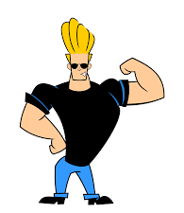
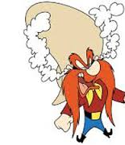
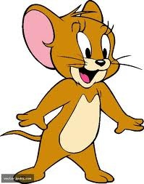
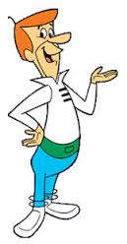
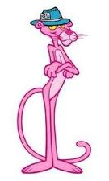
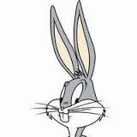
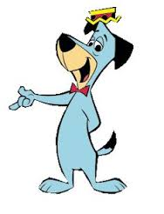
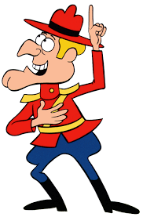
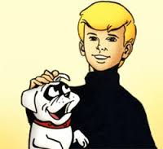
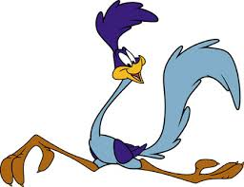
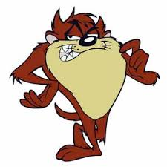
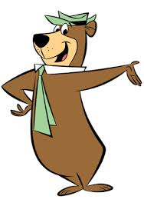
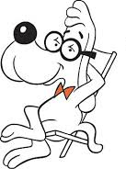
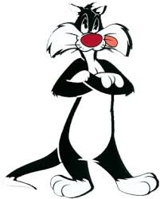
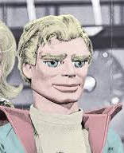
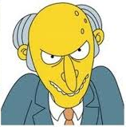
PERSONALITY TYPES
What cartoon character best represents:
ANALYTIC
DRIVER
AMIABLE
EXPRESSIVE

Slide 18
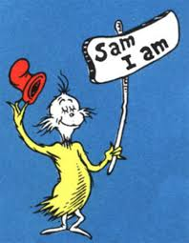
DECISION MAKING
The Choice Decision
To Get A “Yes”
Notes:
Ask questions, buy car, echo, green eggs and ham, hot potato

Slide 19
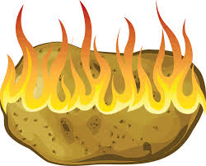
HOT POTATO EXERCISE
Choose a partner
Starter holds the “hot potato” postcard
Ask a question about the chosen subject
You can only give away your hot potato after asking a question
You can’t ask your questions until you’ve answered your partner’s
Notes:
Ask questions, buy car, echo, green eggs and ham, hot potato

Slide 20
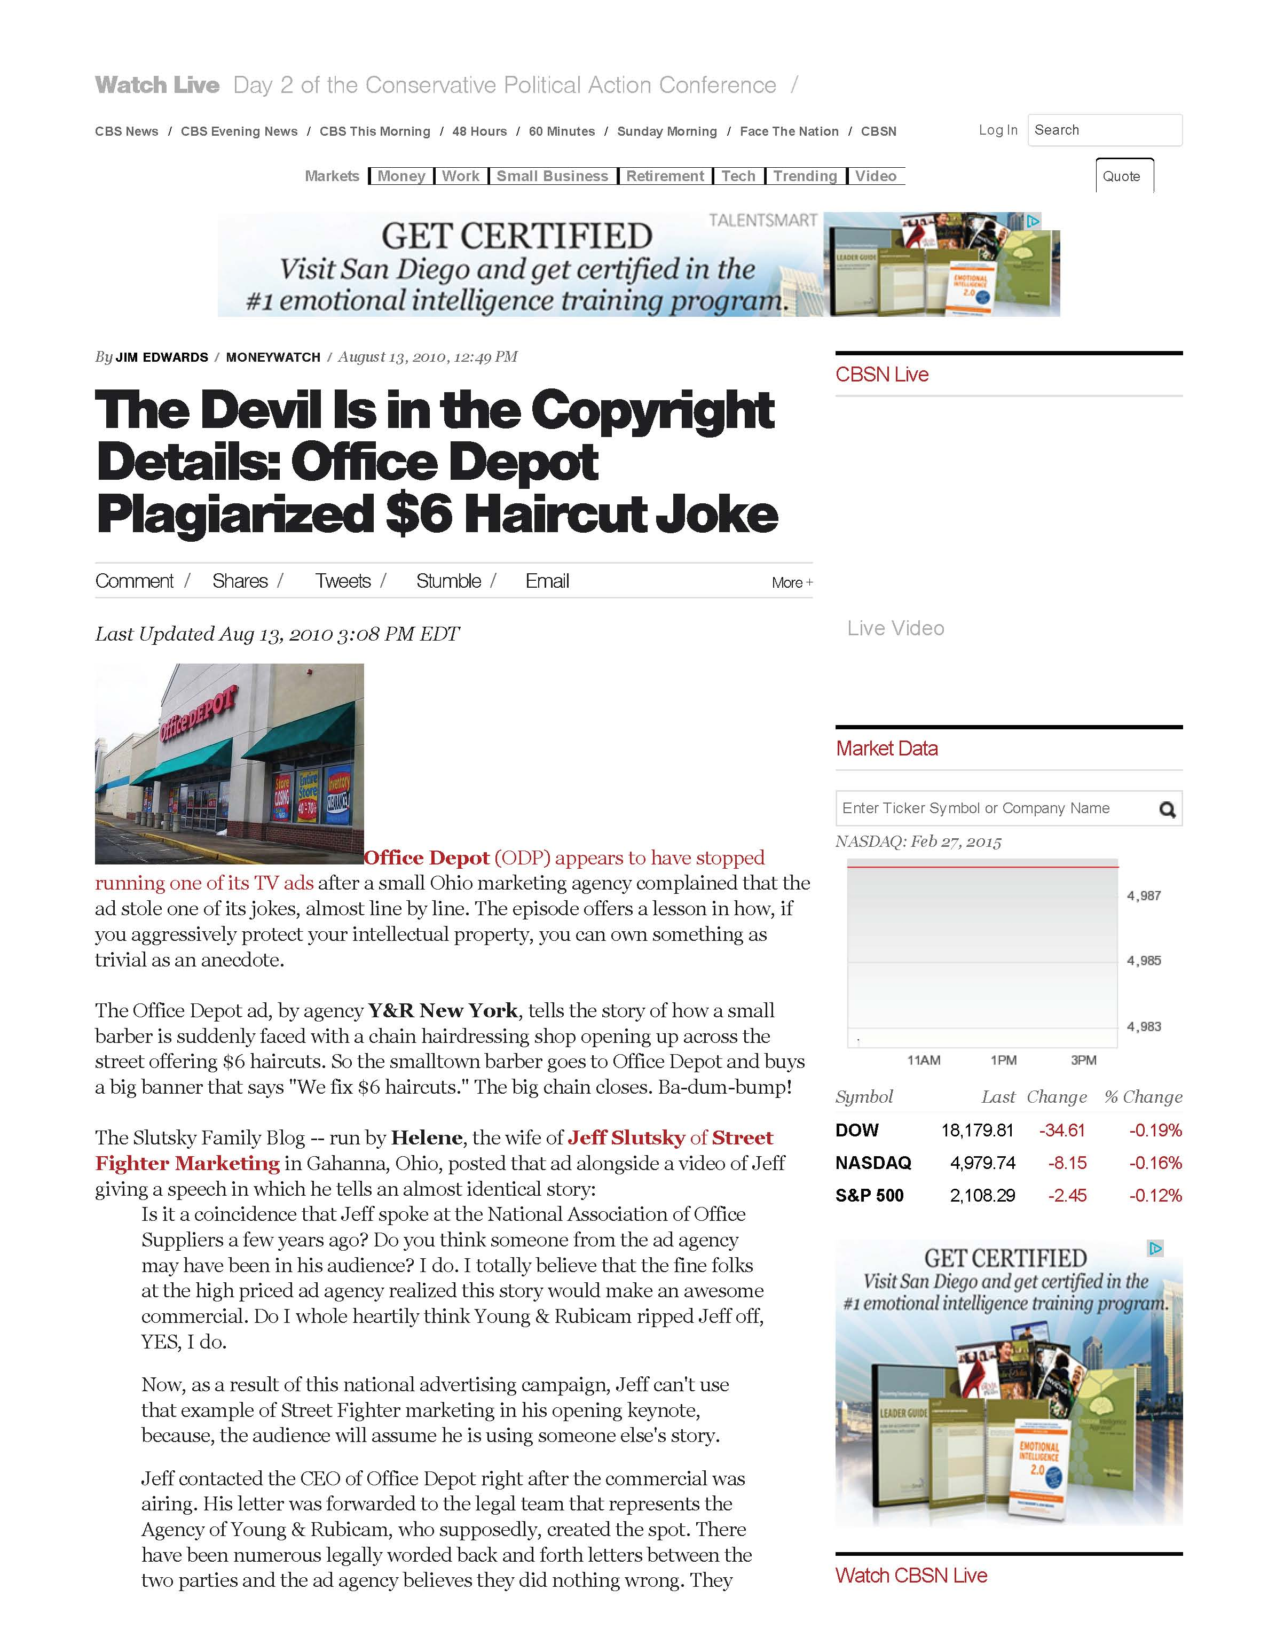
PROTECT YOUR REPUTATION
Your Reputation Is Your Livelihood
Treat Everyone As If The World Is Watching You
Bad Behavior Can Go Viral
There’s No Such Thing As Off The Record
Super Bowl Commercial
Notes:
$6 Haircut Story – With Office Depot. With social media and internet, you cannot afford to get a bad rep. Lear Jet Story

Slide 21
PROTECT YOUR REPUTATION
Your Reputation Is Your Livelihood
Super Bowl Commercial
Notes:
$6 Haircut Story – With Office Depot. With social media and internet, you cannot afford to get a bad rep. Lear Jet Story

Slide 22
CHOOSE WORDS CAREFULLY
Words Have Different Meanings
For Different People And Cultures.
Use Some Common Sense.
Do Your Homework!
Ni How Kai Lan

Slide 23
CHOOSE WORDS CAREFULLY

Slide 24
noun
雪
snow
積雪
snow, accumulated snow
CHOOSE WORDS CAREFULLY
雪
Xuě
Search Results
Snow Edit

Slide 25
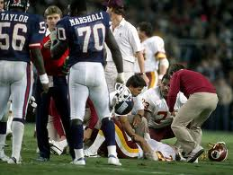
CHOOSE WORDS CAREFULLY
THE INJURY WAS VOTED THE NFL'S
"Most Shocking Moment in History”
Notes:
Theismann's career ended mid 80’s. 10 Years later we were speaking to Bridgestone Dealers in Vegas.
I have a theater background.

Slide 26
LEARN MORE STREET FIGHTING
Street Fighter Books
$20 Each
Or any 3 for $40
ANY 6 for $60

Slide 27
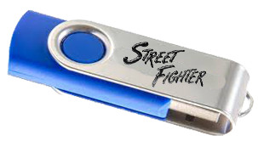
VIDEO & AUDIO WITH COACHING
STREET FIGHTER
FLASH DRIVE
MP3 – MP4
6 VIDEOS
AUDIO ALBUMS (15 CDs)
WORKBOOKS (PDF)
PLUS YOU GET JEFF FOR 1 YEAR!
ONLY
REG.
$500
$199

