Slide 1

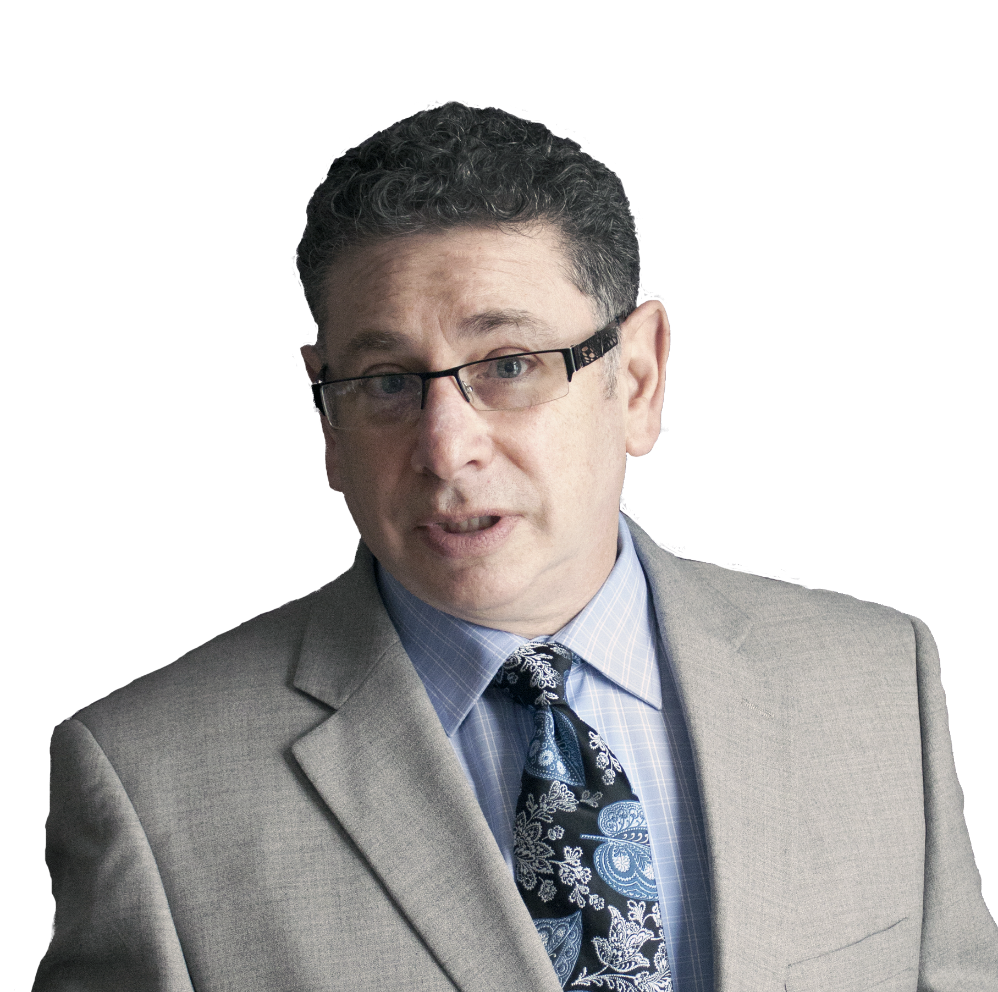
Mastering the Art of
MARKETING
WITHOUT MONEY
A Campground Owners Guide to “Getting More For Less”
JEFF SLUTSKY
Notes:
It’s a fully integrated program that uses the following elements. Not just a collection of ideas.

Slide 2
GETTING RESULTS
GETTING FREE ADVERTISING
WITH CROSS PROMOTIONS
Notes:
Ice Cream. Tooth Paste. Domino’s Yellow Pages; $6 Haircuts; Wendy’s/Mcd/Braile Menu; What the hell.

Slide 3
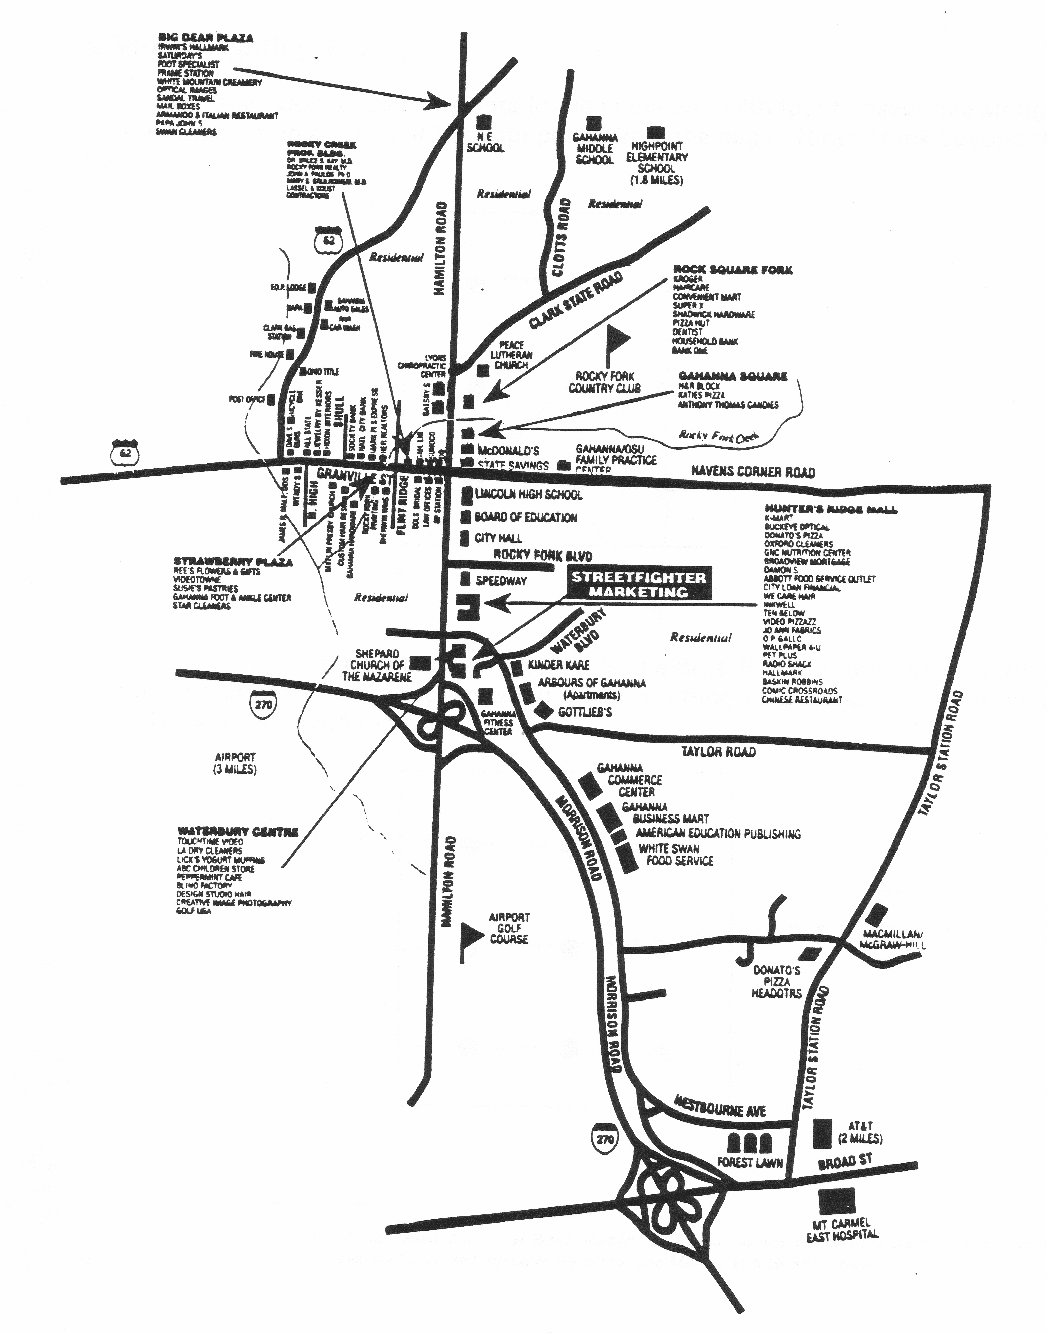
INDENTIFY THE OPPORTUNITIES
Schools
Businesses
Retailers
Hospital
Clinics
Offices
Government
Churches/Temples
Recreation
Manufacturing
Distribution
Shopping Centers
Apartments
Houses
Non profit groups
Clubs
Associations
Entertainment
Events/Festivals
typical communities from where you get your campers
Gahanna, Ohio
Notes:
JEFF: A typical community has hundreds of opportunities for networking and driving sales. You become the Mayor of your community.

Slide 4
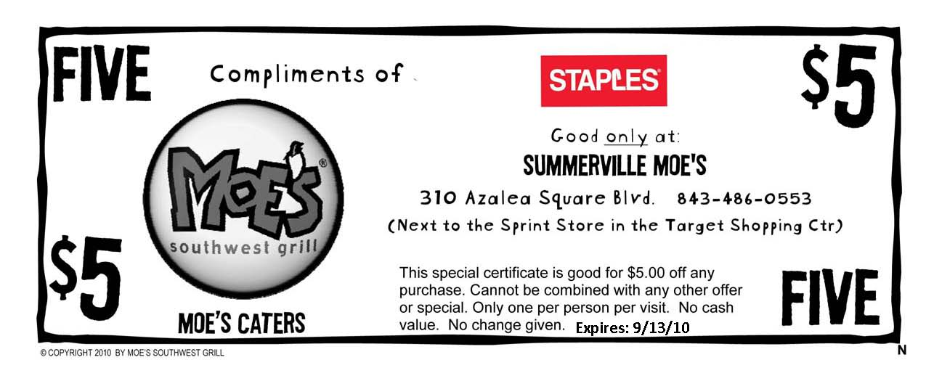
Calculating ROI: Tactical Example
CROSS PROMOTIONS
 | Staples
Pieces Dist. | 2500
Redemptions | 397
First Time Buyers | 128
Anticipated Regulars | 32
Notes:
549 regulars discounted. X $8 = $4392. $2,920 gross profit increase from promotion.

Slide 5
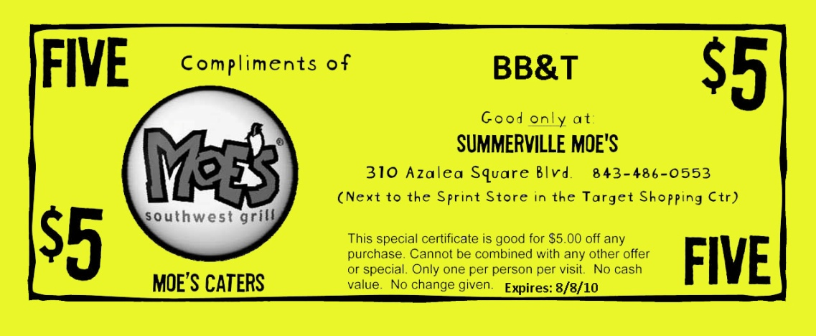
Calculating ROI: Tactical Example
CROSS PROMOTIONS
 | Staples | BB&T
Pieces Dist. | 2500 | 3000
Redemptions | 397 | 615
First Time Buyers | 128 | 226
Anticipated Regulars | 32 | 56.5
 | $39,825
Notes:
549 regulars discounted. X $8 = $4392. $2,920 gross profit increase from promotion.

Slide 6
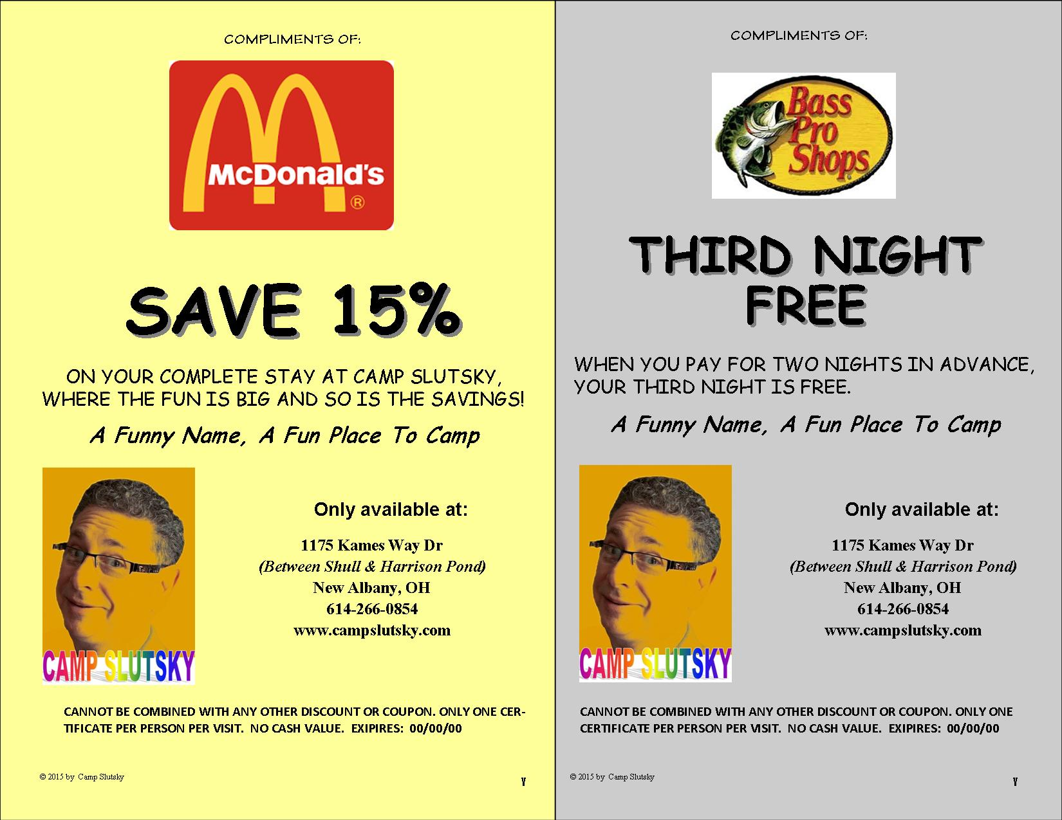
Cross Promotion Certificate Format
Notes:
2 up format. Insert Partner name or logo. Create offer. Add exp date. Track results.

Slide 7
CROSS PROMOTIONS
3 C’s of Cross Promotions
Cost
Control
Credibility

Slide 8
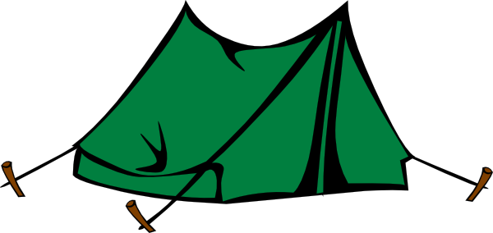
GEOGRAPHIC CONTROL
YOUR CAMPGROUND
Notes:
Identify the top communities that feed into your campground.

Slide 9
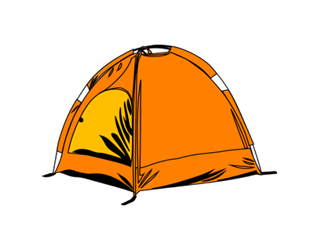
COMPETATIVE CONTROL
YOUR COMPETITOR
YOUR CAMPGROUND
Notes:
Identify the top communities that feed into your campground.

Slide 10
DEMOGRAPHIC CONTROL
Who is most likely to camp?
Serve a similar customer base (CAMPERS)
What do they have in common?
What products and/or services do they buy?
What groups do they belong to?

Slide 11
DEMOGRAPHIC CONTROL
Selecting The BEST Promotional Partners
Serve a similar customer base
Geographically suitable for your business
Large customer counts
You already know the decision maker

Slide 12
TARGET AUDIENCE
PEOPLE MAGNET Exercise
List the types of businesses or organizations who appeal to your customers.
Notes:
Identify businesses that reach “campers.” i.e., tent sales, RV sales, gear, etc.

Slide 13
CROSS PROMOTIONS
Cross Promotion Exercise
List 10 businesses in your trading radius that would make good promo partners.
Identify those with owners or managers you already know.
Notes:
Use handout. Customize for your campground. If more than one, use two handouts.

Slide 14
RECON/INTEL
Business Card Drawing
The Easiest Way To Learn Who Your Customers Are
The Business Card Drawing:
Name
Title
Company
Direct Phone
Email
Address
The promotional opportunities come to you!
Notes:
This is great way to identify potential

Slide 15
PROFIT FROM NON PROFITS
Street Fighter Fund Raiser
Performance based donation limits your risk
The non profit group does all the work
They hand out flyers and put up posters
They send out emails
They contact local media
Non profit only gets credit for business they generate
Single Event or Certificate Distribution
Pick a local cause and a local group
Benefit:
Buying customers is the primary benefit
Goodwill and Exposure are secondary benefits.

Slide 16
PROFIT FROM NON PROFITS
NON PROFIT GROUP EXERCISE
List the types of organizations that camp as part of their activities or events.
Notes:
Post Cards, Invitation, Cumpled, Greeting Cards

Slide 17
PROFIT FROM NON PROFITS
Your Non Profits Exercise
List 5 specific organizations who have asked you for donation or used your campground.
Identify those with decision makers you already know.
Notes:
It’s a fully integrated program that uses the following elements. Not just a collection of ideas.

Slide 18
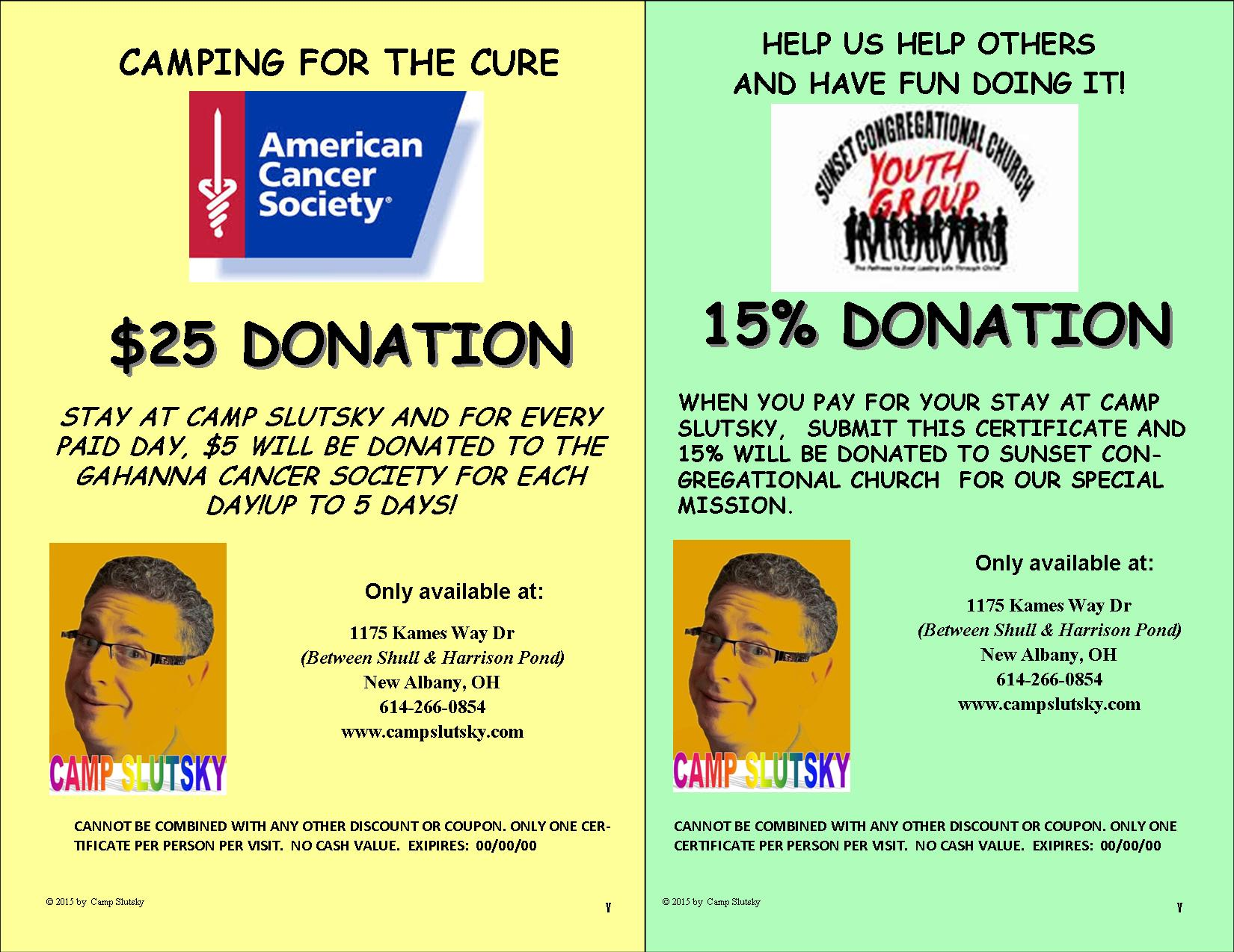
PROFIT FROM NON PROFITS
Notes:
Distrubute certificates or do an email blast with a printable certificate.

Slide 19
IN –THE- LOOP PROMOTION
200 - 400 MILES
YOUR
CAMPGROUND
Notes:
Refer your campers to other campgrounds that are not likely your competition but could be their next stop. They do the same for you. Bypass all the other competitors within the competitive radius.

Slide 20
IN –THE- LOOP PROMOTION
In-The-Loop Exercise
List 5 Campground locations that ARE NOT close enough to you to be a serious competitor yet close enough to refer for their next stop.
Notes:
Ask questions, buy car, echo, green eggs and ham, hot potato

Slide 21
AMBASSADOR PROMOTION
Recruit 10 – 15 loyal customers to start
Create prizes and rewards for referrals
Provide tools for them to reach their friends
Use social media (Facebook, Instagram, etc.)
Mailers & Flyers
Announcements at meetings
Email blasts
Notes:
Assign a unique code that can be used for reservations.

Slide 22
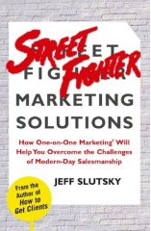
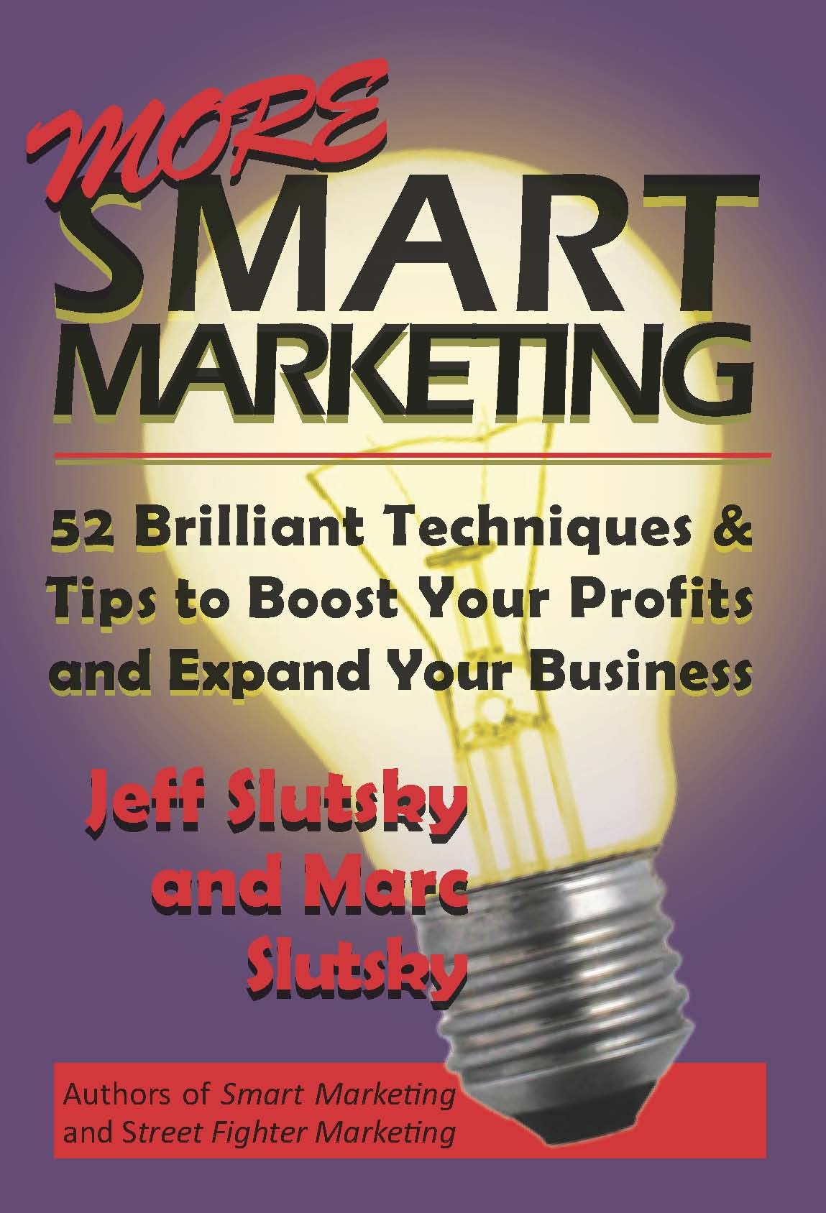


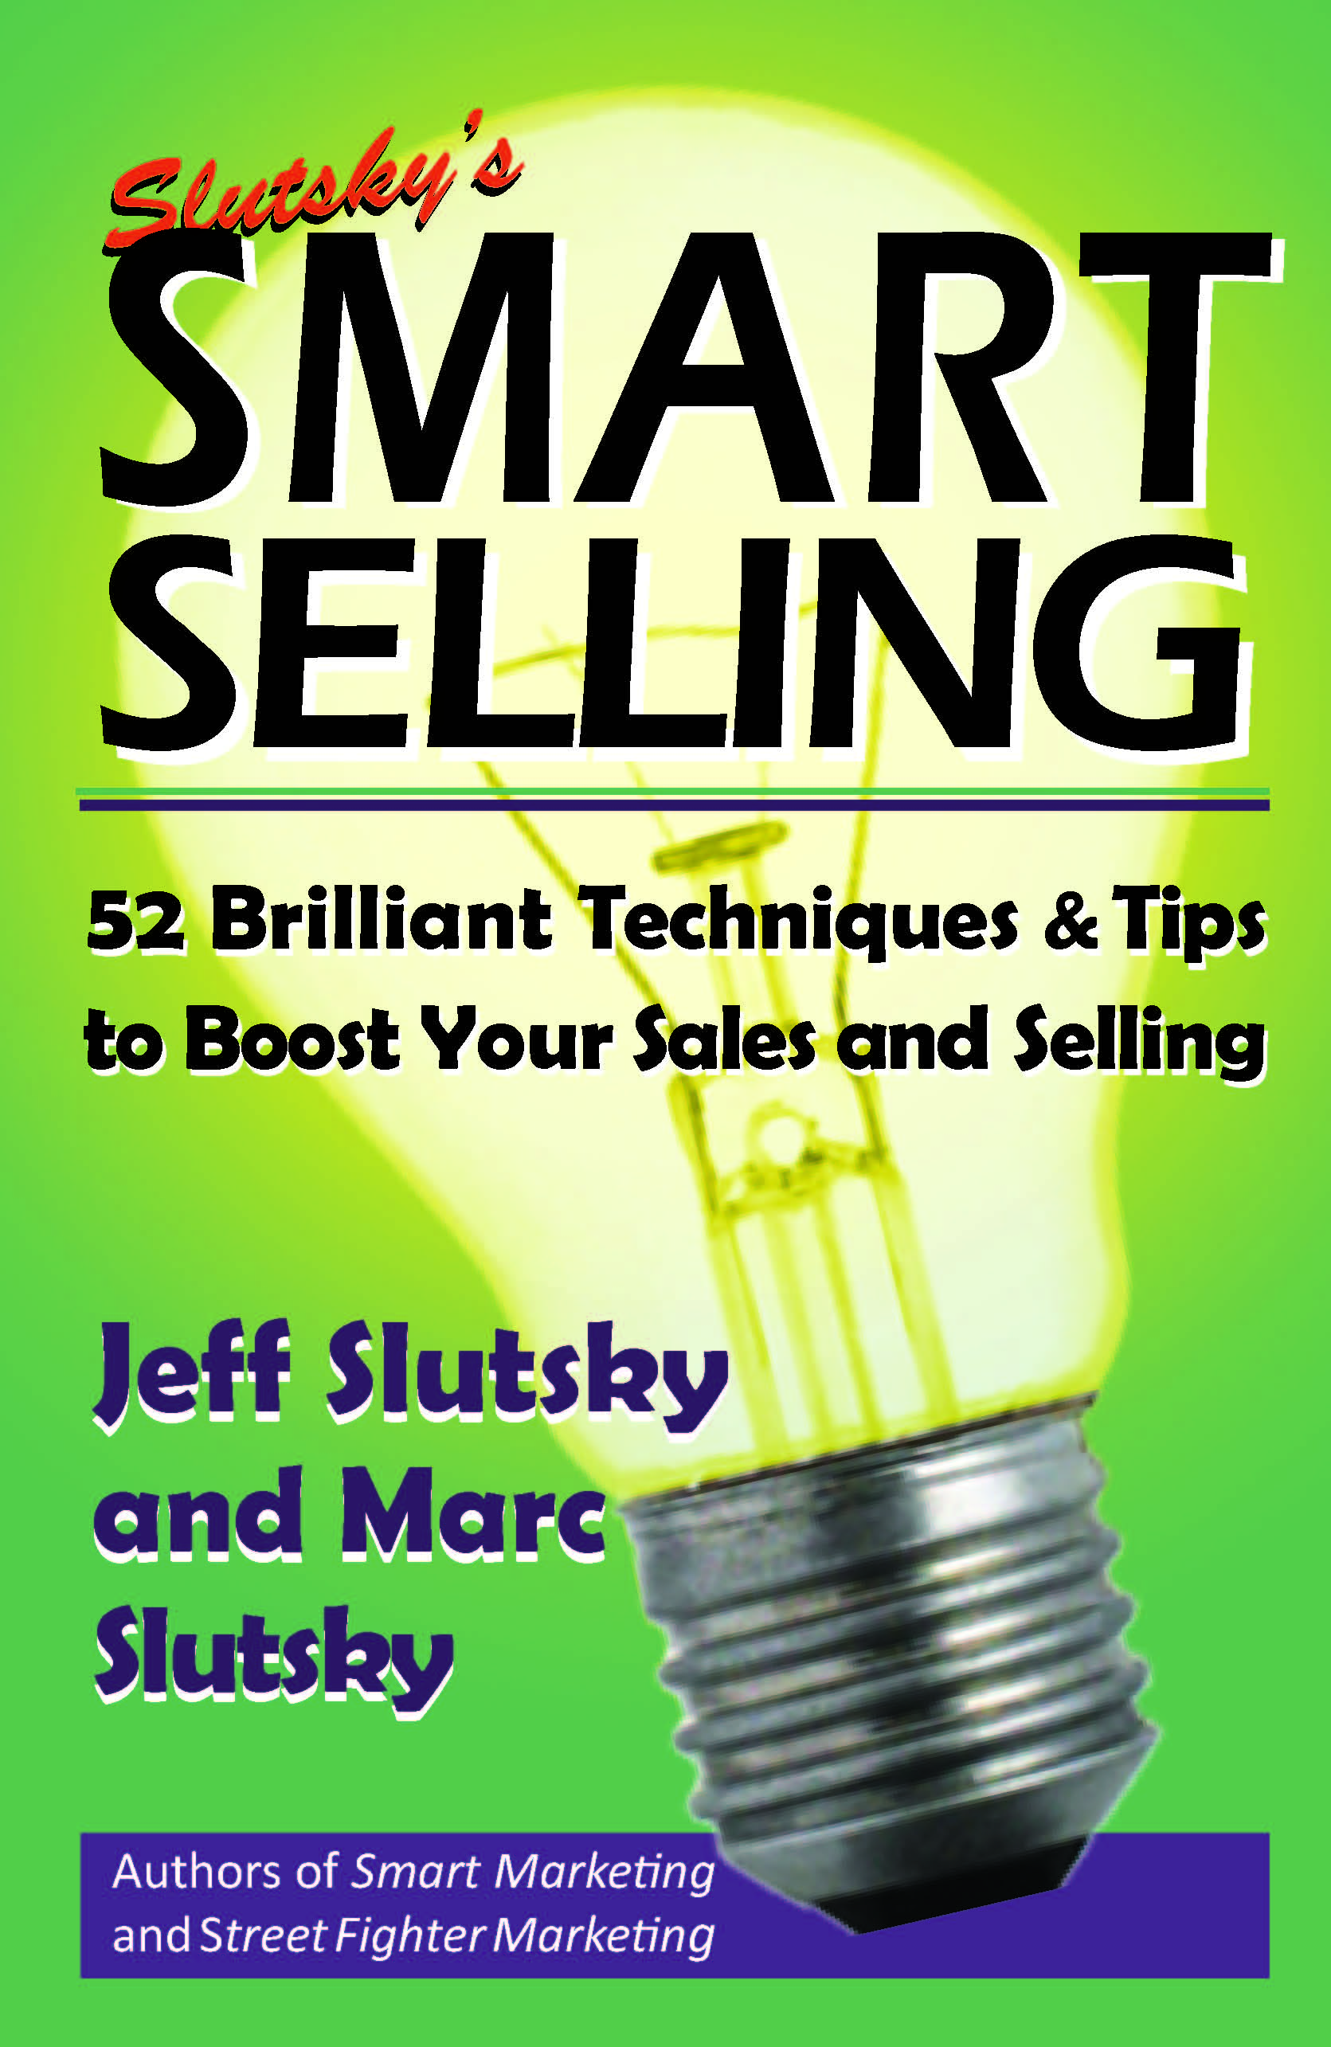

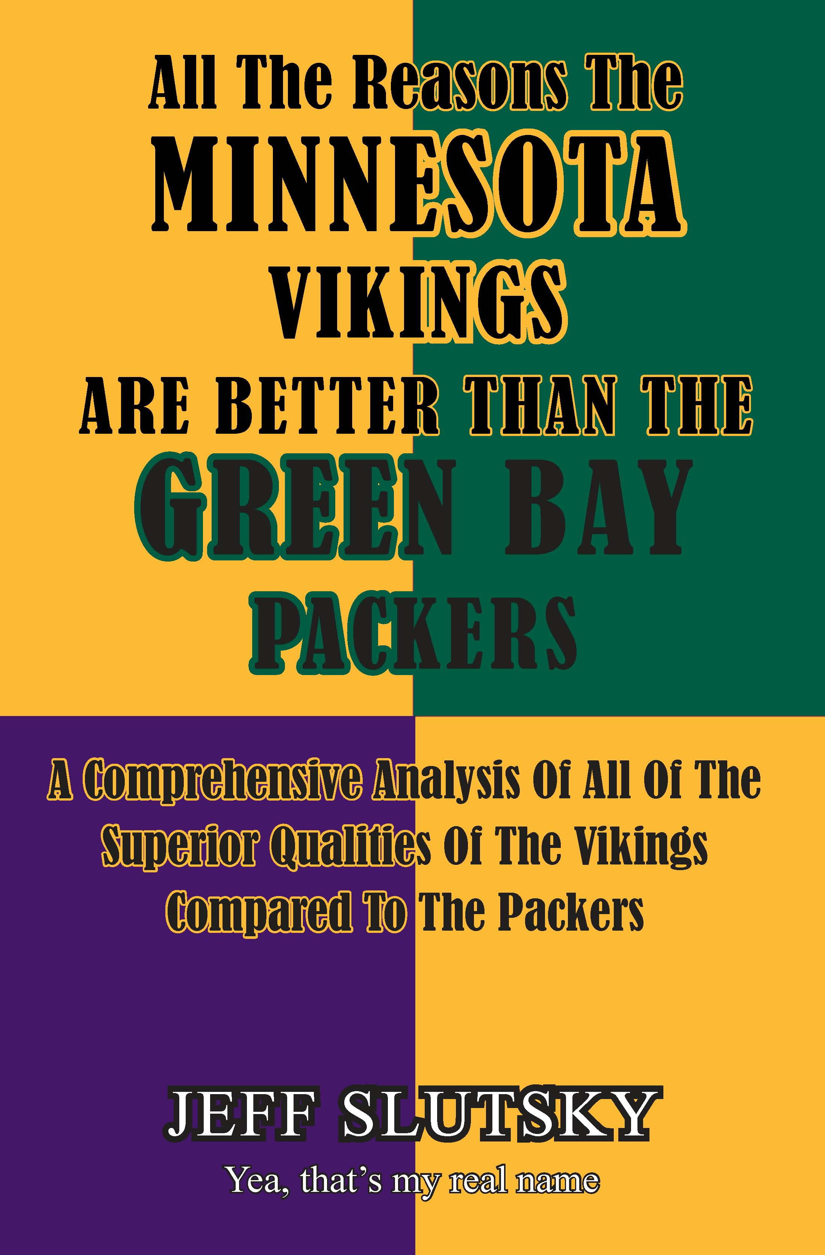


LEARN MORE STREET FIGHTING
Street Fighter Books
$20 Each
Or any 3 for $40
ANY 6 for $60

Slide 23
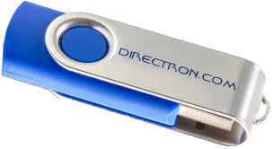
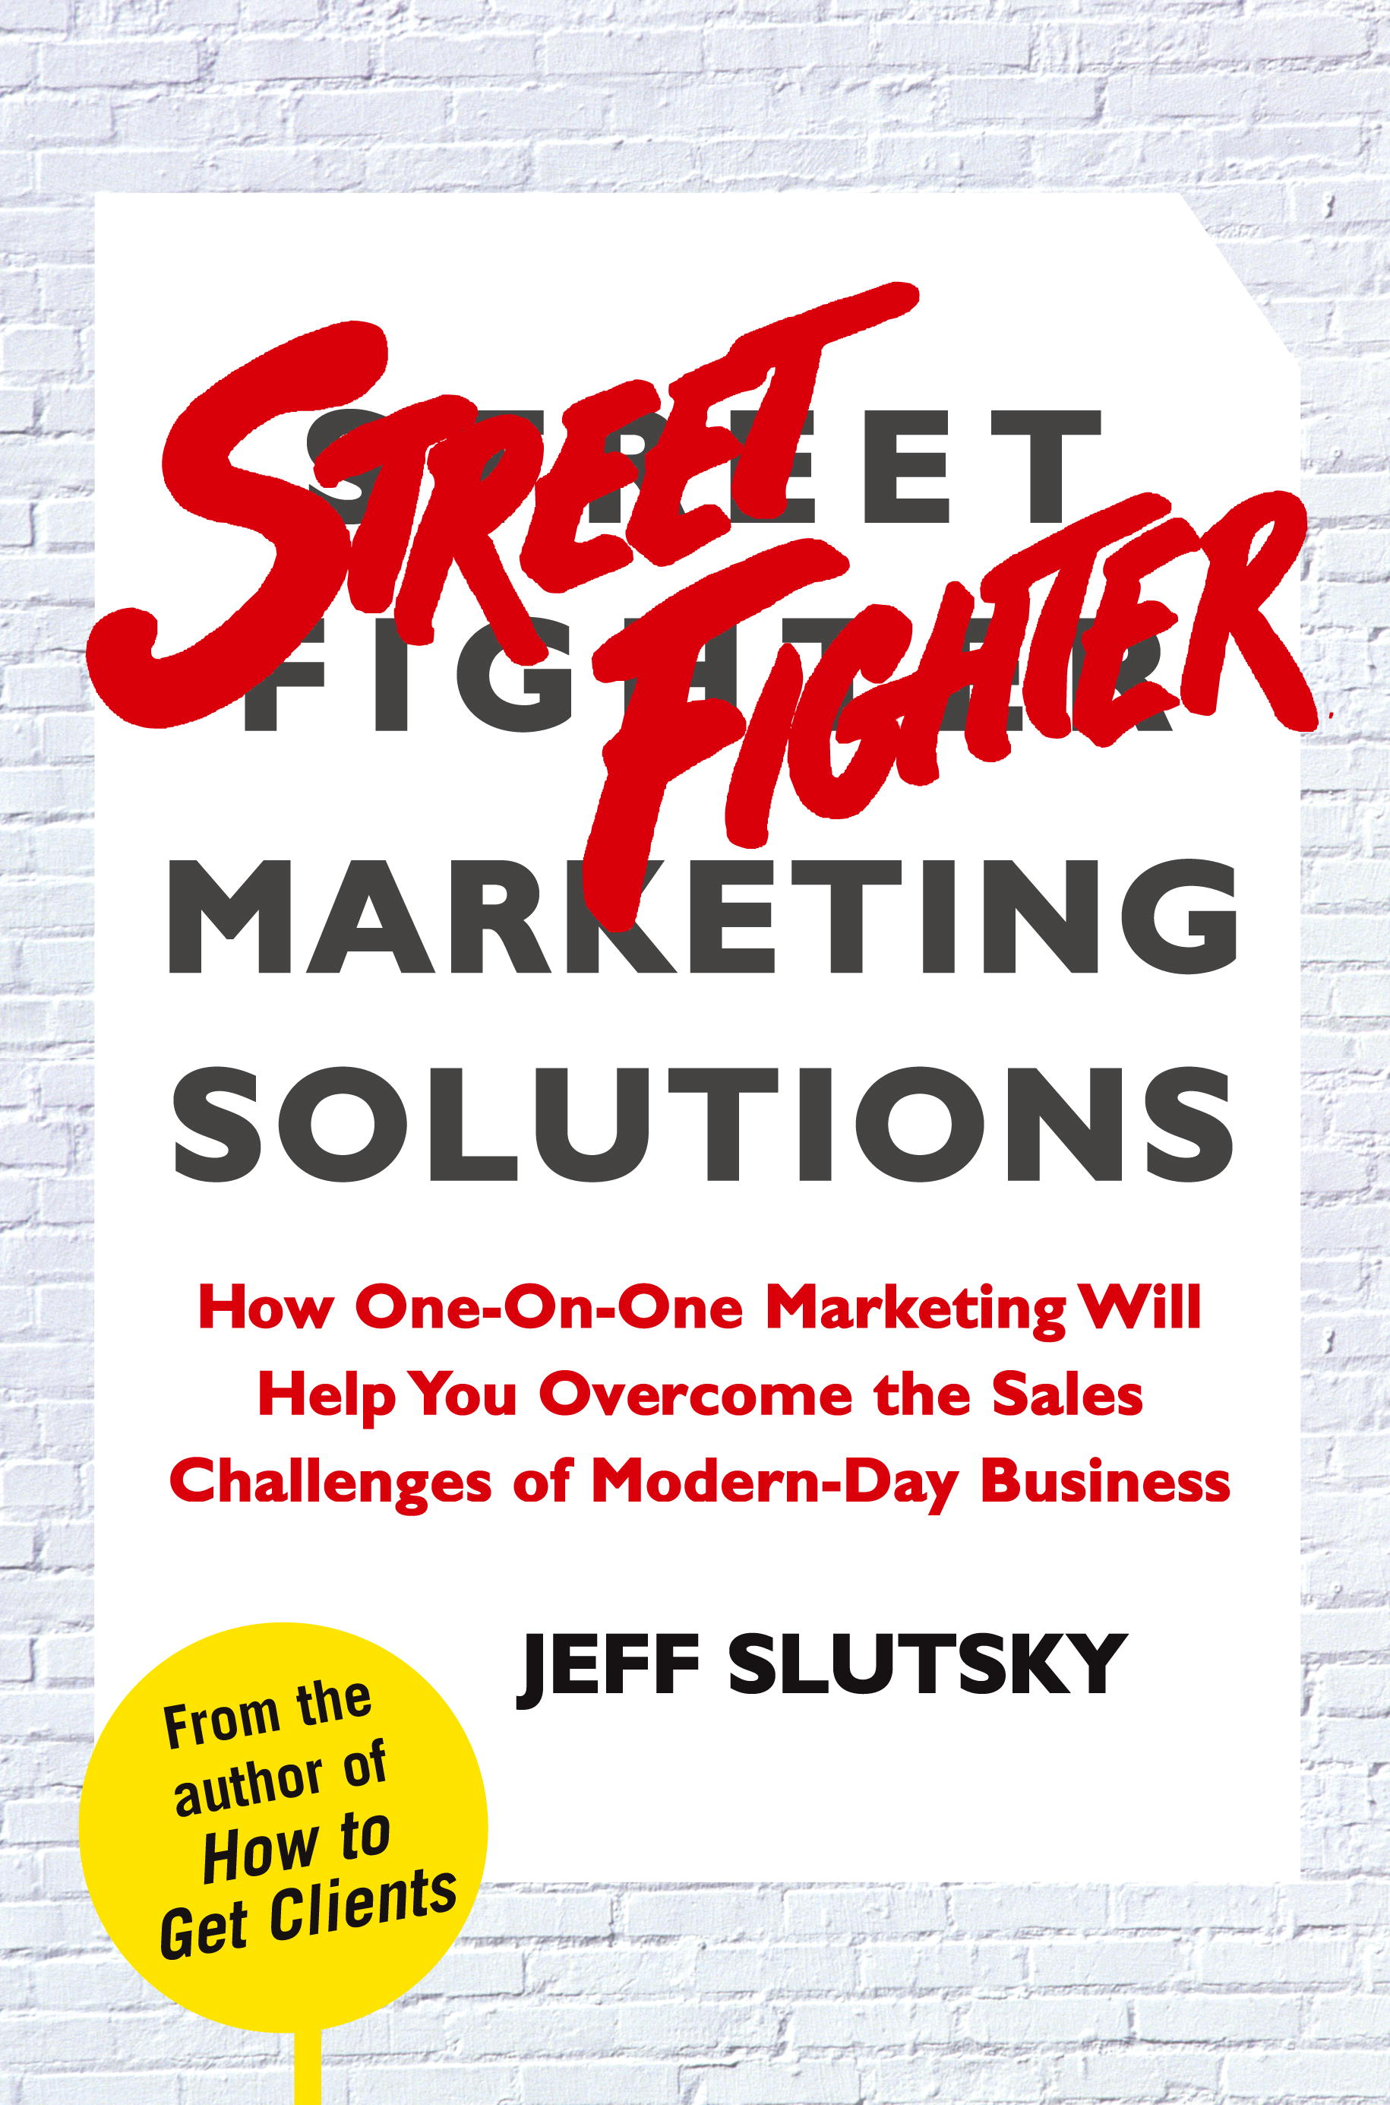

VIDEO & AUDIO WITH COACHING
6 VIDEOS
AUDIO ALBUMS
WORKBOOKS
3 BOOKS
STREET FIGHTER
FLASH DRIVE
MP3 – MP4
PLUS YOU GET JEFF FOR 1 YEAR!
ONLY
REG.
$500
$299

