Slide 1


Outdoor Weather Safety for Campgrounds
2017 Wisconsin Association of Campground Owners Convention
March 15, 2017
Jeff Last, National Weather Service
Green Bay

Slide 2
Weather Safety for Campgrounds
Today’s Presentation
Wisconsin Severe Weather Climatology
Birch Grove Campground Storm
Sources of Weather Information
Sheltering from the Storm
  Weather hazards
  Campground shelters
  Identifying diseased and weak trees
Become a Weather-Ready Nation Ambassador

Slide 3
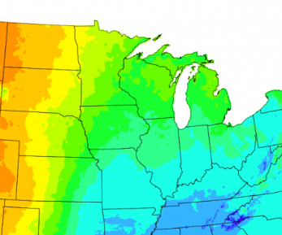
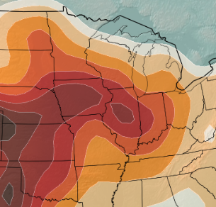
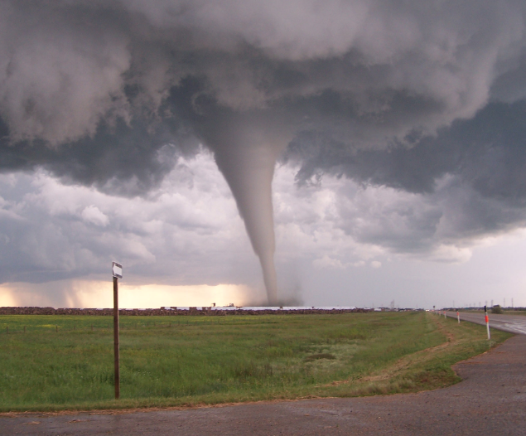
Wisconsin
Severe Weather
Climatology

Slide 4
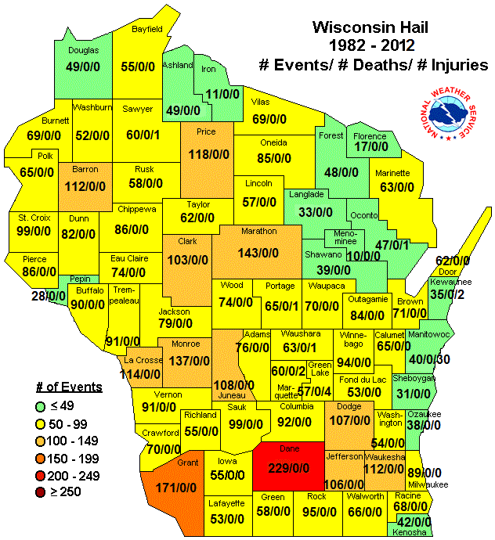
Thunderstorms
Large Hail
(3/4” or larger)

Slide 5
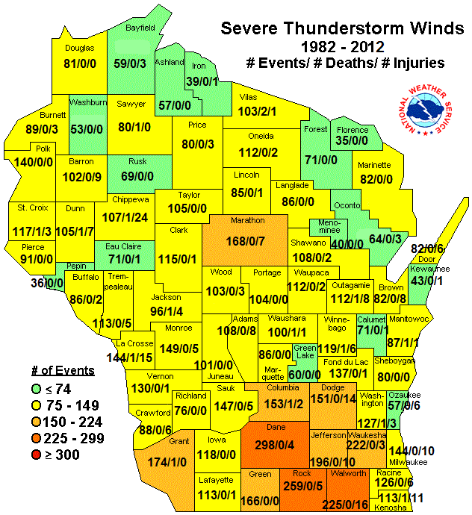
Thunderstorms
Severe Winds
(58 mph or greater)

Slide 6
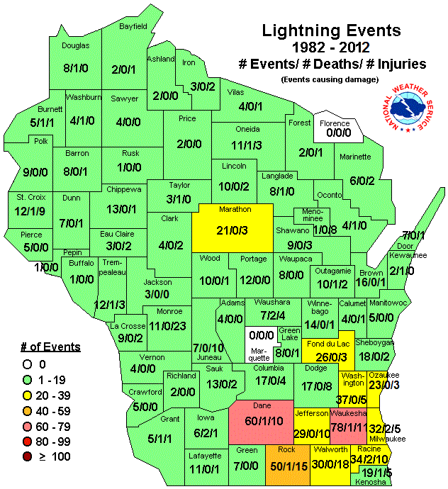
Thunderstorms
Lightning
(Underreported)

Slide 7
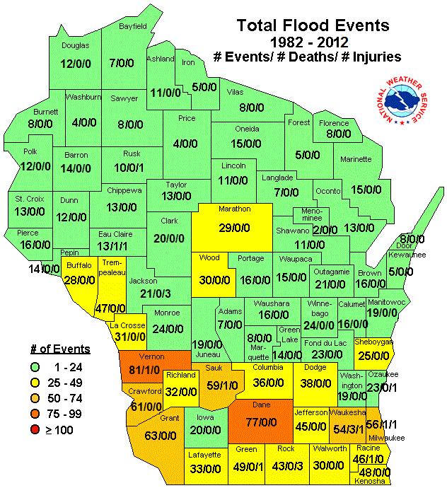
Floods
Significant river flooding and flash floods

Slide 8
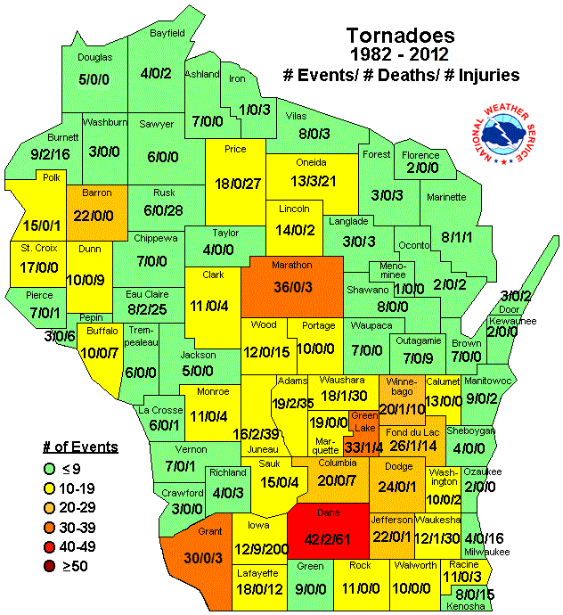
Tornadoes
State average
is 23 tornadoes
per year

Slide 9
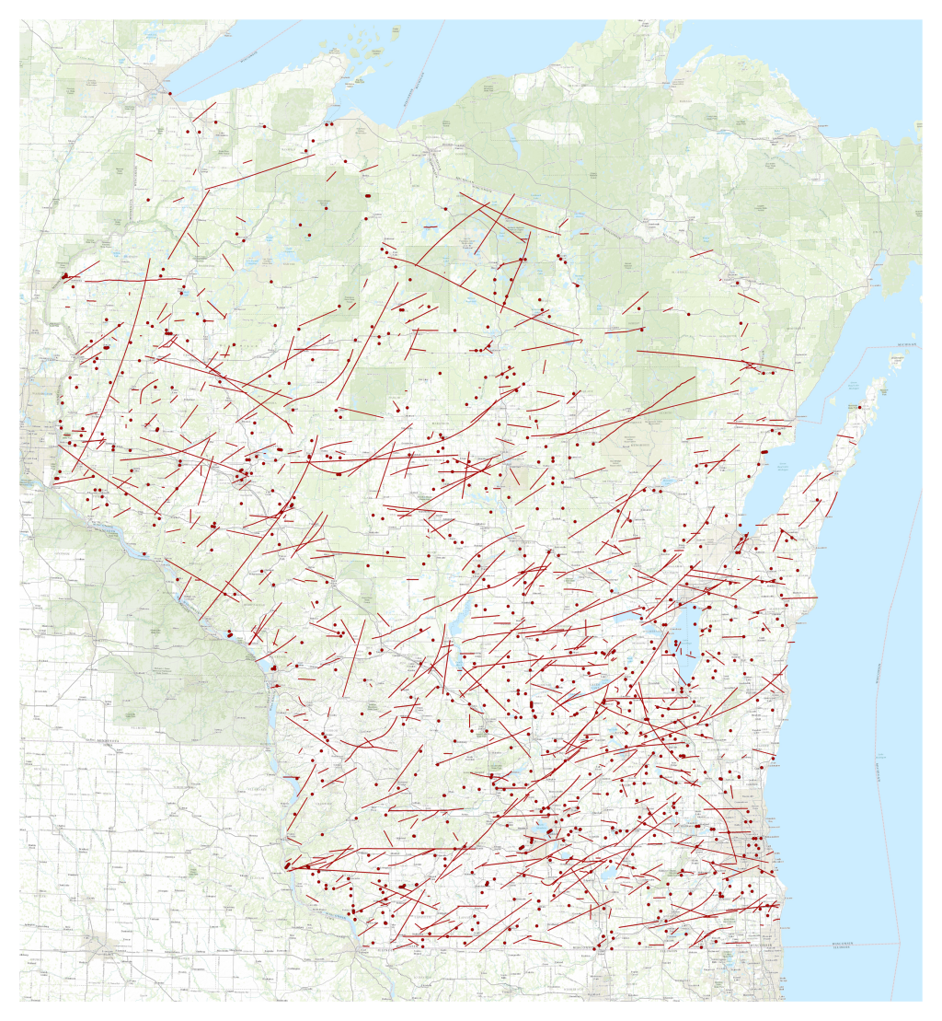

Tornadoes
Wisconsin Tornadoes
1950-2014

Slide 10
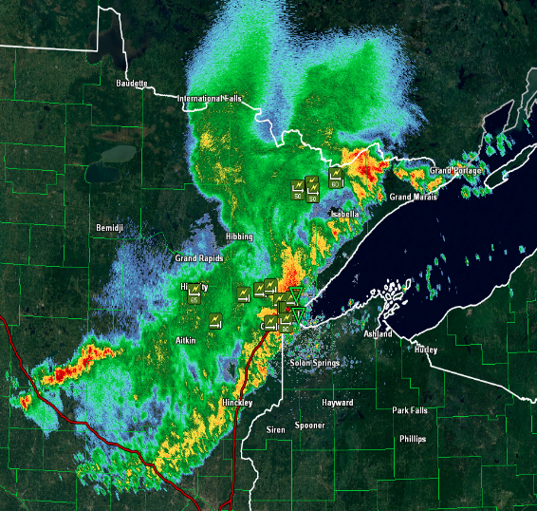
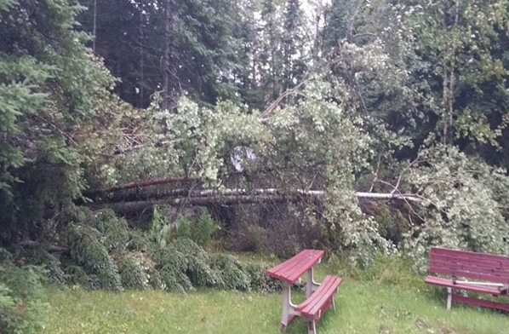
Birch Grove Campground Storm
July 21, 2016
Notes:
Bayfield County, WI (near Iron River)

Slide 11
Birch Grove Campground Storm
A line of thunderstorms moved across Bayfield County between 4:00 am and 4:30 am.
Winds of 75 to 90 mph blew down hundreds of trees around the campground at about 4:18 am.
Four people were injured.

Slide 12
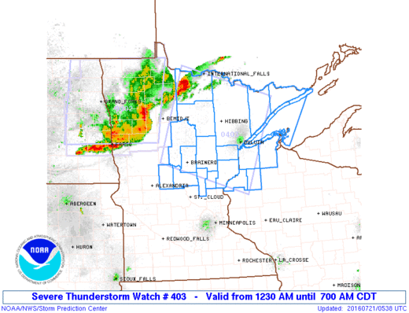
Birch Grove Campground Storm
Severe Thunderstorm Watch issued at
12:30 am
Over 3 ½ hours before
the storms hit the
campground

Slide 13
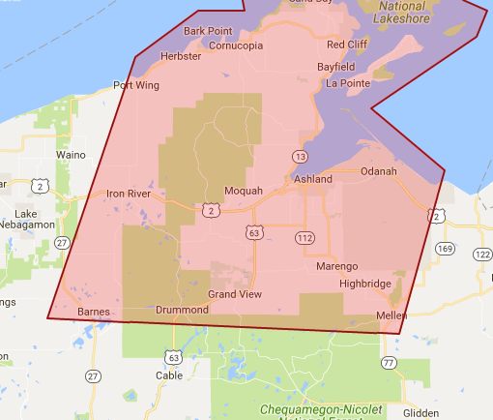
Birch Grove Campground Storm
Severe Thunderstorm Warnings issued at
3:50 am (upstream) and 4:05 am (which included the campground).
About 25 minutes and
13 minutes before
the storms hit the
campground
Notes:
Over 25 minutes lead time if you’re monitoring upstream warnings.

Slide 14
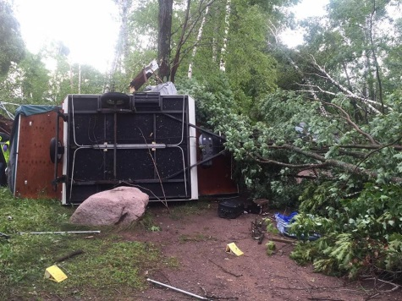
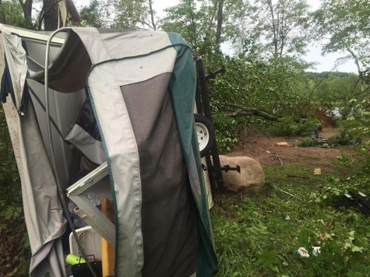
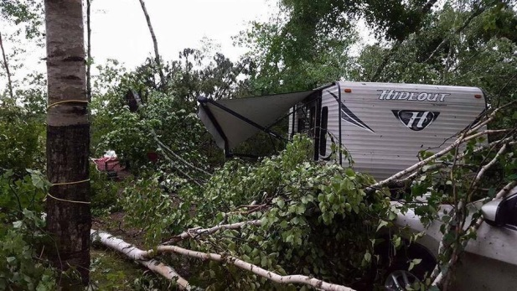
Birch Grove Campground Storm

Slide 15
What are the Dangers?
Nighttime, when campers are sleeping.
Who is monitoring the weather?
Do your campers know which city and county they are in?
Will they recognize it if a warning has been issued for the location?
Are shelters available? Easily accessible? Found in the dark?

Slide 16
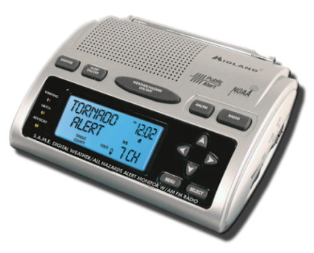
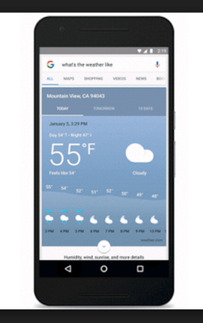
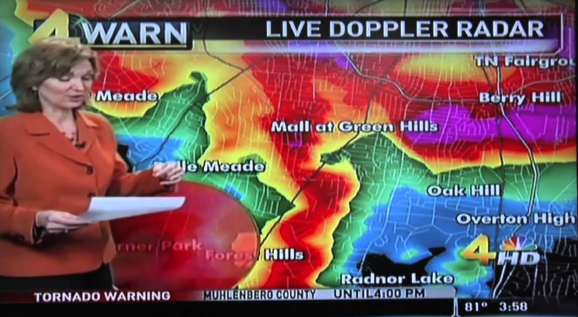
Sources for
Weather Information

Slide 17
Sources for Weather Info
For the safety of your visitors and staff, it is critical to have a 24/7 weather source.
Multiple sources of weather warnings ensure redundancy.

Slide 18
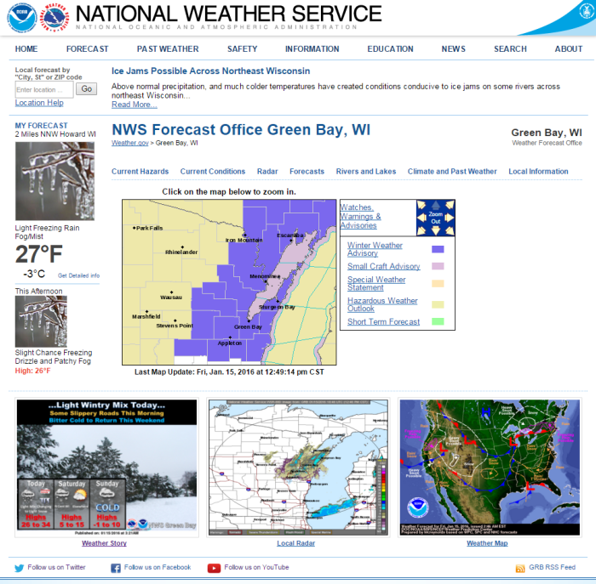
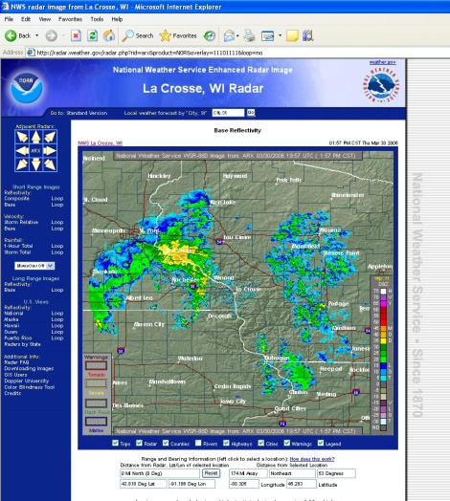
Internet
www.weather.gov
All forecasts, watches and warnings are available, but requires monitoring.

Slide 19
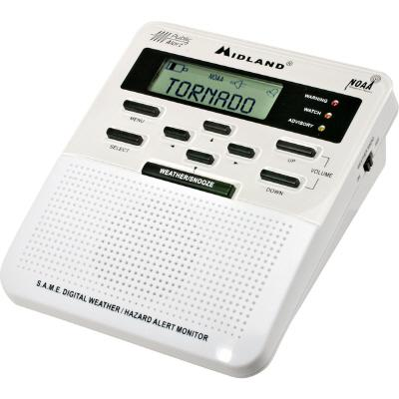
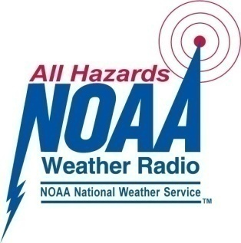
NOAA Weather Radio
24/7 weather info directly from the NWS.
Turns on automatically when alert is issued.
Battery back-up if power is lost.
“The smoke alarm for severe weather”

Slide 20
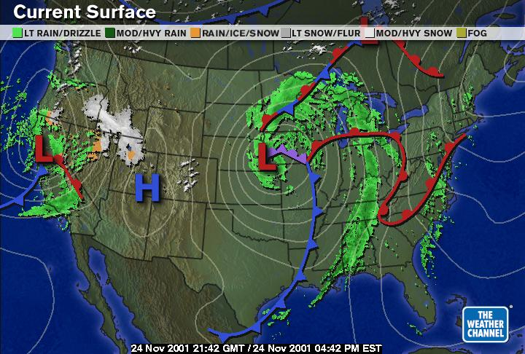

Commercial/Cable TV
Local warnings are broadcast on most local network TV stations and national weather channels.

Slide 21

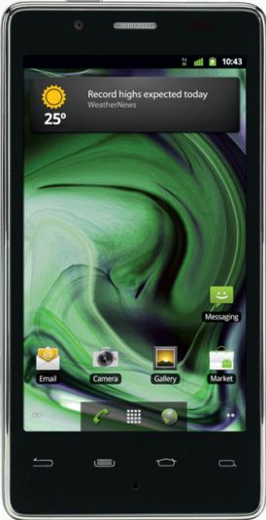
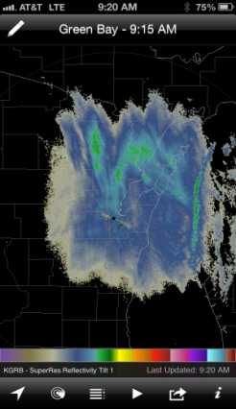
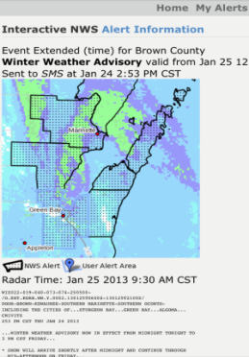
Smart Phones
Numerous apps for forecasts, warnings, and weather data are available (including
Red Cross and FEMA).
Apps can alert you when warning issued for your area.
Check your mobile device app store.

Slide 22
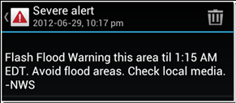
Smart Phones
Wireless Emergency Alerts (WEA) are emergency messages sent by authorized government agencies (including NWS).
Tornado Warnings and Flash Flood Warnings are sent as WEA.
Weather apps should be considered as well to ensure all warnings are received.

Slide 23
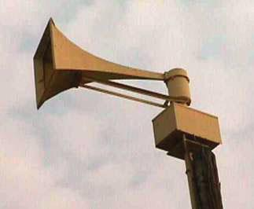
Outdoor Sirens?
Most, but not all, counties have outdoor sirens which are operated by local officials (NOT the NWS).
Different counties have different activation rules.
And you still have to turn on a source of info for details!
Do NOT rely on outdoor sirens alone for alerts.

Slide 24
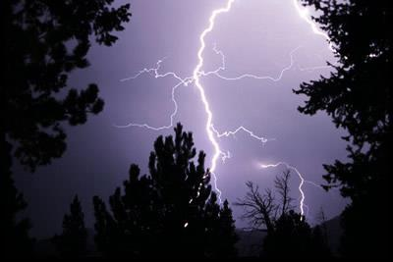
Sheltering from the
Storm

Slide 25
Sheltering
Lightning and high winds are the most likely hazards associated with thunderstorms.
Lightning occurs with all thunderstorms, whether they are “severe” or not.
The key is to get inside a sturdy shelter.
Best shelters are made of concrete, brick or stone.
Shower or bathroom stalls, closets or interior hallways offer the best protection.

Slide 26
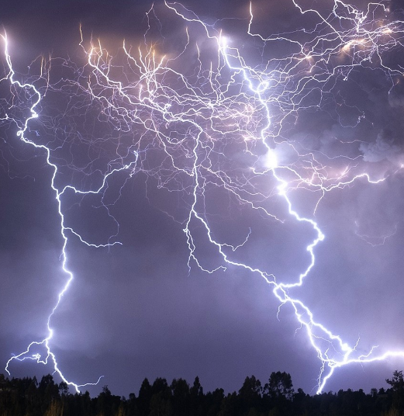
Lightning
Cloud-to-ground lightning
can occur with any storm.
Weather warnings are not
issued for lightning alone.
Tents are not safe.
A metal camper or vehicle
with windows rolled up is
relatively safe in lightning.
A sturdy, permanent shelter is safest.
“When thunder roars, go indoors!”

Slide 27
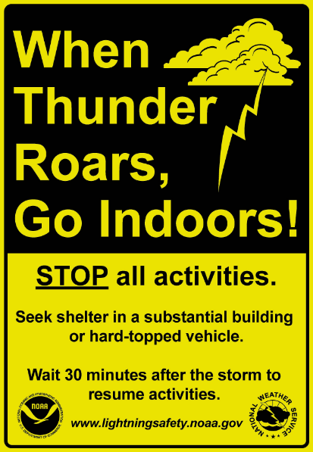
Lightning
When caught outdoors:
Get out of boats and away
from water
Never take shelter under an
isolated tree
In the woods, take shelter
under a grove of shorter trees
Stay away from metal objects,
such as piers, playgrounds,
poles and fences.
“When thunder roars, go indoors!”

Slide 28
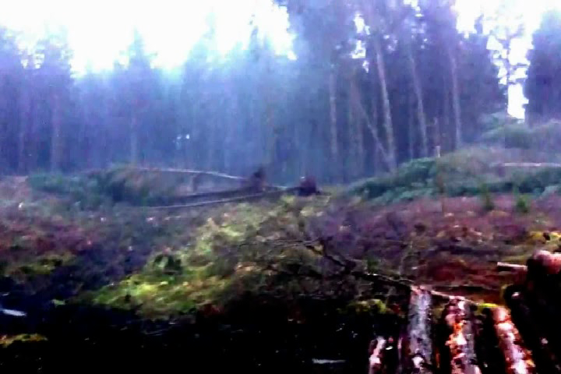
High Winds
The most likely hazard in
a severe thunderstorm is
high winds.
Wind gusts over 70 mph
can blow down numerous
trees.
Pine trees are most
susceptible to winds of 70-80 mph.
Hardwood trees usually require higher winds to snap, although soil moisture and soil type can result in uprooting at lower speeds.
Damaged/diseased trees can be toppled by gusts as low as 40 to 45 mph!

Slide 29
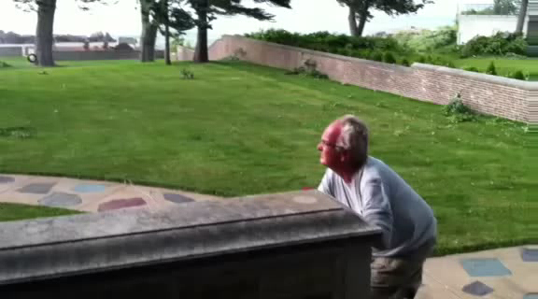
High Winds
Sheltering in a sturdy,
permanent building is
the best option.
Vehicles may provide
some protection, but
it only takes one tree
to crush a camper, car,
or truck.

Slide 30
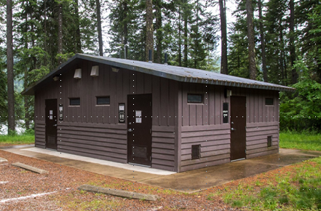
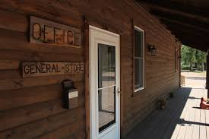
Campground Shelters
Wooden Structures
Okay

Slide 31
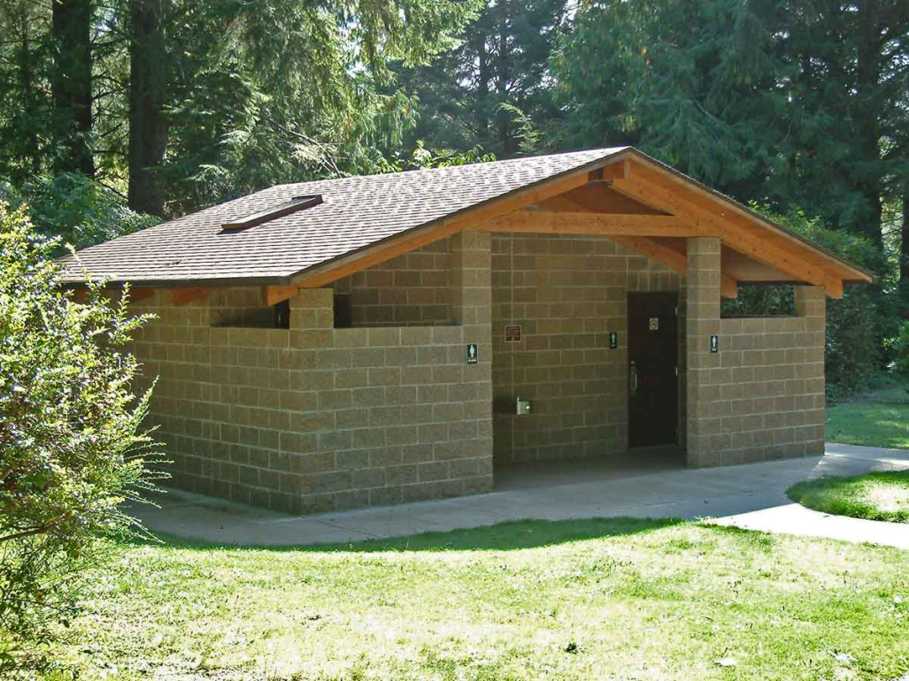
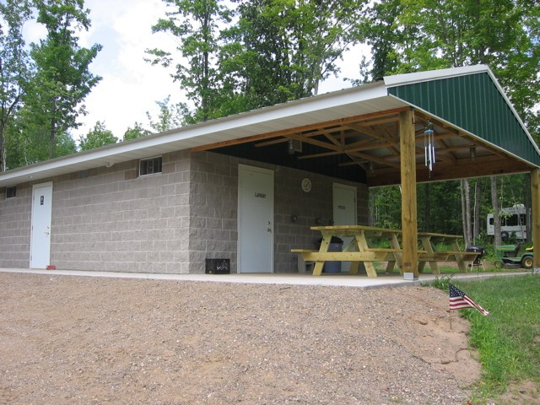
Campground Shelters
Cinder Blocks, Brick
or Stone
Good

Slide 32
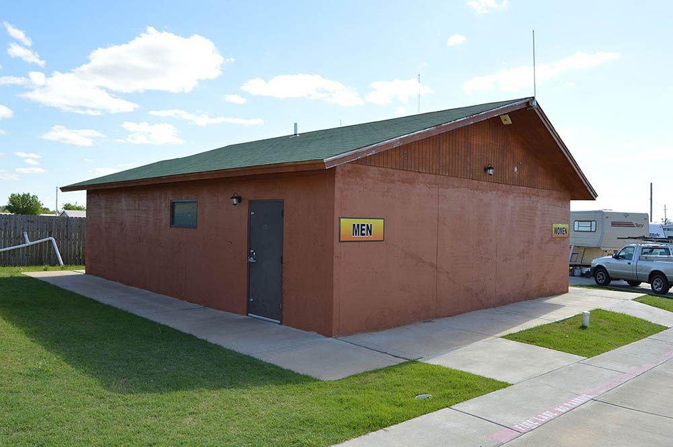
Campground Shelters
Solid Concrete
Better

Slide 33
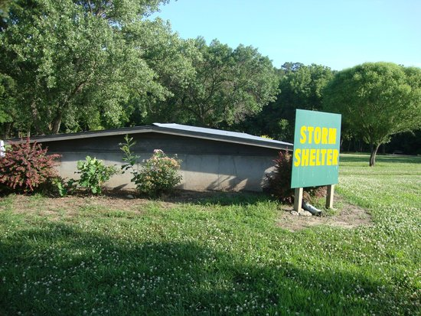
Campground Shelters
Concrete and
Under Ground
Best

Slide 34
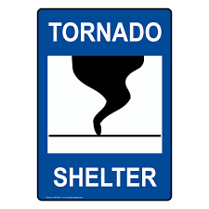
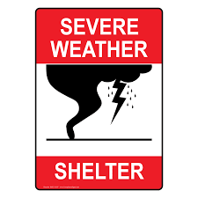
Campground Shelters
Consider adding signage
to designated storm shelters.
Campers will see them
every time they use the
bathroom or shower.

Slide 35
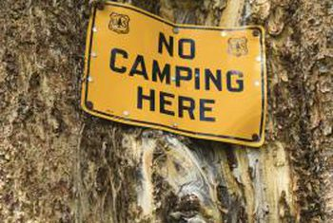
Identifying Diseased or Damaged Trees
Since diseased or damaged trees are at greater risk of falling during windstorms:
  They should be identified and removed, if possible.
  If they cannot be removed, campers should be cautioned not to set up tents, trailers or RVs near them.

Slide 36
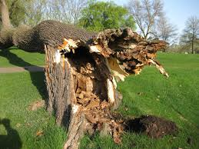
Identifying Diseased or Damaged Trees
Warning Signs of Dead, Damaged, Diseased or Decayed Trees:
  Large cavities or hollows
  Cracks or splits
  Loose or missing bark
  Mushrooms or shelf fungus
  Nesting holes (Carpenter
  Ants, Bees or Birds)
  Bulges
  Deadwood and “Widowmakers”

Slide 37
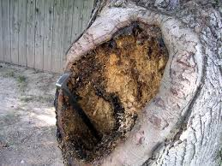
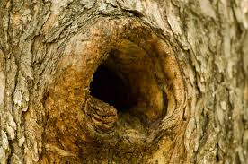
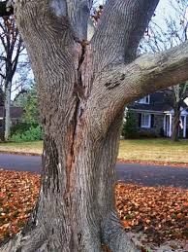
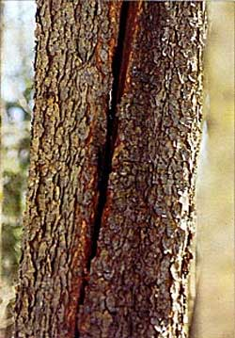
Identifying Diseased or Damaged Trees
Large Cavities or Hollows
Cracks or Splits

Slide 38
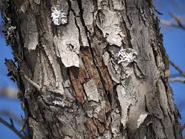
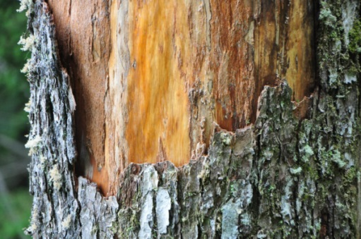


Identifying Diseased or Damaged Trees
Loose or Missing Bark
Mushrooms or
Shelf Fungus

Slide 39




Identifying Diseased or Damaged Trees
Nesting Holes
Bulges

Slide 40


Identifying Diseased or Damaged Trees
Deadwood
“Widowmakers”
Notes:
In forestry, the term widowmaker or fool killer describes a detached or broken limb or tree top and denotes the hazards that such features cause, being responsible for causing fatalities to forest workers.

Slide 41


Shallow Rooted and
Leaning Trees
Shallow Rooted Trees
  Easily uprooted
  when soil is wet
Leaning Trees
  Look for soil mound on
  opposite side of lean

Slide 42

Become a
Weather-Ready Nation Ambassador

Slide 43
Become an Ambassador
Building a nation resilient to hazardous weather takes many people and organizations.
The Weather-Ready Nation Ambassador program recognizes those organizations that are improving the nation’s readiness and responsiveness to severe weather.
www.weather.gov/grb/wrn

Slide 44
Become an Ambassador
Campground owners are a great example of potential Ambassadors, helping the NWS promote weather safety messages.
www.weather.gov/grb/wrn

Slide 45




Safety Brochure

Slide 46


Thank You!
NWS Duluth
Carol Christenson
Carol.Christenson@noaa.gov
NWS Twin Cities
Todd Krause
Todd.Krause@noaa.gov
NWS Green Bay
Jeff Last
Jeff.Last@noaa.gov
Green Bay
NWS La Crosse
Todd Shea
Todd.Shea@noaa.gov
Contact your area’s
Warning Coordination Meteorologist
with questions or comments
specific to your region.
NWS Milwaukee/Sullivan
Tim Halbach
Timothy.J.Halbach@noaa.gov

Slide 47

Acknowledgements
Tim Kieckbusch, Senior Meteorologist

