Slide 1
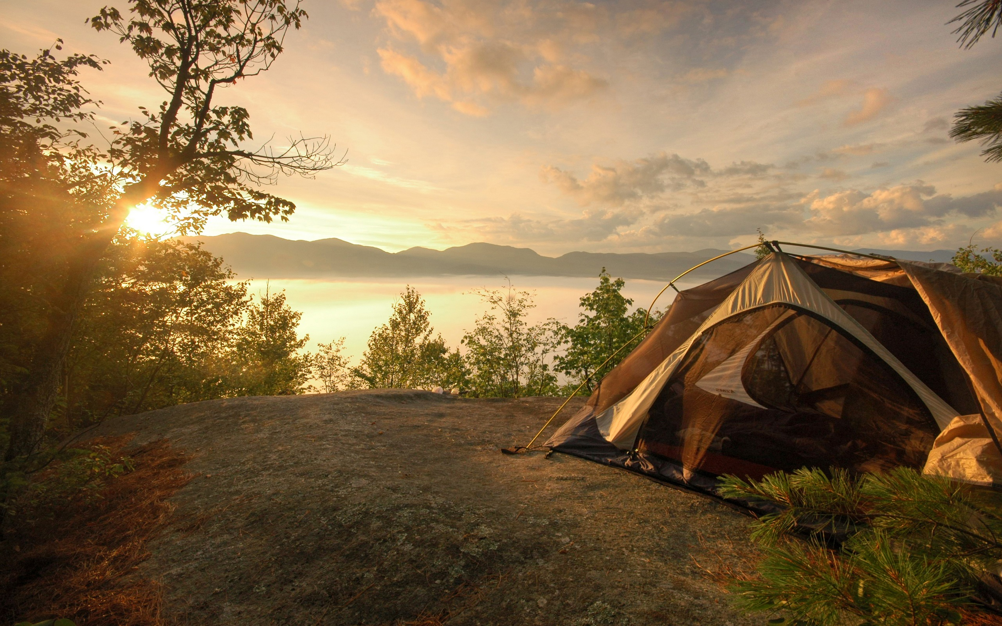
Partnering with Booking.com
March 17th, 2017
Notes:
Cover for external presentations.
Photo is replaceable, behind the blue filter.
Click on photo –> Picture format – Change picture
For external presentations, choose a relevant photo for which we own the copyrights to.

Slide 2
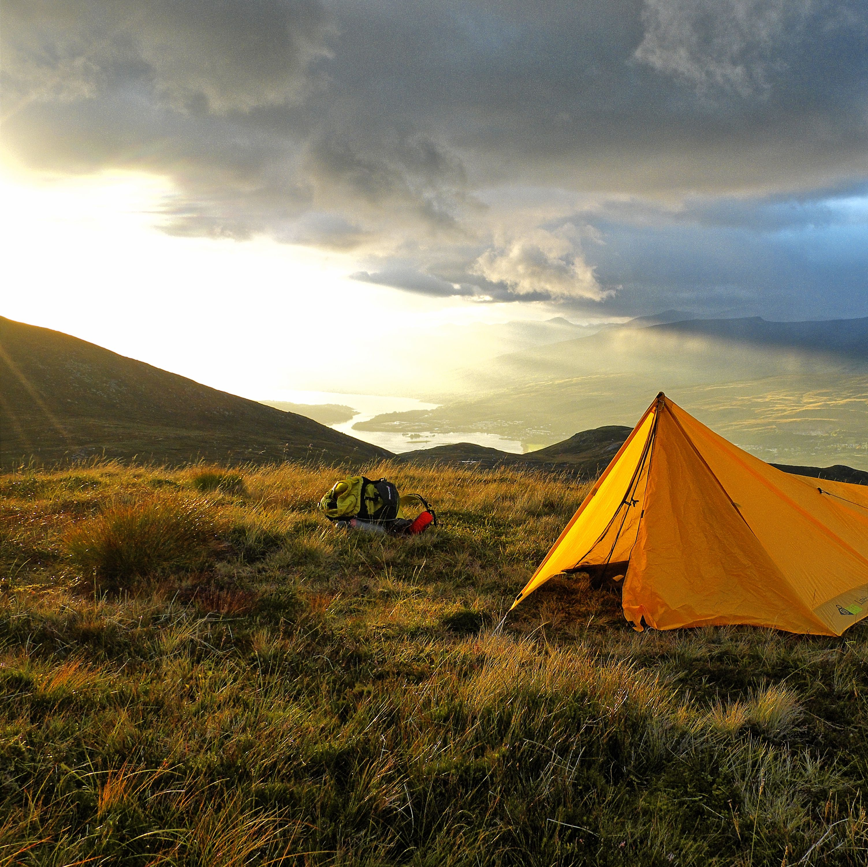
Introduction
Not just a ‘generational’ resource for the technologically gifted, but a tool for all people to help reach their goals, and build successes.
Notes:
Photos are replaceable.
Click on photo –> Picture format – Change picture
For external presentations, choose a relevant photo for which we own the copyrights to.

Slide 3
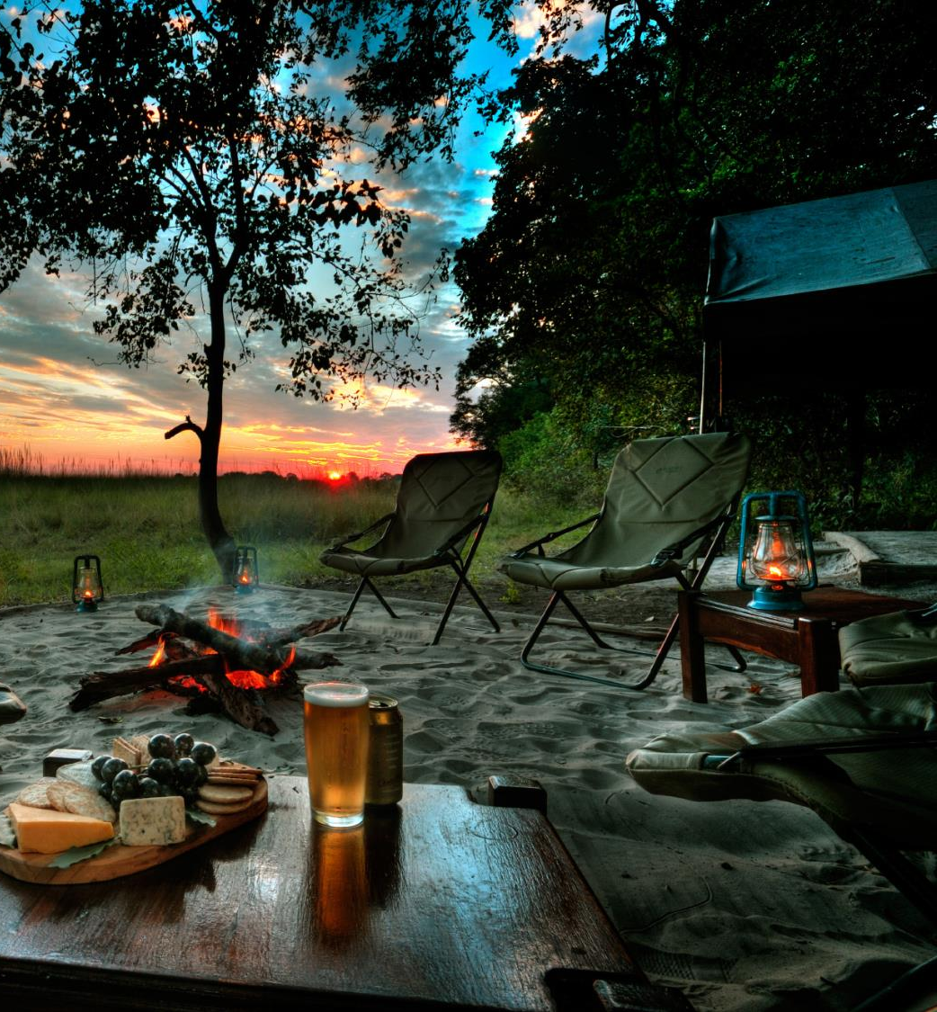
Learning Objectives.
Explore pathways to increase your properties brand name amongst the camping industry.
Self-Manage your property through visible policies and strategic pricing.
Reservation & guest communication manager.
Where is the Industry today?
Notes:
Photo is replaceable, behind the blue filter.
Click on photo –> Picture format – Change picture
For external presentations, choose a relevant photo for which we own the copyrights to.

Slide 4

Where Do I Align.
Traditional methods for property recognition?
  Word of Mouth
  Returning Guests
Organization offering Membership/Discount?
Property Brand Name?
Property Web Page?
Online Travel Agency?
Notes:
Photo is replaceable, behind the blue filter.
Click on photo –> Picture format – Change picture
For external presentations, choose a relevant photo for which we own the copyrights to.

Slide 5
Current Marketing
What resource(s) are used so guests can recognize property?
Factors to consider:
  What reach does this marketing channel have? (Geography)
  What scope does this marketing channel have? (Industry)
  How much do I budget for marketing? (Total Revenue)
  Where does my property stand amongst others? (Competition)
Notes:
Basic slide:

Slide 6
Online Presence.
Promote your business brand name by increasing property awareness amongst other accommodations in your area. Think strategic marketing visibility, consider local competition, and stimulate attraction to your property. Discover the tools available to make managing your business easier.
Notes:
Photos are replaceable.
Click on photo –> Picture format – Change picture
For external presentations, choose a relevant photo for which we own the copyrights to.

Slide 7
Booking.com Marketing
We are an online booking engine.
  Scope is International (Geography)
  Well-Known Brand Name (Industry Expertise)
  Cost to Benefit Analysis (Total Revenue)
  Reinvest in Our Partners (Channel Marketing)
  Local Team Advice & Expertise (2nd Opinion)
Notes:
Basic slide:

Slide 8



Destination Discovery.
Your Local Area
Discovery
Global Travelers
A destination that offers the perfect mix of Amenities, Activities, & Accommodation.
Travelers from every corner of the world. Looking to discover their suitable accommodation.
Travelers use the most comprehensive resource to exhaust all possibilities in new territory.

Slide 9
Property
Policies
Pricing
Promote Policies & Pricing.
Discover what works. Develop appropriate policy and pricing that compliments your environment the best. What are some of the factors that influence your business decision making?
Notes:
Photos are replaceable.
Click on photo –> Picture format – Change picture
For external presentations, choose a relevant photo for which we own the copyrights to.

Slide 10
Custom Policy & Pricing
Is there a deposit once reservation is made?
Are policies reinforced with a copy of the reservation confirmation?
15-30-60-90 day reimbursement policy?
  Different Policies for Cabins, Tents, and RV’s?
  Cancellation Grace Period?
Cancellation Fee- Reimbursement for the time and energy spent.
  Provide a tentative ‘Rain Check’?
Competitive Pricing: Seasonal, Holiday, Weekly Rates
Strategic Pricing: Minimum Stay, Increased Marketing
Notes:
Basic slide:

Slide 11
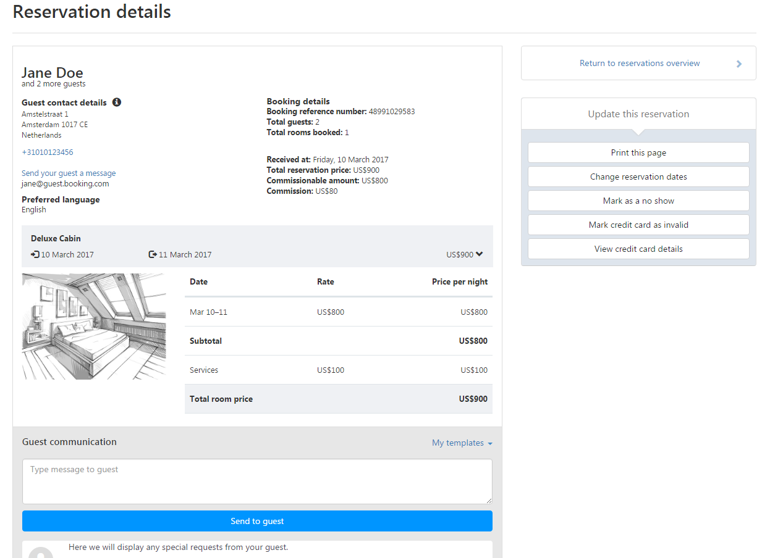
Guest Communication.
What is your purpose for communication once receiving a reservation?
  Property Description/ Directions
  Policy Reinforcement
  Payment Collection
  Occupancy Information
Notes:
Photo is replaceable, behind the blue filter.
Click on photo –> Picture format – Change picture
For external presentations, choose a relevant photo for which we own the copyrights to.

Slide 12




Booking Solution.
Global Visibility
Guest Communication
Property Data Base
Reservation Collector
Full Control

Slide 13

“Don’t like the idea of my property ‘spread around’. Reservations coming from different sources, and I can’t speak with them.”
“We don’t have a lot of employees and we wear a lot of hats. Sometimes we don’t have the time to manage reservations, and we would have to manage yours individually”
Hesitations.
“If it ain’t broke don’t fix it. All reservations on paper and pen, not sure what to think of web marketing”.
Notes:
Photo is replaceable, behind the blue filter.
Click on photo –> Picture format – Change picture
For external presentations, choose a relevant photo for which we own the copyrights to.

Slide 14
Thank you!
All references to “Booking.com", including any mention of “us”, “we” and “our” refer to Booking.com BV, the company behind Booking.com™
Notes:
For legal disclaimer translations go here: https://docs.google.com/spreadsheets/d/1gpxh44EzkwHtn3tFfOTWWjMWoA0a3dNzdH7ptI6b7eg/edit#gid=0

