Slide 1


Larry Brownfield, CPO, OHE – KOA, Inc.
Navigating North: The Path to Effective Leadership

Slide 2

Course Objectives
Identify the type of leader you are.
2. Understand how to lead your team to success.

Slide 3
Leadership is NOT the same as Management
“Manager” & “Leader”; they are not the same thing although it is possible to be both.
Leaders have vision
Managers have plans

Slide 4
Leadership is NOT the same as Management
“Managers do things right but leaders do the right things”

Slide 5
Leadership is NOT the same as Management
QUESTION:
Are you managing your business or are you leading your business?

Slide 6

Identify your leadership type
Take out some paper and number 1-4.
4 multiple choice questions - - write down the two letters that best describes you

Slide 7
Identify your leadership type
1 What’s your catchphrase?
A - “Do what I tell you.”
B - “Do as I do, now”
C - “Come with me”
D - “People come first”
E - “What do you think about this?”
F - “Let’s give it a try.”

Slide 8
Identify your leadership type
2 Two of your employees are having a conflict. What do you do about it?
A - Tell them to knock it off and get back to work.
B - Let them deal with it on their own—it’s not your problem.
C - Tell them if they can’t find a way to get along you will fire them both
D - Take them out for a beer after work and smooth it over.
E - Sit down with them to hash out the problem.
F - Meet individually to develop a resolution.

Slide 9
Identify your leadership type
3 Your employee keeps making the same mistake. How do you handle it?
A - Tell HR to start looking for his replacement.
B - Tell one of your other people to take over the task.
C - Explore different options for that employee
D - Keep looking the other way and hope it changes
E- Ask another employee to train him until he gets it.
F - Mentor him yourself until he gets it.

Slide 10
Identify your leadership type
4 Do you play on the company softball team?
A - I’m too busy for that.
B - I’ll come and watch sometimes.
C - I built the field
D - Play on it? I organized it.
E - Of course! It reinforces teamwork and makes us stronger as a company.
F - I’m the manager of the team and will provide the equipment.

Slide 11
Identify your leadership type
What letters did you get the most of?
A B C D E F
NOTE: Blend – Situation Adaptation

Slide 12
Identify your leadership type
There are many different models of leadership styles, from those that look at how much ‘control’ you want to others based around ‘potential’.
One of the best-known models is Daniel Goleman’s Six Leadership Styles.
Goleman is probably best known for his work on Emotional Intelligence, but he also carried out a ground-breaking study on leadership, published in the Harvard Business Review in 2000 as ‘Leadership that Gets Results’.

Slide 13
Identify your leadership type
A- Coercive leaders demand immediate obedience.
In a single phrase, this style is …
‘Do what I tell you’.

Slide 14
Identify your leadership type
B-Pace-setting leaders expect excellence and self-direction.
This style can be summed up as
‘Do as I do, now’.

Slide 15
Identify your leadership type
C- Authoritative leaders move people towards a vision
This style is probably best summed up as
‘Come with me’.

Slide 16
Identify your leadership type
D- Affiliative leader values and creates emotional bonds and harmony.
Affiliative leaders believe that
‘People come first’.

Slide 17
Identify your leadership type
E- Democratic leader builds consensus through participation.
Democratic leaders are constantly asking
‘What do you think?’

Slide 18
Identify your leadership type
F- Coaching leader will develop people.
The phrase that sums up this leadership style is
‘Try it’

Slide 19
Identify your leadership type
Summary:
A- Coercive leaders demand immediate obedience.
B- Pace-setting leaders expect excellence and self-direction.
C- Authoritative leaders move people towards a vision

Slide 20
Identify your leadership type
Summary:
D- Affiliative leader values and creates emotional bonds and harmony.
E- Democratic leader builds consensus through participation.
F- Coaching leader will develop people.
NOTE: Blend – Situation Adaptation

Slide 21




Navigating North:
Psychological - changes in understanding
of the self
Convictional - revision of belief systems
Behavioral - changes in lifestyle
“Perspective Transformation" has three progressive dimensions

Slide 22
Navigating North:
Finding North Exercise
Stand Up
Close your eyes
Point North
“If you don’t care where you are going, any road will take you there!”

Slide 23

Navigating North:
No Guile
Open
Responsible
Trustworthy
Honest
Compass - for position location bearings
Map – Context to the path

Slide 24

6 Paths to Better Leadership … leading your team to success.
Believe and Envision
Leaders must have a core belief that can be communicated with clarity, concision and passion. This a bedrock belief and a compelling vision.

Slide 25
6 Paths to Better Leadership … leading your team to success.
2. Start Strong and Simple
Understand the PACE
Realize the SCOPE

Slide 26
6 Paths to Better Leadership … leading your team to success.
3. Persuade and Inspire
Leaders must have skills to persuade and inspire.
They must be able to help others see the vision in action; see it as congruent with their own concerns, goals or deep beliefs; and do so
with a strength that inspires
others to sustained action,
even when the leader is
"not looking."

Slide 27
6 Paths to Better Leadership … leading your team to success.
4. Lead Morally
Moral leaders have a clear understanding of their own values and hold themselves accountable for them. Leaders who are ethical demonstrate a level of integrity that emphasizes their
trustworthiness, and this trust
enables followers to accept
the leader's vision.

Slide 28
6 Paths to Better Leadership … leading your team to success.
5. Demonstrate Courage and Compromise
Leaders must have the courage to swim upstream. Because leadership ultimately is a moral commitment, leaders must be prepared to take risks, buck trends,
show courage, persist,
embolden others and use
a nuanced sense of
compromise.

Slide 29
6 Paths to Better Leadership … leading your team to success.
6. Optimize Any Situation
Leaders must excel at situational mastery and emotional intelligence. Ultimately, leaders must have the skills to optimize the situation in which they find themselves and the
resources at hand, and
inspire others to
undertake maximal efforts.

Slide 30
Effective leaders:
Build trust by doing what they say they will do
Build loyalty by being of service to those
they lead and follow
Solicit the input of people who have
the skills and knowledge they may lack

Slide 31
Effective leaders:
Stand by their decisions
Have a sense of urgency
Use authority sparingly—only as a backup

Slide 32
Successful Leaders
See notes in handout ….
Successful leaders embrace these qualities:

Slide 33
Conclusion
Great leadership isn't about winning. It's not about pleasing people, and it's certainly not about titles.
Great leadership is about making the contribution only you can make for your family and friends, your community or organization, your country or the world.
But having that influence requires us to "grow into-and take ownership of-who we are and what we stand for." The journey isn't automatic.
Leadership maturity isn't the natural byproduct of aging. It requires wisdom, courage and effort.

Slide 34

Course Objective Review
Identify the type of leader you are.
2. Understand how to lead your team to success.
“I used to be afraid of failing at something that really mattered to me, but now I'm more afraid of succeeding at things that don't matter." - Bob Goff

Slide 35
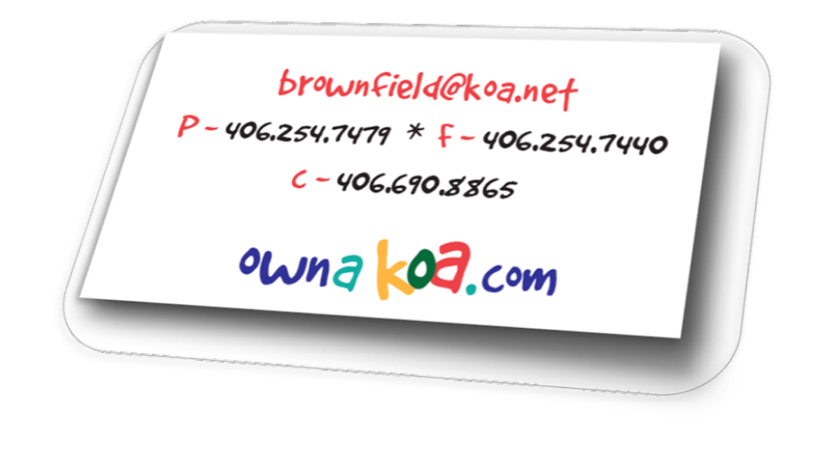





Questions - Comments

